Slide 1
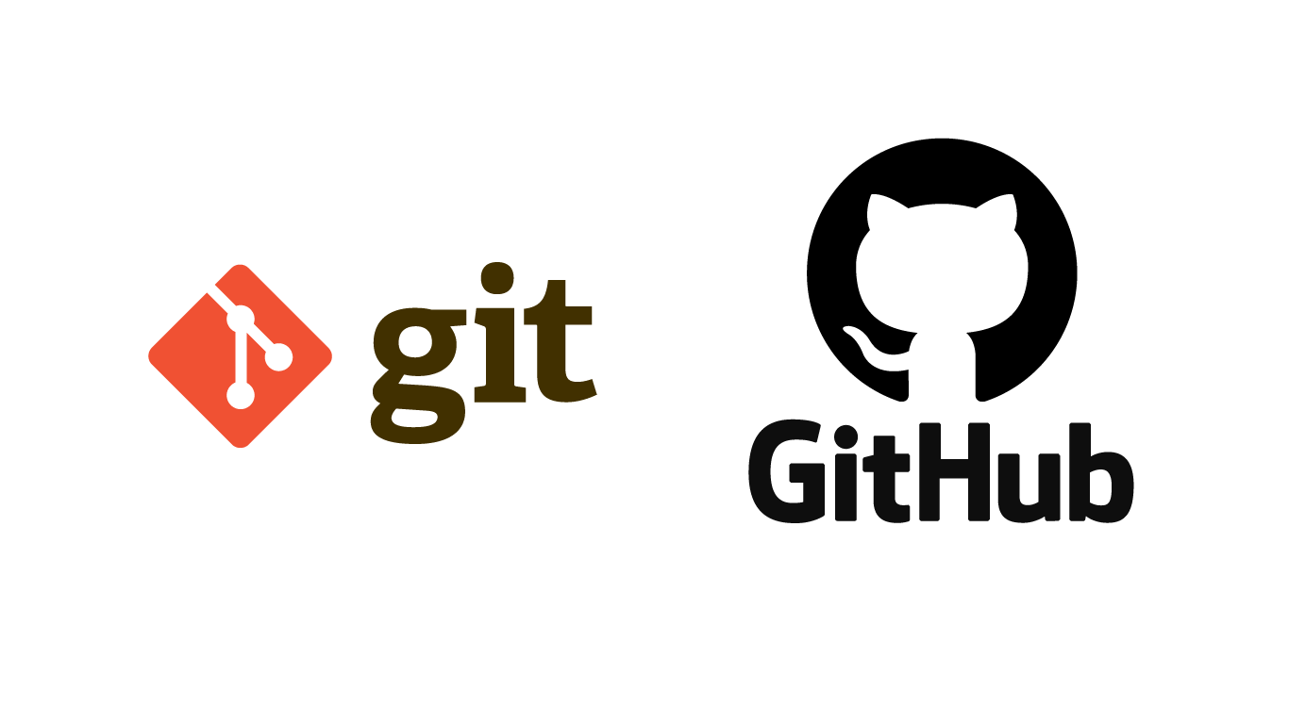

Slide 2


ANYONE WITH LITERALLY ZERO PROGRAMMING KNOWLEDGE CAN LEARN GIT AND GITHUB
It isn’t just for the developers!

Slide 3
GIT
Git is an Open Source Distributed Version Control System that was started by Linus Torvalds.
Git is a command-line tool.
Alternatives of Git: Mercurial, Subversion & CVS.
WHY IS GIT USED?
For Version Control
For Collaboration
Speed, simplicity, fully distributed.

Slide 4
GITHUB
GitHub is a website, basically a code hosting platform for collaboration and version control, where developers store their projects and network with like minded people.
It is owned by Microsoft.
Alternatives of GitHub are: GitLab, Bitbucket, Launchpad.

Slide 5
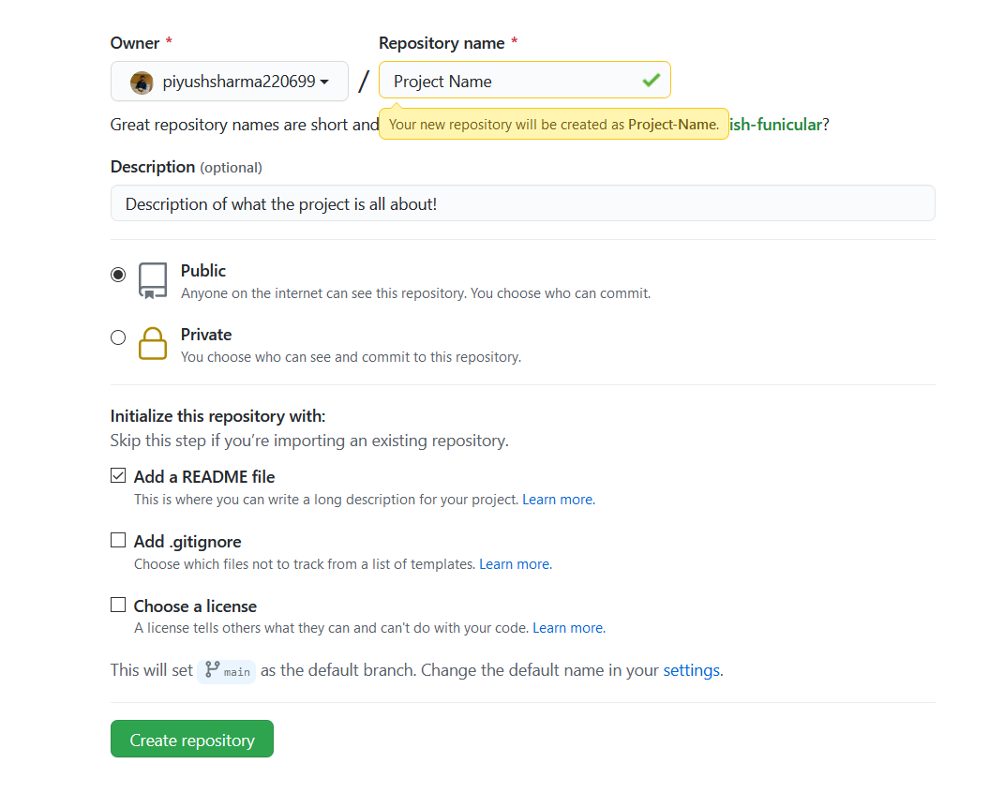
REPOSITORY IN GITHUB
A repository (usually abbreviated to “repo”) is a location where all the files for a particular project are stored.
Each project has its own repo, and you can access it with a unique URL, which can also be shared with others for collaboration.

Slide 6
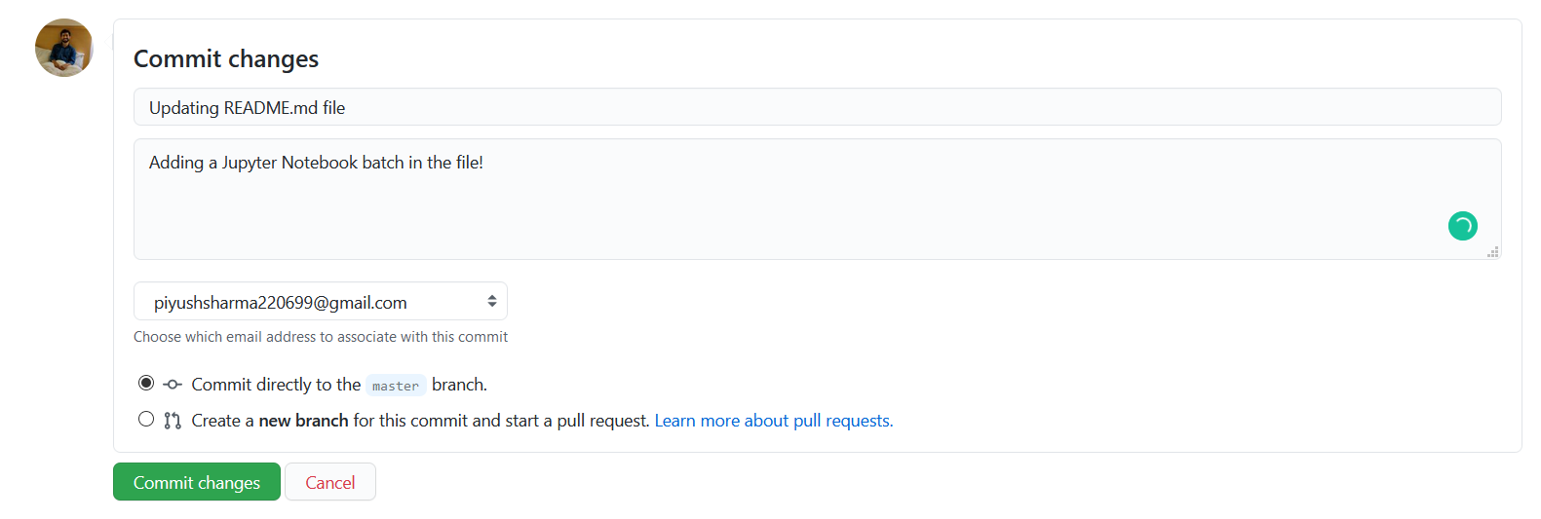
COMMIT
This is just like a snapshot of your entire repository at several times.
It tells a story of the history of your repository and how it came to be the way that it currently is.

Slide 7
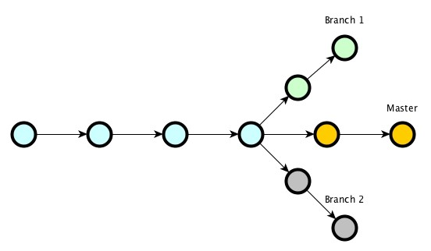
BRANCHING IN GIT
A feature that is used to create an independent, similar copy of the current repository for different usage requirements.
It allows you to work on multiple things without obstructing the active branch (main branch).

Slide 8

FORKING A PROJECT
“Forking” is when you create a new project based off of another project that already exists.
If you find a project on GitHub that you’d like to contribute to, you can fork the repo, make the changes you’d like, and release the revised project as a new repo.
piyushsharma220699
rahulsharma123
FORK

Slide 9
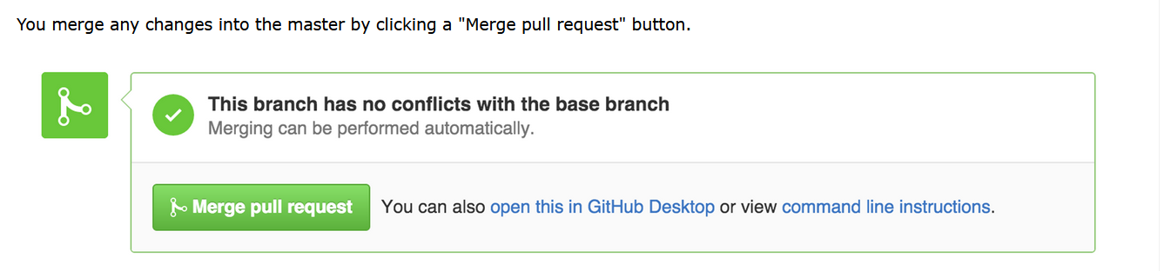
PULL REQUEST (PR) AND MERGE
If someone else has a copy of your repository (be it a branch or fork), and makes changes to it that they would like you to incorporate, they can ask you to pull the changes from their repository; they're requesting a pull, hence the term "pull request".

Slide 10
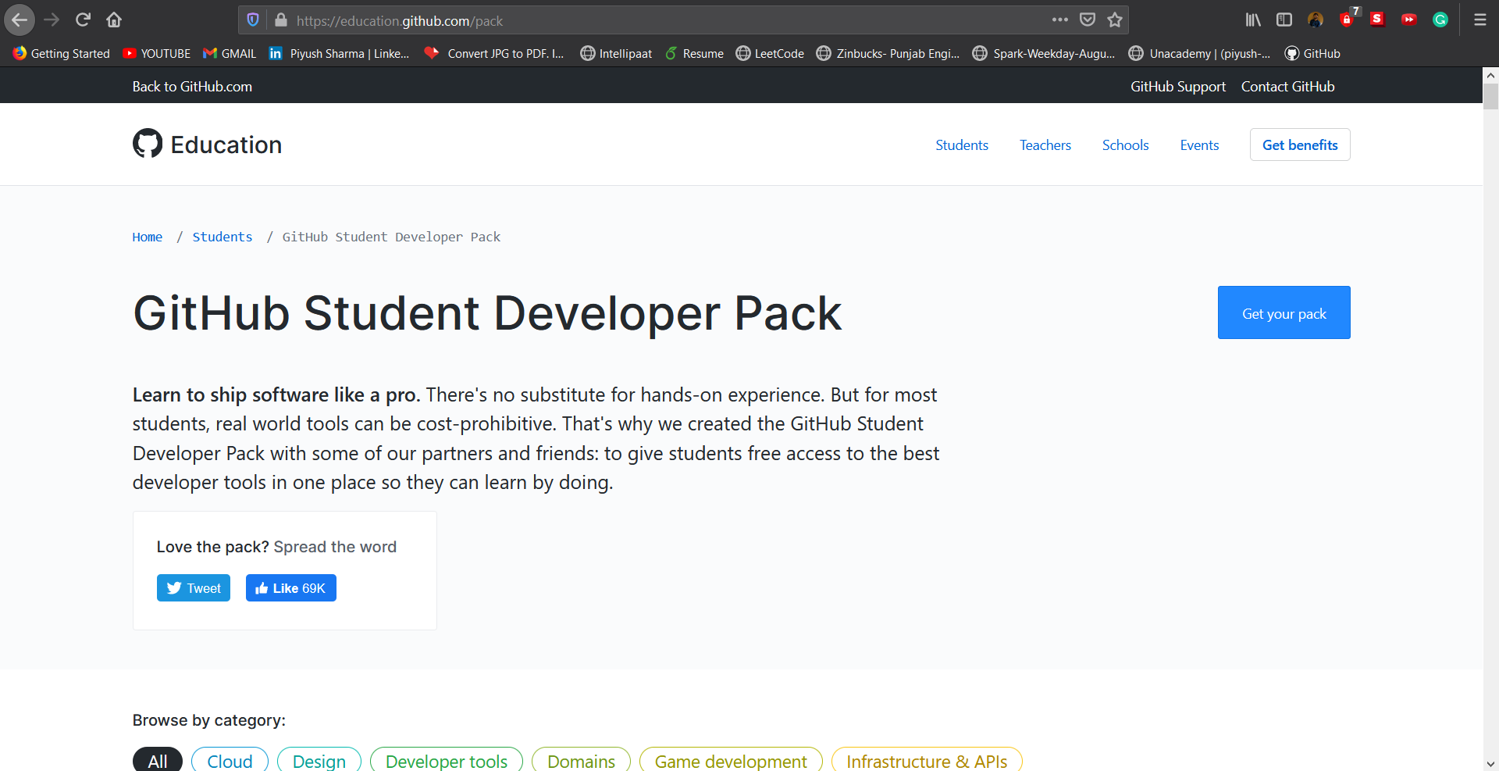

Slide 11
DOUBT SESSION!

