Slide 1
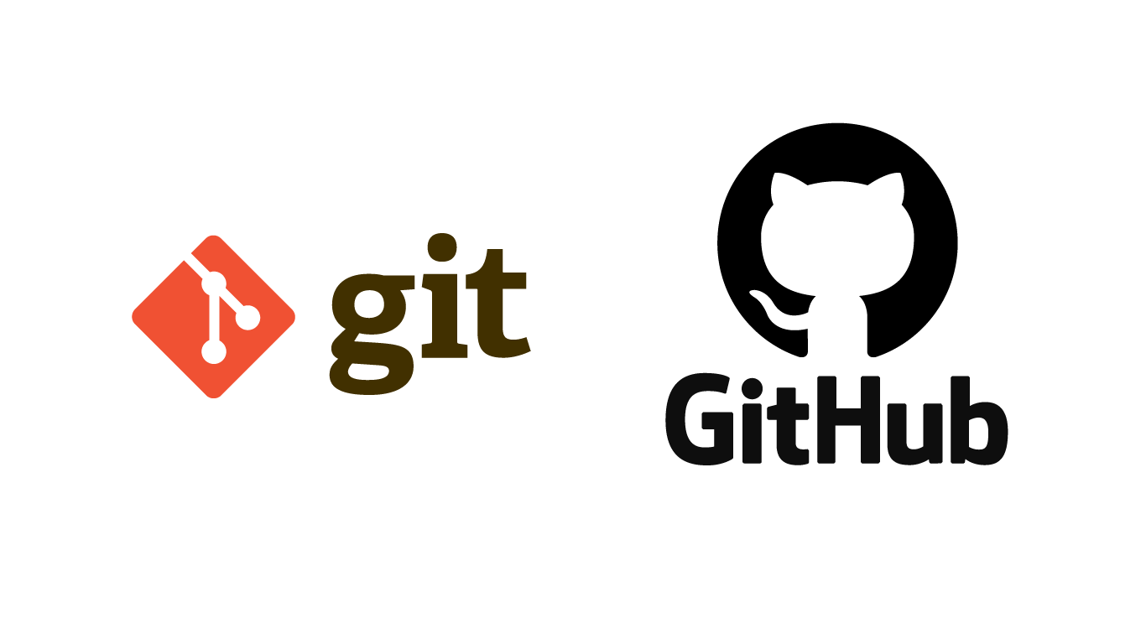

Slide 2


ANYONE WITH LITERALLY ZERO PROGRAMMING KNOWLEDGE CAN LEARN GIT AND GITHUB
It isn’t just for the developers!

Slide 3
GIT
Git is an Open Source Distributed Version Control System that was started by Linus Torvalds.
Git is a command-line tool.
Alternatives of Git: Mercurial, Subversion & CVS.
WHY IS GIT USED?
For Version Control
For Collaboration

Slide 4
GITHUB
GitHub is a code hosting platform for collaboration and version control, where developers store their projects and network with like minded people.

Slide 5
REPOSITORY IN GITHUB
A repository (usually abbreviated to “repo”) is a location where all the files for a particular project are stored.
Each project has its own repo, and you can access it with a unique URL.

Slide 6
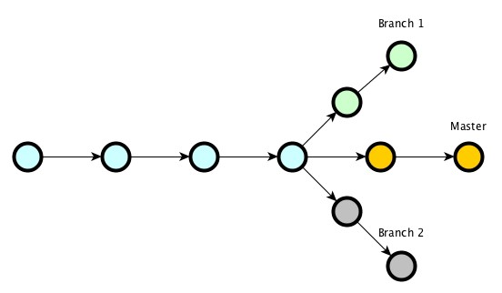
BRANCHING IN GIT
A feature that is used to create an independent, similar copy of the current repository for different usage requirements.
It allows you to work on multiple things without obstructing the active branch (main branch).

Slide 7
