Slide 1
Capstone Project-1 Wine Quality Dataset
Team Members Tisha (2210992465)
Tejasvi (2210992464)
Vanshika (2210992504)
Trisha (2210992468)

Slide 2
CONTENT
Problem Statement
Objective
Tools Used
Data Summary
Exploratory Data Analysis
Challenges
Recommendations
Conclusions
Q & A

Slide 3
PROBLEM STATEMENT
"Given various chemical properties of wines, such as fixed acidity, volatile acidity, citric acid, and others, along with their corresponding quality ratings, the task is to develop a predictive model that can accurately predict the quality rating of wines based on their chemical composition . “
This problem statement frames the task as a supervised learning problem, where the quality rating is the target variable to be predicted, and the chemical properties are the features used for prediction. The goal is to build a model that can generalize well to new, unseen wines and accurately predict their quality ratings based on their chemical composition.

Slide 4


Slide 5
OBJECTIVE
The objective of analyzing wine quality data sets is to leverage machine learning techniques to predict and classify wines based on their quality attributes. By exploring various classification methods and understanding feature importance, these analyses aim to provide valuable insights for vineyards and winemakers in producing high-quality wines.

Slide 6
Tools Used
Jupyter Notebook is used as IDE.
Pandas and NumPy are used for Data Manipulation & Pre-processing and Mathematical functions respectively.
Exploratory data analysis is automated by data prep.
For visualization of the plots, Matplotlib, Seaborn, Plotty are used.
GitHub is used as version control system

Slide 7
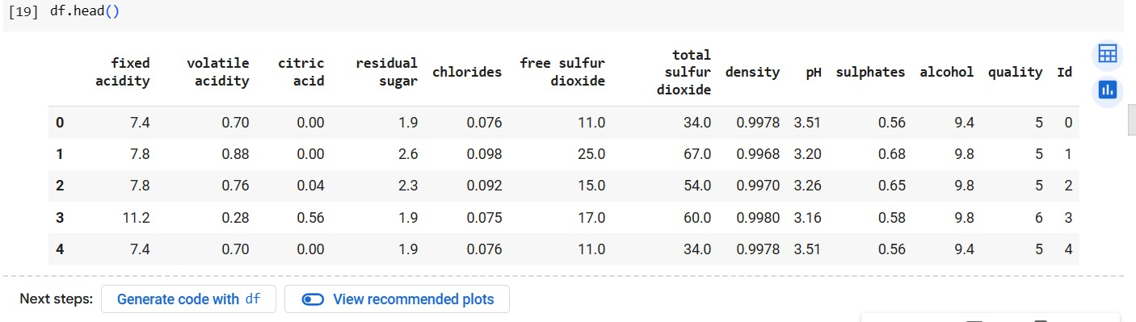
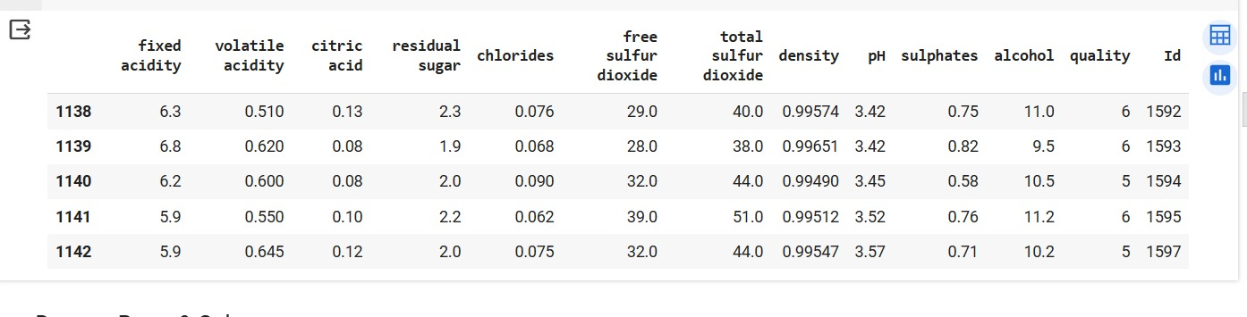
DATA SUMMARY

Slide 8
FEATURES DESCRIPTION
Fixed acidity: The amount of non-volatile acids in the wine, usually given in grams per liter (g/L).
Volatile acidity: The amount of volatile acids in the wine, which can contribute to unpleasant flavors and aromas if present in high quantities. Usually measured in grams per liter (g/L).
Citric acid: The amount of citric acid in the wine, which can add freshness and flavor. Measured in grams per liter (g/L).
Residual sugar: The amount of sugar remaining after fermentation stops, measured in grams per liter (g/L).
Chlorides: The amount of salt in the wine, measured in grams per liter (g/L).
Free sulfur dioxide: The free form of sulfur dioxide present in the wine, which prevents microbial growth and oxidation. Measured in parts per million (ppm).

Slide 9
FEATURES DESCRIPTION
Total sulfur dioxide: The total amount of sulfur dioxide present in the wine, including both free and bound forms. Measured in parts per million (ppm).
Density: The density of the wine, usually in grams per milliliter (g/mL).
pH: The acidity or basicity of the wine, measured on a scale of 0 to 14, with 7 being neutral.
Sulphates: The amount of sulphates present in the wine, which can contribute to its antimicrobial and antioxidant properties. Measured in grams per liter (g/L).
Alcohol: The alcohol content of the wine, typically measured in volume percent (% vol).
Quality: The overall quality rating of the wine, often determined by sensory evaluation or expert judgment. This is the target variable in predictive modeling tasks.

Slide 10
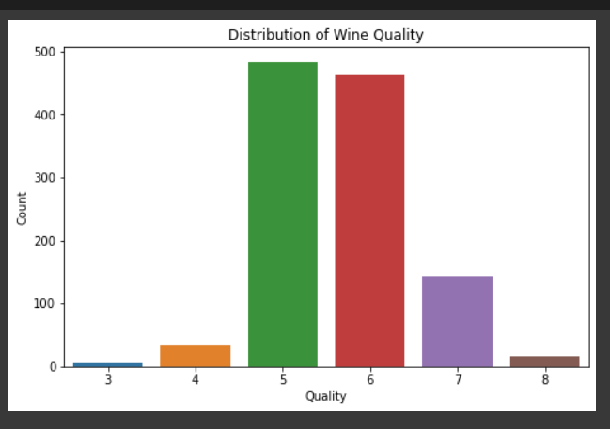
Analysis of the Distribution of Wine
Below is given the distribution of wine which shows how the wine count is affected by wine quality.

Slide 11
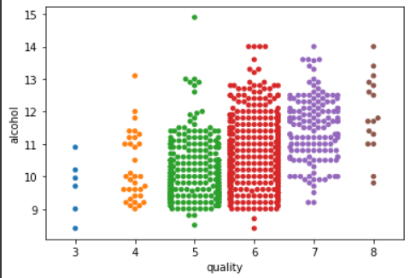
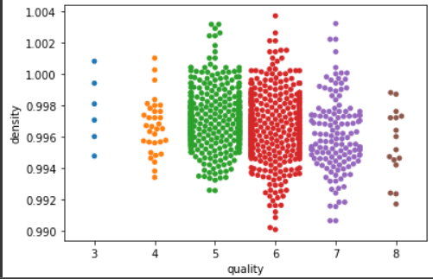
Quality Analysis
Here the graph shows the quality of wine with alcohol content and the density of wine compared to quality.

Slide 12
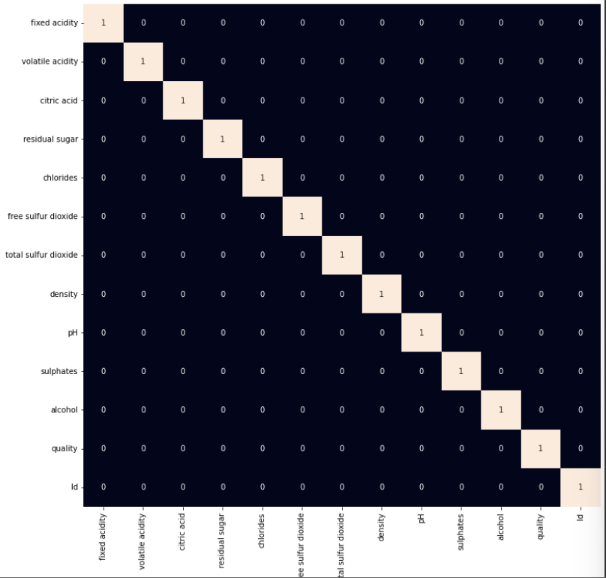
Analysis through heatmap
Heatmap of the correlation matrix is used to effectively visualizes the pairwise correlations between numerical variables in the dataset. Each cell in the heatmap represents the correlation coefficient between two variables, with color indicating the strength and direction of the correlation. Annotating the heatmap with correlation coefficients provides additional information, making it easier to interpret the relationships between variables.

Slide 13
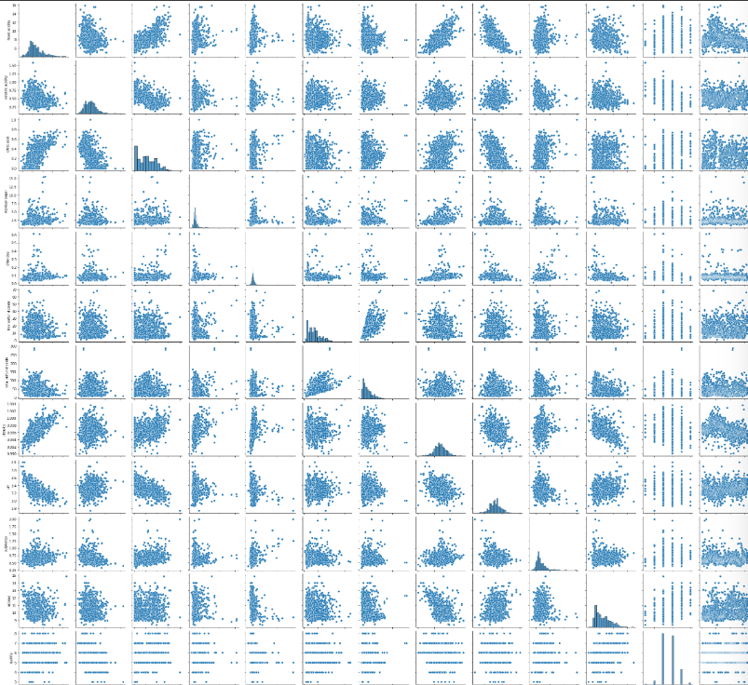
Analysis of data using pair plots
This helps us get the following information from the graphs:-
Diagonal Plots: The diagonal plots represent the distribution of each numerical variable. This helps us understand the distribution of data for each variable individually.
Correlation: We can also visually inspect the correlation between variables. Positive correlation is indicated by points sloping upwards from left to right, while negative correlation is indicated by points sloping downwards.

Slide 14
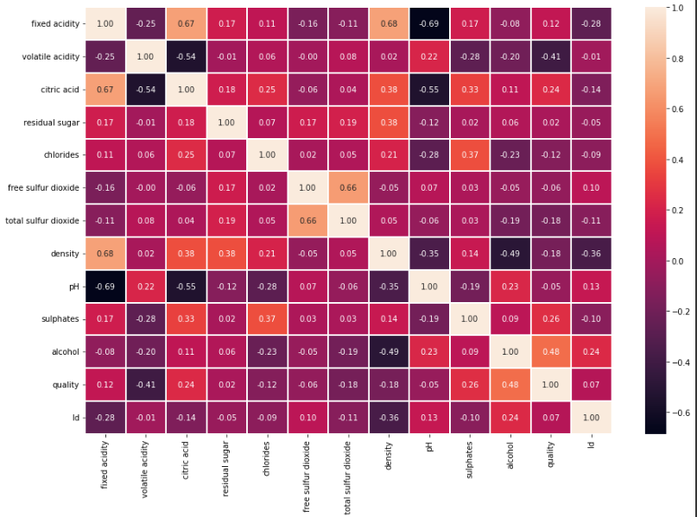
Ph scale of alcohol contents
This shows the Ph of contents used to make wine and how it affects its quality.
The dark side shows high Ph value and light side shows low Ph value.

Slide 15
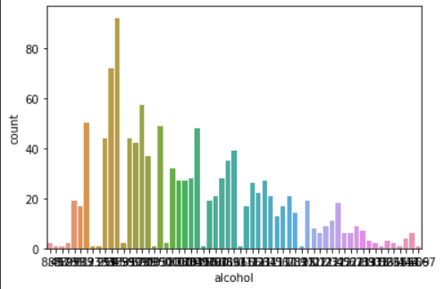
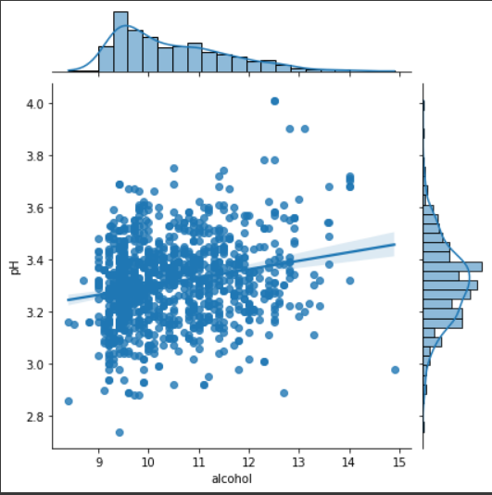
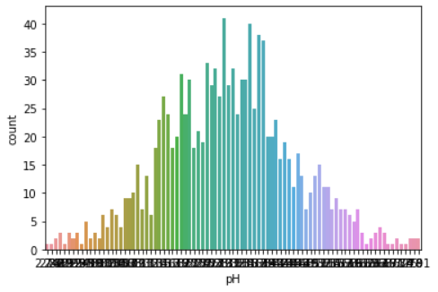
Ph affecting alcohol and count of wine
Alcohol is the most prominent reason which plays a role in change of pH count.

Slide 16
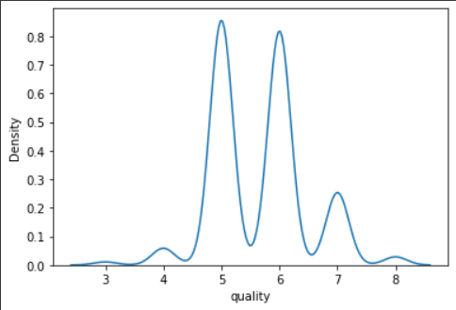
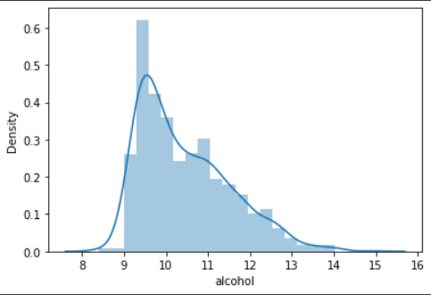
Density
The quality of wine depends on how dense it seems and density is affected by the amount of alcohol present in the wine.
As the density and amount of alcohol increases the quality gets better

Slide 17
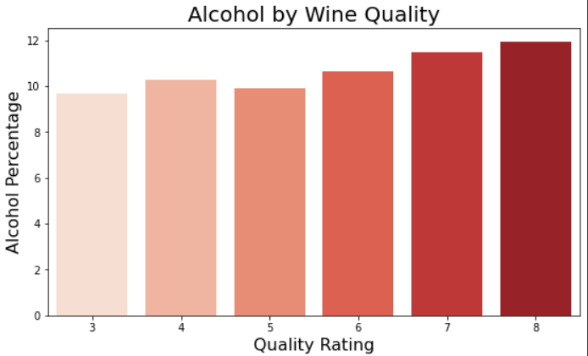
Quality Rating
The higher the alcohol percentage in wine it got more quality rating as compared to if it has less alcohol quantity.

Slide 18
Challenges
We faced Difficulty to get more insights from small data set.
The columns in the dataset took some time to understand and also we have done some research work to understand the quality of wine.
It was not easy to get every detail about wine contents and how do they affect them.

Slide 19
Recommendations
Maintain appropriate levels of acidity and pH throughout the winemaking process.
Acidity adds freshness and balance to the wine, while pH affects its stability and microbial activity. Regular monitoring and adjustments during winemaking can help achieve desired acidity and pH levels.
Pay attention to alcohol content and aim for balance in the wine.
High alcohol levels can overpower the wine's flavors and aromas, while low alcohol levels may result in a thin and unbalanced wine
Pay close attention to the grape varieties and their origin. Different grape varieties and terroirs contribute unique flavors and characteristics to wines. Experiment with different grape varieties and terroirs to find the optimal combination for desired wine styles.

Slide 20
Conclusions
After analyzing the wine quality dataset, several insights have emerged regarding the factors that influence wine quality.
wine quality is influenced by various factors, this analysis sheds light on the key attributes that contribute to perceived quality.
By understanding these factors, both producers and consumers can make more informed decisions, ultimately enhancing the enjoyment and appreciation of wine.
The distribution of features in the dataset reveals that certain attributes, such as alcohol content, volatile acidity, and sulphates, vary significantly across different wines
For winemakers, understanding the key attributes that contribute to wine quality can inform production processes and grape selection. Additionally, consumers can use this information to make more informed choices when selecting wines based on their preferences.

Slide 21
Q & A

