Slide 1
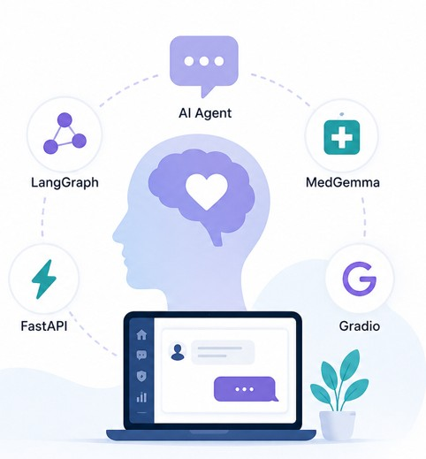
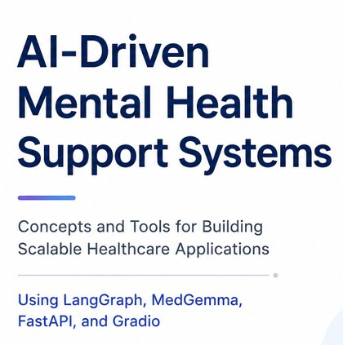
Presented by Jatin Mathur Master in Software Engineering for Industrial Applications Hochschule Hof
01 / 20
Notes:
Opening: introduce topic as Agentic AI, not only an application.
Mention that the project is used as a running example to explain concepts and tools.

Slide 2
OVERVIEW
Presentation Roadmap
01 Concept
02 Reasoning Pattern
What agentic AI means and how it differs from normal LLM chat
ReAct: observe, reason, act, evaluate
03 Main Tool
04 Supporting Tools
LangGraph: stateful graph framework for agents
FastAPI, Gradio, Twilio, OpenStreetMap, Ollama
05 Project Mapping
06 Comparison
SafeSpace AI architecture, safety workflow and results
LLM vs AI agents and MedGemma vs major AI models
02 / 20
Notes:
This slide gives a clear roadmap.
The focus is concept first, then tools, then the project as implementation.

Slide 3
PROJECT MOTIVATION
Problem Context: Why an Agent?
Mental health support gap
Normal chatbot limitation
Agentic solution
Support is often delayed, expensive or unavailable outside working hours. A software system needs to respond quickly and safely.
A plain chatbot mainly answers text. It cannot reliably coordinate risk checks, APIs, routing and structured outputs.
An agent can reason over context, choose actions, call tools and produce different outputs based on risk level.
Input
Reason
Act
Output
User message
Risk and intent
Tool/API call
Response or handoff
Context from SafeSpace AI reference project, selected slides 6, 7, 9, 10, 11, 12, 14, 17, 19, 20 and 21.
03 / 20
Notes:
Explain that the subject is not only mental health.
The real study topic is the concept and tool chain behind the application.

Slide 4
CONCEPT
Core Concept: Agentic AI
Traditional LLM Chat
Agentic AI System
Produces one text answer
Plans, routes and executes steps
No direct external action
Uses APIs, tools and services
Usually stateless interaction
Maintains state, memory and results
Same model for most tasks
Combines models, tools and rules
Passive response pattern
Proactive risk detection and workflow control
Simple idea: an AI agent is an LLM connected to tools, state and control logic.
04 / 20
Notes:
This slide comes from the reference idea: traditional AI versus agentic AI.
Use one sentence: LLM is the brain, tools are the hands, state is the memory, graph is the control system.

Slide 5
CONCEPT
Main Building Blocks of an AI Agent
Model
State
Tools
understands text, reasons and generates the next step
stores messages, risk scores, tool outputs and metadata
external functions such as clinic search or emergency call
Router
Guardrails
Output
decides which path or tool should run next
limits unsafe, off-topic or low-confidence responses
final response, structured note or escalation action
These blocks are implemented with LangGraph + LangChain tools in the project.
05 / 20
Notes:
This slide defines the vocabulary before explaining LangGraph.
It makes the later architecture easier to understand.

Slide 6
CONCEPT
ReAct Pattern: Reason + Act
Observe
Think
Act
Result
Read message, context and previous tool results
Decide intent, risk and next useful action
Call selected tool or model function
Use returned data to answer or continue
ReAct prevents a single-step chatbot response. The agent can reason, use tools, read results and then continue.
Presentation sentence
“ReAct means the model does not only answer; it decides what action is needed, executes it, and uses the result.”
Source: Yao et al., ReAct: Synergizing Reasoning and Acting in Language Models, 2022, arXiv:2210.03629.
06 / 20
Notes:
Say this slowly because ReAct is the core concept.
Mention that ReAct is useful because actions are separated into clear steps.

Slide 7
EASY PRESENTATION SLIDE
ReAct in the SafeSpace Agent
Observe
Think
Act
Result
Message suggests distress or crisis.
Classify risk as LOW, MEDIUM or HIGH.
Route to the correct tool.
Return safe response or escalation.
Risk Level
Agent Behaviour
LOW
Therapy response, breathing guide, sleep advice or mood support
MEDIUM
Supportive response plus crisis resources and monitoring
HIGH
Emergency workflow: hotline information and Twilio escalation
Off-topic
Health-topic filter blocks non-health queries
07 / 20
Notes:
This slide is made for easy speaking.
Use the four words: observe, think, act, result. Then explain the three risk levels.

Slide 8
TOOL
Focus Tool: LangGraph
Definition
Why it fits this project
LangGraph is a framework for building stateful agent workflows as graphs. Nodes represent processing steps; edges control the next step.
The mental-health assistant needs branching logic: normal response, crisis flow, clinic search, pharmacy search, SOAP note and safe refusal.
Graph structure
State object
Tool nodes
clear workflow
shared memory
API execution
Conditional edges
Human-in-loop
Streaming
dynamic routing
approval option
chat UX
Source: LangGraph documentation and SafeSpace AI reference slide 9.
08 / 20
Notes:
This slide introduces the main tool.
Avoid going too deep into code at first; explain why LangGraph is selected.

Slide 9
TOOL DEEP DIVE
LangGraph: How It Works
START
LLM NODE
ROUTER
TOOL NODE
END
request enters
reasoning step
choose path
execute action
response
Shared State
A single state object moves through the graph: messages, risk level, selected tool, API result, location data, and final output.
In code
Result
create_react_agent(llm, tools=[...])
repeatable, debuggable and testable agent workflow
09 / 20
Notes:
Explain graph with one sentence: nodes do work, edges decide movement, state carries memory.
Mention that this is easier to maintain than long if-else chains.

Slide 10
CONCEPT + TOOL
Tool Calling Concept
Tool calling means the model does not directly perform every task. It selects a named function, sends structured arguments, and receives a structured result.
Tool Type
Example in the Project
Clinical response tool
MedGemma generates health-focused supportive response
Crisis escalation tool
Twilio call workflow when high-risk keywords appear
Location tool
OpenStreetMap, Nominatim and Overpass search nearby clinics
Documentation tool
SOAP note generator with ICD-10 style structure
Safety filter
Blocks unrelated or unsafe non-health requests
Key idea
The agent becomes useful because the LLM is connected to real application functions.
10 / 20
Notes:
Focus on the concept, not only the project feature list.
Mention that tool calling is the bridge between language and software actions.

Slide 11
TOOL COMPARISON
LangGraph vs Alternatives
Feature
LangGraph
AutoGen
CrewAI
Sequential Chain
State management
Strong
Partial
Limited
Limited
Cyclic workflows
Supported
Supported
Limited
No
Human approval
Built-in pattern
Manual
Manual
Manual
Debugging / tracing
LangSmith
Basic
Basic
LangSmith
Production control
High
Medium
Medium
Medium
Best fit
complex agents
multi-agent research
role-based tasks
linear flows
11 / 20
Notes:
Do not say other frameworks are bad.
Say LangGraph is most suitable here because the project needs state, routing and safety paths.

Slide 12
TOOL RELEVANCE
Why LangGraph Remains Relevant
Complex workflows
Regulated domains
Agents need branching, loops and conditional steps.
Healthcare-style workflows benefit from state, logging and control.
Local model support
Debugging
Works with Ollama and local models for privacy-oriented deployments.
Graph structure makes behaviour easier to explain during testing.
Presentation point
LangGraph is not the AI model. It is the workflow framework around the model.
12 / 20
Notes:
This clarifies a common confusion.
The model produces text; LangGraph controls the application workflow.

Slide 13
IMPLEMENTATION
System Architecture: Agentic AI Project
Frontend
Gradio desktop chat interface, sidebar, prompts and mood tracking
Backend
FastAPI endpoints, routing logic, validation and service integration
Agent Layer
LangGraph + LangChain tools, ReAct loop and shared state
Model Layer
MedGemma for medical support; Llama/Ollama for orchestration
External Services
Twilio, OpenStreetMap, Nominatim, Overpass and location APIs
13 / 20
Notes:
This corresponds to the project architecture from the reference deck.
Move from the user interface down to external services.

Slide 14
TOOLS
Tool Stack: What Each Tool Does
LangGraph
FastAPI
Gradio
MedGemma
agent graph, state, routing
backend API layer
local chat interface
health-focused generation
Ollama / Llama
Twilio
OpenStreetMap
ICD-10 / SOAP
local orchestration model
emergency call/SMS integration
clinic and pharmacy search
structured clinical-style notes
14 / 20
Notes:
Do not list tools only by name.
For each tool, connect it to the concept it implements.

Slide 15
MODELS
AI Models in the Project
MedGemma
Llama 3.2 / Ollama
Open health AI model family built for medical text and image understanding. In the project it supports health-oriented responses and structured clinical-style output.
Local LLM runtime used for orchestration and agent behaviour. Local execution supports privacy and lower dependency on hosted APIs.
Separation of roles
Specialized model for health response + general local model for workflow control = safer and more modular architecture.
Sources: Google MedGemma documentation; Meta Llama documentation; Ollama documentation.
15 / 20
Notes:
Explain why two models are used.
MedGemma handles health-domain generation; Llama/Ollama helps with local agent orchestration.

Slide 16
COMPARISON
LLM vs AI Agent
Dimension
LLM
AI Agent
Main function
generate text
complete a task through steps
Memory
prompt/context only
state object and history
Tools
optional or none
central part of workflow
Control logic
mostly prompt-driven
graph/routing-driven
Output
answer
answer, API action, document, escalation
Example
ChatGPT-style response
LangGraph SafeSpace workflow
16 / 20
Notes:
This slide answers the common question: why not just use ChatGPT?
The agent adds application control around the model.

Slide 17
MODEL COMPARISON
MedGemma vs Major AI Models
Model Family
Best Strength
Limitation for This Project
Best Role
MedGemma
health-domain text/image comprehension
requires validation before clinical use
medical support response
OpenAI GPT / ChatGPT
general reasoning, coding, tool calling
hosted API and broad general model
general assistant or orchestration
Claude
long-form reasoning and careful writing
hosted API; not health-specialized by default
analysis, documentation, coding
Gemini
multimodal and Google ecosystem integration
general model; needs healthcare adaptation
multimodal assistant
Llama
open/local deployment and privacy control
smaller models can be weaker on medical nuance
local workflow model
Mistral / open models
fast, deployable and cost controlled
domain tuning may be required
lightweight local services
Main decision
MedGemma is preferred for medical content; general LLMs are better for broad tasks and coding.
Sources: Google MedGemma docs, OpenAI model docs, Anthropic Claude docs, Google Gemini docs, Meta Llama docs.
17 / 20
Notes:
This slide is not saying MedGemma is better at everything.
Say the model choice depends on the use case: health specialization versus general reasoning.

Slide 18
PROJECT MAPPING
Safety Workflow: Crisis Detection + SOAP Notes
Risk Level
Detection Example
Agent Response
LOW
sad, anxious, stressed
supportive response and coping exercise
MEDIUM
hopeless, trapped, give up
supportive response plus crisis resources
HIGH
suicide, end life, self-harm
emergency escalation workflow and hotline message
SOAP note generator
Why this matters
Subjective, Objective, Assessment and Plan structure for handoff-style documentation.
The agent output is not only chat. It can create structured documents and trigger safety flows.
Sources: SafeSpace AI reference slides 17 and 19; WHO safe messaging; ICD-10 reference.
18 / 20
Notes:
This slide maps concept to project behaviour.
Stress that safety workflow is a controlled routing system, not only prompt engineering.

Slide 19
EVALUATION
Results, Limitations and Future Work
Implemented
Limitations
Future Work
MedGemma response
LangGraph agent
FastAPI backend
Gradio interface
Crisis detection
Twilio emergency call
Clinic/pharmacy finder
SOAP note output
Not a doctor replacement
Needs clinical validation
Keyword risk detection can miss context
External APIs can fail
Privacy and compliance must be reviewed
Multilingual mode
Voice input
User login
Database history
Human review path
PDF export
Stronger emotion model
19 / 20
Notes:
Be honest here.
Mention implemented features, then limitations, then improvements. This sounds professional.

Slide 20
Thank You
20 / 20
Notes:
End with sources and invite questions.
Keep this slide visible for credibility and trackable references.

