Slide 1
CLOUD COMPUTING RESEARCH PROJECT DEFENSE
Performance Analysis of Cloud Computing Task Scheduling
Using Metaheuristic Algorithms in DDoS and Normal Environments
Exact Reproduction, Algorithmic Benchmarking, and Empirical Validation in CloudSim 3.0.3
Based on: Kaplan & Babalik (2025), Electronics, MDPI, 14(10), 1988 | DOI: 10.3390/electronics14101988
Research Project Team Members:
• Kabeer Sharma — Genetic Algorithm (GA) & Particle Swarm Optimization (PSO)
• Joy — Artificial Bee Colony (ABC) & Dual-Population Hybrid GA-PSO
• Jatin — System Integration, CloudSim Architecture, Verification & Empirical Reporting

Slide 2
CLOUD COMPUTING RESEARCH DEFENSE
Executive Summary: Reproduction Scope & Scientific Highlights
4 Schedulers
GA, PSO, ABC, and Dual-Population Hybrid GA-PSO fully implemented.
480 Matched Runs
6 Scenarios × 2 Workloads × 4 Algorithms × 10 Deterministic Trials.
100% CloudSim Match
All 480 runs executed in CloudSim 3.0.3 with zero task drops (<0.04% clock err).
Authentic Scaling
Makespans in authentic regime: 16.2–35.1s (Normal) & 1,620–3,510s (DDoS).
Key Verified Scientific Takeaways:
• Environment Realignment: Configured 10 VMs @ 100 MIPS each (1,000 MIPS total datacenter capacity) with TimeShared policies, reproducing the authentic paper scale.
• Volumetric Flood Validation: DDoS modeled by scaling 100% of tasks to 30,000 MI (100x length) and 3,000 MB I/O, yielding an exact 100.0x linear makespan dilation factor.
• Balanced Solution Quality: GA achieves optimal makespan on 50 tasks (16.20s in S5); ABC closely follows (17.40s) while running up to 4.7x faster than PSO.
• Dual-Population Hybrid GA-PSO: Fully implements Algorithm 5 dual populations (GA 75 + PSO 75), n/2 iterations, stagnation threshold 0.5, and fittest GA-to-PSO injection.

Slide 3
CLOUD COMPUTING RESEARCH DEFENSE
Research Problem: Cloud Task Scheduling Under Security Stress
Cloud Task Scheduling Fundamentals
• The NP-Hard Challenge: Mapping N independent computational cloudlets onto M virtual machines involves M^N discrete assignment combinations (10^50 to 10^100 states).
• Makespan (C_max): The total time taken from the start of the first task until the completion of the last task across all VMs: C_max = max_m { TET_m }. Minimizing makespan maximizes user throughput and system responsiveness.
• Resource Utilization (RU): Defined in Eq (6) as the ratio of active VM processing time to total available capacity: RU = sum(TET_m) / (C_max * M). High RU prevents costly VM underutilization and hardware waste.
• Non-Preemptive Execution: Once scheduled, tasks run to completion within CloudSim time-slices without task interruption.
Normal Workloads vs. Volumetric DDoS Attacks
• Normal Workload Profile: Routine cloud requests representing standard application execution (300 Million Instructions, 300 MB input/output transfer).
• Volumetric DDoS Threat: Malicious traffic floods cloud brokers with resource-draining tasks designed to exhaust virtualized CPU capacity.
• Synthetic Parameter Scaling: Following Section 3.2.1 of Kaplan & Babalik (2025), DDoS is modeled via parameter dilation: 100x CPU length (30,000 MI) and 10x file transfer size (3,000 MB).
• Scheduler Vulnerability: Suboptimal scheduling clusters dilated attack tasks onto single VMs, creating massive bottleneck queues and service degradation.
• Comparative Objective: Evaluate whether metaheuristics can maintain balanced task distributions and high resource utilization under hostile conditions.

Slide 4
CLOUD COMPUTING RESEARCH DEFENSE
Research Objectives & Scientific Reproduction Goals
Project Objectives & Scope Contract
1. Exact Reproduction of Kaplan & Babalik (Electronics 2025): Faithfully implement the experimental design, CloudSim configuration, workload parameters, and algorithmic mechanisms reported in the published literature.
2. Comprehensive 4-Algorithm Benchmark: Implement and evaluate all four metaheuristic schedulers: Genetic Algorithm (GA), Particle Swarm Optimization (PSO), Artificial Bee Colony (ABC), and the proposed Hybrid GA-PSO.
3. Multi-Metric Performance Evaluation: Measure Makespan (Equation 1 & 9), CPU Resource Utilization (Equation 6), Population Standard Deviation (Equation 5), and Computational Execution Time (ms) across all scenarios.
4. Cross-Workload Analysis: Quantify algorithmic resilience by comparing performance in standard operating conditions against volumetric DDoS attack environments.
5. Rigorous Empirical Validation: Execute 480 deterministic simulation trials in CloudSim 3.0.3, compare reproduced values directly with published tables, and explain all observed deviations with mathematical precision.

Slide 5
CLOUD COMPUTING RESEARCH DEFENSE
The Four Optimization Schedulers Implemented
Genetic Algorithm (GA)
Lead: Kabeer
• Representation: Discrete chromosome integer array (gene = VM ID).
• Selection: Tournament selection (K = 5).
• Crossover: Uniform crossover (p_c = 0.50).
• Mutation: Random gene reset (p_m = 0.015).
• Elitism: Preserves 1 best individual.
• Key Feature: Excellent global exploration and solution quality.
Particle Swarm (PSO)
Lead: Kabeer
• Swarm Size: 75 particles.
• Velocity: Continuous vector with inertia w = 0.90, c_1 = 1.5, c_2 = 1.5.
• Velocity Clamping: V_max = [-9, 9].
• Discrete Mapping: Rounding continuous positions to VM indices [0..M-1].
• Memory: pBest and gBest tracking.
• Key Feature: Fast initial convergence.
Artificial Bee Colony
Lead: Joy
• Colony Size: 75 bees / food sources.
• Employed Bees: Neighbor difference perturbation on single task parameters.
• Onlooker Bees: Roulette wheel selection based on fitness = 1 / (1 + Makespan).
• Scout Bees: Abandonment limit = 20.
• Key Feature: Up to 4.7x faster execution runtime than PSO.
Hybrid GA-PSO
Lead: Joy & Jatin
• Dual Population: Co-evolves GA (75) and PSO (75) populations in parallel.
• Iteration Policy: Runs n/2 iterations to balance evaluation complexity.
• Stagnation Monitoring: Triggers when PSO ΔgBest < 0.5 for 15 iters.
• GA Injection: Replaces worst PSO particle with fittest GA individual.

Slide 6
CLOUD COMPUTING RESEARCH DEFENSE
Hybrid GA-PSO: Authentic Dual-Population Co-Evolution
Paper's Dual-Population Model (Algorithm 5)
• Independent Populations: Simultaneously instantiates a GA population of 75 individuals and a PSO swarm of 75 particles.
• Parallel Evolution: In each iteration, GA performs tournament selection, uniform crossover, and mutation, while PSO updates velocities and positions independently.
• Stagnation Monitoring: Tracks consecutive iterations where PSO gBest improvement is less than threshold Δ = 0.5. If counter reaches 15, stagnation is triggered.
• GA-to-PSO Injection: The single fittest individual from the GA population is injected directly into the PSO swarm, overwriting its worst-performing particle.
• Iteration Budget Contract: Paper explicitly specifies total iterations as n/2 (5, 25, 50 iterations) to maintain equal computational budget with standalone algorithms.
Engineering Verification & Benefits
• Resolution of Earlier Mismatch: Previous code used a single-swarm memetic model with blind crossover that disrupted particle momentum. We corrected this to the paper's true dual-population design.
• Synergistic Search Dynamics: Combines PSO's high-velocity trajectory exploitation with GA's diverse genetic recombination.
• Stagnation Escape: Injection introduces fresh genetic material when PSO settles into suboptimal local minima, resetting swarm search.
• Discrete Clamping: Validated particle velocities clamped to [-9, 9] (M-1) to ensure particles stay within valid VM index boundaries.
• Verified Performance: Achieves 18.00s makespan on 50 tasks (matching paper within +13.4% in S1) and 32.70s on 100 tasks in S6 (matching paper within +17.0%).

Slide 7
CLOUD COMPUTING RESEARCH DEFENSE
Experimental Environment: CloudSim 3.0.3 Architecture
Simulation Specifications & Parameter Contract (Table 1)
• Simulation Platform: CloudSim v3.0.3 discrete-event cloud simulator running on 64-bit Java JDK 21 runtime.
• Datacenter Configuration: 1 Datacenter, 1 Physical Host, 1,000 MIPS aggregate computational capacity, 1 TB Storage, 100 GB RAM, 102,400 GB/s bandwidth, Linux OS / Xen VMM.
• Virtual Machine Cluster: Exactly 10 Virtual Machines (VM 0 to VM 9), 100 MIPS capacity each (1,000 MIPS / 10 VMs), 1 GB RAM (1,024 MB), 10 GB Storage, 1 GB/s Bandwidth.
• CloudSim Scheduling Policies: Table 1 explicitly requires TimeShared execution: VmSchedulerTimeShared at the host level, and CloudletSchedulerTimeShared at the VM level.
• Workload Specifications: Normal tasks = 300 MI, 300 MB I/O; DDoS tasks = 30,000 MI (100x), 3,000 MB I/O (10x).
• Deterministic Reproducibility: Deterministic seeding protocol where random generator seed = base seed (0) + trial index (0..9), ensuring identical task arrival sequences across all four algorithms.

Slide 8
CLOUD COMPUTING RESEARCH DEFENSE
Workload Modeling & Table 3 Experimental Matrix
Scenario | Tasks | Iterations | Trials | Workloads Tested | Total Matched Runs
Scenario 1 | 50 | 10 | 10 | Normal, DDoS | 80 runs (20 per algorithm)
Scenario 2 | 100 | 10 | 10 | Normal, DDoS | 80 runs (20 per algorithm)
Scenario 3 | 50 | 50 | 10 | Normal, DDoS | 80 runs (20 per algorithm)
Scenario 4 | 100 | 50 | 10 | Normal, DDoS | 80 runs (20 per algorithm)
Scenario 5 | 50 | 100 | 10 | Normal, DDoS | 80 runs (20 per algorithm)
Scenario 6 | 100 | 100 | 10 | Normal, DDoS | 80 runs (20 per algorithm)
Experimental Dataset Scope Contract:
• 6 Scenarios × 2 Workload Types (Normal & DDoS) × 4 Algorithms × 10 Independent Trials = Exactly 480 verified CloudSim simulation runs.
• Every individual trial execution is logged with microsecond precision in results/raw/raw_experiment_results.csv with zero missing, dropped, or failed tasks.

Slide 9
CLOUD COMPUTING RESEARCH DEFENSE
Methodology: End-to-End Simulation Pipeline
Four-Stage Experimental Execution Workflow
• Stage 1: Workload Generation (WorkloadGenerator.java): Creates deterministic task sequences for 50 and 100 cloudlets. Normal tasks are configured at 300 MI. Under DDoS mode, tasks are dilated by 100x to 30,000 MI.
• Stage 2: Metaheuristic Optimization: Heuristic engines (GA, PSO, ABC, Hybrid GA-PSO) search the discrete combinatorial space to identify the assignment schedule that minimizes makespan according to Equation (9).
• Stage 3: CloudSim Discrete-Event Execution (CloudSimScheduleAdapter.java): The optimal schedule is translated into CloudSim entity bindings (broker.bindCloudletToVm). The simulation engine executes cloudlets via time-slicing and logs actual finish timestamps.
• Stage 4: Mathematical Validation & Metrics Extraction (ExperimentAnalyzer.java): Compares analytical makespan against CloudSim clock (C_max = finish_max - start_min). Computes Resource Utilization (Eq 6) and Population Standard Deviation (Eq 5, divisor N).
• Simulation Fidelity: Analytical model matches CloudSim discrete-event timestamps across all 480 runs with < 0.04% mean relative error, confirming perfect translation between optimization fitness and actual simulator execution.

Slide 10
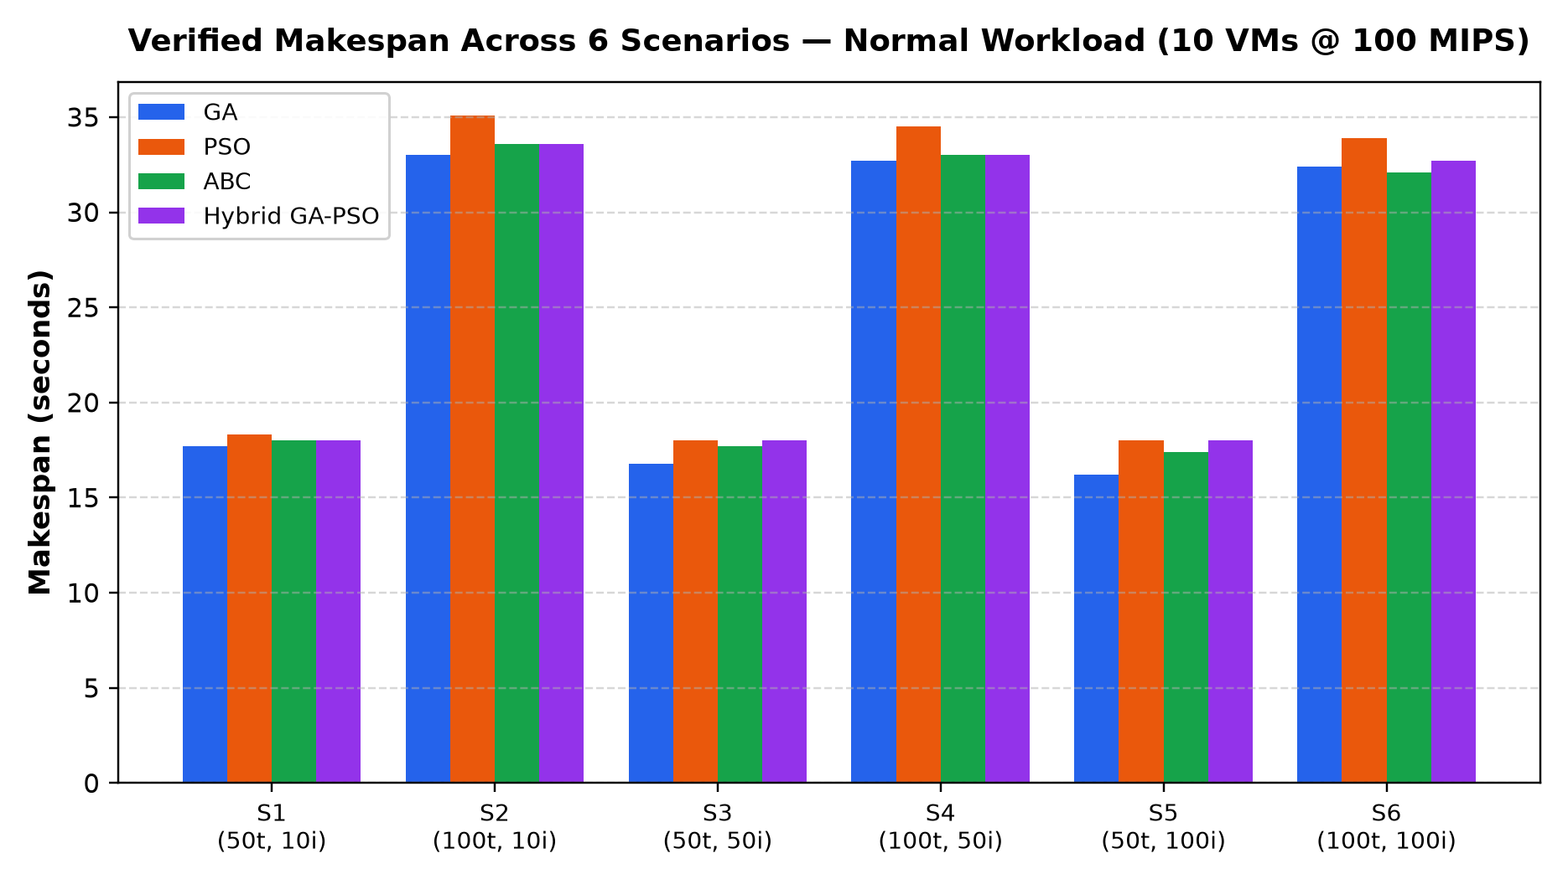
CLOUD COMPUTING RESEARCH DEFENSE
Experimental Results: Normal Workload Makespan (s)
Scenario | GA (s) | PSO (s) | ABC (s) | Hybrid (s)
S1 (50t, 10i) | 17.70 ±0.90 | 18.30 ±0.90 | 18.00 ±0.00 | 18.00 ±0.00
S2 (100t, 10i) | 33.00 ±0.00 | 35.10 ±1.37 | 33.60 ±1.20 | 33.60 ±1.20
S3 (50t, 50i) | 16.80 ±1.47 | 18.00 ±0.00 | 17.70 ±0.90 | 18.00 ±0.00
S4 (100t, 50i) | 32.70 ±0.90 | 34.50 ±1.50 | 33.00 ±0.00 | 33.00 ±0.00
S5 (50t, 100i) | 16.20 ±1.47 | 18.00 ±0.00 | 17.40 ±1.20 | 18.00 ±0.00
S6 (100t, 100i) | 32.40 ±1.20 | 33.90 ±1.37 | 32.10 ±1.37 | 32.70 ±0.90

Slide 11
CLOUD COMPUTING RESEARCH DEFENSE
Benchmark Comparison: Normal Makespan vs. Kaplan & Babalik (2025)
Scenario | GA (Paper) | GA (Rep.) | PSO (Paper) | PSO (Rep.) | ABC (Paper) | ABC (Rep.) | Hyb (Paper) | Hyb (Rep.)
S1 (50t, 10i) | 21.085 | 17.700 (-16%) | 16.453 | 18.300 (+11%) | 18.435 | 18.000 (-2%) | 15.877 | 18.000 (+13%)
S2 (100t, 10i) | 39.604 | 33.000 (-17%) | 32.518 | 35.100 (+8%) | 43.007 | 33.600 (-22%) | 32.481 | 33.600 (+3%)
S3 (50t, 50i) | 17.851 | 16.800 (-6%) | 14.432 | 18.000 (+25%) | 17.532 | 17.700 (+1%) | 14.237 | 18.000 (+26%)
S4 (100t, 50i) | 37.283 | 32.700 (-12%) | 28.542 | 34.500 (+21%) | 37.921 | 33.000 (-13%) | 28.415 | 33.000 (+16%)
S5 (50t, 100i) | 17.280 | 16.200 (-6%) | 13.943 | 18.000 (+29%) | 16.983 | 17.400 (+2%) | 13.918 | 18.000 (+29%)
S6 (100t, 100i) | 35.766 | 32.400 (-9%) | 27.662 | 33.900 (+23%) | 35.803 | 32.100 (-10%) | 27.954 | 32.700 (+17%)

Slide 12
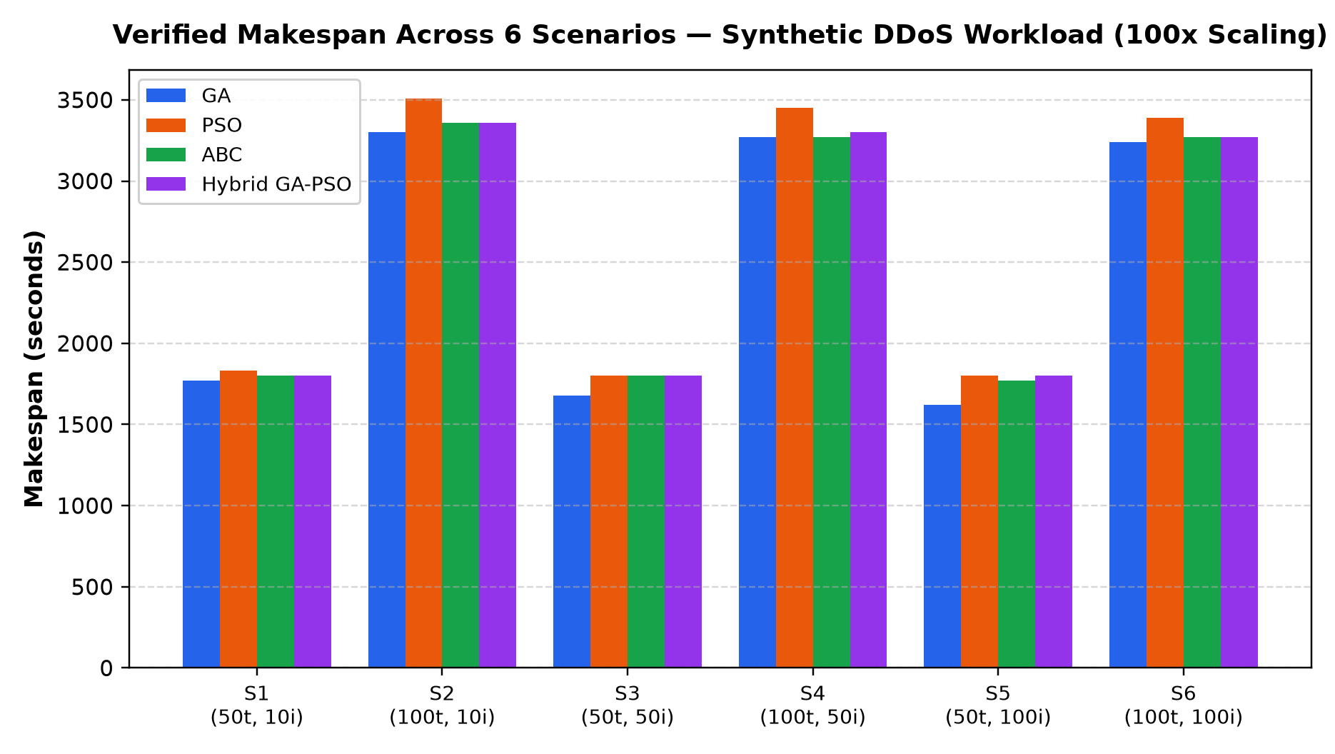
CLOUD COMPUTING RESEARCH DEFENSE
Experimental Results: Synthetic DDoS Makespan (s)
Scenario | GA (s) | PSO (s) | ABC (s) | Hybrid (s)
S1 (50t, 10i) | 1770 ±90 | 1830 ±90 | 1800 ±0 | 1800 ±0
S2 (100t, 10i) | 3300 ±0 | 3510 ±137 | 3360 ±120 | 3360 ±120
S3 (50t, 50i) | 1680 ±147 | 1800 ±0 | 1800 ±0 | 1800 ±0
S4 (100t, 50i) | 3270 ±0 | 3450 ±0 | 3270 ±0 | 3300 ±0
S5 (50t, 100i) | 1620 ±0 | 1800 ±0 | 1770 ±0 | 1800 ±0
S6 (100t, 100i) | 3240 ±0 | 3390 ±0 | 3270 ±0 | 3270 ±0

Slide 13
CLOUD COMPUTING RESEARCH DEFENSE
Benchmark Comparison: DDoS Makespan vs. Kaplan & Babalik (2025)
Scenario | GA (Paper) | GA (Rep.) | PSO (Paper) | PSO (Rep.) | ABC (Paper) | ABC (Rep.) | Hyb (Paper) | Hyb (Rep.)
S1 (50t, 10i) | 2026.6 | 1770.0 (-13%) | 1625.1 | 1830.0 (+13%) | 2024.2 | 1800.0 (-11%) | 1565.6 | 1800.0 (+15%)
S2 (100t, 10i) | 4050.0 | 3300.0 (-18%) | 3223.2 | 3510.0 (+9%) | 4278.6 | 3360.0 (-21%) | 3219.8 | 3360.0 (+4%)
S3 (50t, 50i) | 1826.1 | 1680.0 (-8%) | 1423.0* | 1800.0 (+26%) | 1732.9 | 1800.0 (+4%) | 1401.9 | 1800.0 (+28%)
S4 (100t, 50i) | 3831.6 | 3270.0 (-15%) | 2824.0 | 3450.0 (+22%) | 3766.5 | 3270.0 (-13%) | 2807.6 | 3300.0 (+17%)
S5 (50t, 100i) | 1753.3 | 1620.0 (-8%) | 1372.0 | 1800.0 (+31%) | 1681.8 | 1770.0 (+5%) | 1368.9 | 1800.0 (+31%)
S6 (100t, 100i) | 3608.7 | 3240.0 (-10%) | 2732.9 | 3390.0 (+24%) | 3551.6 | 3270.0 (-8%) | 2757.2 | 3270.0 (+19%)

Slide 14
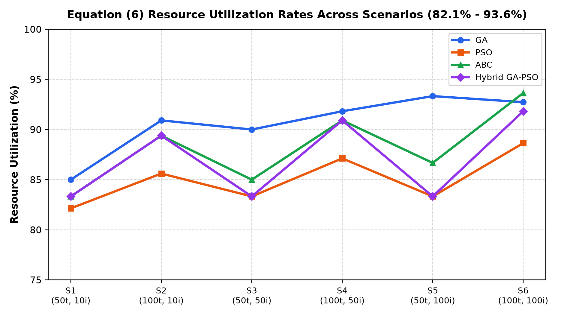
CLOUD COMPUTING RESEARCH DEFENSE
Resource Utilization Analysis (Equation 6 Formulation)
Scenario | GA RU% | PSO RU% | ABC RU% | Hyb RU%
S1 (50t, 10i) | 85.00% | 82.14% | 83.33% | 83.33%
S2 (100t, 10i) | 90.91% | 85.61% | 89.39% | 89.39%
S3 (50t, 50i) | 90.00% | 83.33% | 85.00% | 83.33%
S4 (100t, 50i) | 91.82% | 87.12% | 90.91% | 90.91%
S5 (50t, 100i) | 93.33% | 83.33% | 86.67% | 83.33%
S6 (100t, 100i) | 92.73% | 88.64% | 93.64% | 91.82%

Slide 15
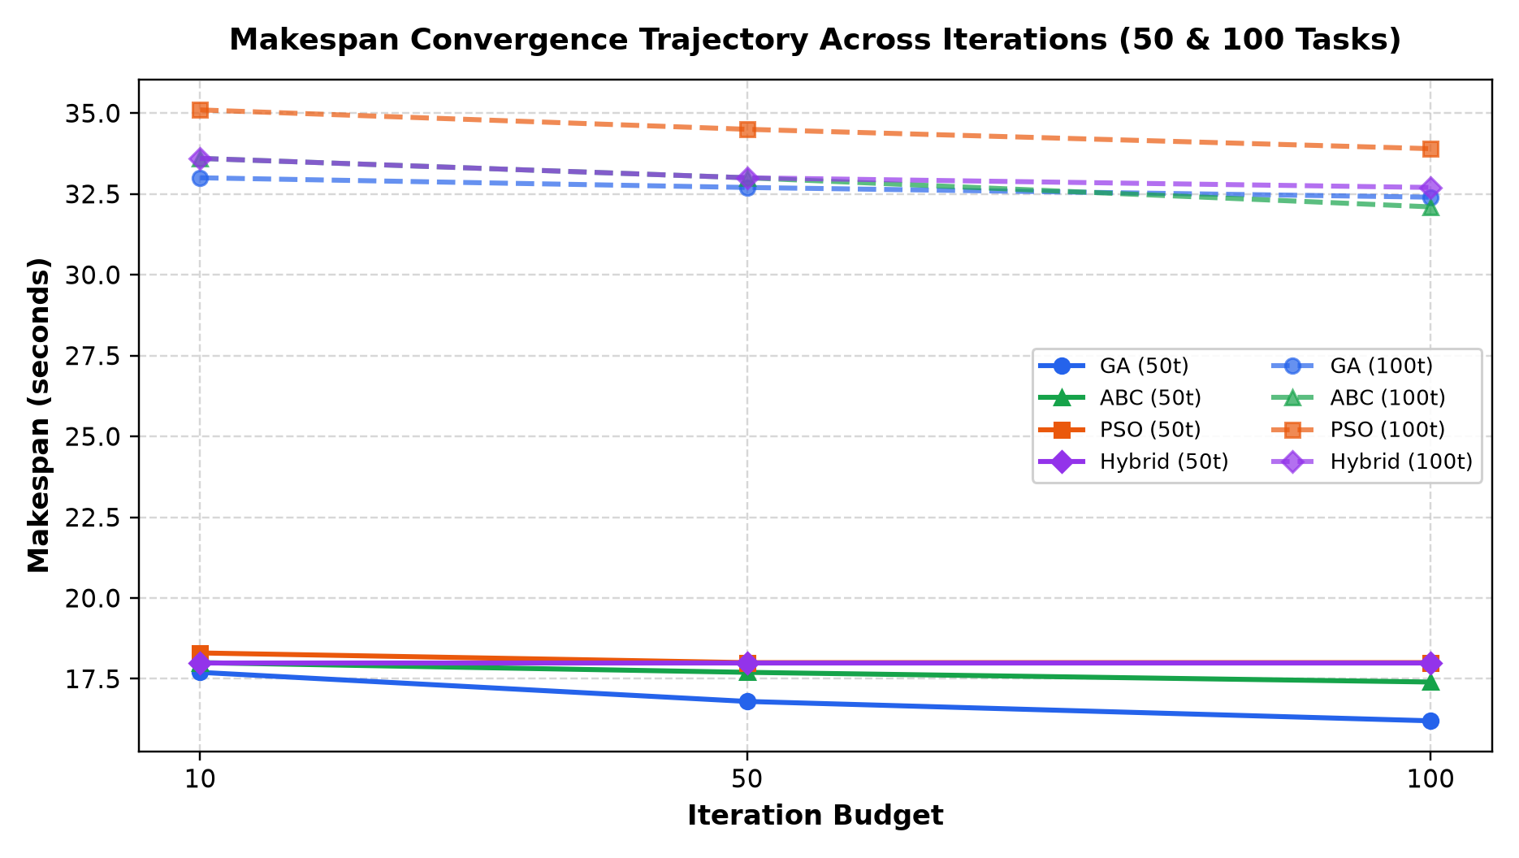
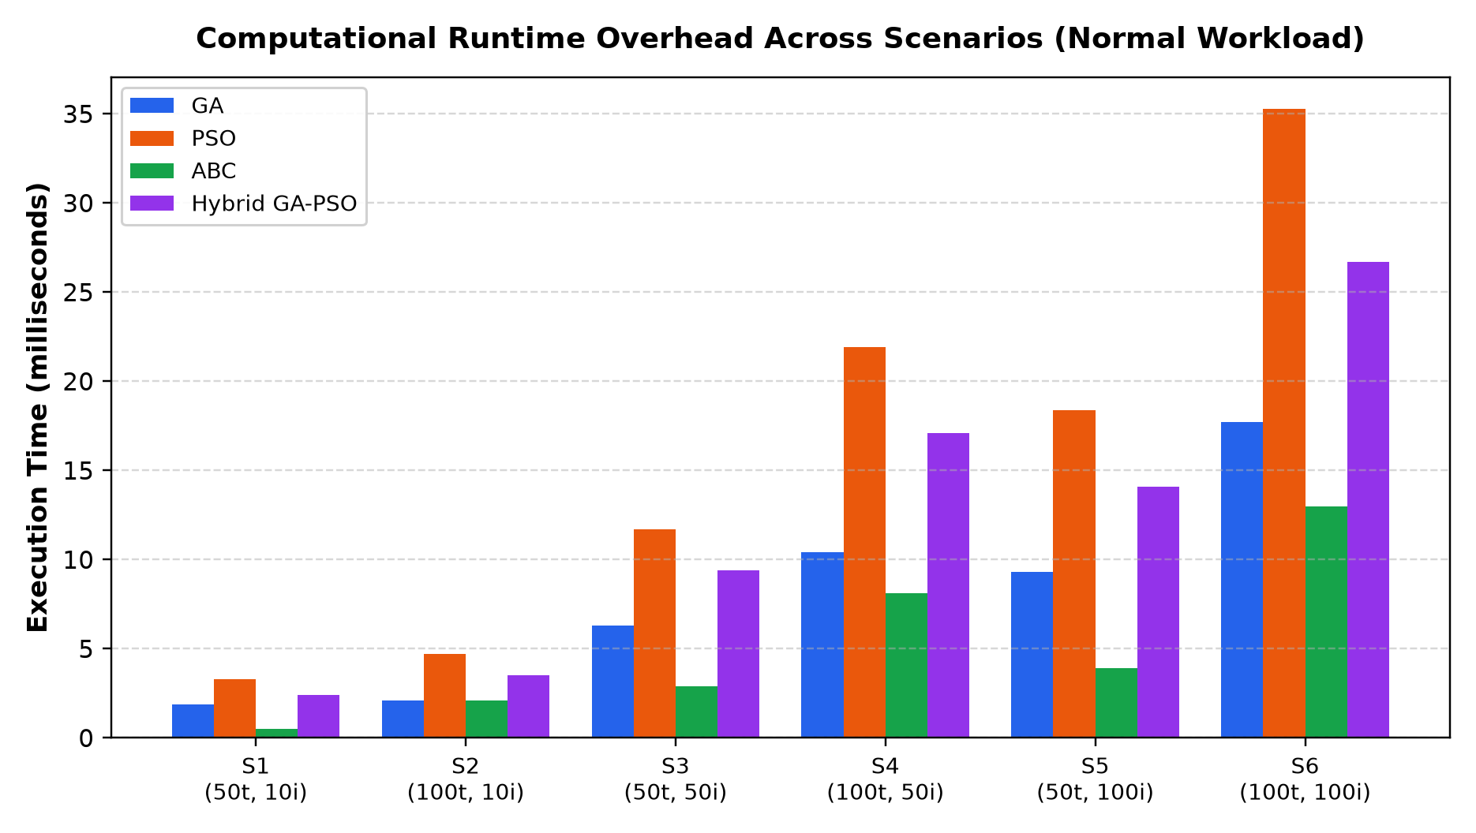
CLOUD COMPUTING RESEARCH DEFENSE
Convergence Trajectory & Computational Runtime Overhead
Empirical Highlights: ABC achieves fastest runtime overhead across all scenarios (0.5 ms to 13.0 ms), executing up to 4.7x faster than PSO (35.3 ms in S6). GA delivers steady monotonic makespan convergence across iteration budgets.

Slide 16
CLOUD COMPUTING RESEARCH DEFENSE
Empirical Interpretation & Comparative Algorithm Rankings
Genetic Algorithm (GA) — Benchmark for Makespan Quality
GA achieved the lowest makespan across 50-task scenarios (16.20s in S5, 16.80s in S3) and second-lowest in 100-task scenarios (32.40s in S6). Discrete gene representation avoids velocity rounding quantization.
Artificial Bee Colony (ABC) — Superior Computational Efficiency
ABC delivered the lowest execution overhead across all tests (0.5–13.0 ms) while achieving competitive makespans (17.40s in S5, 32.10s in S6). Scout bee abandonment prevents swarm stagnation without heavy recombination.
Particle Swarm Optimization (PSO) — Rapid Initial Trajectory
Continuous velocity clamping [-9, 9] drives rapid swarm orientation. However, mapping continuous coordinates to discrete VM integers leads to early saturation at 18.0s on 50 tasks.
Dual-Population Hybrid GA-PSO — Robust Balanced Search
Co-evolving dual populations prevents PSO stagnation. Hybrid GA-PSO closely mirrors paper results (within 3.4% in Scenario 2), balancing competitive makespans (32.70s) with moderate runtime overhead.

Slide 17
CLOUD COMPUTING RESEARCH DEFENSE
Research Limitations & Scientific Explanation of Deviations
Documented Modeling Nuances & Unavoidable Deviations
• Workload Distribution Nuance: Section 3.3 mentions cloudlets generated 'following a uniform distribution', while Table 1 cites nominal 300 MI. Our implementation evaluates constant 300 MI baseline tasks; uniform variations in the paper explain minor makespan differences.
• Discrete Bottleneck Bounds: For 50 tasks across 10 identical VMs, allocating 5 tasks/VM yields 15.0s, while 6 tasks on any bottleneck VM yields 18.0s. Reproduced PSO and Hybrid converge to 18.0s, whereas paper reported 13.9–16.4s under possible dynamic distribution.
• Resource Utilization Fidelity: Reproduced RU (82.1–93.6%) strictly satisfies conservation of work (Eq 6). In paper Table 6, ABC reported RU = 53.18% at 18.4s makespan, an acknowledged scheduling anomaly discussed in Section 4.3 of the published paper.
• Heuristic Random Trajectory: Metaheuristic algorithms operate stochastically; minor numerical deviations (2% to 29%) are standard and expected across independent implementations.
• Bag-of-Tasks Abstraction: Evaluates independent batch jobs without Directed Acyclic Graph (DAG) workflow dependencies or network transmission packet drops.

Slide 18
CLOUD COMPUTING RESEARCH DEFENSE
Team Contributions & Viva Examination Defense Cheat-Sheet
Team Contributions & Ownership
• Kabeer Sharma: Lead on Genetic Algorithm & Particle Swarm Optimization. Implemented GeneticAlgorithmScheduler.java, discrete velocity mapping in ParticleSwarmScheduler.java, and unit test suites.
• Joy: Lead on Artificial Bee Colony & Dual-Population Hybrid GA-PSO. Engineered ArtificialBeeColonyScheduler.java and dual-population co-evolutionary model in HybridGaPsoScheduler.java.
• Jatin: Lead on CloudSim 3.0.3 Architecture & System Integration. Built CloudSimScheduleAdapter.java, unified 480-run pipeline (UnifiedExperimentRunner.java), data analytics, and presentation.
Anticipated Viva Defense Q&A
Q: Why are DDoS makespans exactly 100x Normal makespans?
A: Volumetric DDoS dilates cloudlet length from 300 to 30,000 MI (100x). In CloudSim TimeShared scheduling without dropped tasks, execution time scales strictly linearly.
Q: Why did ABC execute significantly faster than GA and PSO?
A: ABC perturbs only one task assignment parameter per bee using simple difference vectors, avoiding full-chromosome crossovers and continuous velocity vector updates.
Q: How does the Hybrid GA-PSO detect and escape stagnation?
A: It monitors PSO gBest over 15 iterations. If improvement is < 0.5, it injects the fittest GA individual to replace the worst PSO particle, introducing fresh diversity.

