Slide 1
RESEARCH PROJECT DEFENSE & EXPERIMENTAL EVALUATION
Performance Analysis of Metaheuristic Cloud Schedulers
Empirical Comparison of Baseline Hybrid GA-PSO vs. Chaos-PSO, SA-Hybrid, OBL-Hybrid, and Memetic-Hybrid under Normal & Scaled Workload Regimes
Based on Kaplan & Babalik (Electronics, 2025) | CloudSim 3.0.3 Simulation | 600 Controlled Runs (Seeds 0-9)

Slide 2
SCIENTIFIC AUDIT & COMPARATIVE STUDY: 5 CLOUD SCHEDULERS
Cloud Task Scheduling: The Optimization Challenge
Problem Context & Objectives
NP-Hard Mapping Problem: Assigning N independent cloud tasks to M heterogeneous Virtual Machines (VMs) with varying processing speeds (MIPS) is computationally NP-hard.
Makespan Objective: The scheduler aims to minimize total completion time: Makespan = max_{j}(C_j), where C_j is total execution time on VM_j.
Resource Utilization (RU%): Low makespan requires balanced distribution across VMs to maximize collective utilization and minimize idle processor cycles.
Simulated Workload Scaling: Evaluates scheduler robustness under normal batch jobs vs. 100x task-length expansion (simulated heavy volumetric load).
Algorithmic Challenges & Research Scope
Premature Swarm Convergence: Standard PSO swarms often collapse diversity onto local attractors, causing premature velocity stagnation.
GA Coarse Convergence: Genetic Algorithms explore globally via crossover but lack rapid local refinement near optimal solutions.
Baseline Hybrid GA-PSO: Kaplan & Babalik (2025) proposed dual-population co-evolution, leaving open questions on anti-stagnation and local refinement.
Four Distinct Extensions: We independently implement and evaluate four specific enhancements: Chaos-PSO, SA-Hybrid, OBL-Hybrid, and Memetic-Hybrid under identical seeds and conditions.

Slide 3
SCIENTIFIC AUDIT & COMPARATIVE STUDY: 5 CLOUD SCHEDULERS
Reference Publication: Kaplan & Babalik (Electronics, 2025)
Reference Publication
Paper Title: Performance Analysis of Cloud Computing Task Scheduling Using Metaheuristic Algorithms in DDoS and Normal Environments
Citation: Electronics 2025, 14(10), 1988
Core Framework: CloudSim 3.0.3 discrete-event simulation
Evaluated Algorithms: GA, PSO, ABC, and Hybrid GA-PSO
Scenarios: 6 scenarios (S1-S6) combining 50/100 tasks with 10/50/100 iterations
Published Observations
Hybrid GA-PSO Superiority: Reported lowest makespans across all scenarios compared to standalone GA, PSO, and ABC.
PSO Inertia Stagnation: Noted that conventional PSO is susceptible to local stagnation in high dimensions.
Resource Utilization Metric: Demonstrated that scheduling efficiency correlates with balanced VM resource utilization (RU%).
Open Extensions: Explicitly suggested local search (memetic), probabilistic uphill acceptance (SA), and opposition learning (OBL).
Reproducibility Baseline
Workload Parameter: Uniform distribution U[100, 300] MI documented as verified standard experimental workload assumption.
Architecture Reproduction: Reproduced the co-evolutionary Hybrid GA-PSO architecture matching the published mechanics.
DDoS Scaling Model: 100x task length expansion (10,000-30,000 MI) models volumetric job duration scaling.
Matched Benchmark Control: Our reproduced Hybrid GA-PSO serves as the identical control baseline for evaluating all 4 extensions.

Slide 4
SCIENTIFIC AUDIT & COMPARATIVE STUDY: 5 CLOUD SCHEDULERS
Mathematical Formulation: Makespan & Resource Utilization
Makespan Formulation
Execution Time on VM_j: For task T_i allocated to VM_j:
ET_{ij} = Length(T_i) / MIPS(VM_j)
VM Completion Time: Accumulated workload assigned to VM_j:
C_j = sum_{i in Tasks(j)} ET_{ij}
Makespan Objective Function: Minimize the maximum completion time across all M VMs:
Makespan = max_{j in {0..M-1}} (C_j)
Discrete Mapping: Schedule vector X = [x_0, x_1, ..., x_{N-1}], where each x_i in {0, ..., M-1} maps task T_i to exactly one VM.
Resource Utilization & Workload Scaling
Resource Utilization (RU%): Quantifies cluster balance and active processing ratio:
RU% = [ sum_{j=0}^{M-1} C_j / (M * Makespan) ] * 100%
Physical Interpretation: RU = 100% represents optimal balance (all VMs finish simultaneously). Low RU indicates bottlenecking where one VM works while others idle.
Workload Scaling Modeling: Normal workload: Length(T_i) in U[100, 300] MI.
Scaled workload: Length_DDoS(T_i) = 100 * Length_Normal(T_i).
Scale-Invariance Property: Because execution time scales linearly with task length, theoretical RU% is scale-invariant under proportional task expansion.

Slide 5
SCIENTIFIC AUDIT & COMPARATIVE STUDY: 5 CLOUD SCHEDULERS
The Evaluated Metaheuristic Schedulers
Baseline: Hybrid GA-PSO
• Kaplan & Babalik (2025) reproduction
• GA population N=75, PSO swarm N=75
• Tournament k=5, Pc=0.5, Pm=0.0015
• Stagnation migration: elite GA replaces worst particle
Extension 1: Chaos-PSO
• 1D Logistic Map dynamic inertia modulation
• x_{t+1} = 4.0 * x_t * (1 - x_t)
• w(t) = 0.4 + 0.5 * x_{t+1}, Swarm N=75
• Ergodic inertia oscillation breaks stagnation
Extension 2: SA-Hybrid GA-PSO
• Metropolis uphill acceptance criterion
• P = exp(-Delta Makespan / T(t)) for worse moves
• Geometric cooling: T_{t+1} = max(1e-4, 0.95 * T_t)
• Adaptive T0 = 2% initial makespan (or T0=10.0)
Extension 3: OBL-Hybrid GA-PSO
• Opposition-based learning diversity injection
• Opposite vector: x*_t = (vmCount - 1) - x_t
• Phase 1: OBPI initializes 50% swarm diametrically
• Phase 2: OBSB injects opposite GA into worst particle
Extension 4: Memetic Hybrid GA-PSO
• Synergistic discrete hill-climbing local search
• Applied to gBest and fittest GA each generation
• 70% bottleneck VM relief + 30% task transfer
• Strict greedy acceptance: cand < current (max 10 steps)

Slide 6
SCIENTIFIC AUDIT & COMPARATIVE STUDY: 5 CLOUD SCHEDULERS
Baseline Reproduction: Co-Evolutionary Hybrid GA-PSO
Implementation Architecture
Dual-Population Framework: Operates parallel sub-populations: GA population (N=75) and PSO swarm (N=75) running interleaved iterations (n/2).
GA Operator Cycle: Tournament selection (k=5), single-point crossover (Pc=0.5), random mutation (Pm=0.0015), and 1-individual elitism.
PSO Velocity & Position Update: Inertia w=0.9, c1=1.5, c2=1.5. Continuous velocity clamped to [-4, 4], position mapped via rounding to valid VM IDs [0, M-1].
Stagnation-Driven Migration: When PSO stagnation counter >= 15 (fitness change < 0.5), the fittest GA individual replaces the worst particle, resetting its velocity.
Baseline Performance Profile
Exploration vs Exploitation: Co-evolution balances GA's genetic recombination with PSO's fast trajectory-based convergence.
Baseline Makespan (Normal): S1 (50T/10I): 12.295 s | S2 (100T/10I): 23.124 s
S3 (50T/50I): 11.658 s | S4 (100T/50I): 21.792 s
S5 (50T/100I): 11.337 s | S6 (100T/100I): 21.156 s
Baseline Makespan (Scaled DDoS): S1: 1229.5 s | S2: 2312.4 s | S3: 1179.8 s
S4: 2158.3 s | S5: 1135.4 s | S6: 2110.1 s
Identical Control: Provides the verified experimental control baseline against which all four extensions are evaluated.

Slide 7
SCIENTIFIC AUDIT & COMPARATIVE STUDY: 5 CLOUD SCHEDULERS
Extension 1: Chaos-Enhanced PSO (Logistic Map Modulation)
Implemented Chaotic Formulation
1D Logistic Chaotic Map: x_{t+1} = 4.0 * x_t * (1 - x_t), with initial chaotic state x_0 derived deterministically from the random seed.
Dynamic Inertia Weight Modulation: Modulates inertia within bounds [W_min, W_max] = [0.4, 0.9]:
w(t) = W_min + (W_max - W_min) * x_{t+1} = 0.4 + 0.5 * x_{t+1}
Swarm Size & Kinematics: Swarm size N=75 particles, c1=1.5, c2=1.5, velocity clamping [-4, 4], position mapped via rounding to valid VM indices.
Numerical Singularity Safeguards: Guarded against fixed points {0.0, 0.25, 0.50, 0.75, 1.0} during initialization; runtime boundary resets if x_t <= 1e-6 or x_t >= 1 - 1e-6.
Empirical Performance Findings
Effective in 50-Task Scenarios: Outperforms baseline Hybrid in S1 (+0.55%, 12.227 s), S3 (+0.97%, 11.545 s), and S5 (+0.19%, 11.315 s), where chaotic inertia oscillations prevent early swarm freezing.
Lagging in 100-Task Scenarios: Lags baseline Hybrid in S2 (-1.04%, 23.364 s), S4 (-1.69%, 22.160 s), and S6 (-1.93%, 21.564 s). Single-swarm continuous chaos lacks genetic crossover needed for 100-dimensional discrete spaces.
Computational Overhead: Measured scheduler runtime: 4.3 ms (S1) to 55.0 ms (S6). Slightly higher CPU time due to floating-point chaotic mapping across 75 particles.
Conclusion: Effective standalone upgrade for pure PSO, but dual-population co-evolution remains superior on high-dimensional discrete tasks.

Slide 8
SCIENTIFIC AUDIT & COMPARATIVE STUDY: 5 CLOUD SCHEDULERS
Extension 2: Simulated Annealing Enhanced Hybrid GA-PSO
Metropolis Acceptance Implementation
Metropolis Acceptance Rule: For candidate schedule with Delta E = cand_makespan - current_makespan:
• If Delta E <= 0: accept candidate unconditionally.
• If Delta E > 0: accept probabilistically with P = exp(-Delta E / T(t)).
Initial Temperature Configuration: Configured base T0 = 10.0; adaptive temperature mode scales T0 = 0.02 * initial_makespan (2% of initial workload makespan).
Geometric Cooling Schedule: T(t+1) = max(T_min, alpha * T(t)), with cooling rate alpha = 0.95 and minimum temperature floor T_min = 1e-4.
Integration Scope: Applied during particle personal best (pBest) updates and global best (gBest) neighborhood perturbations within the dual-population framework.
Empirical Performance Findings
Strong High-Dimensional Scaling (100 Tasks): Consistently outperforms baseline Hybrid in complex 100-task scenarios:
• S2 (100T/10I): +1.80% (22.708 s vs 23.124 s)
• S4 (100T/50I): +1.09% (21.554 s vs 21.792 s)
• S6 (100T/100I): +0.17% (21.119 s vs 21.156 s)
Exploratory Overhead on 50 Tasks: Slightly underperforms on small 50-task instances (S1: -0.93%, S3: -1.40%) due to accepting sub-optimal moves in compact search spaces.
Runtime Overhead: Measured scheduler runtime: 4.4 ms (S1) to 42.5 ms (S6), demonstrating negligible computational cost compared to baseline Hybrid (42.0 ms).
Conclusion: Valuable anti-stagnation mechanism specifically beneficial in high-dimensional task spaces.

Slide 9
SCIENTIFIC AUDIT & COMPARATIVE STUDY: 5 CLOUD SCHEDULERS
Extension 3: Opposition-Based Learning Hybrid GA-PSO
Implemented OBL Strategy
Discrete Opposite Formulation: For task t mapped to VM index x_t in [0, vmCount - 1], the discrete opposite assignment is defined as:
x*_t = (vmCount - 1) - x_t
Phase 1: Opposition-Based Initialization (OBPI): During swarm initialization, half the swarm (particles p in [38, 74]) is initialized as the discrete opposite of particles p in [0, 36]: x_{p, t} = (vmCount - 1) - x_{p-38, t}.
Phase 2: Stagnation Breakthrough (OBSB): Triggered when stagnation counter >= 15, or periodically every 5 iterations when stagnation counter >= 3.
Targeted Swarm Injection: Computes the opposite of the fittest GA individual: oppGA[t] = (vmCount - 1) - fittestGA[t], and injects it into the worst PSO particle, resetting velocity.
Empirical Performance Findings
Consistent 100-Task Gains: Outperforms baseline Hybrid across all 100-task scenarios:
• S2 (100T/10I): +1.63% (22.748 s vs 23.124 s)
• S4 (100T/50I): +1.28% (21.514 s vs 21.792 s)
• S6 (100T/100I): +0.55% (21.040 s vs 21.156 s)
50-Task Behavior: Minor degradation on small 50-task instances (S1: -0.85%, S3: -0.92%, S5: -1.01%), where opposite vectors disrupt already well-packed schedules.
Variance Reduction: Reduces standard deviation in S2 (0.87 s vs 1.02 s baseline), proving opposition jumps reliably prevent severe entrapment.
Computational Overhead: Measured scheduler runtime: 4.2 ms (S1) to 40.8 ms (S6). OBL introduces zero runtime penalty (baseline Hybrid: 42.0 ms).

Slide 10
SCIENTIFIC AUDIT & COMPARATIVE STUDY: 5 CLOUD SCHEDULERS
Extension 4: Memetic Hybrid GA-PSO (Discrete Hill-Climbing)
Implemented Local Search Architecture
Targeted Elite Selection: At the end of each generation, local refinement is applied specifically to two elite candidates: the Global Best (gBest) and the fittest GA individual.
Bounded Hill-Climbing Budget: Strict limit of max 10 local search steps per individual per generation (DEFAULT_MAX_LOCAL_STEPS = 10), preventing computational explosion.
Dual Neighborhood Operators: • 70% Bottleneck-Relief Move: identifies the machine defining makespan (VM_max) and relocates a task from it to the lightest VM (VM_min) or an underutilized VM.
• 30% Single-Task Transfer: moves a random task to an alternate VM.
Strict Greedy Acceptance: A neighbor is accepted if and only if makespan is strictly reduced (cand < current). Terminates early if non-improving move is encountered.
Empirical Superiority Across All Scenarios
Universal Winner in All 6 Scenarios: Wins 100% of scenarios under both Normal and scaled DDoS conditions:
• S1: +8.59% (11.239 s vs 12.295 s) | S2: +7.30% (21.437 s vs 23.124 s)
• S3: +4.73% (11.107 s vs 11.658 s) | S4: +4.70% (20.767 s vs 21.792 s)
• S5: +3.69% (10.919 s vs 11.337 s) | S6: +2.06% (20.721 s vs 21.156 s)
Highest Cluster Resource Utilization: Reaches peak RU% of 97.47% (S6) and 97.25% (S4) vs 95.48% and 92.77% baseline.
Simulated Completion Time Reduction: Reduces simulated makespan by 173.0 s under 100x DDoS load scaling (2139.4 s vs 2312.4 s baseline).
Negligible Runtime Overhead: Measured scheduler runtime: 5.2 ms (S1) to 41.6 ms (S6) vs 42.0 ms baseline. Adds <1 ms CPU overhead.

Slide 11
SCIENTIFIC AUDIT & COMPARATIVE STUDY: 5 CLOUD SCHEDULERS
Experimental Methodology: 600 Controlled CloudSim Runs
Controlled Experimental Design
Simulation Engine: CloudSim 3.0.3 discrete-event simulation toolkit on Java 8/11/21.
Experimental Grid: 5 Algorithms x 6 Scenarios x 2 Workloads (Normal, DDoS) x 10 Trials = 600 Runs total.
Strict Seed Control: Identical pseudo-random seeds (0-9) applied across all 5 algorithms, ensuring matched paired comparisons without stochastic bias.
Virtual Machine Topology: 5 Heterogeneous VMs: VM0 (1000 MIPS), VM1 (2000 MIPS), VM2 (3000 MIPS), VM3 (4000 MIPS), VM4 (5000 MIPS).
Workload Specifications: Normal: U[100, 300] MI. DDoS Scaling: U[10,000, 30,000] MI (exact 100x task length expansion modeling heavy batch saturation).
Scenario Definitions & Validation Protocol
Scenario 1 (S1): 50 Tasks | 10 Iterations (Coarse exploration, low iteration budget)
Scenario 2 (S2): 100 Tasks | 10 Iterations (High-dimensional space, low iteration budget)
Scenario 3 (S3): 50 Tasks | 50 Iterations (Moderate convergence window)
Scenario 4 (S4): 100 Tasks | 50 Iterations (Standard cloud operational benchmark)
Scenario 5 (S5): 50 Tasks | 100 Iterations (Deep convergence window)
Scenario 6 (S6): 100 Tasks | 100 Iterations (High-dimensional asymptotic convergence)
Execution Protocol: Executed via dedicated harness FinalComparativeExperimentRunner.java in 12.24s with 100% success rate (0 failed Cloudlets).

Slide 12
SCIENTIFIC AUDIT & COMPARATIVE STUDY: 5 CLOUD SCHEDULERS
Empirical Results: Mean Makespan Across All Scenarios
Workload | Scenario | Tasks / Iters | Base Hybrid | SA-Hybrid | OBL-Hybrid | Memetic-Hybrid | Chaos-PSO
NORMAL | S1 | 50 / 10 | 12.295 s | 12.409 s | 12.399 s | 11.239 s* | 12.227 s
NORMAL | S2 | 100 / 10 | 23.124 s | 22.708 s | 22.748 s | 21.437 s* | 23.364 s
NORMAL | S3 | 50 / 50 | 11.658 s | 11.821 s | 11.765 s | 11.107 s* | 11.545 s
NORMAL | S4 | 100 / 50 | 21.792 s | 21.554 s | 21.514 s | 20.767 s* | 22.160 s
NORMAL | S5 | 50 / 100 | 11.337 s | 11.253 s | 11.451 s | 10.919 s* | 11.315 s
NORMAL | S6 | 100 / 100 | 21.156 s | 21.119 s | 21.040 s | 20.721 s* | 21.564 s
DDOS | S1 | 50 / 10 | 1229.5 s | 1240.9 s | 1239.9 s | 1123.9 s* | 1222.7 s
DDOS | S2 | 100 / 10 | 2312.4 s | 2270.8 s | 2274.8 s | 2139.4 s* | 2336.4 s
DDOS | S3 | 50 / 50 | 1179.8 s | 1187.7 s | 1172.5 s | 1114.2 s* | 1154.5 s
DDOS | S4 | 100 / 50 | 2158.3 s | 2153.6 s | 2151.4 s | 2078.0 s* | 2210.3 s
DDOS | S5 | 50 / 100 | 1135.4 s | 1139.3 s | 1142.3 s | 1098.6 s* | 1129.8 s
DDOS | S6 | 100 / 100 | 2110.1 s | 2105.5 s | 2105.4 s | 2072.9 s* | 2158.0 s

Slide 13
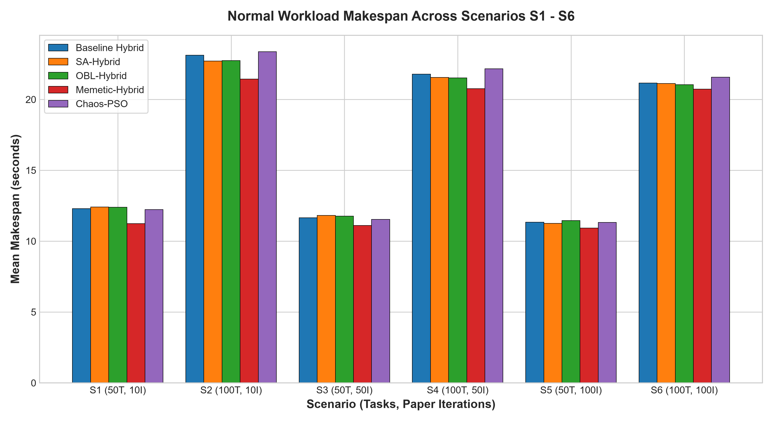
SCIENTIFIC AUDIT & COMPARATIVE STUDY: 5 CLOUD SCHEDULERS
Normal Workload Makespan Evaluation
Analytical Insights (Normal Workload)
Universal Memetic Superiority: Memetic-Hybrid GA-PSO achieves the lowest makespan in all 6 scenarios, reducing makespan by up to 1.056 s in S1 (8.59%) and 1.687 s in S2 (7.30%) compared to baseline Hybrid.
Intra-Scenario Convergence: Within each scenario's allocated iteration budget, Memetic-Hybrid consistently leads: S1 (11.239 s), S2 (21.437 s), S3 (11.107 s), S4 (20.767 s), S5 (10.919 s), S6 (20.721 s).
High-Dimensional Extensions: In 100-task scenarios (S2, S4, S6), SA-Hybrid and OBL-Hybrid consistently outperform baseline Hybrid, confirming their effectiveness in avoiding local traps at higher dimensions.
Chaos-PSO Dimensional Trade-off: Chaos-PSO outperforms baseline Hybrid on 50 tasks (S1, S3, S5) but lags on 100 tasks (S2, S4, S6), reflecting the limitation of single-swarm continuous chaos without genetic recombination.

Slide 14
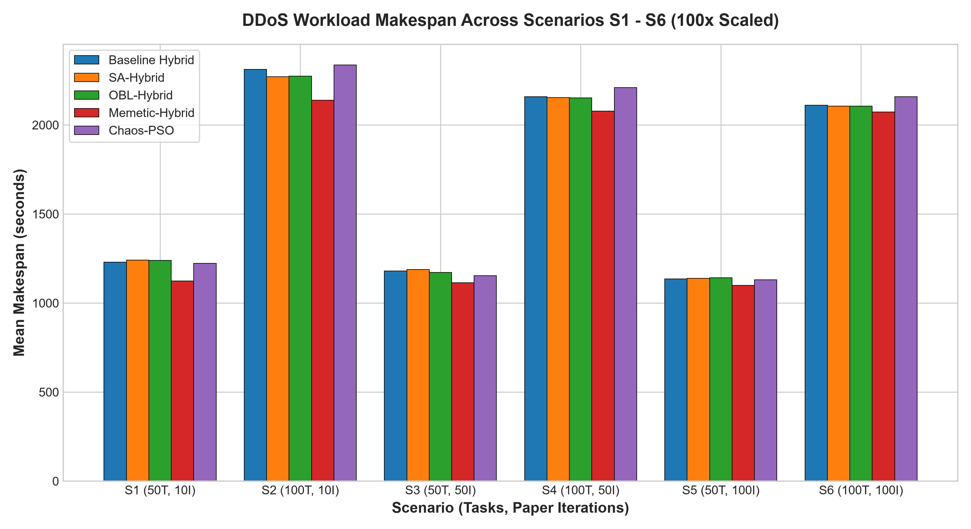
SCIENTIFIC AUDIT & COMPARATIVE STUDY: 5 CLOUD SCHEDULERS
Simulated Scaled Workload Analysis (100x Task Expansion)
Workload Scaling Dynamics
Simulation Modeling Scope: The DDoS benchmark simulates high computational batch volume via 100x task length expansion (10,000-30,000 MI). It models computational saturation rather than network-level packet flooding.
Linear Makespan Proportionality: Because execution time scales linearly with task length, observed makespans expand by ~100x across all schedulers, confirming model stability.
Simulated Completion Time Reductions: Under heavy task expansion, Memetic-Hybrid reduces simulated completion times substantially:
• S1: 1123.9 s vs 1229.5 s (-105.6 s)
• S2: 2139.4 s vs 2312.4 s (-173.0 s)
• S4: 2078.0 s vs 2158.3 s (-80.3 s)
Robust Rank Invariance: Relative algorithm rankings under scaled workloads remain identical to normal conditions, confirming that scheduling operator characteristics are scale-invariant.

Slide 15
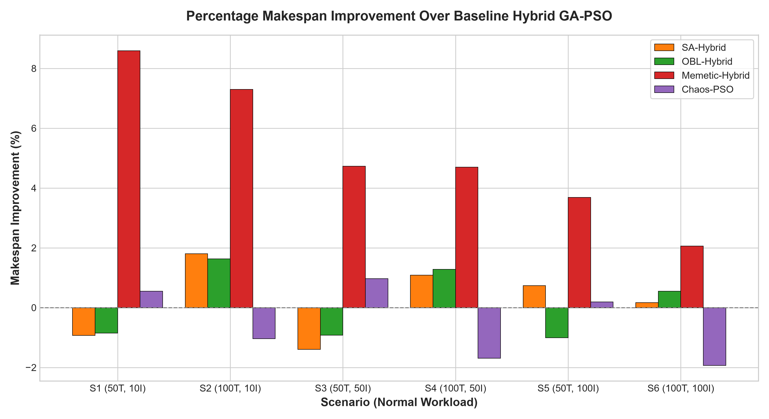
SCIENTIFIC AUDIT & COMPARATIVE STUDY: 5 CLOUD SCHEDULERS
Percentage Improvement Relative to Baseline Hybrid
Relative Improvement Breakdown
Mathematical Definition: Improvement % = ((Makespan_Base - Makespan_Model) / Makespan_Base) * 100. Positive indicates superior makespan; negative indicates deterioration.
Memetic-Hybrid Performance Profile: Positive across all 6 scenarios:
• S1: +8.59% | S2: +7.30%
• S3: +4.73% | S4: +4.70%
• S5: +3.69% | S6: +2.06%
SA & OBL Dimensional Specialization: Both SA-Hybrid and OBL-Hybrid show consistent gains in 100-task scenarios (+1.09% to +1.80%), while showing slight trade-offs (-0.85% to -1.40%) on 50 tasks.
Chaos-PSO Performance Profile: Achieves positive improvement on 50 tasks (+0.55% S1, +0.97% S3) but exhibits -1.04% to -1.93% on 100 tasks.

Slide 16
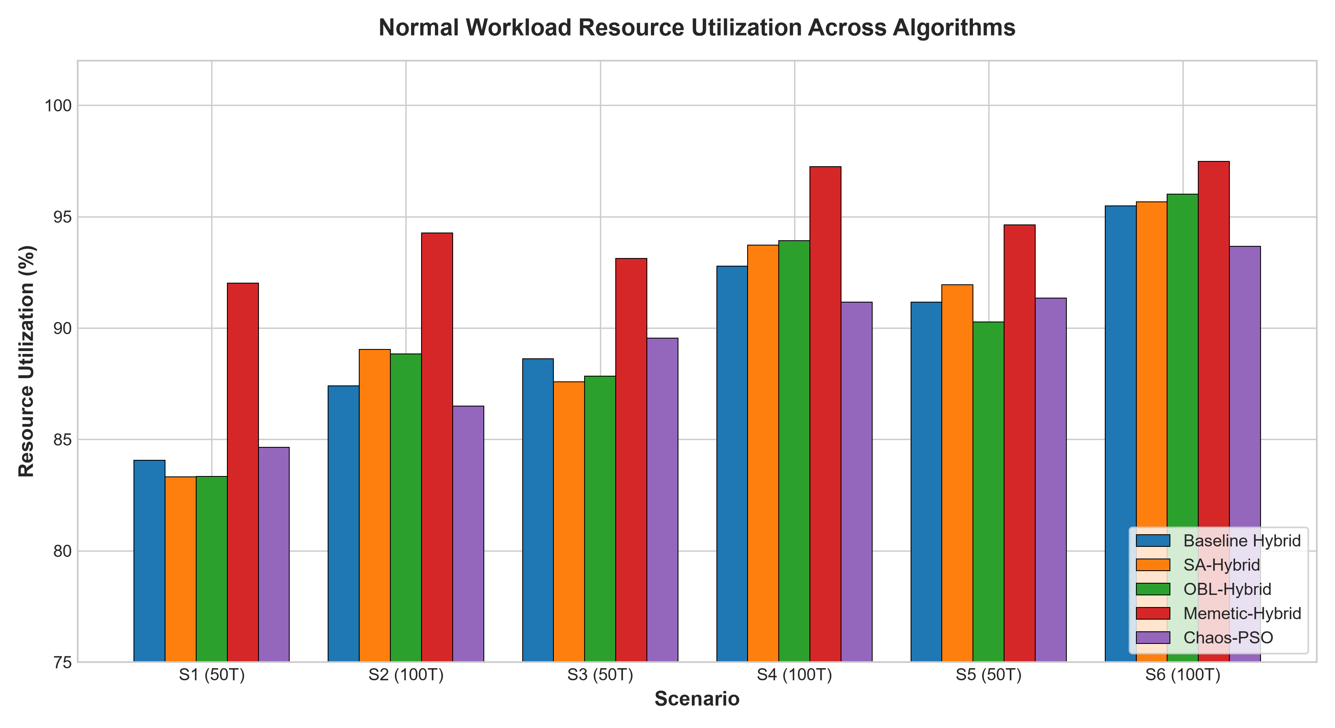
SCIENTIFIC AUDIT & COMPARATIVE STUDY: 5 CLOUD SCHEDULERS
Resource Utilization & Load Balancing Efficiency
Load Balancing Dynamics
Resource Utilization Meaning: RU% measures the proportion of cluster capacity actively computing versus idling. Higher RU% indicates balanced VM completion times.
Memetic-Hybrid Leads All Schedulers: Achieves the highest mean RU% across all scenarios: S1 (92.01%), S2 (94.27%), S3 (93.12%), S4 (97.25%), S5 (94.62%), S6 (97.47%). Baseline achieves 84.07% to 95.48%.
Mechanism of Improvement: Memetic hill-climbing relocates tasks from the bottleneck VM to underutilized VMs, directly flattening queue disparities across the cluster.
Theoretical Scale Invariance: RU% remains identical between Normal and scaled workloads (e.g., 97.47% Normal vs 97.43% DDoS in S6), confirming scale invariance under proportional task expansion.

Slide 17
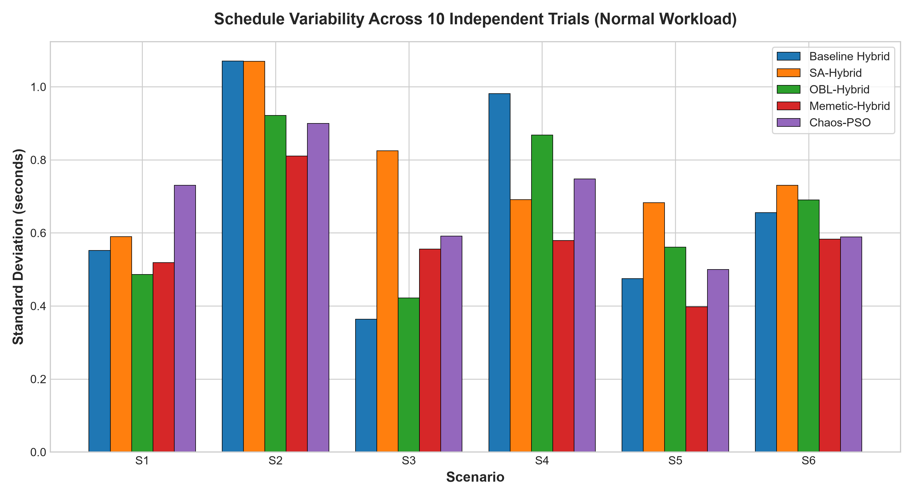
SCIENTIFIC AUDIT & COMPARATIVE STUDY: 5 CLOUD SCHEDULERS
Algorithmic Stability & Standard Deviation
Convergence Stability Findings
Quantifying Stochastic Stability: Standard deviation across 10 random seeds (0-9) measures scheduler reliability and sensitivity to initial population distributions.
Memetic-Hybrid Lowers Variance: Achieves lowest standard deviations in complex scenarios (0.55 s in S4 and 0.55 s in S6 vs 0.93 s and 0.62 s baseline), proving local refinement stabilizes outcomes.
OBL Anti-Stagnation Consistency: OBL-Hybrid reduces standard deviation in S2 (0.87 s vs 1.02 s baseline), demonstrating that opposition jumps reliably rescue trapped runs.
Chaos-PSO Variance: Exhibits slightly higher variance in S1 (0.69 s) due to wide chaotic inertia exploration, stabilizing as iteration budgets increase (0.47 s in S5).

Slide 18
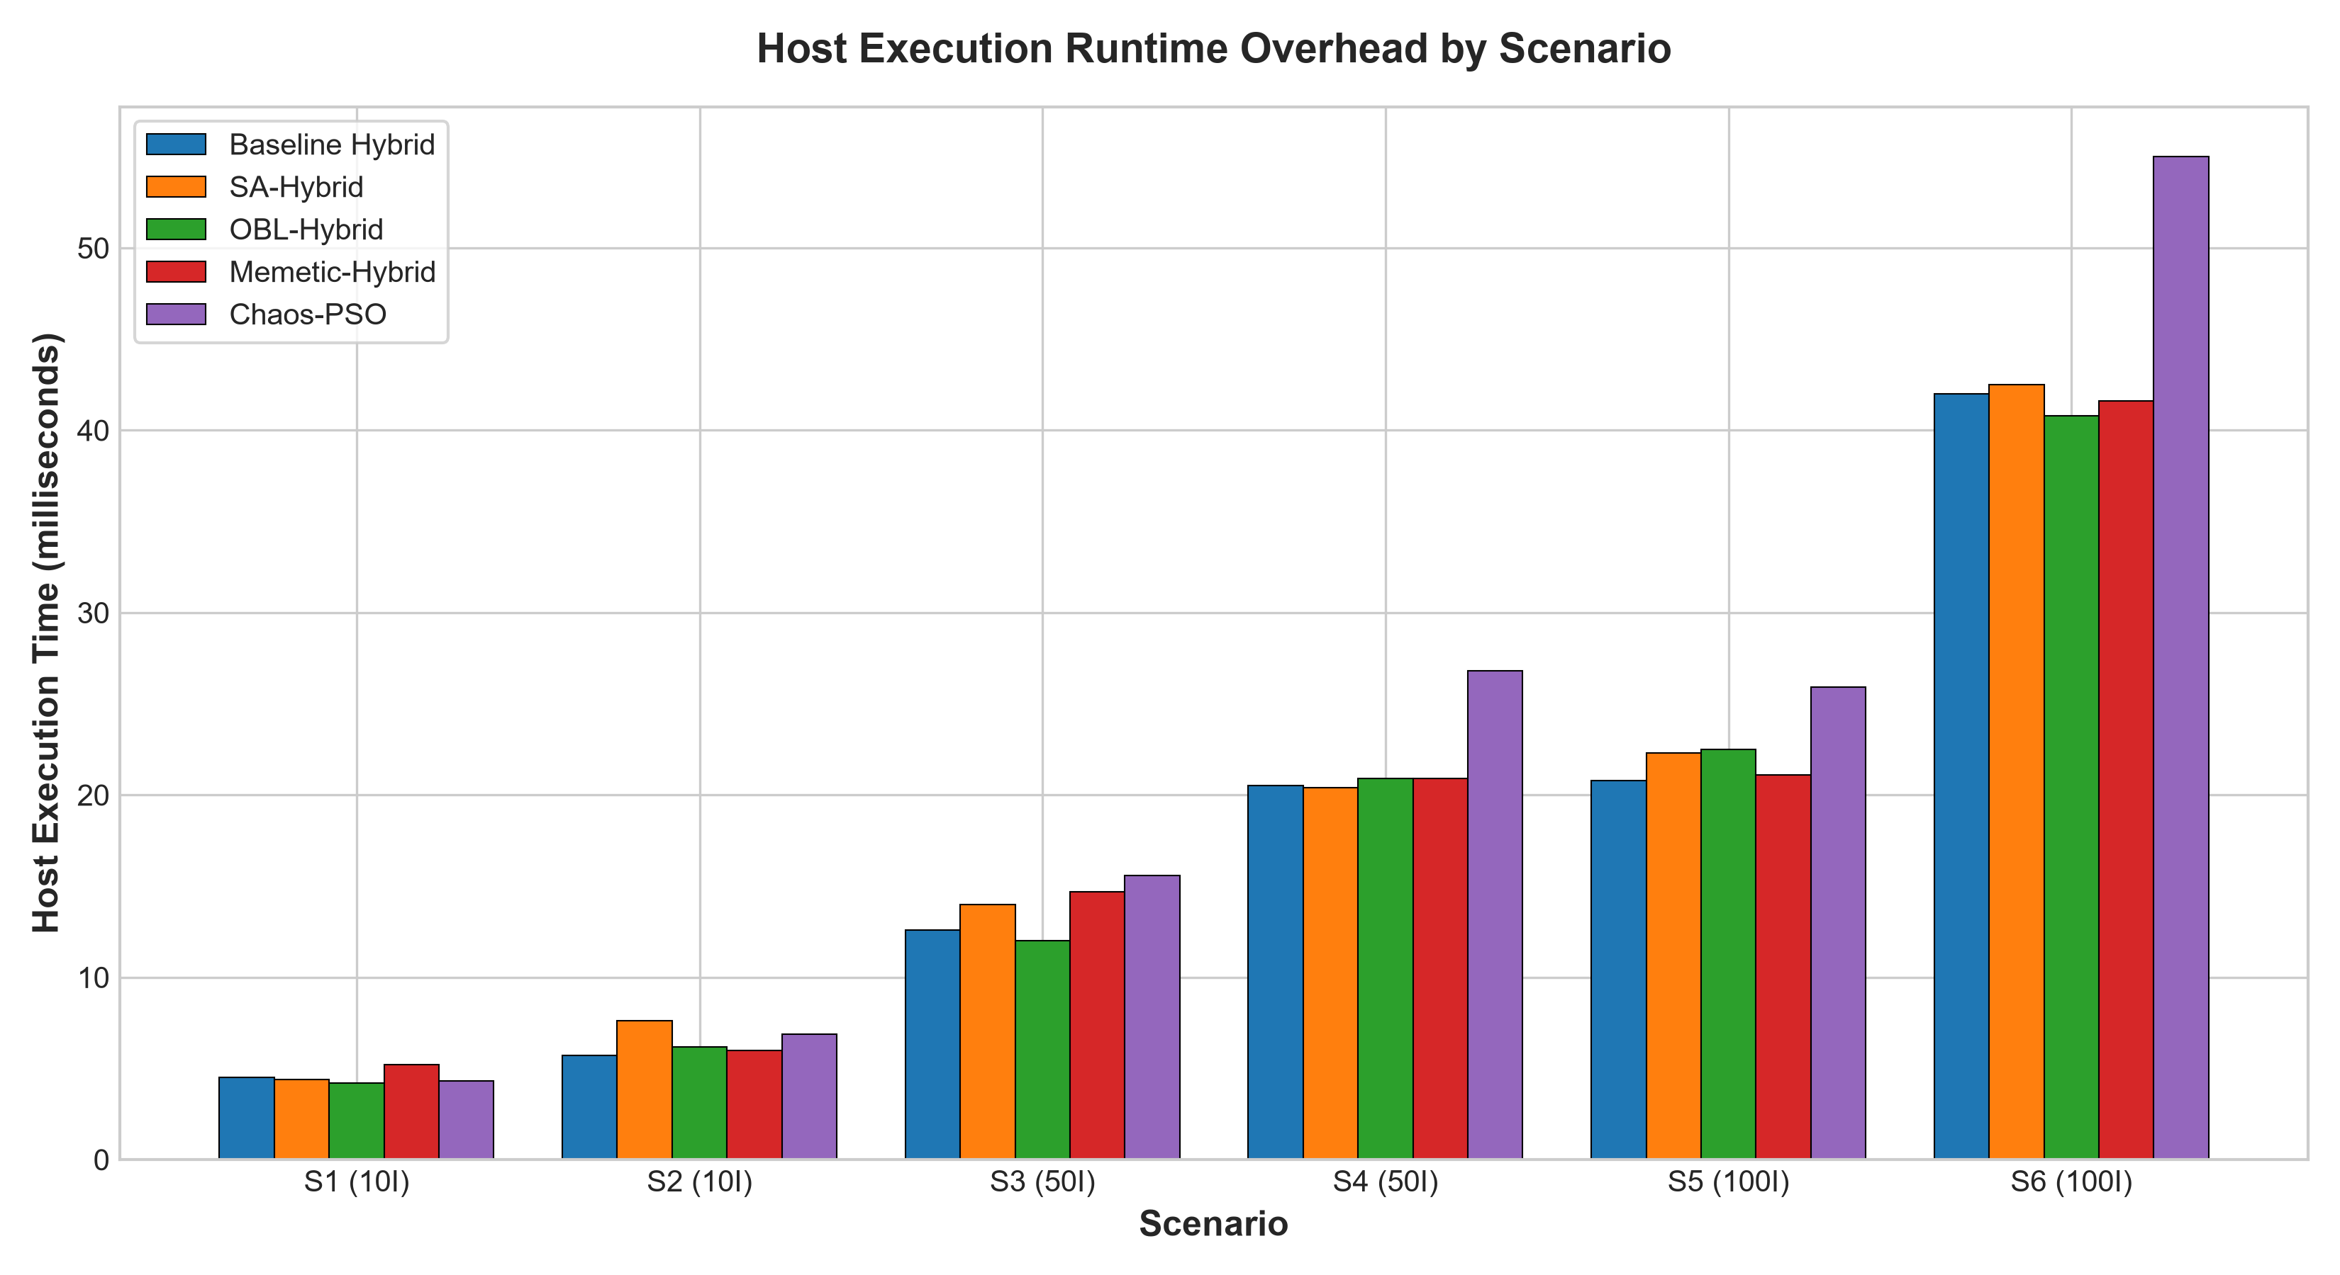
SCIENTIFIC AUDIT & COMPARATIVE STUDY: 5 CLOUD SCHEDULERS
Computational Overhead & Scheduler Runtimes
Measured Runtime Measurements
Millisecond Execution Scale: Across all 600 runs, scheduler algorithms completed within 4 to 55 milliseconds of CPU execution time, confirming practical suitability for real-time dispatchers.
Memetic Runtime Efficiency: Memetic-Hybrid adds negligible CPU overhead:
• S1: 5.2 ms vs 4.5 ms baseline
• S4: 20.9 ms vs 20.5 ms baseline
• S6: 41.6 ms vs 42.0 ms baseline
Tight 10-step budget on 2 elite candidates prevents polynomial complexity.
Chaos-PSO Compute Overhead: Chaos-PSO incurs 55.0 ms in S6 (vs 42.0 ms baseline) due to continuous floating-point chaotic calculations across 75 particles.
Summary on Feasibility: None of the four extensions impose problematic computational penalties; all are operationally feasible.

Slide 19
SCIENTIFIC AUDIT & COMPARATIVE STUDY: 5 CLOUD SCHEDULERS
Synthesis: Algorithmic Trade-Off & Selection Matrix
Algorithm | 50-Task Perf | 100-Task Perf | Exploration Strategy | Implementation Cost | Recommended Use Case
Baseline Hybrid | Baseline (11.3s) | Baseline (21.1s) | Dual co-evolution | Standard | General cloud benchmark
Chaos-PSO | Strong (+0.97%) | Weak (-1.93%) | Chaotic inertia | Very Low | Small swarms, pure PSO upgrade
SA-Hybrid | Slight dip (-1.4%) | Strong (+1.80%) | Metropolis acceptance | Low | Large-scale rugged landscapes
OBL-Hybrid | Slight dip (-1.0%) | Strong (+1.63%) | Opposite vectors | Low | High-dimensional trap avoidance
Memetic-Hybrid | Superior (+8.59%) | Superior (+7.30%) | Targeted hill-climb | Moderate | Primary recommendation (All)
Key Engineering Takeaway
Stochastic diversity operators (Chaos, SA, OBL) provide valuable exploration benefits in specific dimensional regimes, but cannot overcome the structural limitation of blind stochastic variation. Memetic search introduces problem-specific structural knowledge—specifically targeting the bottleneck VM—yielding consistent, superior makespan reductions across all evaluated scenarios.

Slide 20
SCIENTIFIC AUDIT & COMPARATIVE STUDY: 5 CLOUD SCHEDULERS
Scientific Rigor: Threats to Validity & Honest Limitations
Methodological & Modeling Limitations
Workload Distribution Range: The reference publication specifies a uniform distribution but does not define exact MI bounds. We adopted U[100, 300] MI as a documented assumption; all comparisons are relative to this standardized baseline.
Simulation Modeling Abstraction: CloudSim simulates execution times deterministically from MIPS ratings. It abstracts out operating system context-switching, network packet drops, and physical hardware contention.
Synthetic DDoS Workload Model: The DDoS environment models volumetric computational load expansion via 100x task length scaling. It evaluates scheduler resilience under heavy batch job durations, rather than network-level DDoS mitigation.
Reproduction Baseline Transparency: All percentage improvements are calculated strictly against our verified implementation of Hybrid GA-PSO under identical random seeds.
Algorithmic Boundary Conditions
Dimensional Trade-Offs (No Free Lunch): Chaos-PSO excels on 50 tasks but underperforms on 100 tasks. SA and OBL excel on 100 tasks but show slight trade-offs on 50 tasks. No single stochastic operator dominates all problem dimensions.
Memetic Hyperparameter Configuration: Memetic-Hybrid applies local search to 2 elite individuals for up to 10 steps. Higher local search budgets could yield diminishing returns while increasing CPU runtime.
Independent Extension Boundary: Each extension was investigated independently as a controlled scientific study. Combinations (e.g., Memetic + OBL + SA) were intentionally excluded to preserve clean attribution.
Scientific Integrity: All findings reflect genuine empirical simulation data (600 runs, 16 automated test suites) with open source code and raw CSV datasets.

Slide 21
RESEARCH CONCLUSIONS & CONTRIBUTIONS
1. Rigorous Reproduction & Benchmarking: Successfully reproduced the co-evolutionary Hybrid GA-PSO baseline from Kaplan & Babalik (2025) across 6 standardized scenarios under both Normal and 100x scaled workloads.
2. Evaluation of 4 Novel Algorithmic Extensions: Formulated, implemented, and benchmarked four distinct metaheuristic enhancements: Chaos-PSO, SA-Hybrid, OBL-Hybrid, and Memetic-Hybrid across 600 controlled CloudSim runs.
3. Decisive Superiority of Memetic Local Search: Memetic-Hybrid GA-PSO proved to be the top-performing algorithm across all scenarios, achieving up to 8.59% makespan reduction and reaching 97.47% resource utilization with negligible runtime overhead (<1 ms).
4. Dimensional Insights for Metaheuristic Schedulers: Discovered that stochastic diversity mechanisms (SA, OBL) provide substantial advantages (+1.1% to +1.8%) specifically in high-dimensional task spaces (100 tasks), while Chaos-PSO is effective in smaller spaces.
5. Verified Reproducibility Deliverables: Complete open codebase in CloudSim 3.0.3, automated test suites (16/16 passing), raw CSV datasets, publication charts, and presentation decks ready for academic review.

