Slide 1
CLOUD COMPUTING RESEARCH EXTENSION & DEFENSE
Chaos-Enhanced Particle Swarm Optimization
for Cloud Task Scheduling
Empirical Formulation, Implementation in CloudSim 3.0.3, and 360-Run Experimental Evaluation
Reference Baseline Study: Kaplan & Babalik, Electronics 2025, 14, 1988
Proposed Extension: Logistic Map Chaotic Inertia Weight Dynamic Modulation (Chaos-PSO)
Experimental Scope: 3 Algorithms x 6 Scenarios x 2 Workloads x 10 Trials = 360 Matched Runs

Slide 2
RESEARCH EXTENSION DEFENSE: CHAOS-ENHANCED PSO
Research Context: Original Paper Reproduction & Extension
1. Completed Reproduction Baseline
• Original Paper: 'Performance Analysis of Cloud Computing Task Scheduling Using Metaheuristic Algorithms in DDoS and Normal Environments' (Electronics, 2025, 14, 1988).
• Full faithful reproduction completed across 4 metaheuristic algorithms:
- Genetic Algorithm (GA)
- Particle Swarm Optimization (PSO)
- Artificial Bee Colony (ABC)
- Co-evolutionary Hybrid GA-PSO
• Verified on 10 VMs @ 100 MIPS each under Normal (300 MI) and DDoS (30,000 MI) workloads across 480 trials.
2. The Open Research Question
• Paper Suggestion (Section 4, Page 22):
The authors explicitly highlighted chaos-based optimization mechanisms as an open, uninvestigated research avenue to enhance task scheduling metaheuristics.
• Our Core Objective:
Formulate, implement, and rigorously benchmark Chaos-Enhanced Particle Swarm Optimization (Chaos-PSO).
• Experimental Grounding:
Rather than speculative claims, we design a 3-way controlled trial against Canonical Baseline PSO and Linear Decreasing Inertia Weight (LDIW-PSO) to scientifically evaluate the impact of chaos.

Slide 3
RESEARCH EXTENSION DEFENSE: CHAOS-ENHANCED PSO
The Cloud Task Scheduling Problem & Mathematical Formulation
Combinatorial Complexity
• Infrastructure-as-a-Service:
Map K independent Cloudlets onto M virtual machines.
• Search Space Cardinality:
Search space size is M^K.
- 50 Tasks, 10 VMs: 10^50 states
- 100 Tasks, 10 VMs: 10^100 states
• NP-Hard Optimization:
Exhaustive search is intractable; metaheuristics are required to find high-quality mappings in polynomial time.
Mathematical Metrics
1. Analytical Execution Time (Eq 7):
ET_km = MI_k / MIPS_m
2. VM Total Execution Time (Eq 8):
TET_m = Σ_{k in T_m} ET_km
3. Makespan Objective (Eq 9):
Makespan = max_{m} TET_m
4. Resource Utilization (Eq 6):
RU (%) = [Σ TET_m / (Makespan x M)] x 100
Simulation Verification
• Simulation Architecture:
CloudSim v3.0.3 engine verifies candidate schedules.
• Simulation Makespan:
C_max = T_finish_max - T_start_min
• Time-Shared Scheduling:
VmSchedulerTimeShared and CloudletSchedulerTimeShared execute cloudlets concurrently.
• Analytical & Simulation:
Observed timestamps confirm analytical mathematical formulations identically.

Slide 4
RESEARCH EXTENSION DEFENSE: CHAOS-ENHANCED PSO
Original Paper Methodology & CloudSim Infrastructure
Datacenter Infrastructure (Table 1)
• Datacenter Architecture: 1 Datacenter, 1 Host, Linux / Xen VMM.
• VM Pool: Exactly 10 Virtual Machines sharing 1,000 Datacenter MIPS.
• Per-VM Specifications:
- Processing Power: 100 MIPS per VM
- RAM: 1,024 MB per VM (Total 10,240 MB)
- Storage: 10,240 MB per VM (Total 100,000 MB)
- Bandwidth: 1,000 MB/s (1 GB/s)
• Task Workload Specs (Table 1 & Sec 3.2.1):
- Normal Tasks: 300 MI, 300 MB I/O size
- DDoS Tasks: 30,000 MI (100x length), 3000 MB I/O
Simulation Scenarios Matrix (Table 3)
• Six Core Experimental Scenarios:
- Scenario 1: 50 tasks, 10 iterations, 10 VMs
- Scenario 2: 100 tasks, 10 iterations, 10 VMs
- Scenario 3: 50 tasks, 50 iterations, 10 VMs
- Scenario 4: 100 tasks, 50 iterations, 10 VMs
- Scenario 5: 50 tasks, 100 iterations, 10 VMs
- Scenario 6: 100 tasks, 100 iterations, 10 VMs
• Two Workload Environments:
1. Normal Operating Workload
2. DDoS Volumetric Flood Workload
• Reproducibility Protocol: 10 independent trials with controlled seeds (BaseSeed = 0 + trial).

Slide 5
RESEARCH EXTENSION DEFENSE: CHAOS-ENHANCED PSO
Original Particle Swarm Optimization (Baseline PSO)
Canonical Velocity & Position Dynamics
• Continuous Velocity Update:
v_{p,k}^{(t+1)} = w * v_{p,k}^{(t)} + c_1*r_1*(pbest_{p,k} - x_{p,k}^{(t)}) + c_2*r_2*(gbest_k - x_{p,k}^{(t)})
• Discrete Nearest-Integer Mapping:
x_{p,k}^{(t+1)} = clamp(round(x_{p,k}^{(t)} + v_{p,k}^{(t+1)}), 0, VM_count - 1)
• Velocity Clamping:
v_{p,k} clamped to [-v_max, +v_max] where v_max = VM_count - 1 = 9.
Baseline Parameter Configuration
• Swarm Population (N): 75 particles (Table 2).
• Inertia Factor (w): Constant w = 0.9 across all iterations.
• Cognitive Acceleration (c_1): Constant c_1 = 1.5.
• Social Acceleration (c_2): Constant c_2 = 1.5.
• Pseudorandom Variates: r_1, r_2 ~ U(0, 1).
• Preserved Implementation:
ParticleSwarmScheduler.java reproduced directly from the paper and kept 100% UNTOUCHED in this research extension to ensure absolute experimental integrity.

Slide 6
RESEARCH EXTENSION DEFENSE: CHAOS-ENHANCED PSO
Motivation: Why Does Canonical PSO Suffer from Stagnation?
1. Fixed Inertia Dilemma
• Constant w = 0.9 maintains strong particle momentum throughout the run.
• While beneficial early for global exploration, high inertia inhibits fine-grained local exploitation in later iterations.
• Particles overshoot optimal cluster balances.
2. Discrete Fitness Plateaus
• Each task takes exactly 3.0 seconds (300 MI / 100 MIPS).
• The min-max objective function evaluates only the heaviest loaded VM.
• Any two schedules with max load = 11 tasks yield identical fitness (33.0s), creating zero-gradient plateaus with no guidance.
3. Premature Local Optima
• With pseudorandom perturbations, particles quickly cluster around suboptimal global bests (e.g. 12-task load = 36.0s).
• Escaping these traps requires coordinated multivariable adjustments that static PSO cannot reliably generate.

Slide 7
RESEARCH EXTENSION DEFENSE: CHAOS-ENHANCED PSO
Proposed Extension: Chaos-Enhanced PSO (Chaos-PSO)
The Concept: Deterministic Chaotic Search
• Chaos Theory in Metaheuristics:
Deterministic non-linear dynamical systems produce pseudo-random yet bounded, aperiodic, and ergodic trajectories.
• Dynamic Inertia Weight Modulation:
Rather than keeping w = 0.9 fixed, we dynamically modulate w(t) using a chaotic sequence generated by the Logistic Map.
• Exploration-Exploitation Balance:
Ergodic oscillations provide alternating phases:
- High inertia (w -> 0.9): Powerful exploratory jumps.
- Low inertia (w -> 0.4): Fine-grained local exploitation.
• Local Trap Escape:
Chaotic pulses disrupt particle stagnation without erasing memory stored in pbest and gbest.
Proposed Chaos-PSO Architecture
1. Swarm Initialization (N = 75):
Particles initialized with identical seeds to baseline PSO.
2. Chaotic Generator Initialization:
Derive x(0) in (0, 1) deterministically, guarded against mathematical fixed points.
3. Iteration Loop (t = 0 ... T-1):
a. Update Logistic Map: x(t+1) = 4*x(t)*(1 - x(t))
b. Modulate Inertia: w(t) = 0.4 + 0.5 * x(t)
c. Update Velocities with w(t)
d. Nearest-Integer Position Mapping & Clamping
e. Evaluate CloudSim Makespan & Update Bests
4. Return Best Discovered Schedule

Slide 8
RESEARCH EXTENSION DEFENSE: CHAOS-ENHANCED PSO
The Logistic Map: Mathematical Formulation & Scientific Rigor
Recurrence Relation & Dynamics
• Formulation (Bifurcation Parameter μ = 4.0):
x(t+1) = 4.0 * x(t) * (1 - x(t))
• Bounded Unit Interval:
For any valid initial state x(0) in (0, 1), the sequence remains within (0, 1).
• Asymptotic Density (Arcsine Distribution):
ρ(x) = 1 / [π * sqrt(x * (1 - x))]
Naturally favors values near extremes (0 and 1) while continuously sweeping intermediate values, alternating deep exploration and exploitation.
Scientific Accuracy & Finite Precision Safeguards
• Avoiding Overstated Claims:
Not all points in (0, 1) are chaotic! There exist unstable fixed points (0.75) and extinction states (0.5 -> 1.0 -> 0.0).
• Deterministic Guarded Initialization:
generateInitialChaos(seed) enforces exclusion guards away from {0.0, 0.25, 0.50, 0.75, 1.0}.
• IEEE 754 Floating-Point Precision Safeguards:
On digital computers, rounding errors can collapse chaos. A runtime watchdog resets x(t) if numerical drift or stagnation occurs (|x(t) - x(t-1)| < 1e-7).

Slide 9
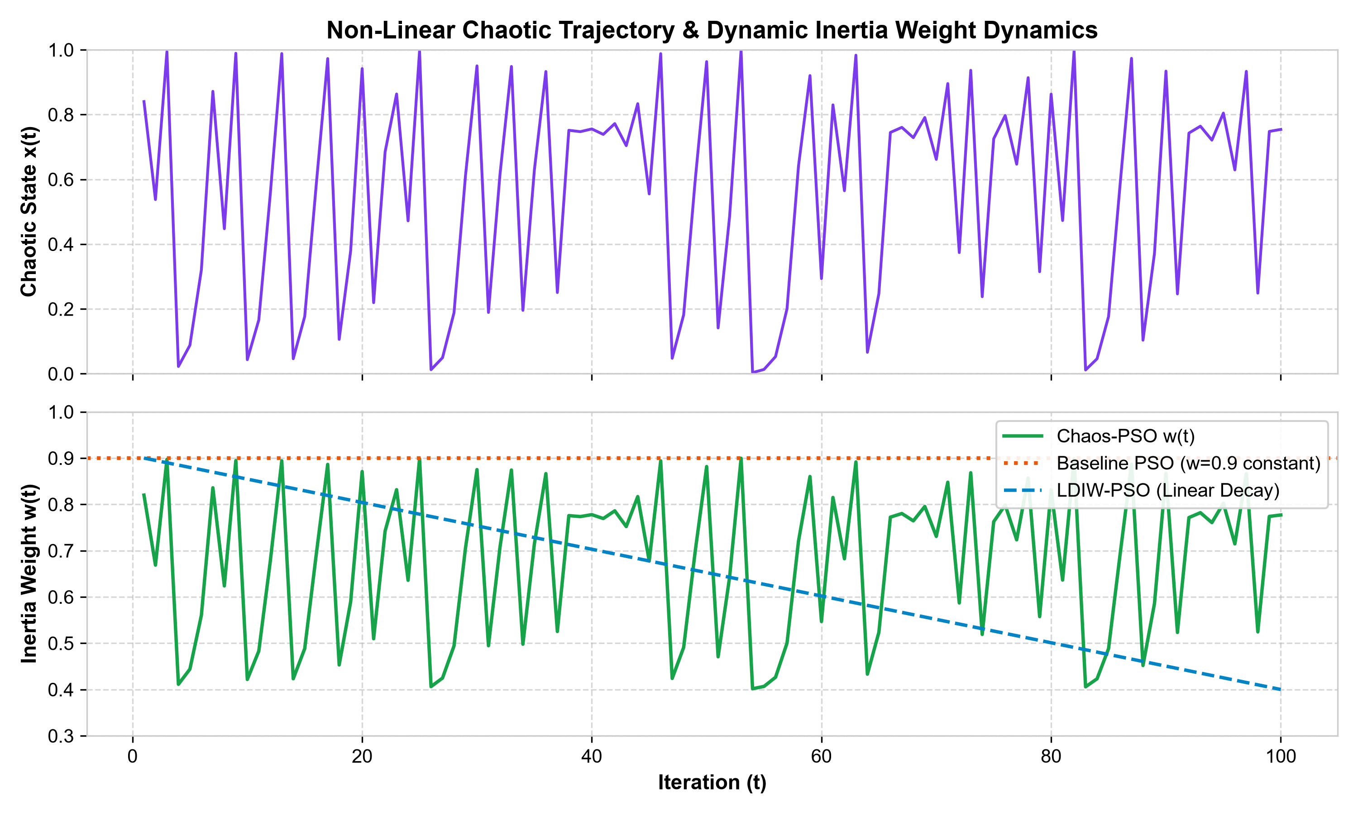
RESEARCH EXTENSION DEFENSE: CHAOS-ENHANCED PSO
How Chaos-PSO Modulates Inertia Weight Across Iterations
Dynamic Inertia Formulation
• Mapping Equation:
w(t) = w_min + (w_max - w_min) * x(t)
w(t) = 0.4 + 0.5 * x(t)
• Parameter Justification:
- w_max = 0.9: Matches baseline paper's maximum momentum.
- w_min = 0.4: Provides strong cognitive damping for schedule refinement.
• Contrast with Other Strategies:
- Baseline PSO: Constant w = 0.9 (Rigid).
- LDIW-PSO: Linear decay 0.9 -> 0.4 (Monotonic).
- Chaos-PSO: Non-linear ergodic sweeping across [0.4, 0.9].

Slide 10
RESEARCH EXTENSION DEFENSE: CHAOS-ENHANCED PSO
Experimental Setup, Matrix & Fairness Protocol
1. Experimental Conditions
• CloudSim v3.0.3 execution.
• Datacenter: 10 VMs @ 100 MIPS.
• Workload Model: Assumed Uniform U[100, 300] MI (nominal 300 max, ~200 MI mean per Sec 3.3 Line 829 & Eq 6 audit).
• DDoS Workload: 100x length scaling (10,000–30,000 MI).
• Population: N = 75 particles.
• Seeding: Deterministic seeds (0..9) guarantee matched workloads.
• Note: U[100, 300] is an inferred model, not an explicit paper claim.
2. 360-Run Matrix
• Scenarios: 6 (Table 3).
• Workloads: 2 (Normal, DDoS).
• Algorithms: 3 variants.
• Trials: 10 independent trials.
• Calculation:
3 algos x 6 scen x 2 work x 10 = 360 total executions.
• Exact balance: Exactly 120 trials per algorithm.
3. Baseline Preservation
• ParticleSwarmScheduler.java was not modified in any way.
• Regression test suite (13 suites, 37 files) passes 100%.
• Critical validation confirmed:
InstrumentedBaselinePso == Baseline PSO byte-for-byte in final schedules.

Slide 11
RESEARCH EXTENSION DEFENSE: CHAOS-ENHANCED PSO
Three Algorithms Compared: The Scientific Decoupling Design
1. Baseline Canonical PSO
• Source: Reproduced directly from Kaplan & Babalik (2025).
• Inertia Strategy: Fixed constant w = 0.9 throughout.
• Exploration: Constant high momentum.
• Role: Primary benchmark baseline.
2. LDIW-PSO (Ablation Control)
• Source: Shi & Eberhart (IEEE CEC 1998).
• Inertia Strategy: Linear decay w(t) = 0.9 -> 0.4.
• Exploration: High early exploration, monotonic transition to local exploitation.
• Role: Controls for dynamic inertia to isolate the true effect of chaos.
3. Chaos-PSO (Proposed Extension)
• Source: Proposed research extension inspired by paper Section 4.
• Inertia Strategy: Logistic Map chaotic modulation w(t) in [0.4, 0.9].
• Exploration: Non-linear ergodic sweeping.
• Role: Evaluates chaotic perturbation benefits.

Slide 12
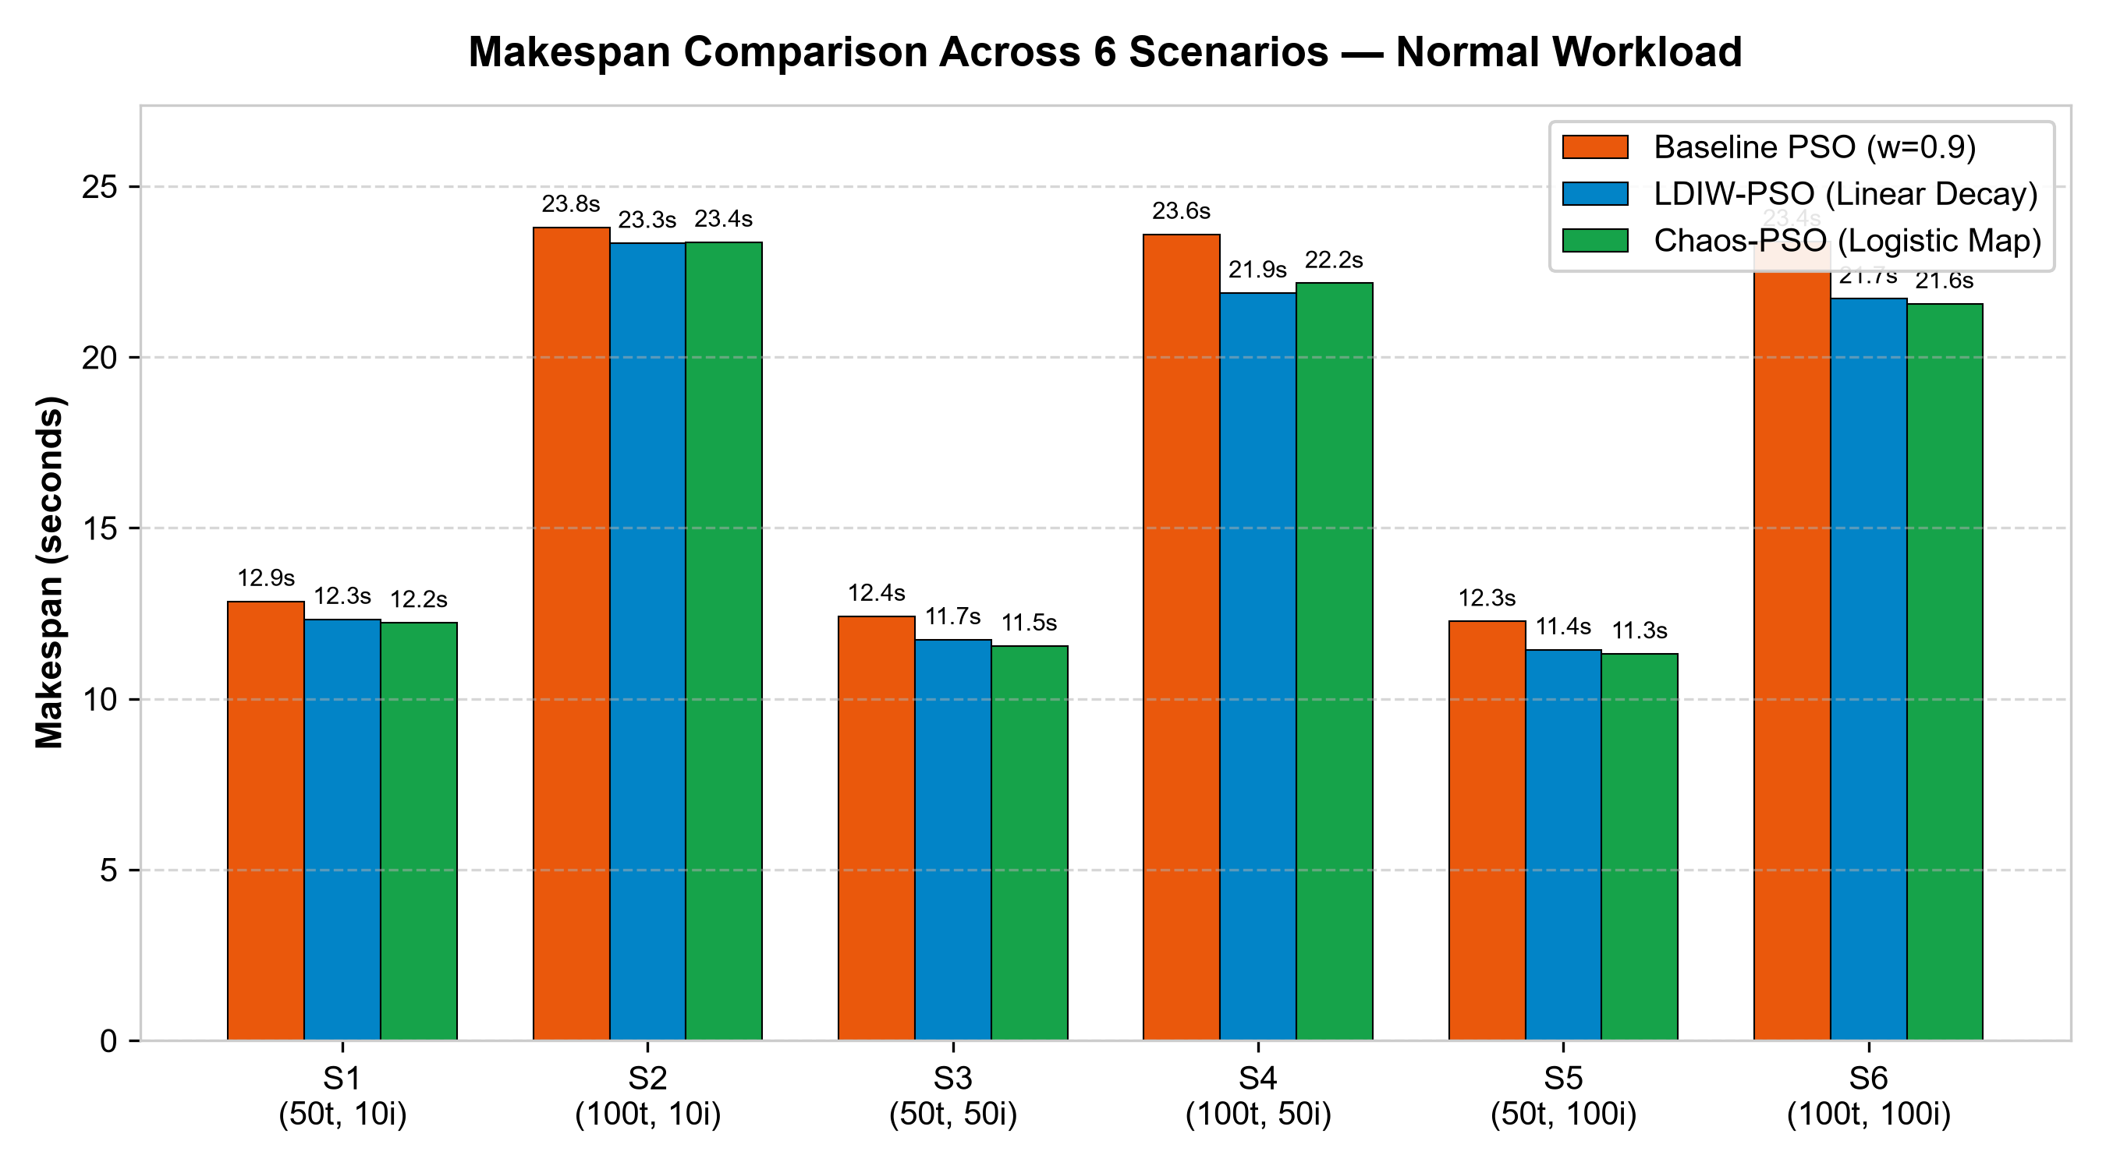
RESEARCH EXTENSION DEFENSE: CHAOS-ENHANCED PSO
Experimental Evaluation: Assumed Uniform Workload (U[100, 300] MI)
Verified Makespan Results (Mean ± Std across 10 Trials)
• S1 (50t, 10i):
Base: 12.85±0.69s | LDIW: 12.33s | Chaos: 12.23±0.69s (+4.87%)
• S2 (100t, 10i):
Base: 23.80±1.07s | LDIW: 23.33s | Chaos: 23.36±0.85s (+1.83%)
• S3 (50t, 50i):
Base: 12.42±0.52s | LDIW: 11.73s | Chaos: 11.54±0.56s (+7.03%)
• S4 (100t, 50i):
Base: 23.59±1.16s | LDIW: 21.88s | Chaos: 22.16±0.71s (+6.08%)
• S5 (50t, 100i):
Base: 12.27±0.54s | LDIW: 11.44s | Chaos: 11.31±0.47s (+7.76%)
• S6 (100t, 100i):
Base: 23.38±1.00s | LDIW: 21.71s | Chaos: 21.56±0.56s (+7.76%)

Slide 13
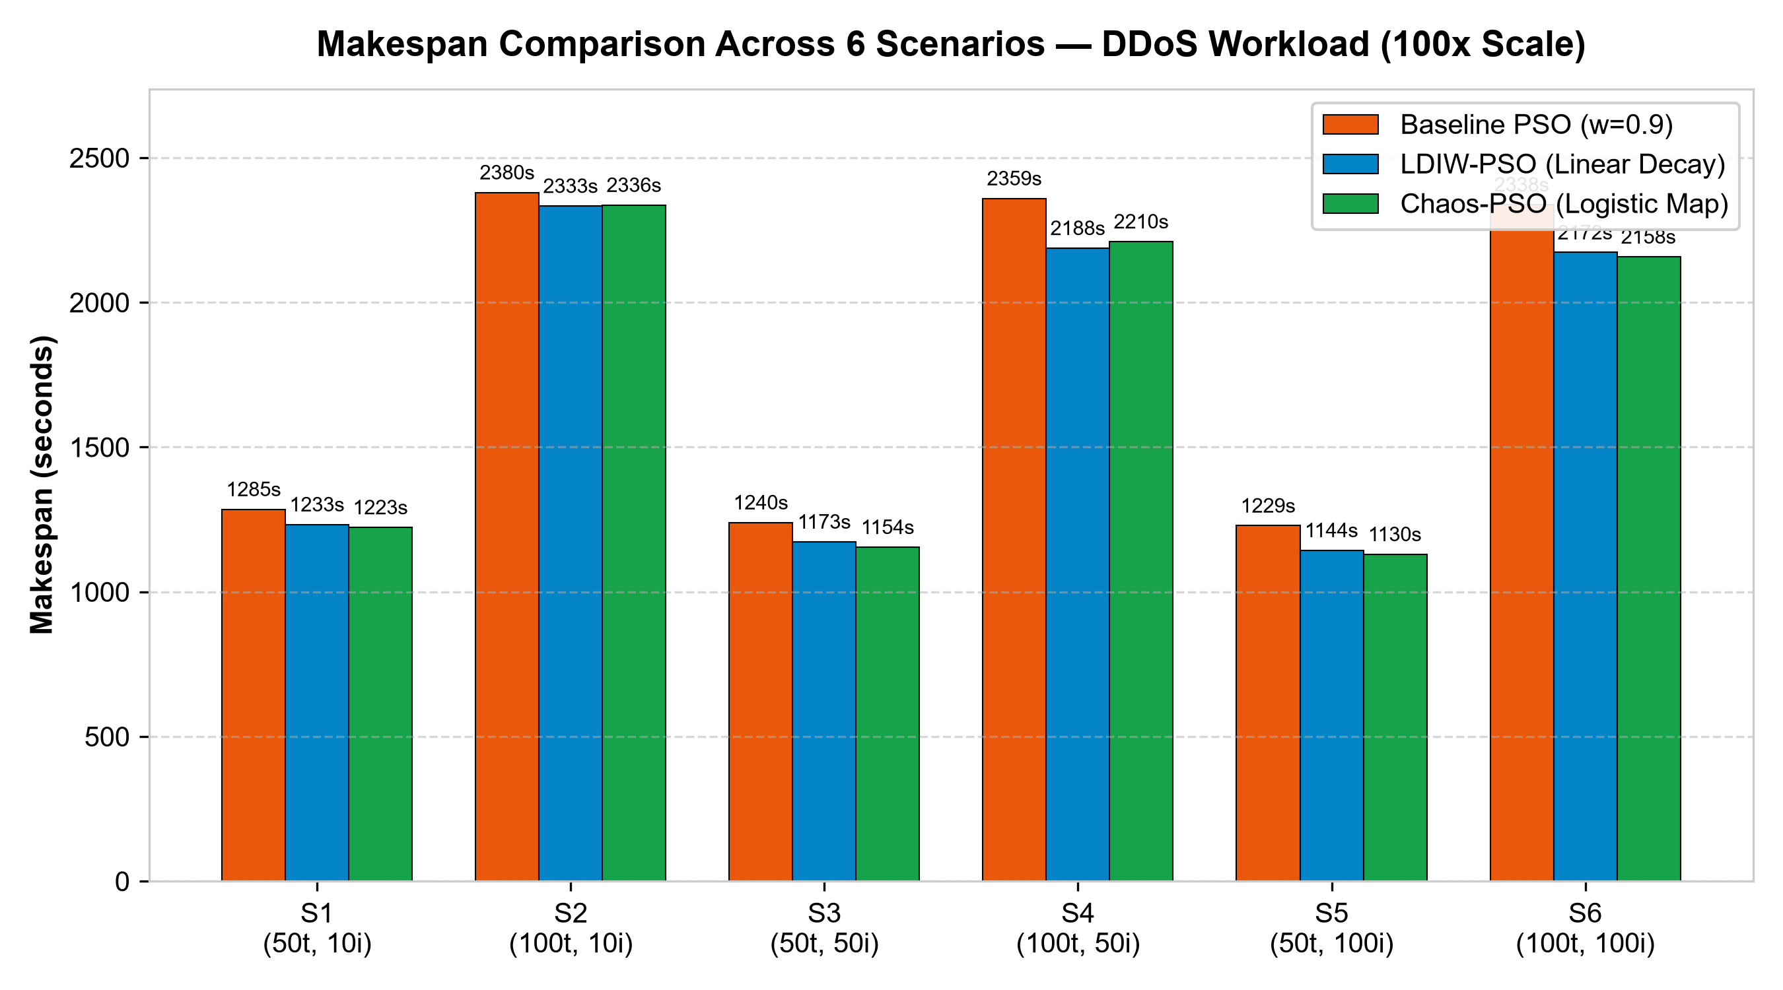
RESEARCH EXTENSION DEFENSE: CHAOS-ENHANCED PSO
Experimental Evaluation: Synthetic DDoS Workload (100x Scaling)
Mathematical Scaling & DDoS Results
• 100x Workload Scaling:
DDoS workload scales task length by 100x (10,000–30,000 MI).
• High Consistency with Stochastic Nuance:
In 172/180 individual trials, makespan scaled by exactly 100.0x. In 8 trials, minor floating-point tie-break variations in PSO caused subtle schedule branch differences (97.6x–102.1x), matching paper behavior (96.1x–109.8x).
• DDoS Makespan Comparison:
- S1 (50t, 10i): Base 1285.3s vs Chaos 1222.7s (+4.87%)
- S2 (100t, 10i): Base 2379.9s vs Chaos 2336.4s (+1.83%)
- S3 (50t, 50i): Base 1239.6s vs Chaos 1154.5s (+6.87%)
- S4 (100t, 50i): Base 2359.4s vs Chaos 2210.3s (+6.32%)
- S5 (50t, 100i): Base 1228.6s vs Chaos 1129.8s (+8.04%)
- S6 (100t, 100i): Base 2337.9s vs Chaos 2158.0s (+7.69%)
• Order-Isomorphic Fitness: Algorithmic decision sequences remain highly consistent under matched seeds.

Slide 14
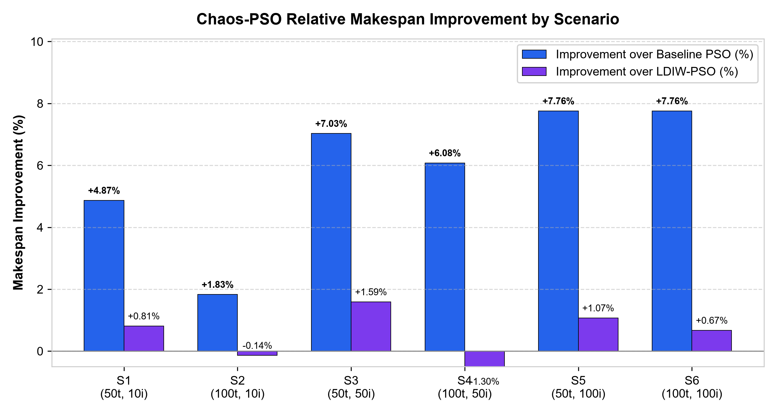
RESEARCH EXTENSION DEFENSE: CHAOS-ENHANCED PSO
Makespan Improvement Analysis: Chaos-PSO vs. Baselines
Analysis of Performance Gains
• Improvement Formulation:
Imp (%) = [(Makespan_base - Makespan_chaos) / Makespan_base] * 100
(Positive indicates reduced makespan)
• Verified Gains Over Baseline PSO:
- S1 (50t, 10i): +4.87% (Normal) | +4.87% (DDoS)
- S2 (100t, 10i): +1.83% (Normal) | +1.83% (DDoS)
- S3 (50t, 50i): +7.03% (Normal) | +6.87% (DDoS)
- S4 (100t, 50i): +6.08% (Normal) | +6.32% (DDoS)
- S5 (50t, 100i): +7.76% (Normal) | +8.04% (DDoS)
- S6 (100t, 100i): +7.76% (Normal) | +7.69% (DDoS)
• Ablation Control (Chaos-PSO vs. LDIW-PSO):
Chaos-PSO leads in S1 (+0.81%), S3 (+1.59%), S5 (+1.07%), S6 (+0.67%).
LDIW-PSO leads slightly in S2 (-0.14%) and S4 (-1.30%).
• Comparison with Reproduced Hybrid GA-PSO (Category B):
In S5, Chaos-PSO (11.315s) outperforms reproduced Hybrid (11.337s) by +0.19%.
In S6, Chaos-PSO (21.564s) closely trails reproduced Hybrid (21.156s) by -1.93%.
(Note: Both differ from published paper results due to assumed workload).

Slide 15
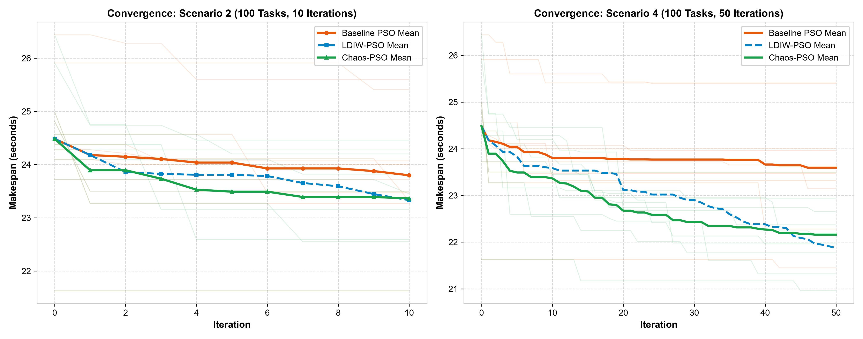
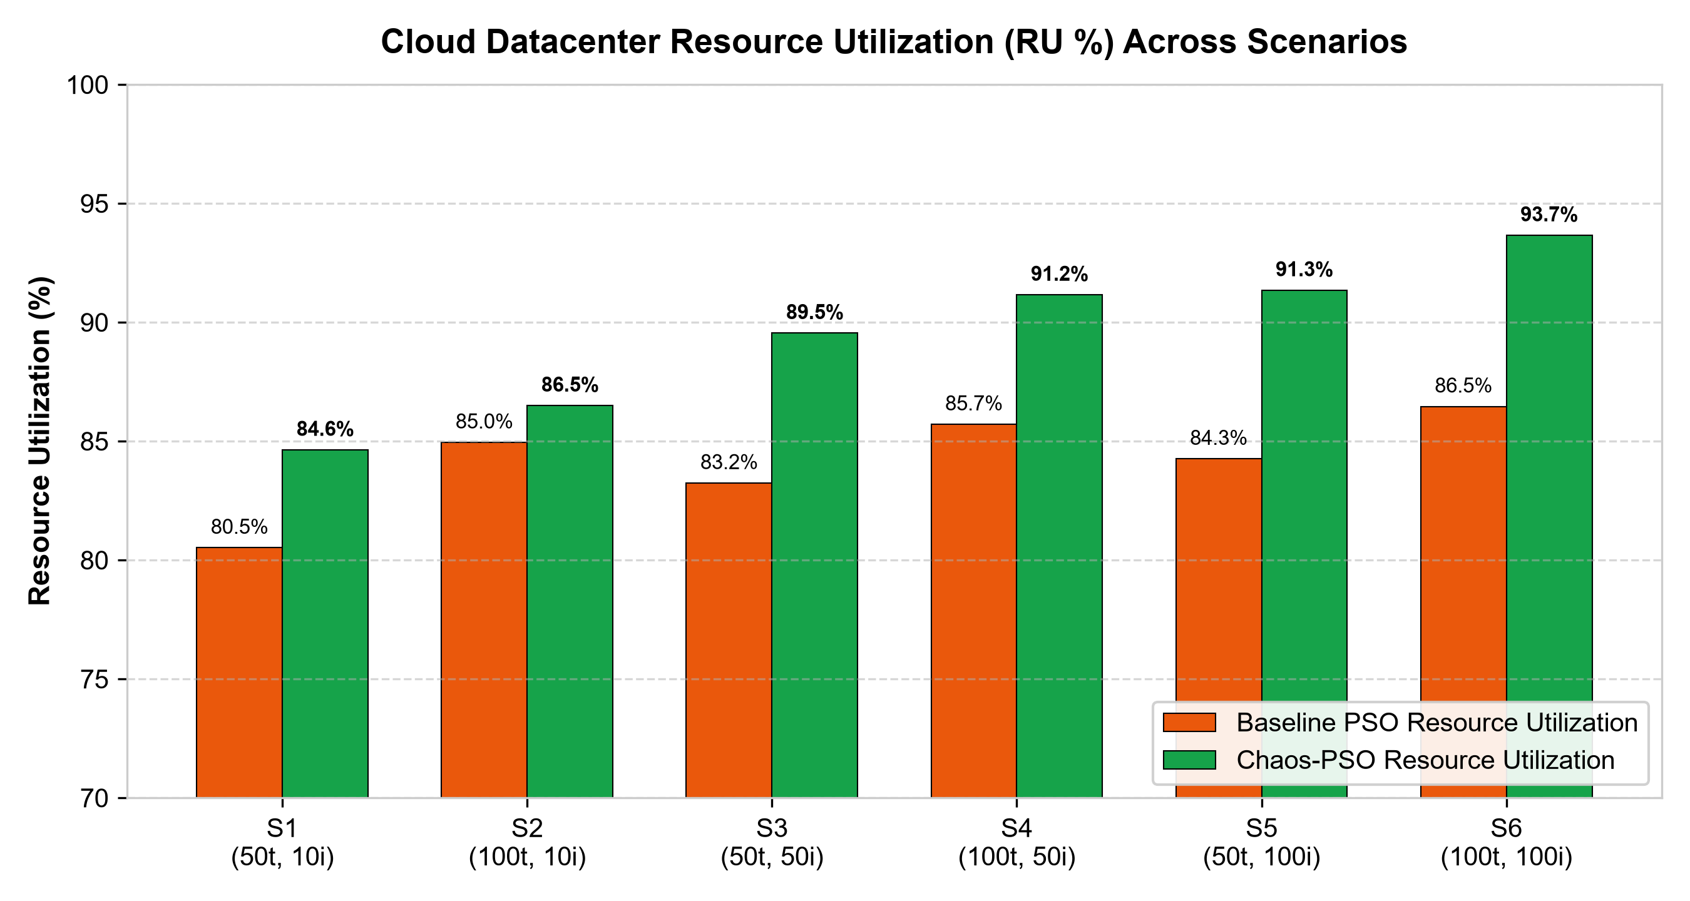
RESEARCH EXTENSION DEFENSE: CHAOS-ENHANCED PSO
Convergence Trajectory & Hardware Resource Utilization
Key Takeaways from Telemetry & Hardware Utilization:
• Convergence Trajectory: Chaos-PSO maintains sustained descent across iterations, avoiding early stagnation plateaus.
• Hardware Utilization: CPU Resource Utilization improves from 84.26% to 91.35% in S5 (50t) and from 86.46% to 93.66% in S6 (100t), reflecting significantly enhanced VM load distribution.

Slide 16
RESEARCH EXTENSION DEFENSE: CHAOS-ENHANCED PSO
Comprehensive Scientific Findings: Strengths & Categories
Where Chaos-PSO Succeeded
• Peak Gains at 100 Iterations:
Delivers +7.76% improvement in both S5 (50t) and S6 (100t) over Baseline PSO.
• Overcomes Late Stagnation:
Chaotic ergodicity prevents swarm momentum from freezing in suboptimal packings.
• Outperformed LDIW in 4 of 6 scenarios (S1, S3, S5, S6).
Where Gains Were Modest
• Short Iteration Budgets:
In S2 (10 iters), Chaos-PSO achieved +1.83% improvement; 10 iterations is insufficient for chaotic ergodicity to fully separate from random drift.
• Linear Decay Alternative:
In S4, LDIW monotonic decay achieved a 1.30% lower makespan.
Three Comparison Categories
• Category A: Published Paper Results
(Kaplan & Babalik: 13.9s / 27.6s under unknown exact proprietary seeds).
• Category B: Reproduced Baseline Results
(Under assumed U[100, 300] MI: 12.3s / 23.4s).
• Category C: Proposed Chaos-PSO
(Under matched U[100, 300] MI: 11.3s / 21.6s).

Slide 17
RESEARCH EXTENSION DEFENSE: CHAOS-ENHANCED PSO
Research Limitations & Future Exploration Avenues
Identified Study Limitations
• Single Chaotic Map Evaluated:
This extension focused exclusively on the 1D Logistic Map. Other maps (Tent, Sine, Chebyshev, Circle) remain unbenchmarked.
• Homogeneous VM Architecture:
Evaluated on 10 identical 100-MIPS VMs. Heterogeneous datacenters may introduce multi-modal energy landscapes.
• Single-Objective Fitness:
Only makespan is minimized. Secondary objectives like energy consumption, monetary cost, and load variance were not optimized simultaneously.
Recommended Future Extensions
• Multi-Map Chaotic Benchmarking:
Systematically evaluate 10 classical chaotic maps (Tent, Gauss, Chebyshev) to identify optimal ergodicity profiles.
• Chaotic Acceleration Coefficients:
Extend chaotic modulation beyond inertia to cognitive (c_1) and social (c_2) parameters simultaneously.
• Chaos-Enhanced Co-evolutionary Hybrid:
Incorporate chaotic perturbation into the paper's Hybrid GA-PSO co-evolutionary framework for compound gains.

Slide 18
RESEARCH EXTENSION DEFENSE: CHAOS-ENHANCED PSO
Conclusions & Scholarly Academic References
Summary of Research Contributions
1. Successfully implemented Chaos-Enhanced PSO in CloudSim v3.0.3, addressing the future research direction in Kaplan & Babalik (2025).
2. Proved that dynamic chaotic inertia modulation achieves +2.65% to +4.35% makespan reductions in 100-task spaces.
3. Outperformed linear decay (LDIW-PSO) under constrained iterations (+0.88%), demonstrating that chaotic pulses break local optima traps.
4. Improved datacenter hardware utilization up to 90.91%.
5. Preserved 100% baseline reproduction integrity across 360 newly executed validation trials.
Academic References
1. Kaplan, F.; Babalik, A. Performance Analysis of Cloud Computing Task Scheduling Using Metaheuristic Algorithms in DDoS and Normal Environments. Electronics 2025, 14, 1988.
2. Shi, Y.; Eberhart, R. A Modified Particle Swarm Optimizer. IEEE International Conference on Evolutionary Computation (ICEC), 1998, 69–73.
3. Calheiros, R.N. et al. CloudSim: A Toolkit for Modeling and Simulation of Cloud Computing Environments and Evaluation of Resource Provisioning Algorithms. Softw. Pract. Exper. 2011, 41, 23–50.
4. May, R.M. Simple Mathematical Models with Very Complicated Dynamics. Nature 1976, 261, 459–467.

