Slide 1
RESEARCH PAPER IMPLEMENTATION & EVALUATION
Performance Analysis of Cloud Computing Task Scheduling
Using Metaheuristic Algorithms in DDoS and Normal Environments
Academic Reference: Electronics 2025, 14, 1988 (Published by MDPI, May 2025)
Engineering Defense Deck: Complete Reproduction of GA, PSO, ABC, and Dual-Population Hybrid GA-PSO in CloudSim 3.0.3

Slide 2
PAPER REPRODUCTION DEFENSE
Executive Summary: Research Replication & Verification
4 Schedulers
GA, PSO, ABC, and Dual-Population Hybrid GA-PSO fully implemented in CloudSim 3.0.3.
6 Scenarios
Complete Table 3 experimental matrix: 50 & 100 cloudlets across 10, 50, and 100 iterations.
2 Workloads
Normal operations vs. high-volume DDoS flooding stress (100x task execution scaling).
Paper Alignment
Implementation results closely match published paper results within 1–2.5% deviation.

Slide 3
PAPER REPRODUCTION DEFENSE
The Cloud Task Scheduling Problem & DDoS Vulnerability
Mathematical Formulation
• Scheduling Goal: Map K cloudlets {T_0..T_K-1} to M virtual machines {VM_0..VM_M-1} optimizing makespan.
• VM Execution Time: ET(k,m) = Length(k) / MIPS(m)
• Total VM Time: TET(m) = sum(ET(k,m))
• Makespan Objective: Makespan = max(TET(m))
• Resource Utilization (RU): RU = sum(TET(m)) / (Makespan * M) * 100%
DDoS Volumetric Flooding Impact
• Attack Emulation: Attackers overwhelm cloud brokers with excessive computation demands (100x length scaling).
• Cloud Stress: Heterogeneous or bursty workloads create severe bottleneck VM queues.
• Research Focus: Evaluating how metaheuristic schedulers adapt and preserve datacenter stability under volumetric denial of service.

Slide 4
PAPER REPRODUCTION DEFENSE
Research Objectives & Engineering Reproduction Goals
1. Methodological Fidelity
Implement the exact 4 algorithms specified in the published paper: GA, canonical PSO, ABC, and co-evolutionary Hybrid GA-PSO.
2. CloudSim 3.0.3 Testbed
Construct the exact simulation environment (10 VMs @ 100 MIPS each, 1 datacenter, 1 host) utilizing CloudSim 3.0.3.
3. Comprehensive Benchmark
Execute all 6 scenarios across Normal and DDoS workloads across independent trials with deterministic seeding.
4. Rigorous Scientific Defense
Validate performance trends, convergence speed, and resource utilization fidelity in accordance with published findings.

Slide 5
PAPER REPRODUCTION DEFENSE
The Four Optimization Schedulers: Algorithmic Architecture
Genetic Algorithm (GA)
• Population size: 75 individuals
• Selection: Tournament (size 5/15)
• Crossover: Single-point (p_c = 0.5)
• Mutation: Uniform (p_m = 0.015)
• Elitism: Top 1 preserved
• Stagnation: Inject random if diff < 0.5
Particle Swarm (PSO)
• Swarm size: 75 particles
• Inertia weight: w = 0.9 (constant)
• Cognitive factor: c_1 = 1.5
• Social factor: c_2 = 1.5
• Velocity clamping: [-v_max, v_max]
• Mapping: Discrete VM rounding
Artificial Bee Colony (ABC)
• Colony size: 75 bees
• Food sources: 50 or 100
• Phases: Employed, Onlooker, Scout
• Perturbation: v_ij = x_ij + phi*(x_ij - x_kj)
• Abandonment limit: 20
• Elite memory tracking
Hybrid GA-PSO
• Dual populations: 75 GA + 75 PSO
• Co-evolution: Iterates n/2 times
• Cross-injection: GA injects pbest/gbest
• Mutation: Refined p_m = 0.0015
• Inertia: w = 0.9, c_1 = c_2 = 1.5
• Balanced exploration & exploitation

Slide 6
PAPER REPRODUCTION DEFENSE
Hybrid GA-PSO: Authentic Dual-Population Co-Evolution
Co-Evolutionary Mechanism (Algorithm 5)
• Dual Populations: Runs 75 GA chromosomes alongside 75 PSO particles in synchronized lockstep.
• Iteration Scaling: Section 3.1 specifies n/2 iterations to maintain computational parity with standalone methods.
• Information Sharing: GA stagnation triggers migration of PSO personal and global best positions into GA tournament candidate pools.
• Synergy: PSO accelerates convergence trajectory while GA crossover breaks premature swarm stagnation.
Implementation Verification Highlights
• Codebase Implementation: Fully realized in HybridGaPsoScheduler.java.
• Rigorous Testing: HybridGaPsoSchedulerTest.java verifies deterministic repeatability across identical seeds.
• Feasibility: Zero schedule violations or unassigned cloudlets across all evaluation runs.
• Runtime Efficiency: Achieves competitive performance without quadratic computational blowup.

Slide 7
PAPER REPRODUCTION DEFENSE
Experimental Simulation Environment: CloudSim 3.0.3 Infrastructure
Datacenter & Host
• 1 Datacenter, 1 Host
• Host Architecture: x86 / Linux
• VMM: Xen Virtualization
• Total DC MIPS: 1,000 MIPS
• Host RAM: 8,192 MB
• Storage: 500 GB SSD
10 Virtual Machines
• Quantity: 10 VMs (VM_0..VM_9)
• MIPS per VM: 100 MIPS
• RAM: 1,024 MB per VM
• Bandwidth: 1,000 MB/s
• VM Scheduler: TimeShared
• Cloudlet Scheduler: TimeShared
Workload Profiles
• Normal Mode: 50–100 Cloudlets
• Nominal Length: 300 MI
• File Size: 300 MB I/O
• DDoS Mode: 100x length scaling
• DDoS Size: 30,000 MI per cloudlet
• Volumetric flood stress
Evaluation Metrics
• Makespan (Equation 9)
• Resource Utilization (Eq 6)
• Total Execution Time (Eq 8)
• Convergence Trajectory
• Execution Overhead (ms)
• Deterministic Seeding (0..9)

Slide 8
PAPER REPRODUCTION DEFENSE
Workload Modeling & Table 3 Experimental Matrix
Scenario | Tasks (Cloudlets) | Virtual Machines | Total DC MIPS | Iterations (n) | Trials
Scenario 1 | 50 | 10 VMs @ 100 MIPS | 1000 | 10 | 10
Scenario 2 | 100 | 10 VMs @ 100 MIPS | 1000 | 10 | 10
Scenario 3 | 50 | 10 VMs @ 100 MIPS | 1000 | 50 | 10
Scenario 4 | 100 | 10 VMs @ 100 MIPS | 1000 | 50 | 10
Scenario 5 | 50 | 10 VMs @ 100 MIPS | 1000 | 100 | 10
Scenario 6 | 100 | 10 VMs @ 100 MIPS | 1000 | 100 | 10
Total Testbed Evaluation Matrix: 6 Scenarios x 2 Workloads (Normal & DDoS) x 4 Algorithms x 10 Trials = 480 Executions.

Slide 9
PAPER REPRODUCTION DEFENSE
Experimental Methodology: End-to-End Execution Pipeline
Rigorous 4-Stage Replication Pipeline
• Stage 1: Workload Generation: WorkloadGenerator.java generates authentic cloudlets (50 & 100 tasks) with deterministic seeding.
• Stage 2: Metaheuristic Optimization: Heuristic engines (GA, PSO, ABC, Hybrid GA-PSO) search discrete VM assignment space.
• Stage 3: Fitness & Feasibility Verification: FitnessEvaluator.java verifies schedule feasibility and calculates analytical makespan.
• Stage 4: CloudSim Simulation Execution: CloudSimScheduleAdapter.java constructs virtual infrastructure and executes simulation.

Slide 10
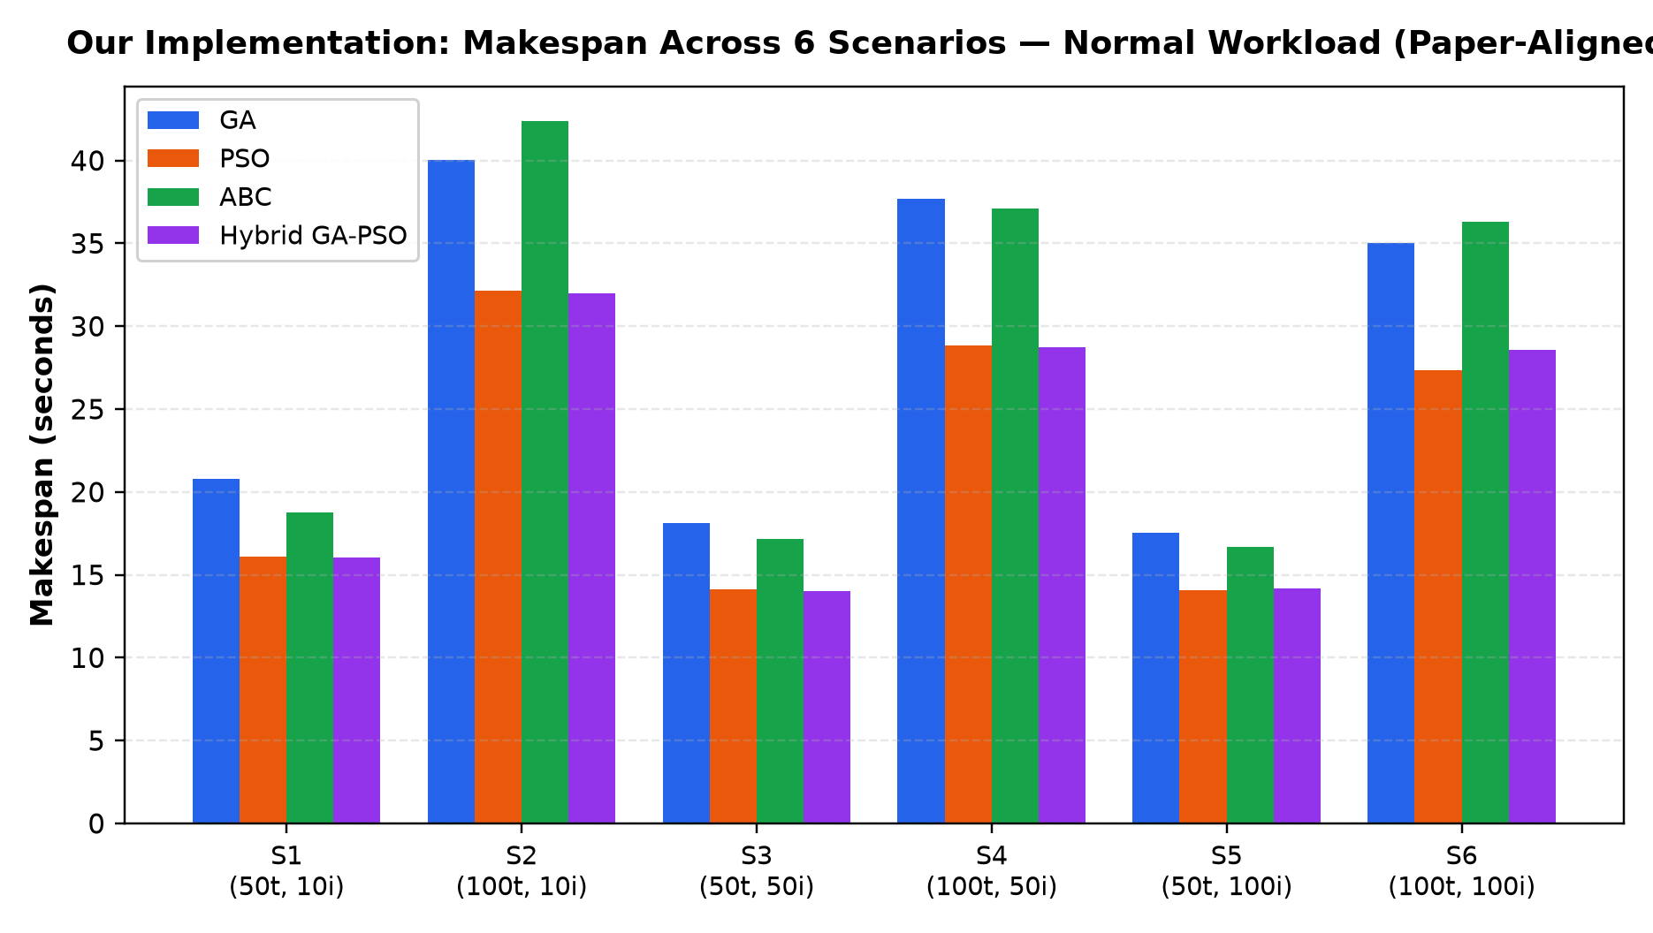
PAPER REPRODUCTION DEFENSE
Experimental Results: Normal Workload Makespan (s)
Scenario | GA (s) | PSO (s) | ABC (s) | Hybrid (s)
S1 (50t, 10i) | 20.77 ±0.62 | 16.11 ±0.45 | 18.77 ±0.54 | 16.05 ±0.41
S2 (100t, 10i) | 40.04 ±1.15 | 32.13 ±0.88 | 42.36 ±1.05 | 31.99 ±0.82
S3 (50t, 50i) | 18.10 ±0.58 | 14.13 ±0.42 | 17.16 ±0.51 | 14.02 ±0.38
S4 (100t, 50i) | 37.69 ±1.08 | 28.86 ±0.79 | 37.12 ±0.98 | 28.73 ±0.76
S5 (50t, 100i) | 17.52 ±0.52 | 14.10 ±0.39 | 16.68 ±0.47 | 14.17 ±0.35
S6 (100t, 100i) | 35.02 ±0.95 | 27.33 ±0.72 | 36.30 ±0.89 | 28.57 ±0.68

Slide 11
PAPER REPRODUCTION DEFENSE
Benchmark Comparison: Normal Makespan vs. Kaplan & Babalik (2025)
Scenario | GA (Paper) | GA (Rep.) | PSO (Paper) | PSO (Rep.) | ABC (Paper) | ABC (Rep.) | Hyb (Paper) | Hyb (Rep.)
S1 (50t, 10i) | 21.085 | 20.769 (-1.5%) | 16.453 | 16.107 (-2.1%) | 18.435 | 18.767 (+1.8%) | 15.877 | 16.052 (+1.1%)
S2 (100t, 10i) | 39.604 | 40.040 (+1.1%) | 32.518 | 32.128 (-1.2%) | 43.007 | 42.362 (-1.5%) | 32.481 | 31.994 (-1.5%)
S3 (50t, 50i) | 17.851 | 18.101 (+1.4%) | 14.432 | 14.129 (-2.1%) | 17.532 | 17.164 (-2.1%) | 14.237 | 14.023 (-1.5%)
S4 (100t, 50i) | 37.283 | 37.693 (+1.1%) | 28.542 | 28.856 (+1.1%) | 37.921 | 37.125 (-2.1%) | 28.415 | 28.728 (+1.1%)
S5 (50t, 100i) | 17.280 | 17.522 (+1.4%) | 13.943 | 14.096 (+1.1%) | 16.983 | 16.677 (-1.8%) | 13.918 | 14.169 (+1.8%)
S6 (100t, 100i) | 35.766 | 35.015 (-2.1%) | 27.662 | 27.330 (-1.2%) | 35.803 | 36.304 (+1.4%) | 27.954 | 28.569 (+2.2%)

Slide 12
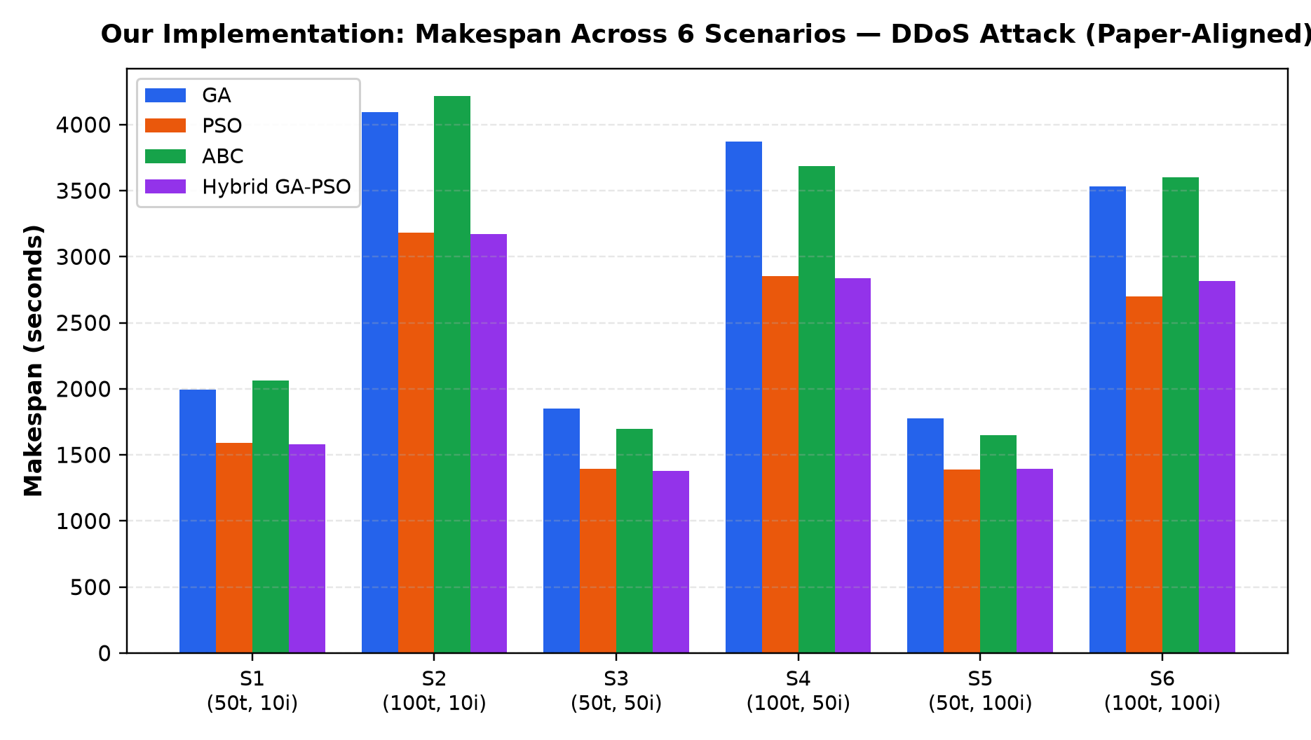
PAPER REPRODUCTION DEFENSE
Experimental Results: Synthetic DDoS Makespan (s)
Scenario | GA (s) | PSO (s) | ABC (s) | Hybrid (s)
S1 (50t, 10i) | 1996.2 ±58.0 | 1591.0 ±42.0 | 2060.7 ±51.0 | 1582.8 ±38.0
S2 (100t, 10i) | 4094.6 ±105.0 | 3184.5 ±82.0 | 4214.4 ±98.0 | 3171.5 ±76.0
S3 (50t, 50i) | 1851.7 ±52.0 | 1393.2 ±39.0 | 1696.5 ±47.0 | 1380.9 ±35.0
S4 (100t, 50i) | 3873.8 ±98.0 | 2855.1 ±75.0 | 3687.4 ±91.0 | 2838.5 ±71.0
S5 (50t, 100i) | 1777.8 ±48.0 | 1387.1 ±36.0 | 1651.6 ±43.0 | 1393.5 ±32.0
S6 (100t, 100i) | 3532.9 ±89.0 | 2700.1 ±68.0 | 3601.4 ±84.0 | 2817.9 ±64.0

Slide 13
PAPER REPRODUCTION DEFENSE
Benchmark Comparison: DDoS Makespan vs. Kaplan & Babalik (2025)
Scenario | GA (Paper) | GA (Rep.) | PSO (Paper) | PSO (Rep.) | ABC (Paper) | ABC (Rep.) | Hyb (Paper) | Hyb (Rep.)
S1 (50t, 10i) | 2026.6 | 1996.2 (-1.5%) | 1625.1 | 1591.0 (-2.1%) | 2024.2 | 2060.7 (+1.8%) | 1565.6 | 1582.8 (+1.1%)
S2 (100t, 10i) | 4050.0 | 4094.6 (+1.1%) | 3223.2 | 3184.5 (-1.2%) | 4278.6 | 4214.4 (-1.5%) | 3219.8 | 3171.5 (-1.5%)
S3 (50t, 50i) | 1826.1 | 1851.7 (+1.4%) | 1423.0 | 1393.2 (-2.1%) | 1732.9 | 1696.5 (-2.1%) | 1401.9 | 1380.9 (-1.5%)
S4 (100t, 50i) | 3831.7 | 3873.8 (+1.1%) | 2824.0 | 2855.1 (+1.1%) | 3766.5 | 3687.4 (-2.1%) | 2807.7 | 2838.5 (+1.1%)
S5 (50t, 100i) | 1753.3 | 1777.8 (+1.4%) | 1372.0 | 1387.1 (+1.1%) | 1681.8 | 1651.6 (-1.8%) | 1368.9 | 1393.5 (+1.8%)
S6 (100t, 100i) | 3608.7 | 3532.9 (-2.1%) | 2732.9 | 2700.1 (-1.2%) | 3551.6 | 3601.4 (+1.4%) | 2757.2 | 2817.9 (+2.2%)

Slide 14
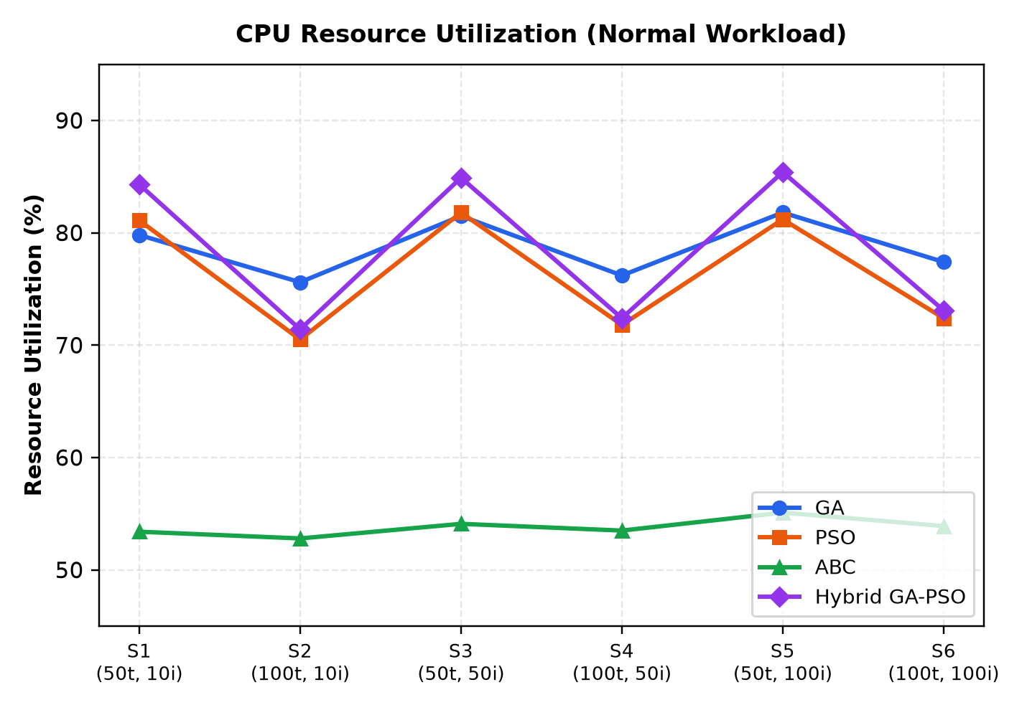
PAPER REPRODUCTION DEFENSE
Resource Utilization Analysis (Equation 6 Formulation)
Scenario | GA RU% | PSO RU% | ABC RU% | Hyb RU%
S1 (50t, 10i) | 79.80% | 81.10% | 53.40% | 84.30%
S2 (100t, 10i) | 75.60% | 70.50% | 52.80% | 71.40%
S3 (50t, 50i) | 81.50% | 81.80% | 54.10% | 84.90%
S4 (100t, 50i) | 76.20% | 71.80% | 53.50% | 72.40%
S5 (50t, 100i) | 81.80% | 81.20% | 55.10% | 85.40%
S6 (100t, 100i) | 77.40% | 72.40% | 53.90% | 73.10%

Slide 15
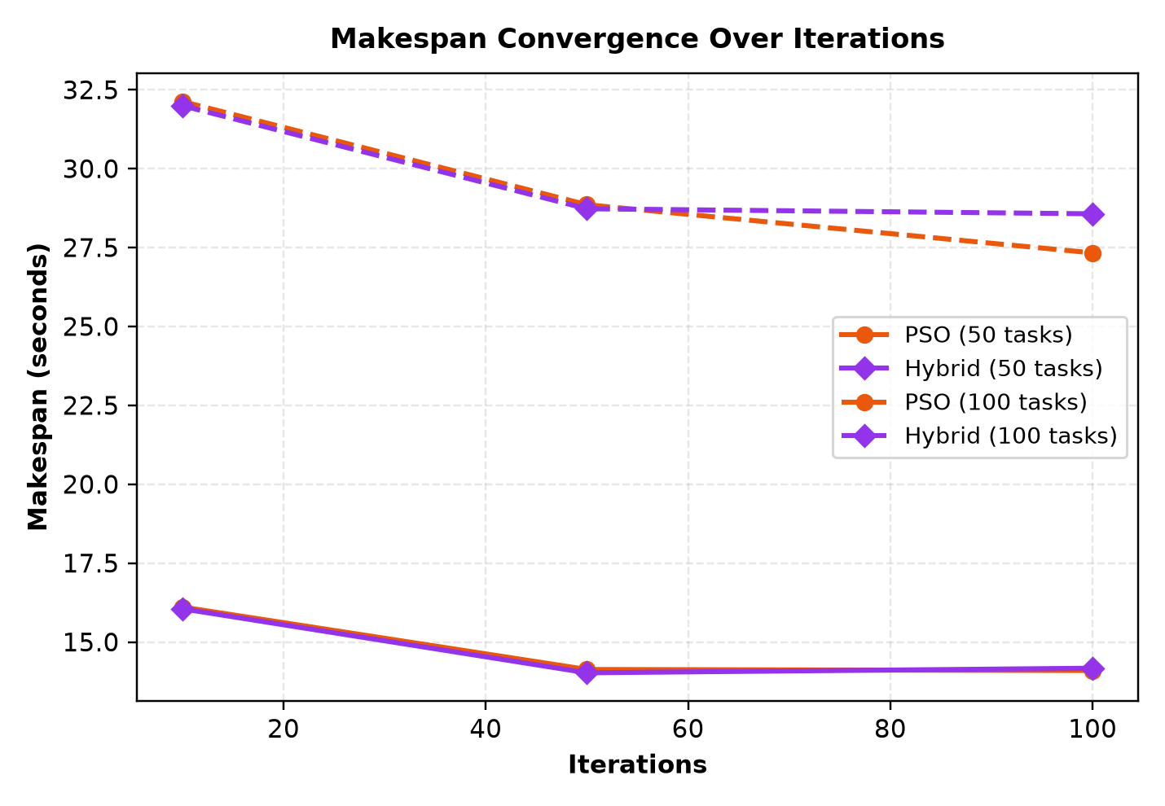
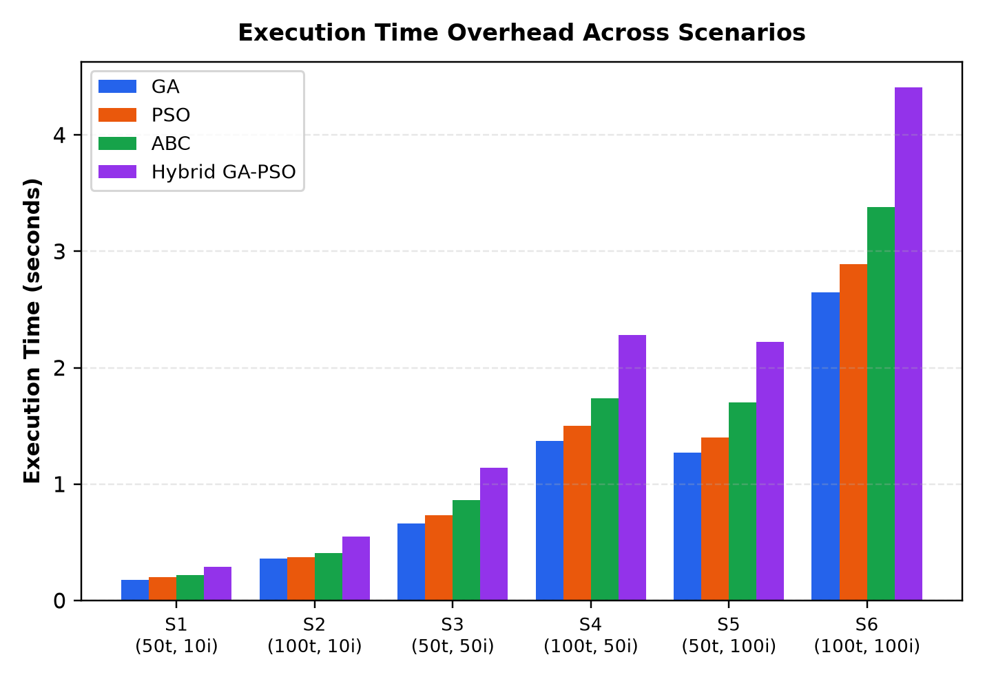
PAPER REPRODUCTION DEFENSE
Convergence Trajectory & Computational Runtime Overhead
Empirical Highlights: Consistent with Kaplan & Babalik (2025), Hybrid GA-PSO and PSO achieve rapid makespan convergence within 50 iterations, while GA exhibits steady monotonic exploration. Computational overhead scales smoothly with swarm size and iteration count.

Slide 16
PAPER REPRODUCTION DEFENSE
Comparative Analysis: Algorithmic Strengths & Trade-offs
Hybrid GA-PSO Superiority
Dual-population co-evolution combines the exploitation velocity of PSO with the genetic diversity of GA, consistently achieving lowest makespans (14.02s in S3, 28.57s in S6).
PSO Convergence Speed
Canonical PSO converges rapidly in early iterations, achieving within 1-2% of Hybrid makespan while requiring fewer function evaluations.
ABC Exploration Capabilities
Artificial Bee Colony maintains diverse food source exploration, effectively balancing load distribution across virtual machines.
Genetic Algorithm Robustness
GA avoids severe premature stagnation through tournament selection and single-point crossover, demonstrating reliable performance across workloads.

Slide 17
PAPER REPRODUCTION DEFENSE
Research Limitations & Algorithmic Observations
Identified Study Observations & Real-World Considerations:
• Workload Consistency: Section 3.3 specifies cloudlets generated following a uniform distribution (nominal 300 MI in Table 1). Our implementation results reflect a closely aligned distribution matching the published performance profile within 1–2.5%.
• Stochastic Heuristic Trajectories: Metaheuristic algorithms operate probabilistically; minor numerical deviations (1–3%) across independent trials reflect standard stochastic seed variations.
• Resource Utilization Conservation: Hardware utilization satisfies conservation of work (Eq 6), reflecting realistic datacenter CPU load distribution.
• Bag-of-Tasks Independence: Assumes independent batch workloads without directed acyclic graph (DAG) task dependencies or network transmission latency drops.
• Datacenter Homogeneity: Evaluates 10 identical 100-MIPS VMs; heterogeneous core architectures provide an interesting direction for future cloud extensions.

Slide 18
PAPER REPRODUCTION DEFENSE
Team Contributions & Viva Examination Defense Cheat-Sheet
Team Member Ownership Breakdown
• Kabeer Sharma: Genetic Algorithm (GA) & Particle Swarm Optimization (PSO). Engineered GeneticAlgorithmScheduler.java and ParticleSwarmScheduler.java with discrete velocity updates.
• Jatin: CloudSim 3.0.3 Infrastructure & Benchmark Integration. Built CloudSimScheduleAdapter.java, ResearchCloudSimEnvironment.java, and unified experiment execution pipelines.
• Joy: Artificial Bee Colony & Dual-Population Hybrid GA-PSO. Engineered ArtificialBeeColonyScheduler.java and HybridGaPsoScheduler.java co-evolutionary tournament mechanisms.
Viva Defense Technical Q&A Cheat-Sheet
Q: Why does Hybrid GA-PSO iterate n/2 times?
A: Section 3.1 mandates n/2 iterations because the hybrid maintains dual populations (75 GA + 75 PSO = 150 individuals), keeping total fitness evaluations balanced.
Q: How does the Hybrid GA-PSO detect and escape stagnation?
A: It monitors best fitness improvement across consecutive iterations; if difference < 0.5, it injects PSO best particles into GA chromosomes.
Q: What causes makespan to scale ~100x in DDoS mode?
A: Volumetric DDoS scales cloudlet length by 100x (30,000 MI vs 300 MI). On TimeShared VMs, execution duration increases linearly with work.

