Slide 1

Project Title :Currency Converter App Using Frankfurter API and Tkinter

Slide 2
PROJECT DESCRIPTION
Project Description:
The Currency Converter App is a real-time, desktop-based currency conversion tool built using Python Tkinter and powered by the Frankfurter API. This application allows users to convert an amount from one currency to another using up-to-date exchange rates.
Users can select the source currency, target currency, and amount, and the app will instantly display:
The converted value
The exchange rate
The inverse rate
The transaction date
The application uses a modular structure with helper functions (format_latest_url, call_api, extract_api_result) to fetch and parse data from the Frankfurter API. The GUI is styled for clarity and usability, including drop-downs, hover effects, and input validation to enhance user experience.

Slide 3
Technologies & Tools Used:
Technology / Tool | Purpose / Description
Python 3 | Core programming language for logic and structure
Tkinter | GUI toolkit used to build the desktop interface
Frankfurter API | Provides real-time currency exchange rate data
requests | Used to send HTTP requests to the API and fetch data
ttk (Themed Tkinter) | Enhanced widgets like dropdowns and styled buttons
messagebox | To show alerts and error messages for input validation and API issues
Custom Modules | Includes api.py and currency.py for modular code organization
JSON | Data format returned by API and parsed by the app

Slide 4
Challenges Faced:
Challenge | Solution / Approach
Ensuring API response accuracy and reliability | Used call_api() with proper .json() handling and fallback for empty responses
Validating numeric user input (amount field) | Added input validation logic using .isdigit() and messagebox.showerror()
Handling API failures or no internet connection | Implemented conditional checks and error messages if the API call fails
Keeping the UI clean and readable | Designed a structured layout with ttk.Combobox, custom colors, and result containers
Displaying both exchange and inverse rates | Used helper method reverse_rate() in currency.py for clarity and completeness
Making code modular and maintainable | Split logic into separate modules (api.py, currency.py) for clean architecture
Avoiding hardcoded currency options | Fetched currency list dynamically using get_currencies() from the API

Slide 5

Project Approach:
The application follows a modular, API-driven design. When the user inputs the amount and selects the currencies:
1.The app dynamically builds the request URL using format_latest_url().
2.It calls the Frankfurter API via call_api() to fetch the latest exchange rate.
3.The response is parsed using extract_api_result() from a custom module.
4.The app calculates the conversion and displays:
Converted amount
Exchange rate
Inverse rate
Transaction date
5.The GUI provides a clean and intuitive interface using Tkinter and ttk.

Slide 6
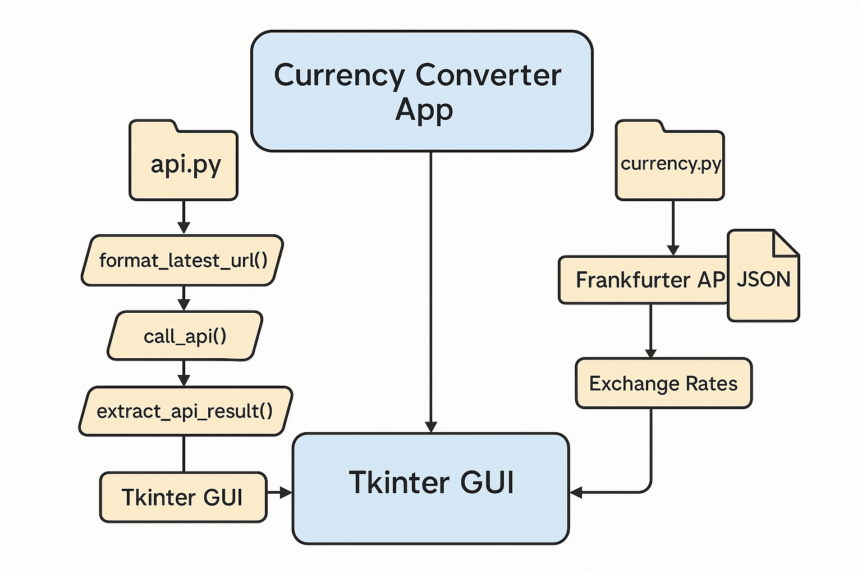
Architecture

Slide 7
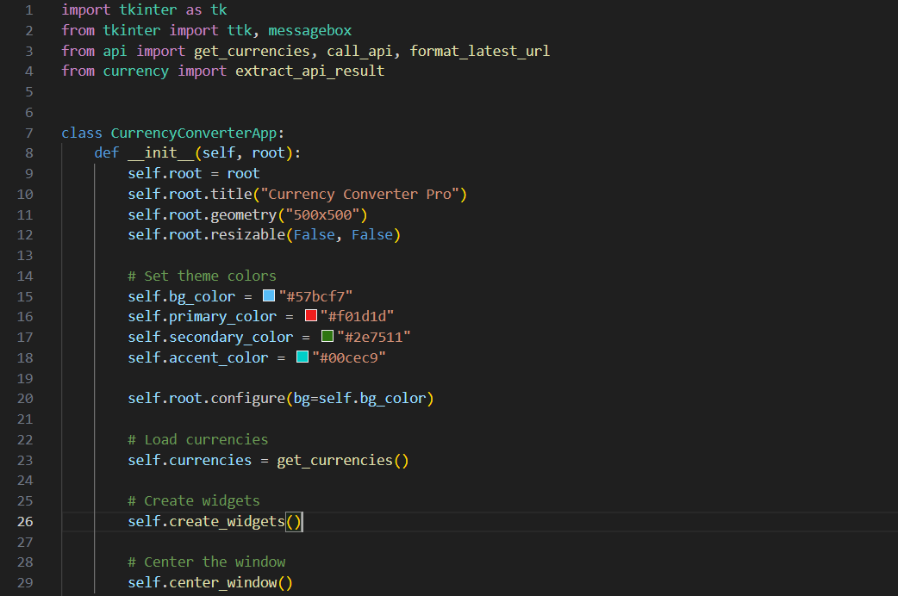
Gui_app.py

Slide 8
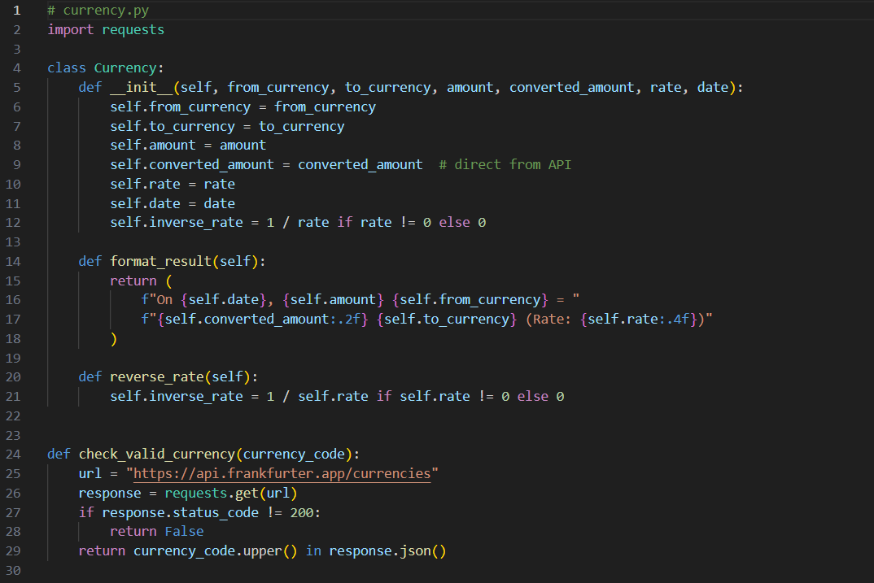
currency.py

Slide 9
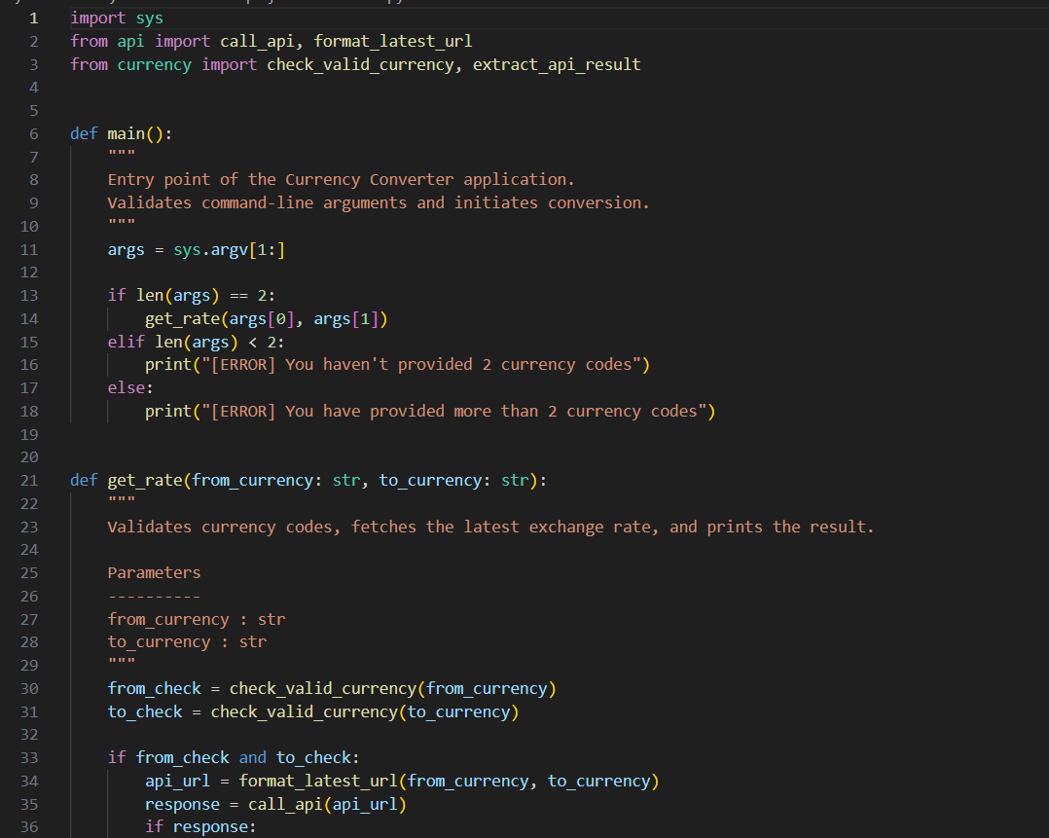
main.py

Slide 10
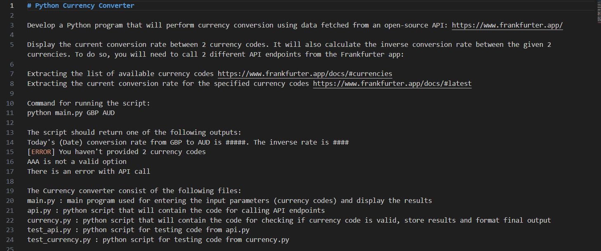
Readme.md

Slide 11
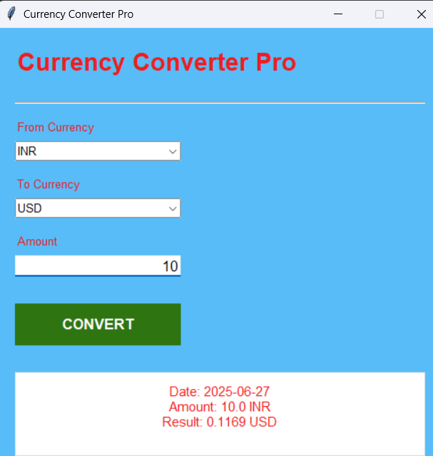
FINAL OUTPUT:

Slide 12
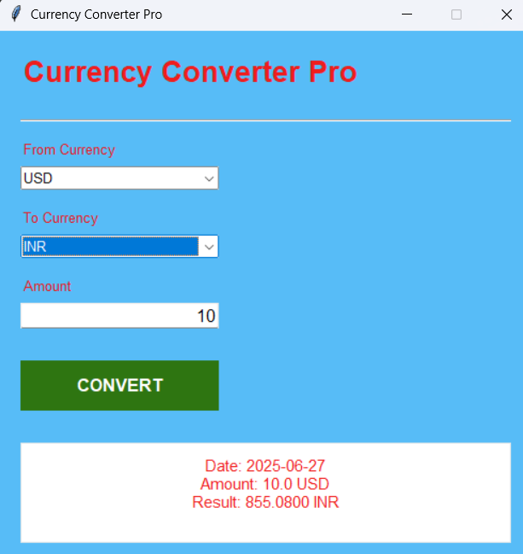

Slide 13

Project Title :Currency Converter App Using Frankfurter API and Tkinter
SUBMITTED BY: JATIN KUMAR
SUBMITTED TO TAMIZHAN SKILLS

