Slide 1

Project Title: Real-Time Weather App Using Open-Meteo API and Tkinter

Slide 2


Project Description:
The Real-Time Weather App is a desktop application built using Python's Tkinter library and the Open-Meteo API.
This app allows users to retrieve live weather information for any city around the world by simply entering the city name. The application converts the city name into geographic coordinates using a Geocoding API,and then uses those coordinates to fetch real-time weather data such as temperature, wind speed, and general weather condition.
To make the weather conditions more engaging and intuitive, the app maps the numerical weather codes returned by the API to descriptive labels and emojis (e.g., ☀️ Clear sky, 🌫️ Fog, 🌧️ Rain).
The interface is clean and user-friendly, offering a modern, responsive look with hover effects and theme-based colors.

Slide 3





🛠️ Technologies & Tools Used
Technology / Tool | Purpose / Description
Python 3 | Core programming language used for backend logic
Tkinter | Python's standard GUI library for creating the application interface
requests | To make HTTP requests to the Open-Meteo and Geocoding APIs
Open-Meteo API | Provides real-time weather data based on coordinates
Open-Meteo Geocoding API | Converts city names to latitude and longitude coordinates
JSON | Data format used to parse API responses
Emoji Mapping (Dict) | Maps weather codes to human-readable and emoji-based weather descriptions
Custom UI Styling | Button hover effects, color themes, and layout management

Slide 4
Challenges Faced
Challenge | Solution/Approach
Handling invalid or misspelled city names | Implemented error messages using messagebox when city geocoding returns no result
Parsing weather data safely from API response | Added .get() checks and fallback handling to avoid KeyError or NoneType issues
Mapping numeric weather codes to descriptions | Created a custom dictionary mapping weather codes to readable text and emojis
Designing a clean and user-friendly UI | Used Tkinter styling with padding, colors, and hover effects for better UX
Real-time API fetching delays | Kept API calls lightweight by limiting result count and handling response time safely
Ensuring app does not crash on API failure | Wrapped API calls and parsing in conditional logic to handle None or failed calls

Slide 5

Project Approach :
The app takes a city name from the user, uses the Open-Meteo Geocoding API to fetch coordinates, then retrieves real-time weather data via the Open-Meteo Weather API. The data is parsed and displayed in a clean Tkinter GUI with emoji-based weather descriptions and proper error handling.

Slide 6
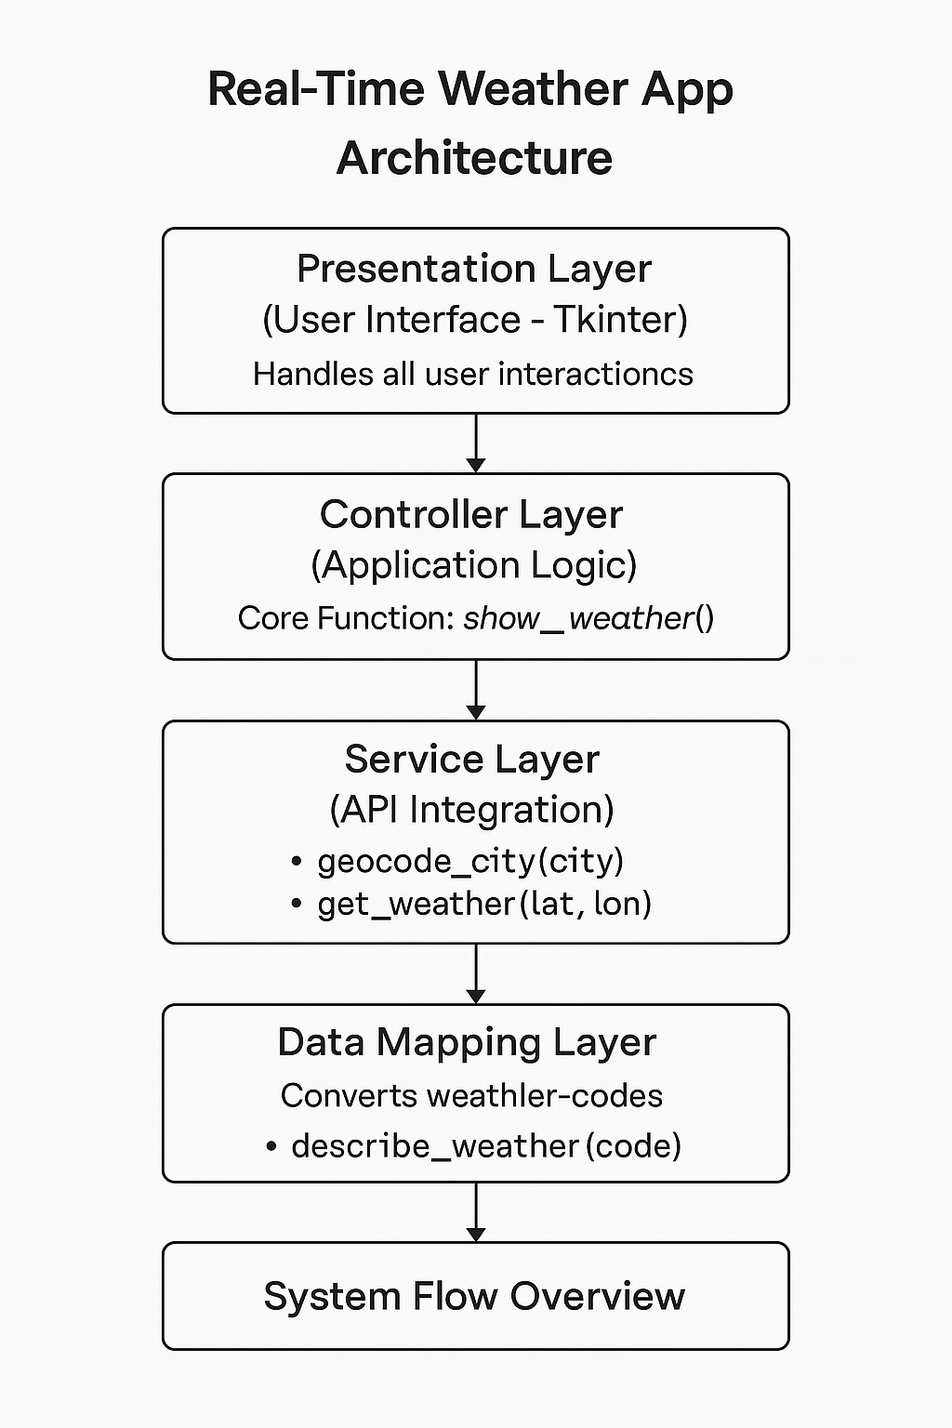
PROJECT ARCHITECTURE

Slide 7
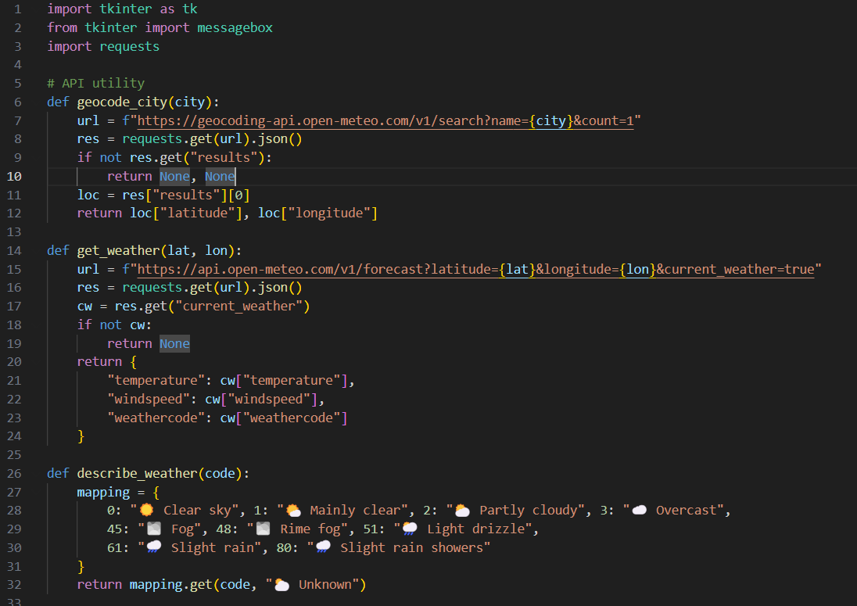
CODES:

Slide 8
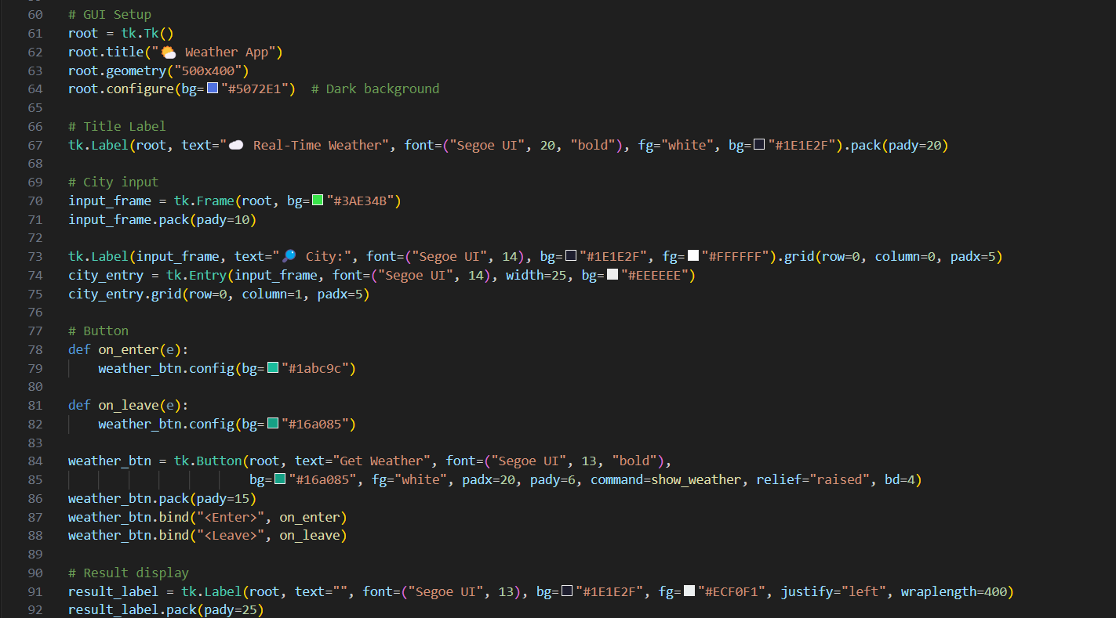

Slide 9
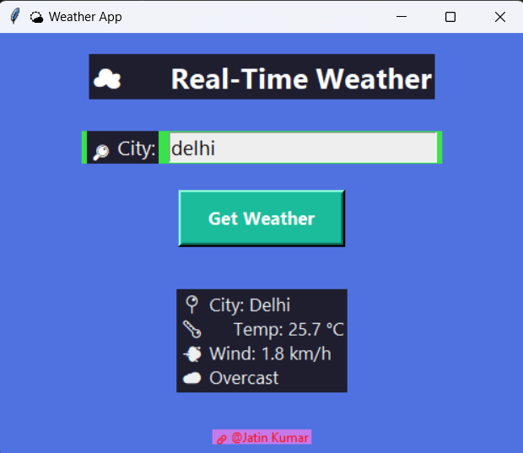

Slide 10
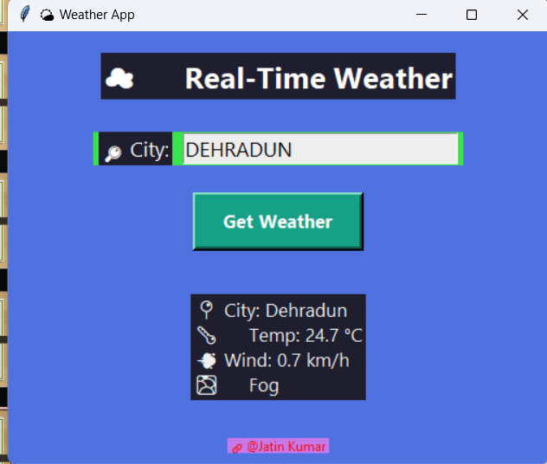

Slide 11

Project Title: Real-Time Weather App Using Open-Meteo API and Tkinter
SUBMITTED BY: JATIN KUMAR
SUBMITTED TO TAMIZHAN SKILLS

