Slide 1


CISC 856 TCP/IP and Upper Layer Protocols
DOMAIN NAME SYSTEM
RFC 1034 & RFC 1035
Presented by Neeta Jain

Slide 2
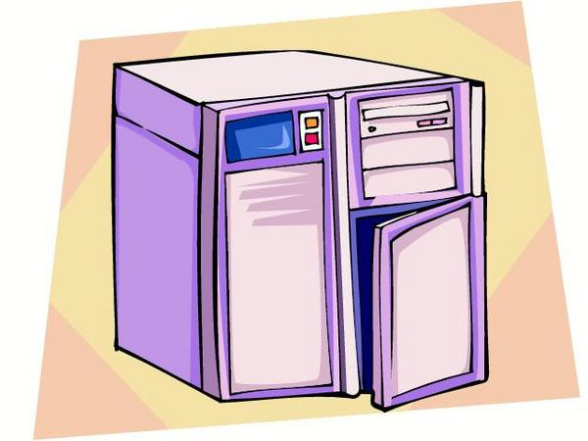

Introduction
1. What is the IP address of udel.edu ?
It is 128.175.13.92
1. What is the host name of 128.175.13.74
It is strauss.udel.edu

Slide 3


Real Life Analogy: Telephone Example
Telephone connection
Source: Child
Newark, DE
Destination: Dad
Udel-Newark, DE
Information Child Needs: Dad’s Phone #

Slide 4
Calls dad
Child
1
(What is Dad’s Phone#?)
Dad’s phone is
302-831-1949
8
Dials 0: (what is Newark’s area code?)
Dad’s phone is 302-831-1949
7
Older sister
2
University
operator
operator
3
Dials 302-831-4567:
(what is Dad phone #?)
(Newark’s area code is 302)
6
(University number: 302-831-4567)
5
4
Dials 302-731-1212:
(What is University # ?)
Directory
assist

Slide 5
DNS Components
There are 3 components:
Name Space:
Specifications for a structured name space and data associated with the names
Resolvers:
Client programs that extract information from Name Servers.
Name Servers:
Server programs which hold information about the structure and the names.

Slide 6
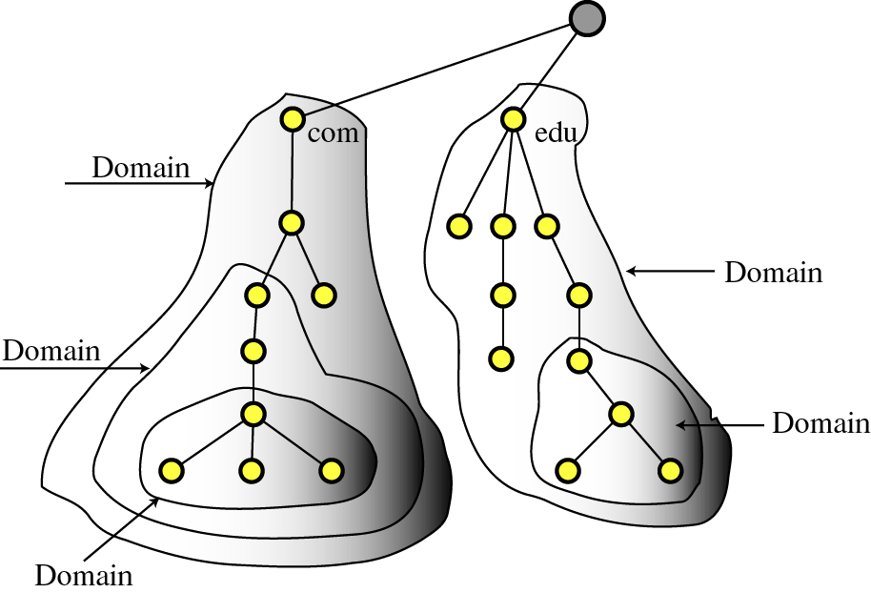
Name Space

Slide 7
Resolvers
A Resolver maps a name to an address and vice versa.
Query
Response
Resolver
Name Server

Slide 8

Iterative Resolution
a.root server
a3.nstld.com
a.gtld- server
5
udel server
ns1.google.com
3
7
iterative response (referral)
“I don't know. Try a.root-servers.net.”
iterative response (referral)
“I don't know. Try a.gtld-servers.net.”
9
1
iterative response (referral)
“I don't know. Try a3.nstld.com.”
iterative response (referral)
“I don't know. Try ns1.google.com.”
2
4
6
iterative response
“The IP address of www.google.com is 216.239.37.99.”
8
client
10
iterative request
“What is the IP address of www.google.com?”

Slide 9
Recursive Resolution
root server
edu server
3
com server
7
4
udel server
2
8
google
server
6
5
9
1
10
recursive request
“What is the IP address of www.google.com?”
client
recursive response
“The IP address of www.google.com is 216.239.37.99.”

Slide 10
Name Server
Architecture:
Zone
data
file
Name Server Process
From
disk
Authoritative Data
(primary master and
slave zones)
Master
server
Zone transfer
Cache Data
(responses from
other name servers)
Agent
(looks up queries
on behalf of resolvers)

Slide 11
Name Server (cont’d)
Authoritative Data:
Name Server Process
Authoritative Data
(primary master and
slave zones)
Response
Cache Data
(responses from
other name servers)
Agent
(looks up queries
on behalf of resolvers)
Resolver
Query

Slide 12
Name Server (cont’d)
Using Other Name Servers:
Name Server Process
Authoritative Data
(primary master and
slave zones)
Cache Data
(responses from
other name servers)
Response
Response
Arbitrary
name
server
Agent
(looks up queries
on behalf of resolvers)
Query
Resolver
Query

Slide 13
Cached Data :
Name Server (cont’d)
Name Server Process
Authoritative Data
(primary master and
slave zones)
Response
Cache Data
(responses from
other name servers)
Agent
(looks up queries
on behalf of resolvers)
Query
Resolver

Slide 14
Block Diagram
Query
Query
Foreign
Name
Server
User
Program
Resolver
Response
Response
Addition
Reference
Cache

Slide 15
DNS Messages
Messages
Query
Response

Slide 16
DNS Message Format
Header (12 bytes)
Header (12 bytes)
Question section
Question section
2 bytes
2 bytes
Answer section
Identification
Flags
Authoritative section
Number of
Answer Records
(zeroed in query)
Additional section
Number of
Question Records
0
no error
1
format error
2
problem at name server
Number of Auth-
oritative Records
(Zeroed in query)
Number of
Additional Records
(zeroed in query)
3
domain reference problem
4
query type not supported
5
administratively prohibited
6-15
reserved
0 = query,
1 = response
QR
OpCode
AA
TC
RD
RA
0
0
0
rCode
0 = standard, 1 = inverse,
2 = server status request
Authoritative Answer flag
Recursion Available flag
Truncated flag
Recursion Desired flag

Slide 17
Question Record Format
sent in query;
repeated in response
Query name
(variable length)
class of network (1 = Internet)
Query type
(16 bits)
Query class
(16 bits)
1
A
Address – IPv4
2
NS
Name Server (authoritative)
5
CNAME
Canonical Name (alias)
12
PTR
Pointer – reverse lookup
15
MX
Mail Exchange
28
AAAA
Address - IPv6
252
AXFR
Zone Transfer
3
r
e
n
5
e
e
c
i
s
4
u
d
e
l
3
e
d
u
0
counts

Slide 18
Resource Record Format
answer, authoritative, and
additional sections in response
name of host/domain that this record provides information for
Domain Name
(variable length)
type of data in resource record
(same types as used in question record)
Domain type
(16 bits)
Domain class
(16 bits)
same as in question record
Time to Live
(32 bits)
number of seconds this record may be cached
data length
(16 bits)
length of resource data
the “payload” of the resource record
Resource data
(variable length)

Slide 19
Compression
bytes 0-11
Header (12 bytes)
Query name
(variable length)
byte 12
Question
Section
3
r
e
n
5
e
e
c
i
s
Query type
(16 bits)
Query Class
(16 bits)
4
u
d
e
l
3
e
d
u
0
Domain Name
(variable length)
C0
0C
Answer
Section
1100000000001100 = 12₁₀

Slide 20

Example forward query/response
“What is the IP address
of www.udel.edu?”
“www.udel.edu's IP address
is 128.175.13.63.”
Hdr
ident
0x0100
same ident
0x8180
Hdr
0x0001
0x0000
0x0001
0x0001
0x0000
0x0000
0x0004
0x0004
Qry
3 'w' 'w' 'w'
4 'u' 'd' 'e'
'l' 3 'e' 'd'
'u' 0
3 'w' 'w' 'w'
4 'u' 'd' 'e'
'l' 3 'e' 'd'
'u' 0
Qry
0x0001(A)
0x0001(A)
0x0001(IN)
0x0001(IN)
flags: recursion desired (RD)
0xC00C
0x0001(A)
Ans
flags: query response (QR),
recursion desired (RD),
recursion available (RA)
0x0001(IN)
0x0000...
...0xB2F5
0x0004
0x80AF0D3F
(128.175.13.63)
TTL: 45301 seconds ≈ 12.6 hours
...

Slide 21

Example inverse query/response
“What is the name of the
host at 128.175.13.63?”
“The host at 128.175.13.63
is named www.udel.edu.”
Hdr
ident
0x0100
same ident
0x8180
Hdr
0x0001
0x0000
0x0001
0x0001
0x0000
0x0000
0x0004
0x0004
Qry
2 '6' '3' 2
'1' '3' 3 '1'
'7' '5' 3 '1'
'2' '8' 7 'i'
'n' '-' 'a' 'd'
'd' 'r' 4 'a'
'r' 'p' 'a' 0
2 '6' '3' 2
'1' '3' 3 '1'
'7' '5' 3 '1'
'2' '8' 7 'i'
'n' '-' 'a' 'd'
'd' 'r' 4 'a'
'r' 'p' 'a' 0
Qry
0x000C(PTR)
0x0001(IN)
0x000C(PTR)
0x0001(IN)
0xC00C
0x000C(PTR)
Ans
0x0001(IN)
0x0000...
...0xB003
0x000E
3 'w' 'w' 'w'
4 'u' 'd' 'e'
'l' 3 'e' 'd'
'u' 0
TTL: 45056 seconds ≈ 12.5 hours
...

Slide 22
Resource Record Sections
Resource Record sections:
  answer = record(s) sent in response to query(s).
  authoritative = DNS servers which are authoritative for answer record(s).
  additional = any other related information.
MX records:
  mail exchange (MX) records provide mail addressing info.
  MX query asks “What hosts will accept mail for domain X?”
  MX resource records say “You can send mail for domain X to host Y.”
MX Resource Data
preference (2 bytes)
delivery priority (lower value = higher priority)
exchange
(variable length)
domain name of host that will accept mail

Slide 23



Example MX response
...
Hdr
ident
0x8180
0xC00C
0x0002(NS)
Auth
0x0001
0x0002
0x0001(IN)
0x0000...
0x0004
0x0006
...0x19FA
0x0007
Qry
4 'u' 'd' 'e'
'l' 3 'e' 'd'
'u' 0
4 'D' 'N' 'S'
'1' 0xC00C
0x000F(MX)
0xC00C
0x0002(NS)
Auth
0x0001(IN)
0x0001(IN)
0x0000...
Ans
0xC00C
0x000F(MX)
...0x19FA
0x0007
0x0001(IN)
0x0001...
4 'D' 'N' 'S'
'2' 0XC00C
...0x28F6
0x000C
0x000A 7 'c'
'o' 'p' 'l' 'a'
'n' 'd' 0xC00C
...
0xC028
0x0001(A)
Adtl
0x0001(IN)
0x0001...
Ans
0xC00C
0x000F(MX)
...0x2FB4
0x0004
0x0001(IN)
0x0001...
128.175.13.74
...0x28F6
0x000C
0xC040
0x0001(A)
Adtl
0x0014 7 's'
't' 'r' 'a' 'u'
's' 's' 0xC00C
0x0001(IN)
0x0001...
...0x0D5D
0x0004
128.175.13.92
...
...

Slide 24
Transport
IP
header
UDP
header
DNS message
max. 512 bytes
DNS messages are encapsulated in UDP by default.
If the resolver expects the response to exceed 512 bytes, the resolver encapsulates the query in TCP instead.
If a request is sent over UDP and the response is longer than 512 bytes, the server sends the first 512 bytes of the response using UDP and sets the TC (truncated) flag. The resolver then re-sends the query using TCP.
no limit (up to max. TCP payload size)
IP
header
TCP
header
2-byte
DNS msg.
length
DNS message

Slide 25
Dynamic DNS
IP Address?
DHCP Server
Update
IP Address
Client
Zone File
Primary DNS Server

Slide 26
Acknowledgements
Many thanks to :
Behrouz A. Forouzan http://www.mhhe.com/engcs/compsci/forouzan/tcpipppt.mhtml
David Conrad
www.itu.int/osg/spu/enum/workshopjan01/annex2-conrad.ppt
Greg Forte
http://www.cis.udel.edu/~amer/856/dns.03f.ppt

Slide 27

Questions

