Slide 1
DNS
Domain Naming Server

Slide 2
Topics Covered
What is DNS
Why DNS
DNS Overview (Hierarchical flow)
Resource Records
Types of Name Servers
Authoritative Name Servers
Zones
Zone Transfers

Slide 3
What is DNS?
A DNS server is a server (Role installed on the server) that contains a database of public IP addresses and their associated hostnames.
It serves to resolve, or translate, those common names to IP addresses as requested.

Slide 4
Why DNS
To identify an entity, TCP/IP protocols use the IP address, which uniquely identifies the connection of a host to the Internet. However, people prefer to use names instead of numeric addresses. Therefore, we need a system that can map a name to an address or an address to a name.

Slide 5
How DNS Works
Application layer
Application
DNS Client
DNS Server

Slide 6
DNS Hierarchical Flow
DNS has the inverted tree structure.
Root servers are at the top of the inverted tree, gTLD (Generic Top Level Domains) & CCTLD (Country Code Top Level Domains) comes below the root servers, and then comes the DNS servers of the forest or domain.
13 Root Servers
Generic Top Level Domains
Com, org, edu, etc
Country Code Top Level Domains (in, us, uk)
Example1.com
Example3.uk
Example3.edu
Example2.org
Example2.us
Example1.in

Slide 7
A domain name is the sequence of labels from a node to the root, separated by dots (“.”s), read left to right
The name space has a maximum depth of 127 levels
Domain names are limited to 255 characters in length
A node’s domain name identifies its position in the name space

Slide 8
ROOT
Label
CORP
Domain Name: Corp.
Label
BANK
Domain Name: Bank.corp.
Label
WFB
Domain Name: wfb.bank.corp
Label
ENT
Domain Name: ent.wfb.bank.corp

Slide 9
Comprised of three components
Namespace
Name servers which make that namespace available
Resolvers (clients) which query the servers about the name space

Slide 10
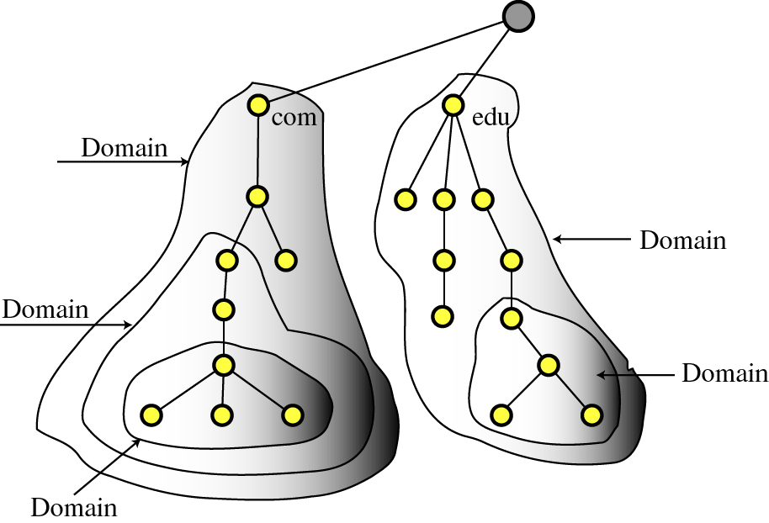
Namespace
The namespace is the structure of the DNS database.
An inverted tree with the root node at the top.
To be unambiguous, the names assigned to device\server\site must be carefully selected from a name space with complete control over the binding between the names and IP addresses. In other words, the names must be unique because the addresses are unique.

Slide 11
Name Servers
Name servers store information about the name space in units called “zones”
The name servers that load a complete zone are said to “have authority for” or “be authoritative for” the zone
Usually, more than one name server are authoritative for the same zone
a single name server may be authoritative for many zones

Slide 12
Resource Records
A domain contains resource records
Resource records are analogous to files in the file structure.
They are classified into different types. Some of the important types are SOA, NS, A, CNAME and MX.

Slide 13
The “A” Record
The “Address” record
normally used to define a host
Contains an IPv4 Address (the address computers use to uniquely identify each other on the internet)
Eg. The record:
DNSLAB1 A 203.18.56.31
In the example.com domain, defines the host uniquely identifiable as “DNSLAB1.example.com” to be reachable at the IPv4 Address 203.18.56.31
For the IPv6 addresses, the host record is given by Tetra A (AAAA) record.

Slide 14
The “CNAME” Record
A CNAME defines an alias
The alias will then be resolved, if another CNAME is encountered then the process continues until an A record is found
Eg. The record:
search CNAME www.google.com.
In the example.com domain, defines the name uniquely identifiable as “search.example.com” to be and alias to www.google.com.

Slide 15
The “MX” Record
An MX record defines the mail servers for a particular domain
Mail exchange records hold the name of hosts, and their priorities, able to deliver mail for the domain.
Eg. The record:
example.com MX 10 mail
In the example.com domain, defines the host mail to be the priority 10 mail server for the “example.com” domain.

Slide 16
The “NS” Record
An NS record defines the authoritative Name servers for the domain.
The “Name Server” records also define the name servers of children domains
Eg. The record:
internal NS ns1.example1.com.
In the example1.com domain, defines the host “ns1.example1.com” to be a name sever for the “example1.com” domain.

Slide 17
Master (Primary) Name Servers
A Master DNS defines one or more zone files for which this DNS is Authoritative ('type master'). The zone has been delegated (via an NS Resource Record) to this DNS.

