Slide 1
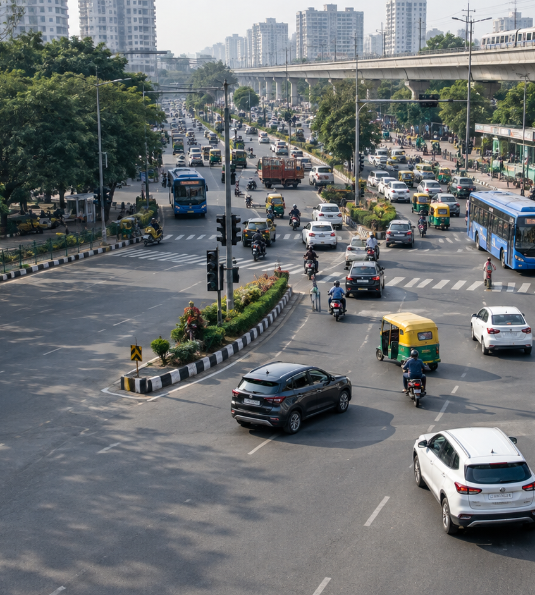

MINOR PROJECT PROPOSAL
VISTA
Vehicle Intelligence and
Smart Traffic Analytics
Department of Computer Science & Engineering
SUBMITTED BY
GUIDE
[Student name & roll no.]
[Guide name]
Academic Year 2026-27
Notes:
Introduce VISTA as a proposed minor project in computer vision and traffic analytics.
State that the demo will use fixed-camera road footage. The aim is to turn vehicle movements into counts that can be checked against manual annotation.
The cover image is AI-generated illustration, not footage or an output from the proposed system. Logo and institutional wording are from the supplied university template.

Slide 2
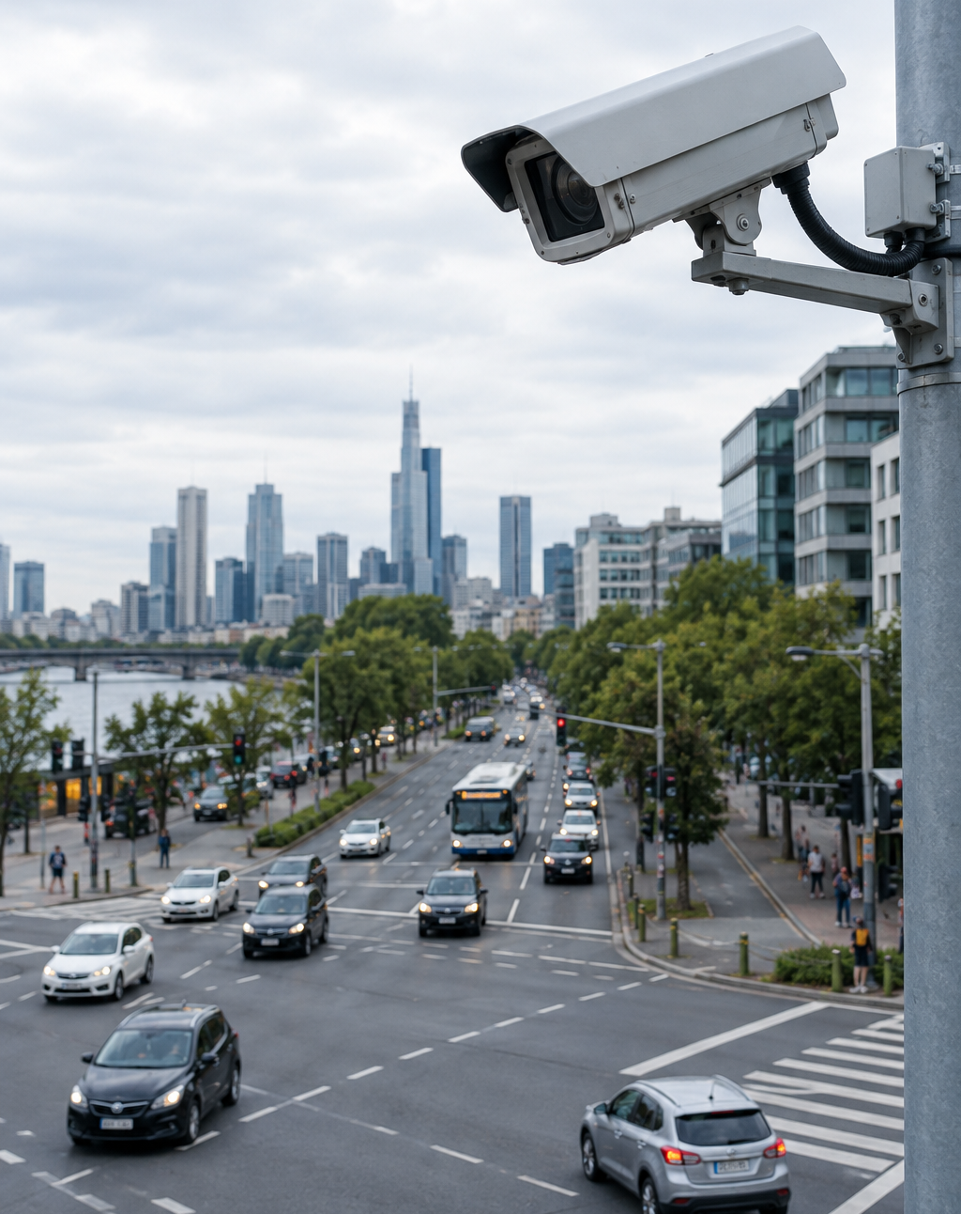
VISTA
Background & Domain
A junction camera shows traffic, but hours of video need manual review.
The useful record answers three questions:
FLOW
How many vehicles passed each way?
WAITING
How many are visibly stopped?
TIME
When does waiting persist?
Illustrative camera view
SRM University Delhi-NCR, Sonepat
02
Notes:
The user is a traffic analyst reviewing one fixed junction camera. The pain is having to inspect long recordings to learn which approach carries traffic and when visible vehicles stay stopped.
Flow means tracked line-crossing events by direction. Waiting means the count of low-motion vehicles inside a marked approach area and the time they remain visible there.
A visible stopped-vehicle count is a camera-view proxy. It is not the physical queue length beyond the camera view or the total intersection delay.
The traffic camera image is AI-generated illustration, not project data.

Slide 3
VISTA
Literature & Review
SOURCE
EXISTING METHOD
LIMITATION FOR THIS PROJECT
Sodegaonkar & Khan [1]
IRJET, 2026
YOLOv8 and BoT-SORT track vehicles in video.
No measured crossing counts or approach waiting history.
Alims-Repo [2]
GitHub
Traffic app with YOLO counts and forecasting.
Frame counts and synthetic forecasts; no measured waiting time.
pratheeshkumar99 [3]
GitHub
YOLOv8 classifies lane traffic from visible boxes.
Fixed Heavy/Smooth threshold; no tracked waiting duration.
SRM University Delhi-NCR, Sonepat
03
Notes:
[1] P. Sodegaonkar and R. A. Khan, 'Real-Time Vehicle Detection and Tracking Using YOLOv8 and BoT-SORT for Traffic Surveillance,' IRJET, vol. 13, no. 4, pp. 1151-1156, Apr. 2026. https://www.irjet.net/archives/V13/i4/IRJET-V13I04173.pdf
The paper reports 13.14 average visible vehicles per frame and 6.96 processing FPS, but does not present manually labeled directional crossing counts or a record of per-approach waiting.
[2] Alims-Repo, 'Smart Traffic Management System,' GitHub, https://github.com/Alims-Repo/Smart-Traffic-Management-System . The inspected Python detector reports visible boxes each frame. Its forecasting data generator uses synthetic count sequences.
[3] pratheeshkumar99, 'Real-Time Vehicle Detection and Traffic Flow Classification System,' GitHub, https://github.com/pratheeshkumar99/Real-Time-Vehicle-Detection-and-Traffic-Flow-Classification-System- . Its runtime script resets counts each frame and applies a fixed x-coordinate lane split with a threshold of 10 boxes.
The proposed project builds on existing detection and tracking methods. Its contribution is a configurable junction record of crossings and visible waiting, with evaluation against manual annotations.

Slide 4
VISTA
Problem Identification
A busy approach can stay backed up for long periods.
CCTV alone gives no searchable record of when it happens.
01
Manual review cannot cover every hour of footage.
02
A frame count misses how long vehicles remain stopped.
03
A fixed Heavy/Smooth threshold changes with camera view.
SRM University Delhi-NCR, Sonepat
04
Notes:
The concrete problem is missing operational history at a junction monitored only by fixed-camera video: how many vehicles pass each direction, which approach has visible stopped vehicles, and when waiting persists.
A detector returns boxes in each frame. One frame cannot show how long a vehicle has waited, and summing boxes cannot yield unique crossings.
A Heavy/Smooth label based on a fixed number of visible boxes depends on camera framing. VISTA will save approach zones and lines per camera.
A red signal can cause ordinary waiting. VISTA will report visible waiting patterns for review rather than assert the cause of every stop. FHWA discusses queues and delay as separate measures: https://ops.fhwa.dot.gov/publications/fhwahop08024/chapter3.htm

Slide 5
VISTA
Project Planning
COMPLETED FOR PHASE 2
NEXT MILESTONES
Source review
01
Select and label junction footage
One paper and two codebases examined
Rule engine
02
Calibrate the line, zone and stop threshold
10 tests pass on tracked-coordinate cases
Video prototype
03
Measure crossing and stop accuracy
377 sample frames processed; 2 crossings logged
PROTOTYPE DEMO
YOLOv8n + BoT-SORT → annotated video, SQLite, CSV, dashboard
Sample output is not a validated traffic count; junction footage is next.
SRM University Delhi-NCR, Sonepat
05
Notes:
This is the verified Phase 2 status as of the prototype run. Reference review, event rules and a local video pipeline are complete.
The event rules are in phase2_prototype/vista_events.py; ten unittest cases pass. The included Intel sample video was processed end to end with YOLOv8n and BoT-SORT: 377 frames, 30.16 seconds, two logged crossing events and no visible stop events. These are software outputs, not manually verified counts or accuracy measures.
The pipeline writes an annotated MP4, SQLite database, CSV, JSON and offline HTML dashboard. The sample is an overhead road clip, not a fixed signalized junction. YOLOv8n loses some overhead detections, so junction-specific footage and manual labels are required before accuracy claims.
Suggested review demonstration: open phase2_prototype/runs/intel_demo/dashboard.html, play the annotated clip, show events.csv, then run 'python3 -m unittest -v' from phase2_prototype. Explain that stopped-vehicle logic was tested on scripted/noisy tracks while the sample video has no stop events.

Slide 6
VISTA
Methodology
UML ACTIVITY DIAGRAM
Read video
frame
YOLOv8n
detects vehicles
BoT-SORT
assigns IDs
Track ID?
NO
Next frame
For each frame
YES
Review dashboard
and exports
Save event +
timestamp
Apply line and
stop-zone rules
EVENT RULES
Line crossing → direction + time | Low motion in zone → visible stop
Output is a camera-view record; junction accuracy needs manual labels.
SRM University Delhi-NCR, Sonepat
06
Notes:
This is an editable UML-style activity diagram of the implemented per-frame pipeline. Follow the top row left to right: read a frame, detect vehicles, assign BoT-SORT IDs, then test whether a tracked ID exists. If not, move to the next frame. If yes, apply the event rules.
The crossing rule logs a stable side change over a configured line. The stop rule uses low motion over a one-second window inside a configured zone and requires at least two seconds of visible stillness. Thresholds depend on camera position and need calibration.
Generated records include a track ID, class, direction or stop duration, and video time. SQLite and CSV store event records; an annotated MP4 and offline HTML dashboard support review. No live traffic signal control is implemented.
The Intel sample clip was processed end to end. It is not a signalized junction; compare system output with manually labelled fixed-junction footage before reporting accuracy.
Technical reference for model tracking API: https://docs.ultralytics.com/modes/track/ .

Slide 7
VISTA
System Architecture & Algorithm
SYSTEM MODULES
RULE LOGIC IN THE PROTOTYPE
Vision worker
Crossing
OpenCV frames, YOLOv8n boxes, BoT-SORT IDs
Stable side changes across a 5 px line margin.
Count once per track and direction.
Event engine
Configured crossing line and stop-zone rules
Visible stop
Inside a marked zone, movement stays below
8 px/s for at least 2 s (1 s window).
Data and interface
SQLite, CSV and offline HTML dashboard
CURRENT STATUS
End-to-end sample run complete. Junction validation is next.
Sample clip is not a junction; thresholds need camera-specific calibration.
SRM University Delhi-NCR, Sonepat
07
Notes:
The architecture has three implemented parts. The video worker uses OpenCV, YOLOv8n and BoT-SORT. The event engine converts tracked bottom-center points to crossing and visible stop events. SQLite, CSV, JSON and an offline dashboard save and present the results.
For a line in the scripted demo, points beyond a 5-pixel dead band establish a stable side. A side change records one crossing per track and direction; a long tracking gap resets track state.
The current video configuration checks displacement over a one-second window and marks a visible stop after at least two seconds at or below eight image pixels per second inside the zone. This is a camera-view proxy, not physical speed or total queue length.
The Intel sample run processed 377 frames and produced two crossing events and no stop events. The sample is not a junction and the model misses some overhead vehicles, so there is no accuracy claim. Calibrate and manually label a suitable fixed-junction clip next.
Ten tests in phase2_prototype/test_vista_events.py cover direction, jitter, stationary and moving tracks, noisy boxes, tracking gaps and stale stopped counts.

Slide 8
VISTA
References
[1]
Sodegaonkar & Khan. Real-Time Vehicle Detection and Tracking Using YOLOv8 and BoT-SORT for Traffic Surveillance.
IRJET 13(4), pp. 1151-1156, Apr. 2026 · irjet.net
[2]
Alims-Repo. Smart Traffic Management System.
GitHub repository · github.com/Alims-Repo/Smart-Traffic-Management-System
[3]
pratheeshkumar99. Real-Time Vehicle Detection and Traffic Flow Classification System.
GitHub repository · github.com/pratheeshkumar99
[4]
Federal Highway Administration. Traffic Signal Timing Manual, Chapter 3.
Traffic performance measures · ops.fhwa.dot.gov
[5]
Ultralytics. Multi-Object Tracking and Object Counting guides.
Technical documentation · docs.ultralytics.com
SRM University Delhi-NCR, Sonepat
08
Notes:
[1] https://www.irjet.net/archives/V13/i4/IRJET-V13I04173.pdf
[2] https://github.com/Alims-Repo/Smart-Traffic-Management-System
[3] https://github.com/pratheeshkumar99/Real-Time-Vehicle-Detection-and-Traffic-Flow-Classification-System-
[4] https://ops.fhwa.dot.gov/publications/fhwahop08024/chapter3.htm
[5] https://docs.ultralytics.com/modes/track/ and https://docs.ultralytics.com/guides/object-counting/
Online sources accessed 26 Sep. 2026.
The two GitHub repositories are implementation references, not peer-reviewed papers. They were inspected as examples of existing systems and practical limitations.

