Slide 1
Dropzone HQ
By Paul Bayruns, Jatin Bhakta, Andres Blotta, Brian Krick, Jon Spratt, Paul Turner

Slide 2
Concept and Motive
Burble Dropzone Management System - Covers Manifest and Customer Info
Paper / Whiteboard record keeping across the back end of the business
Back end website for the dropzone for record keeping

Slide 3
Technical Terms
AAD: Small device that deploys a parachute at a certain altitude if it hasn’t been already.
Container: The part of the system that the skydiver wears.
Canopy: The conventional idea of what is known as a "parachute."
Main Canopy: The main canopy is the first one that is deployed.
Reserve Canopy: The reserve canopy is the backup canopy used in cases of the main canopy malfunctioning.
Rig: A Rig is the combination of all of the above.
Load: Each time the plane takes off with a group of skydivers.

Slide 4
Technologies
Front End
ReactJS - A javascript library made by Facebook.
Back End
Django - Backend framework and object relational model built to power complex data-driven websites.
MySQL - Familiarity, compatibility with Django.
Amazon Web Services (AWS) - Hosting

Slide 5
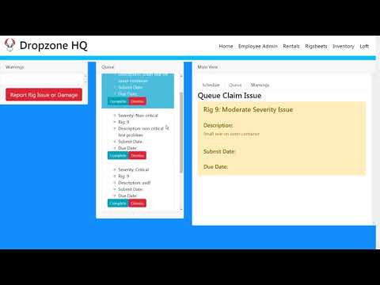
Video Overview
https://www.youtube.com/watch?v=RyRn7iHOCAY&feature=youtu.be

Slide 6
Database Design
Two main discussions on database design include:
Use of a simple table vs. enumerated field:
Case by case basis.
Adding or removing from the field? Simple table. For example, item types.
Constant set of values that never change? Enumerated field. Claim types is one example. Our choices were critical, non-critical, and cosmetic. Not likely to change.
Two 1-to-many relationships vs. One many-to-many relationship with a bridging table:
Primarily seen in our model of employees to sign-outs.
2 employees are involved in each sign-out. Who signed the rig out and who repacked the rig after the jump?
We chose a many-to-many relationship. Possibility of another association with a sign-out. I.e. who inspected the repack?
Two 1-to-many relationships relies on the constancy of roles associated and focuses more on the role of the employee instead of who is “touched” the rig.

Slide 7
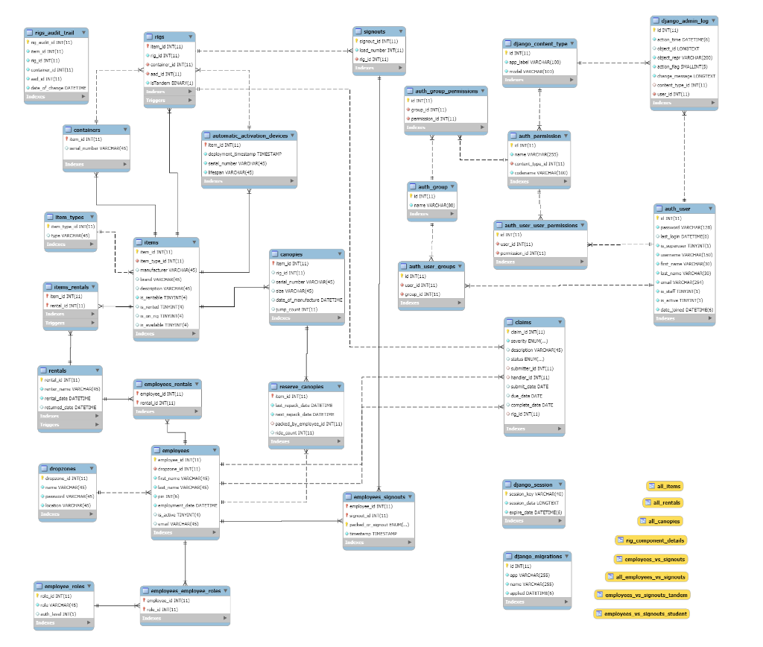

Slide 8
Frontend Difficulties and Solutions
Difficulty: The application required a complex flow of data between components.
Solution: Use generic modular components in React that help consolidate the passing of data to avoid writing dozens of callbacks.
Difficulty: Some areas required two components at the same level to change each others’ data.
Solution: Follow the pattern of having sibling components in a parent component that will manage both of their data and keep the data flow going from parent to child components (React’s overall design pattern)

Slide 9
Backend Difficulties and Solutions
Difficulty: Authentication using Django’s Built-in functionality does not couple well to the functionality of React. Ie : Serving the registration/login.html
Solution: Create several custom authentication views that handle the authentication of the user, this is possible to fix the errors associated with the React routing system and the Django routing system.
Difficulty: Creation of the MySQL Database in MySQL
Solution: Use the Django migrate functionality and write consistently in only Django for the relational models to couple well together

Slide 10
Authentication
Dropzone as User
Employee custom pin authentication upon necessary screen or action
After considerable conversation about the effects of the Authentication system there needs to be a rebuild of the system for Employee’s to be the User and Dropzone to be the database that they would connect to
Notes:
The initial strategy for the implementation of the authentication system was multitiered users that would require a nested login from employees, this system was implemented naively after the creation of the initial database and using dropzone as a proxy user. This implementation caused several errors when attempting to refactor the database or refactor the authentication system for the use of a User one-to-one. After consideration and discussion the use of Employee as the User and their authentication would have not only made the authentication easier but also allow for a single tiered login, with the associated permissions that the employee would have.

Slide 11
Two things we learned along the way
The ability to reuse components in ReactJS saved our team a significant amount of time in developing many screens. Managing updates is easy in ReactJS because all components are isolated and changing one doesn’t affect most others.
Django offers generic API views. Easy way to make different http requests and view responses. Shortens code drastically while also creating an easy way to override request methods like post, put, and patch.

Slide 12
Future Implications
Backend Revisit
Pitching to Burble
Selling as a product

Slide 13

Questions?

