Slide 1
Amazon E-Commerce Sales Dashboard
Task 3 – Data Analyst Internship
Created using Power BI
Dataset: Amazon_sales.xlsx
Name:- Jatin Bhandari

Slide 2
🎯 Project Objective
Design an interactive sales dashboard using Power BI to help business stakeholders track performance, sales trends, and order behavior, enabling data-driven decisions.

Slide 3
📌 Key Performance Indicators
- Total Sales Revenue
- Total Orders
- Cancelled Orders & Cancellation Rate
- Monthly Sales Trend
- Sales by Category
- Sales by State (Top 5)
- Fulfilment Channel Analysis

Slide 4
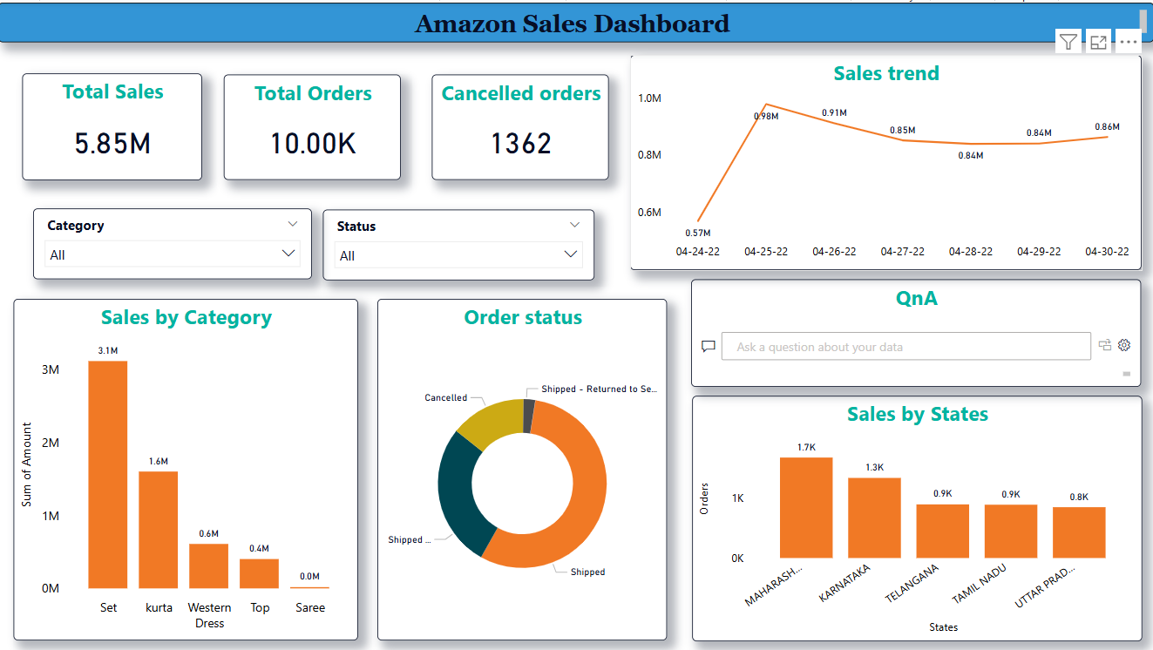
📊 Dashboard Overview
Screenshot of Power BI dashboard goes here.
(Include KPI cards, sales trend, bar charts, and slicers)

Slide 5
🔍 Insights & Observations
- Maharashtra and Karnataka are top revenue-generating states.
- Most sales occur through Amazon-fulfilled orders.
- Highest cancellations observed in 'Western Dress' category.
- April had a noticeable peak in sales volume.

Slide 6
🧩 Filters & Interactivity
- Dynamic slicers: Category, Sales Channel, Fulfilment Type
- Charts update automatically based on selected filters
- Enables deeper analysis and user-driven insights
- Also there is a QnA box which answer the other business inquire questions

Slide 7
📘 Conclusion
- Power BI enables powerful visual storytelling
- Sales trends and order behavior can be tracked in real-time
- Dashboard helps in making informed business decisions

