Slide 1

Introduction to the Admission Module in ERP System
The admission module in an ERP system simplifies and automates the entire student admission process, from applications to enrollment.

Slide 2

Student Registration and Enrollment
1
Streamlined Application
2
Efficient Enrollment
Students can easily apply online using a user-friendly interface, submit required documents, and track their application status.
The module manages student enrollment, course registration, and fee payments, ensuring a smooth transition to academic life.
3
Comprehensive Database
4
Automated Processes
The system maintains a central database, storing all student information, academic records, and admission details for easy access and reference.
The module automates tasks such as admission notifications, enrollment confirmation, and communication with students, saving time and effort.

Slide 3
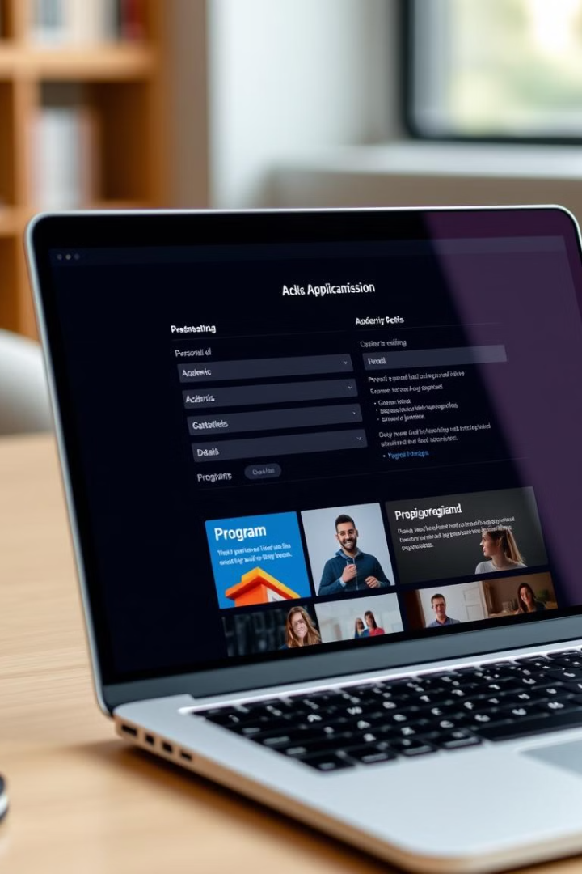
Application and Admission Process
1
Application Submission
Students can submit their applications online, uploading necessary documents like transcripts, recommendation letters, and essays.
2
Application Review
The module allows admissions officers to review applications, assess eligibility, and evaluate candidates based on predefined criteria.
3
Decision and Notification
Admissions decisions are made and communicated to applicants automatically through email or SMS, reducing manual efforts and delays.
4
Enrollment and Fee Payment
Successful applicants receive enrollment instructions and can proceed with fee payment online through secure payment gateways.

Slide 4
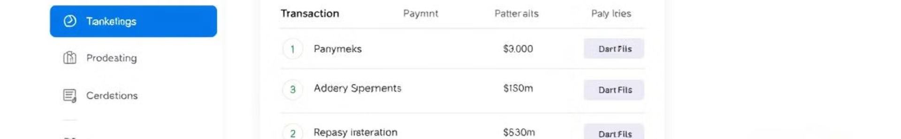
Fee Management and Payment
Fee Structure
The module defines and manages fee structures for different programs, courses, and student categories.
Payment Options
Students can choose from various secure payment methods, including credit cards, debit cards, online banking, and e-wallets.
Payment Tracking
The system records and tracks all fee payments, providing students with real-time updates on their payment status and outstanding balances.
Automated Reminders
The module sends automated reminders to students about upcoming fee deadlines, preventing late payments and ensuring timely financial management.

Slide 5
Reporting and Analytics
Real-time Insights
Data-Driven Decisions
Performance Tracking
The module provides real-time data and reports on application trends, enrollment statistics, fee payment patterns, and other crucial admission metrics.
The insights gained from analytics enable administrators to make informed decisions regarding admission policies, recruitment strategies, and program optimization.
The module tracks and analyzes admission performance, identifying strengths and weaknesses to improve the overall admission process and increase enrollment rates.

Slide 6
THANK YOU

