Slide 1

HOW TO RESOLVE A TICKET
Halo Service Desk
Ticket Resolution Guide

Slide 2
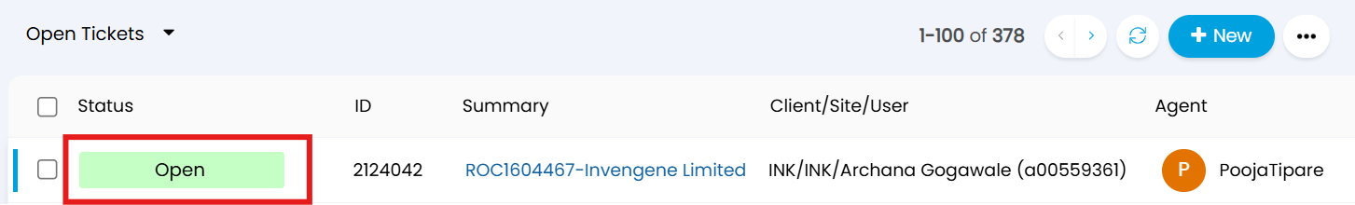
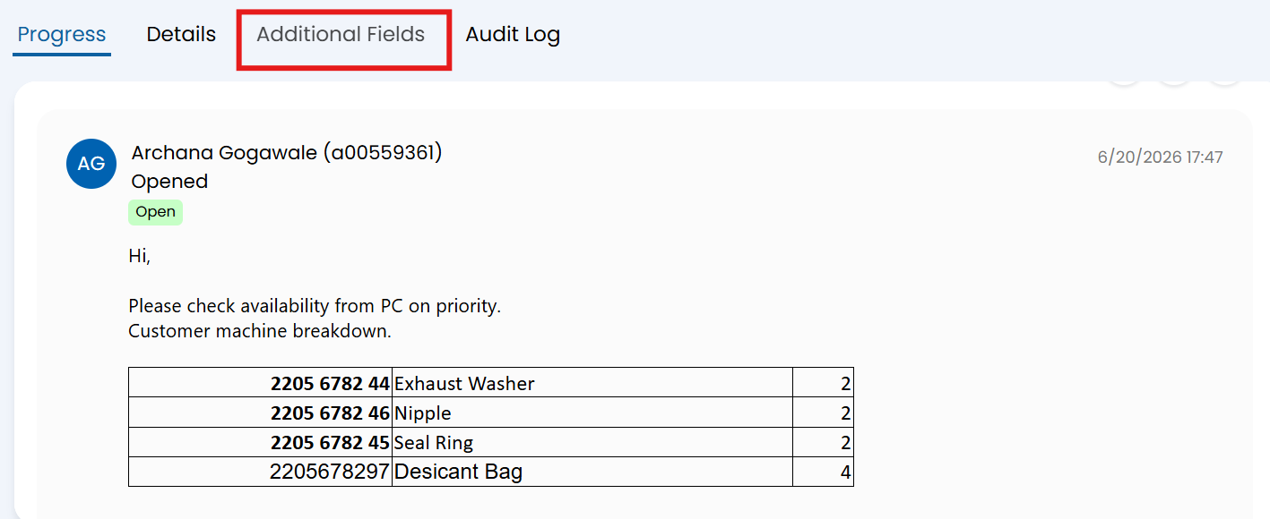
Process Overview
Halo Service Desk | Ticket Resolution Workflow
01
Open Ticket
Click the Ticket ID to open and review the request.
02
Read & Identify
Read the message and check the Subject in Additional Fields.

Slide 3
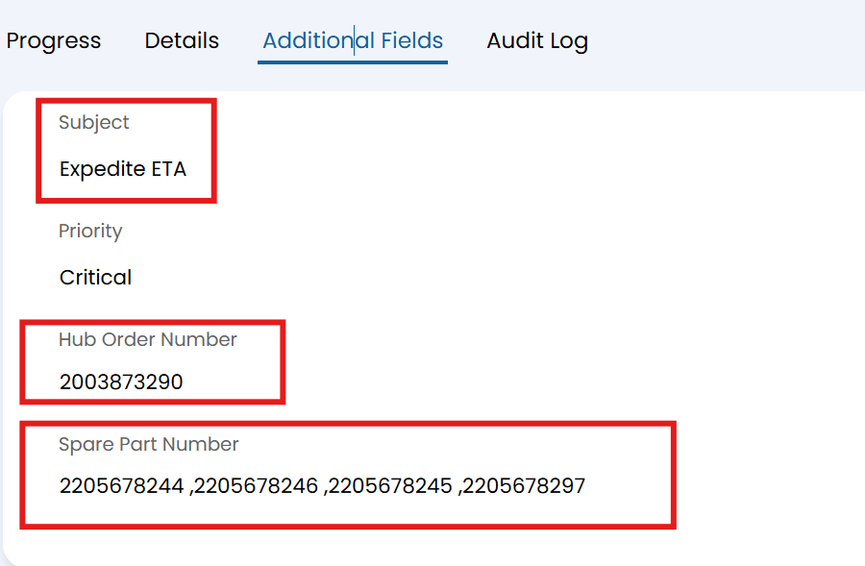
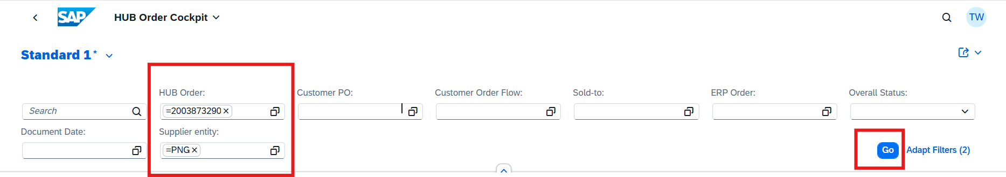
Process Overview
Halo Service Desk | Ticket Resolution Workflow
03
Key Details
Copy HUB Order No. and Material No. for reference.
04
HUB Order Cockpit
Enter Order No. and Supplier Entity, then click Go.

Slide 4
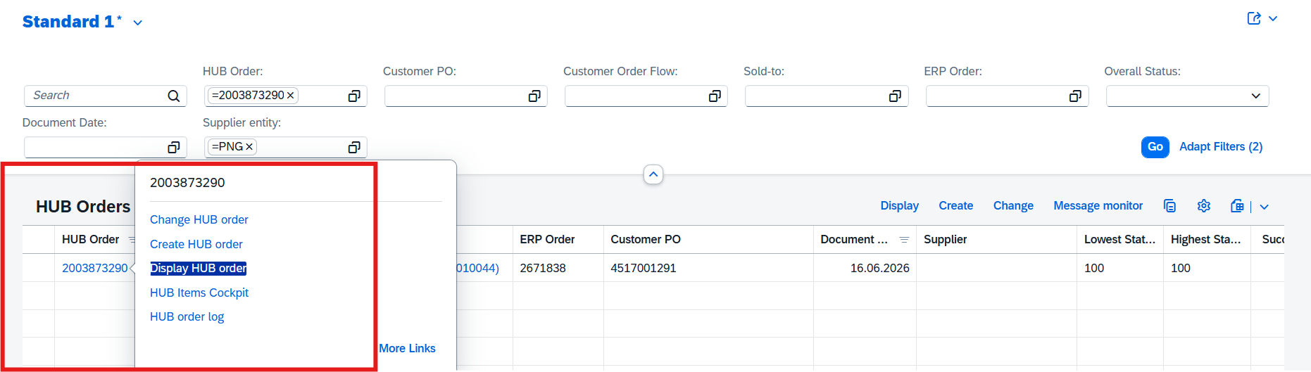
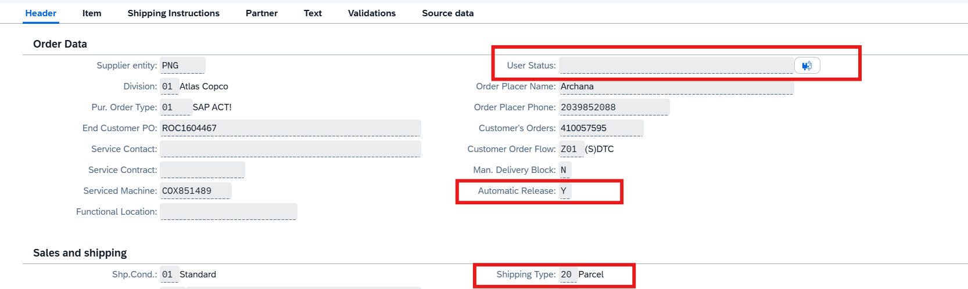
Process Overview
Halo Service Desk | Ticket Resolution Workflow
05
Display HUB Order
Right-click the HUB Order No. and select Display HUB Order.
06
Check Header Tab
Verify User Status blocks, Shipping Type, and Auto OBD release block.

Slide 5
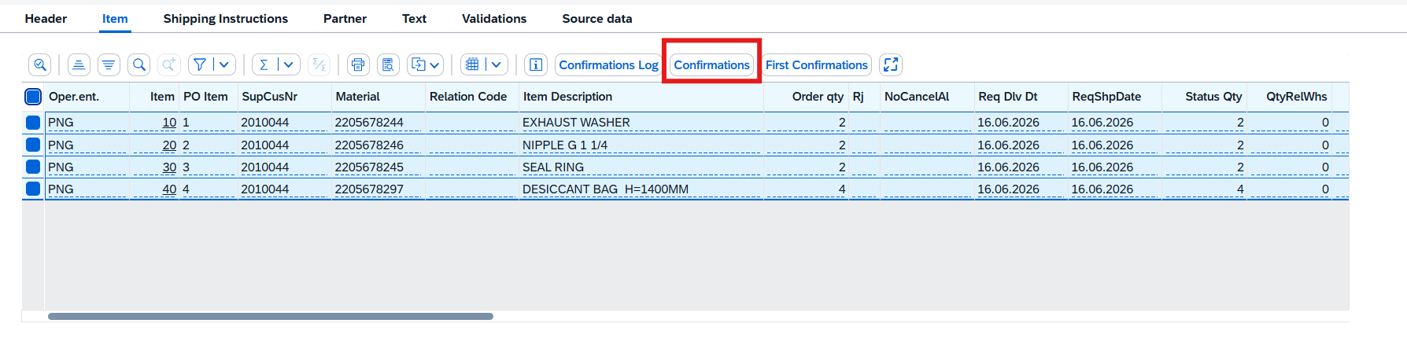
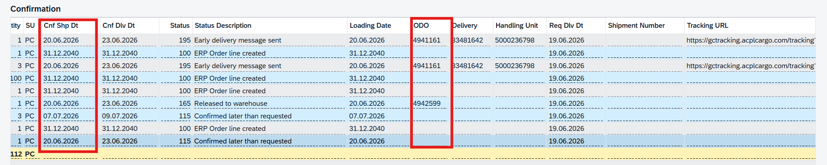
Process Overview
Halo Service Desk | Ticket Resolution Workflow
07
Check Item HUB
Select Material with Status 100 and 115.
08
Delivery date Or OBD no. View
Click on Confirmation for Delivery Date view, Raise a Child ticket if date is mentioned as 31.12.20240 .

Slide 6
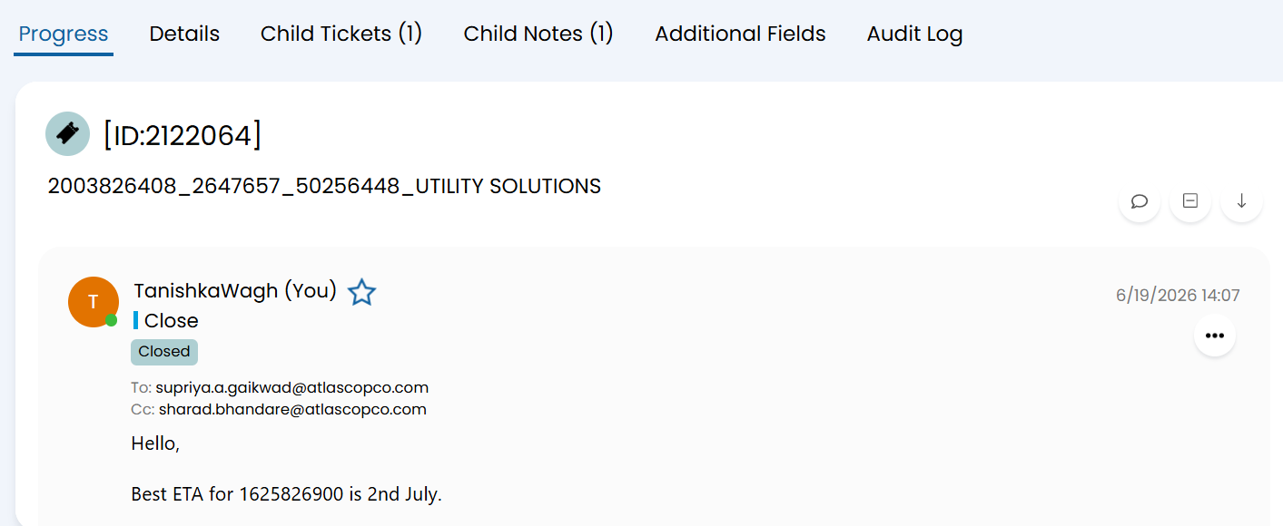
Process Overview
Halo Service Desk | Ticket Resolution Workflow
09
Revert on Main Ticket
Click the Ticket ID to open and review the request.

Slide 7






Step-by-Step: Opening & Verifying a Ticket
1. Open the Ticket
2. Read & Identify
Click on the Ticket ID to open the ticket and access its full details.
Read the customer's message carefully, then navigate to Additional Fields to review the Subject.
3. Key Information
4. Enter Details in HUB Order Cockpit
Copy the HUB Order Number and Material Number for use in the next steps.
Input the HUB Order Number and Supplier Entity in the HUB Order Cockpit, then click Go.
5. Display HUB Order
6. Check Header Tab
Right-click the HUB Order Number and select "Display HUB Order" from the context menu.
Verify that no blocks appear in the User Status. Ensure Shipping Type is set for Auto OBD Release is marked as 'Y'.

Slide 8





Handling Delivery Date Tickets
Follow the steps below based on the delivery date scenario
Step 1: Select Materials Below Status 115
Select all materials with a status below 115 (including status 100) and click on Confirmations to proceed.
Step 2: Date 31.12.2040 — Raise Child Ticket
If the delivery date year shows 31.12.2040, raise a child ticket to the Planner to obtain a confirmed delivery date.
Step 3: Identify Planner via MD04
To raise a child ticket, check the assigned Planner using the MD04 tile in SAP.
Step 4: Purchase Group 100/500 (Non-Kit)
If the Purchase Group is 100 or 500 and the item is not a kit, raise a child ticket to the Sourcing Team for Vendor Mapping.
Step 5: Date Confirmed — Reply on Main Ticket
If a valid delivery date is available, reply directly on the main ticket with the confirmed date.

Slide 9
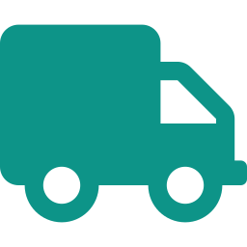


ETA Tickets & Special Cases
Quick reference for ETA handling, AOQ errors, and stock reallocation
ETA Ticket Handling
AOQ Error
Reassign the ticket to Omkar Phansalkar for resolution.
• Within 2 days:
Reply on the main ticket with the ETA date.
• More than 2 days away:
Raise a child ticket to the Planner to confirm the earliest possible new date.
Stock Reallocation
Contact Pooja Tipare for assistance with stock reallocation requests.
📌 Key Reminder
Always verify that the Shipping Date is set and Auto OBD Release is marked as 'Y' before processing any ticket. This ensures smooth automatic Out Bound Delivery (OBD) release and avoids processing delays.

Slide 10


Additional Ticket Scenarios
Other common cases and the correct action to take
Material Not Live in System
Lead Time & Certificate Requests
• If a material is not yet active or visible in the system, do not attempt to process it manually.
• For any ticket related to Lead Time queries or Certificate requests, do not attempt to resolve these independently.
• Raise a child ticket to the Master Data Team to have the material activated or corrected in the system.
• Raise a dedicated ticket to the Planner, who is responsible for providing accurate lead time information and issuing the required certificates.
• Reply on the main ticket once the Master Data Team has confirmed the update.
• Ensure all relevant order details are included in the ticket raised to the Planner.

Slide 11




Handling Order Cancellation Requests
Check status carefully before taking any action
1. Check Order Status in HUB
2. Status > 165? (OBD Released — Cannot Cancel)
Open the order in HUB and check its current status. This is the first and most critical step before any action.
If the status is above 165, the Order-Based Delivery (OBD) has already been released. Inform the Customer Center that cancellation is not possible.
3. CC Insisting? Escalate to Omkar Phansalkar
4. Status ≤ 165 — Raise Child Ticket to Planner
If the Customer Center is strongly insisting on cancellation despite the status, do not act alone — discuss the matter with Omkar Phansalkar before taking any further steps.
If the status is 165 or below, raise a child ticket to the Planner to confirm whether cancellation is acceptable.
5. Planner Approves — Cancel the Order in HUB
6. Planner Declines — Reply on Main Ticket
If the Planner confirms that cancellation is acceptable, proceed to cancel the order in HUB and update the main ticket accordingly.
If the Planner does not approve, do not cancel. Reply on the main ticket informing the Customer Center that cancellation cannot be processed at this time.

Slide 12
THANK YOU

