Slide 1


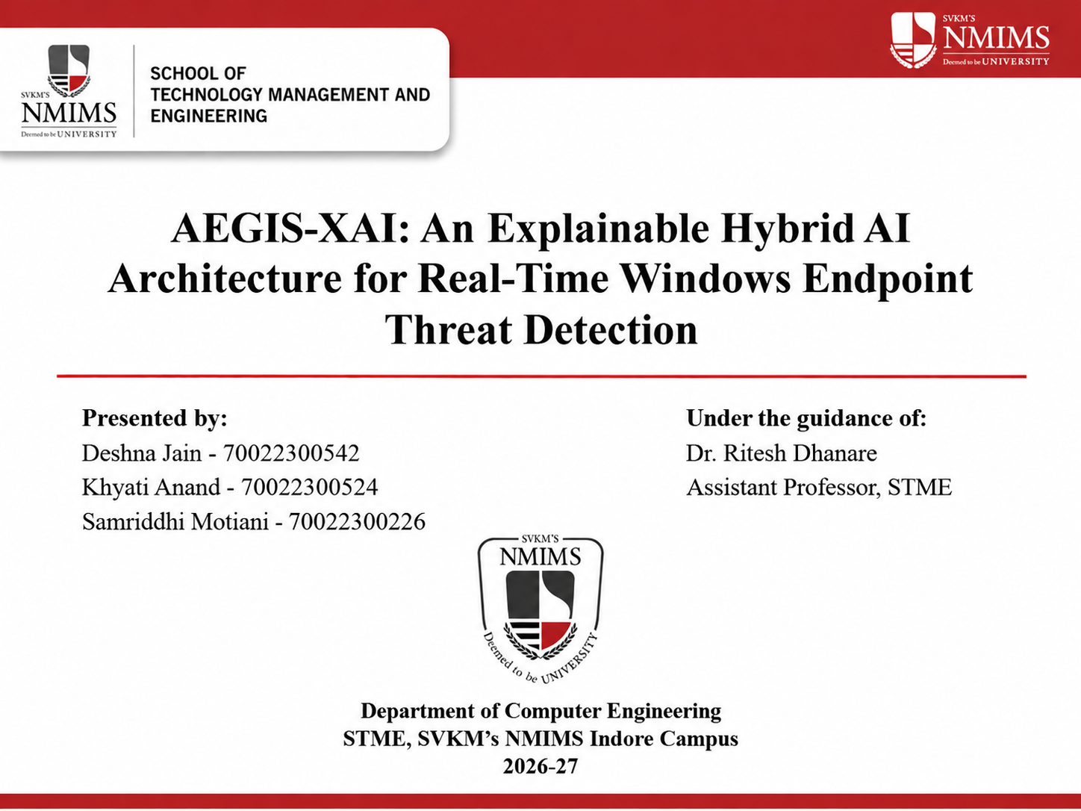
SecureKYC AI: Active Challenge-Response Biometric Verification for Video KYC via Speech Aerodynamics and Trellis Forced Alignment
Presented by:
Jatin Dhawad - 70022400652
Param Rawal - 70022300480
Under the guidance of:
Dr. Abhinav Pathak
Assistant Professor, STME
Department of Computer Engineering
STME, SVKM's NMIMS Indore Campus
Capstone Project (Group G34) | 2026-27
Notes:
Introduce the team and guide. One line on the project: SecureKYC AI asks a Video KYC applicant to speak a random phrase and checks whether the lips physically seal on /m/, /b/, /p/ - a cue that real-time face-swap puppeteering often fails to reproduce.

Slide 2
Outline
Sr | Section | What this presentation covers | Slides
1 | Introduction and Literature Review | Why Video KYC needs active liveness; 24 cited works; research gap | 3 - 4
2 | Problem Statement and Objectives | Formal problem, purpose and the five project objectives | 5
3 | System Design and Live Console | Challenge-response pipeline, D_lip, trellis alignment, late fusion, FastAPI console | 6 - 10
4 | Implementation | Identity-disjoint dataset (691 clips, 43 identities) and experimental setup | 11
5 | Results and Analysis | Held-out test metrics, model comparison, fusion ablation, robustness and negative results | 12 - 15
6 | Attainment of Objectives | Objective-by-objective evidence and status | 16
7 | Publication | Paper submitted to IC4'27 (under review) | 17
8 | Limitations, Future Scope, Conclusion | Honest limitations, next steps and key takeaways | 18 - 19
9 | References | 24 cited research works | 20
Notes:
Roadmap: motivation and related work first, then the method and live console, then results (including negative results), objective attainment, publication status, limits and conclusion.

Slide 3
Introduction
Background
Challenges
Remote Video KYC lets banks onboard customers over a webcam, and it is now a common route for account opening.
Real-time generative face reenactment (for example DeepFaceLive) can drive a victim's face from a live puppeteer.
The attacker can inject the synthetic stream as a virtual camera, so the verifier sees clean frames with no glare or moire artefacts.
Passive detectors rely on artefacts and signals that better generators can remove.
Active defences such as GOTCHA use gestures and ignore the audio and the physics of speech.
Transcription-based audio-visual methods depend on open-vocabulary speech recognition errors, and a live puppeteer defeats legacy passive checks (ISO/IEC 30107-3).
SecureKYC AI: a short spoken bilabial challenge, aligned by a trellis, with a physical lip-seal test and constrained late fusion
Sources: [1], [3], [9], [11], [17]-[19]
Notes:
Viva: Why not just use a passive deepfake detector? Because in a live injection attack the verifier controls nothing - the attacker supplies clean frames. An active challenge lets the verifier ask for something physical.

Slide 4
Literature Review and Research Gap
Study | Contribution | Limitation
GOTCHA [9] | Active visual challenges (occlusion, movement); 80.1% automated AUC | Visual only; multi-gesture cascade; ignores audio
Agarwal et al. [11] | Phoneme-viseme mismatch on bilabials in recorded speech | Offline; open-domain transcription
LipFD [14] / PIA [15] | Audio-visual lip inconsistency; phoneme-temporal and identity dynamics | Learned features or transcription; no physical seal test
BioLip [16] / Haliassos [13] | Biomechanical lip jitter; mouth-region forgery cues | Not tied to forced alignment of a known prompt
Face X-ray [10] / FakeCatcher [6] | Blending boundary; biological signals | Passive; weak under direct injection
Biometric works [22]-[24] | Multimodal and continuous biometric authentication, expression recognition | Not an active speech-based liveness challenge
Research Gap: No surveyed work combines a verifier-issued spoken challenge, deterministic forced alignment to that known text, and a direct test of whether the lips physically sealed. SecureKYC AI fills this gap with a 3D aperture metric, a cross-modal desynchronization score and constrained late fusion.
Sources: [1]-[24]
Notes:
Viva: closest works are GOTCHA (active but gesture-based, visual only) and Agarwal et al. (bilabials, but offline and transcribed). We combine an active spoken challenge with forced alignment and a physical closure threshold.

Slide 5
Problem Statement and Objectives
Problem Statement
Project Objectives
Remote Video KYC is exposed to real-time face reenactment and virtual-camera injection that pass passive liveness checks.
Existing active defences are gesture-based and visual only; audio-visual lip detectors depend on transcription or learned features.
No surveyed system tests the physical lip seal that bilabial speech requires, at known times given by a verifier-issued phrase.
Ground liveness in speech aerodynamics: the lip seal needed for /m/, /b/, /p/.
Locate bilabial intervals by forced alignment against the known prompt, not blind ASR.
Build a scale-invariant 3D lip aperture metric and a cross-modal desynchronization score.
Combine a visual branch and a desynchronization branch with a stable late-fusion model.
Measure accuracy, error rates and latency honestly, and report negative results.
Sources: [1], [9], [11], [14]-[16], [19]-[21]
Notes:
State the problem once, then read the five objectives. Objective 5 (honest measurement) matters: this is a prototype with limited accuracy and we report that.

Slide 6
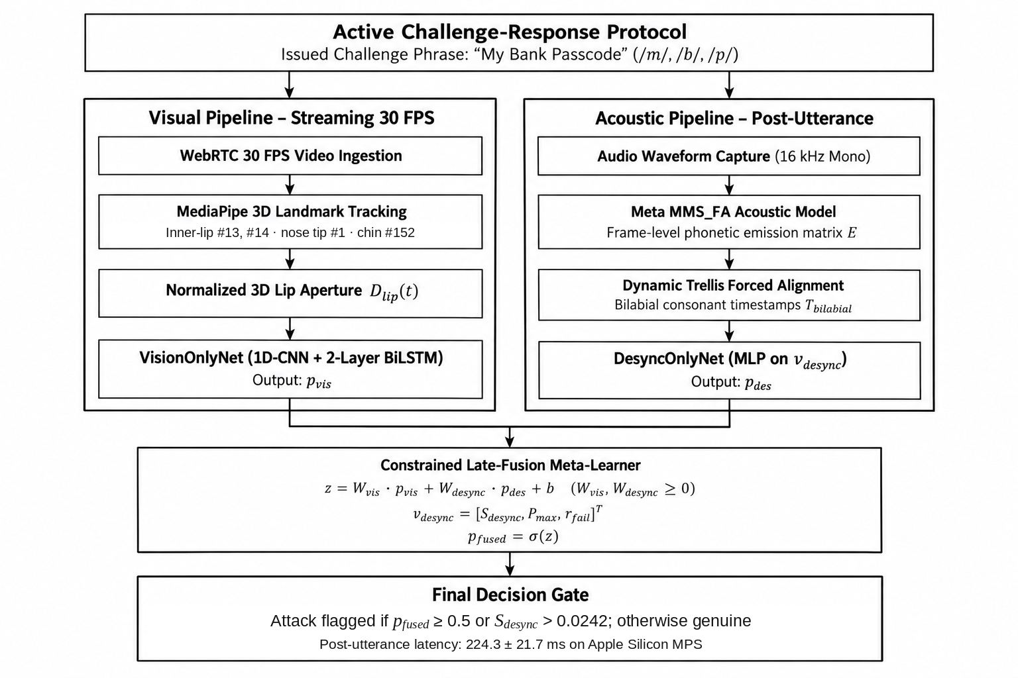
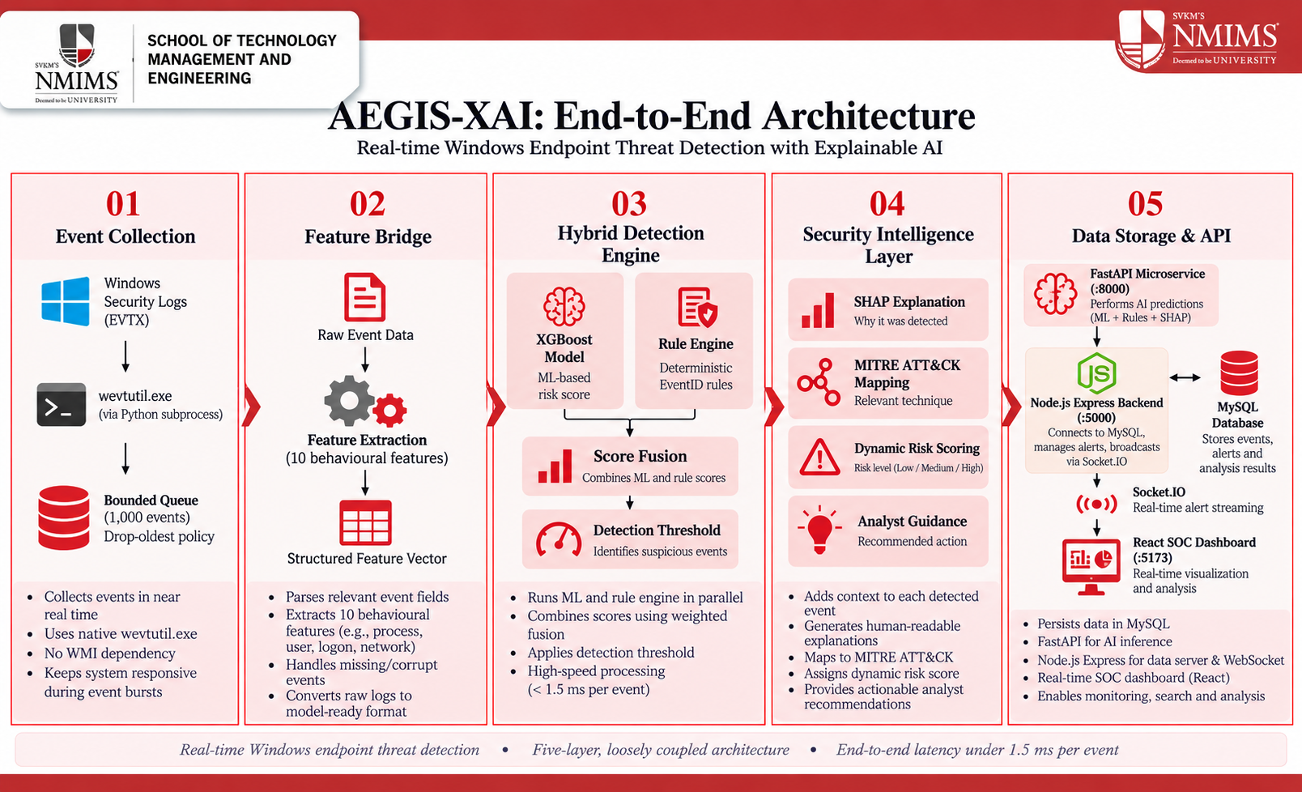
System Architecture: Active Challenge-Response Pipeline
Notes:
Walk the diagram top-down: the server issues a phrase; a visual stream tracks 3D lip aperture at 30 FPS; after the utterance an audio stream runs MMS_FA trellis alignment to find bilabial times; two base models are fused by a non-negative meta-learner; the final gate flags an attack if fused >= 0.5 OR S_desync > 0.0242.

Slide 7
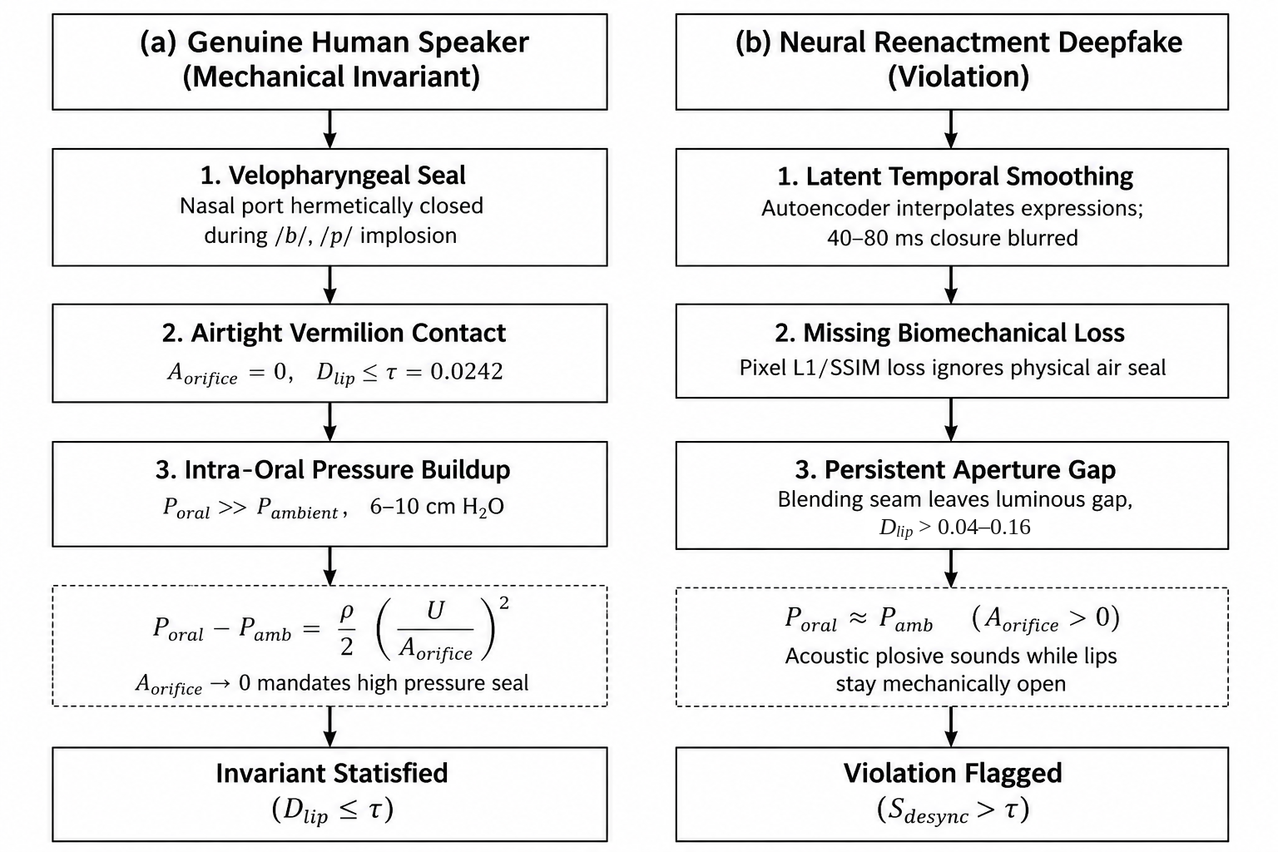
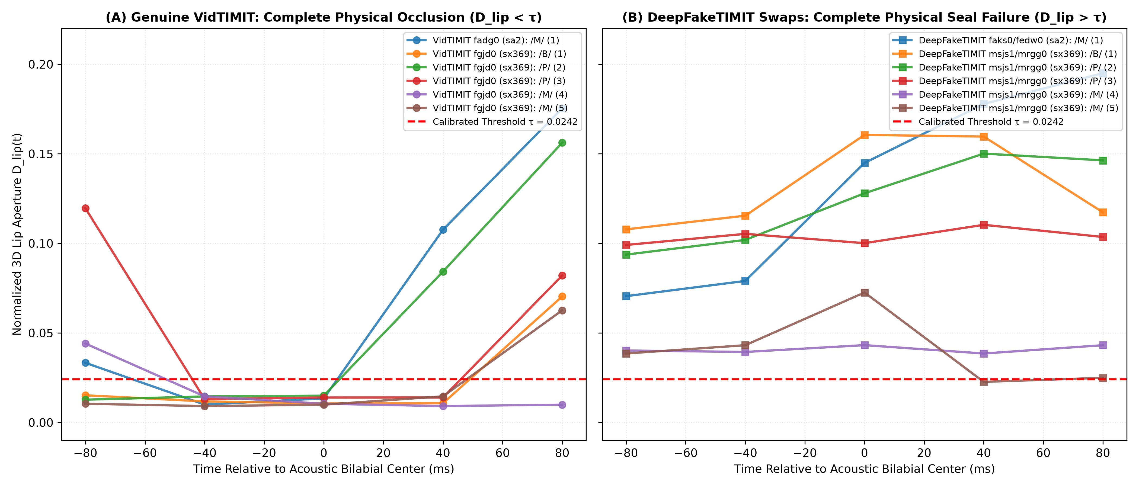
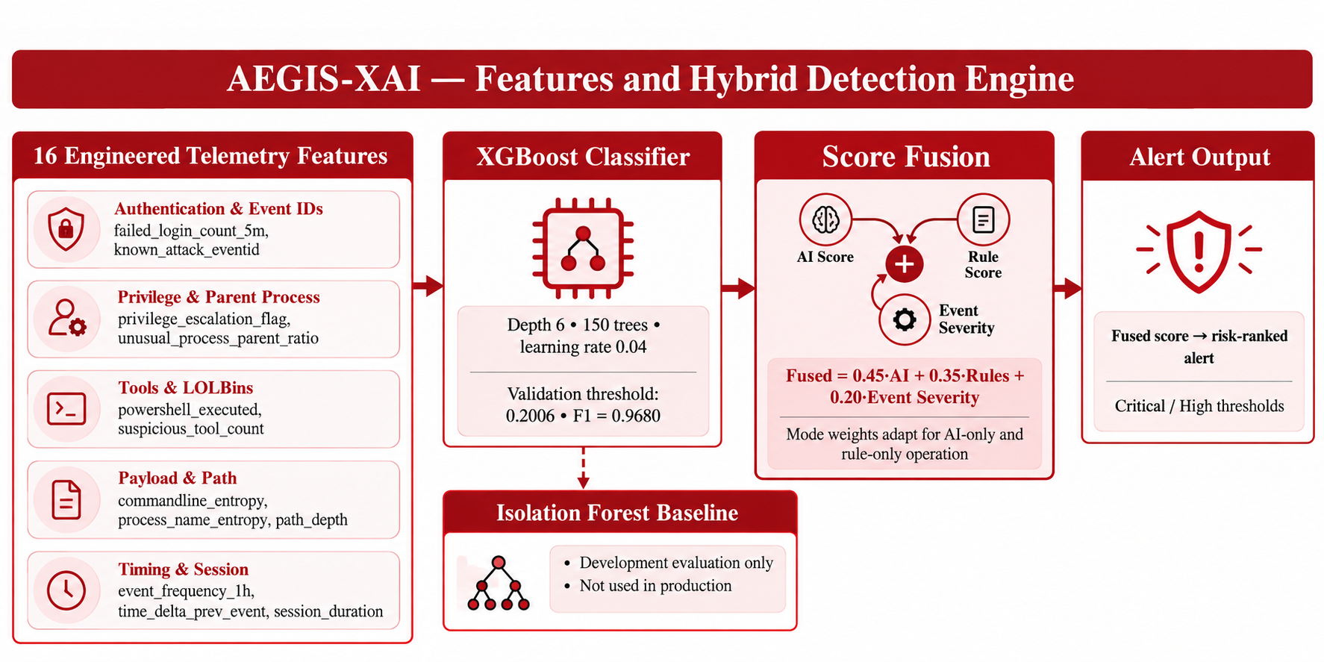
Method: Closure Test and Alignment
Physical Invariant
Closure Metric and Alignment
D_lip = ||p13 - p14|| / ||p1 - p152||, a 3D scale-invariant aperture (MediaPipe Face Mesh).
Seal test: D_lip <= tau = 0.0242 (95th percentile of 320 genuine events).
Alignment: MMS_FA trellis on the known phrase; window = bilabial centre +/- 2 frames (80 ms).
Desync: v = [S_desync, P_max, r_fail] feeds DesyncOnlyNet.
Genuine speech needs an airtight seal (P_oral >> P_ambient) on /m/, /b/, /p/.
Reenacted faces often leave a persistent aperture gap during these sounds.
Notes:
Viva: why bilabials? /m/ /b/ /p/ cannot be produced without lip contact, so a genuine speaker must close the lips at the times the audio says. tau is the 95th percentile of normalised aperture over 320 genuine events from 15 speakers (two of whom overlap with the test set - a stated limitation).

Slide 8
Decision Logic, Fusion and Prompt Gate
Component | Specification | Value
Visual branch | VisionOnlyNet: 1D-CNN + 2-layer BiLSTM on D_lip(t) | Output P_vis
Desync branch | DesyncOnlyNet: MLP on [S_desync, P_max, r_fail] | Output P_desync
Late fusion | z = 5.3688 P_vis + 4.9111 P_desync - 6.0411 (weights >= 0) | P_fused = sigmoid(z)
Decision rule | Attack if P_fused >= 0.5 OR S_desync > 0.0242 | Deployed in app/main.py
Prompt gate | CER between decoded and issued phrase > 0.60 -> reject | 0 / 1,675 mismatches accepted
Constrained Late Fusion
Prompt Gate and Latency
Branches are trained independently and fused by an L2-regularised meta-learner.
Non-negative weights stop sign inversion: unconstrained fold 1 gave W_vis = -0.0111 and AUC 0.4613.
Early fusion failed (AUC 0.6423 vs 0.7105) because S_desync ~ 1e-2 while r_fail ~ 1.
Gate rejects clips whose speech does not match the challenge; 15.2% of genuine clips (51/335) are also rejected.
Streaming tracking: 5.02 +/- 0.12 ms per frame (14.05 ms first call).
Post-utterance decision: 224.3 +/- 21.7 ms (local client, Apple Silicon MPS).
Sources: [19]-[21]
Notes:
Viva: why late fusion? Early concatenation let the large-scale r_fail feature starve the small-scale S_desync feature; training each branch separately and learning only 3 meta parameters removes that interference. The CER gate is a heuristic (0.60, midpoint of a 15-clip sweep), not a validated security boundary.

Slide 9
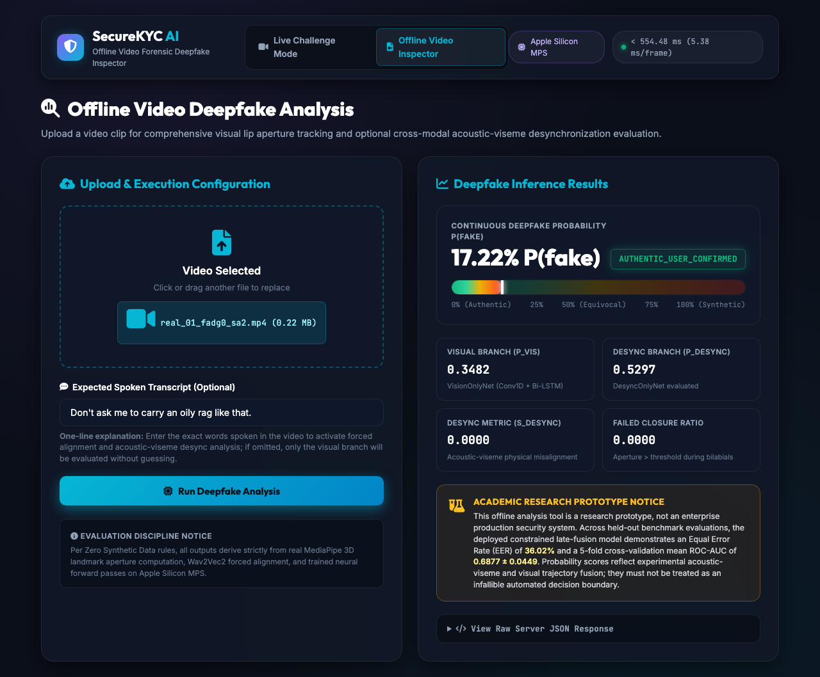
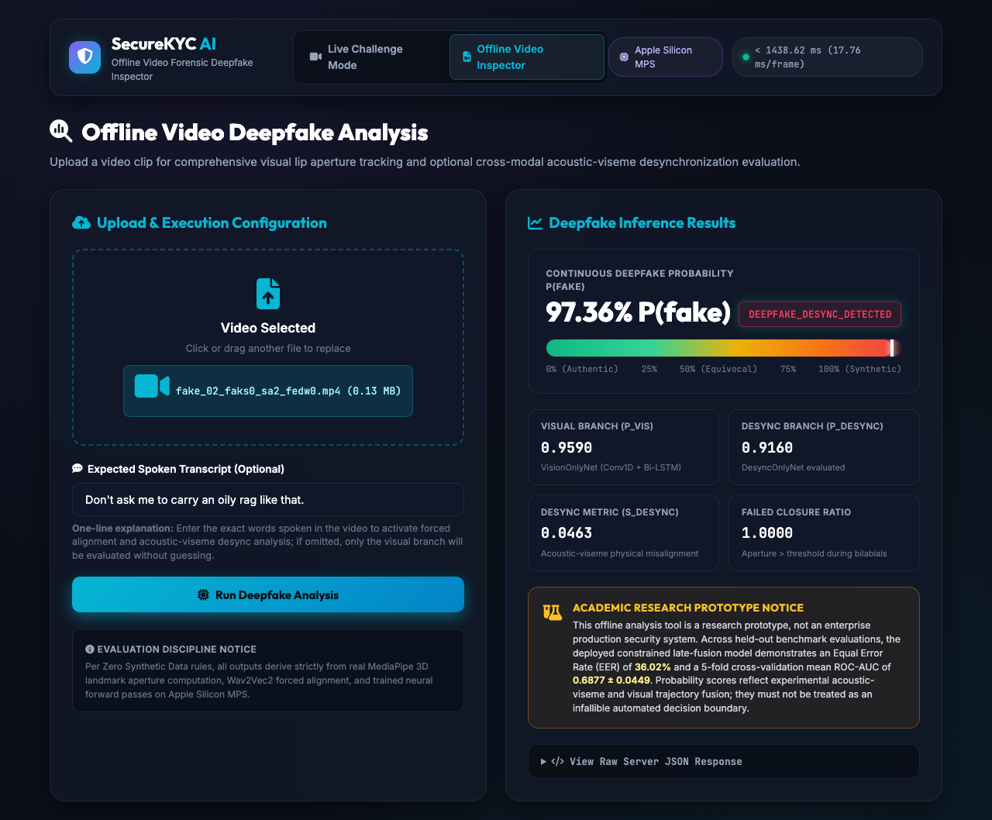
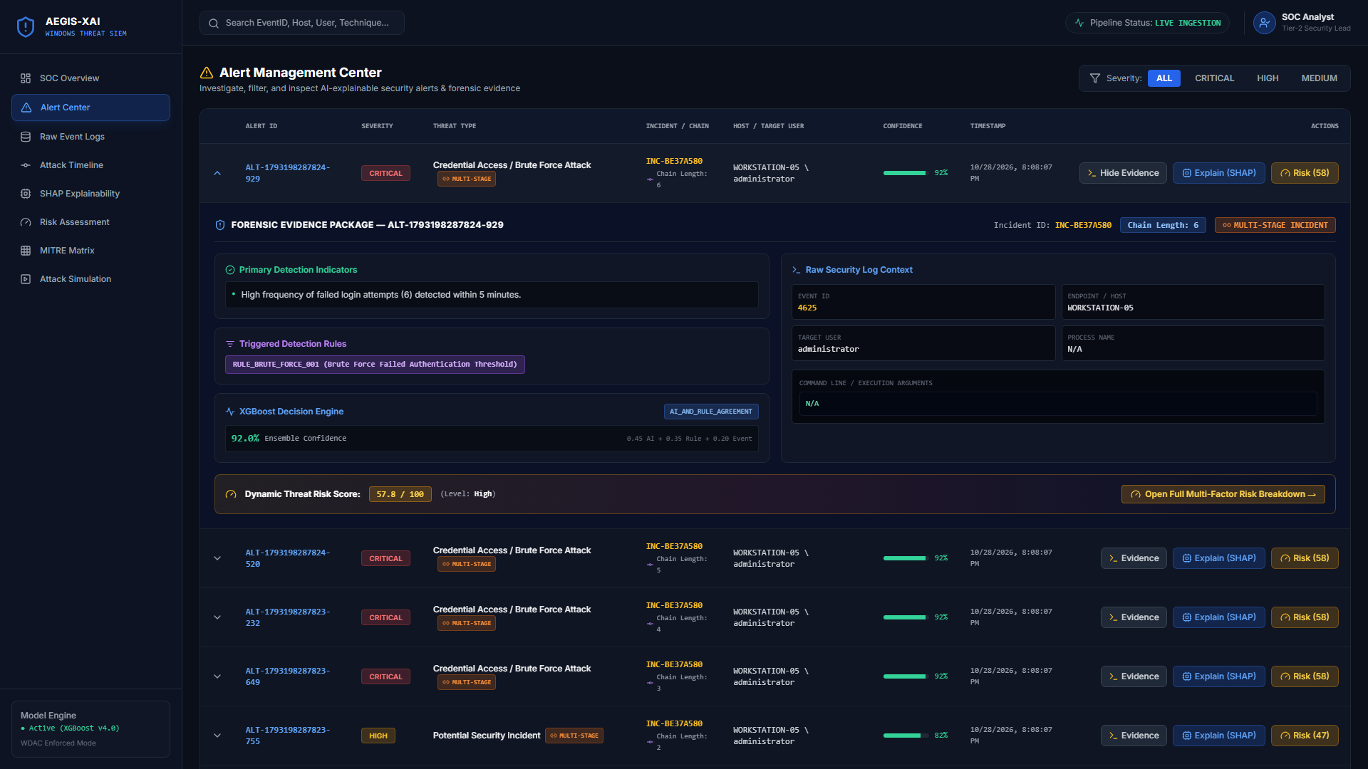
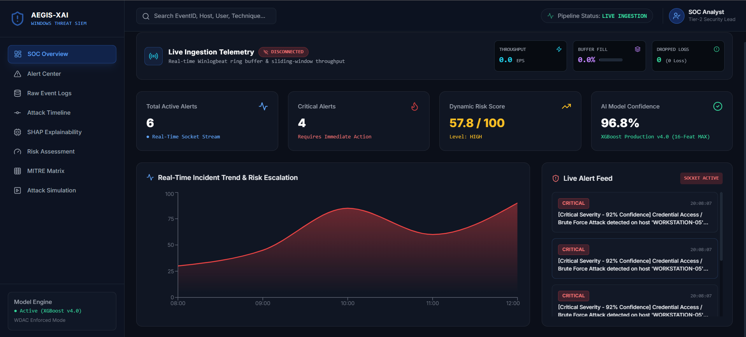
System Implementation: Offline Video Inspector
FastAPI backend with Apple Silicon MPS inference; genuine vs reenacted result
Genuine clip: real_01 (VidTIMIT)
Reenacted clip: fake_02 (DeepFakeTIMIT)
Genuine: P(fake) 17.22%, S_desync 0.0000, closure-failure ratio 0 - classified authentic.
Pipeline: Upload clip, optional expected transcript, then visual + desync branches run.
Notice: The UI states it is a research prototype (EER 36.02%, CV AUC 0.6877 +/- 0.0449).
Reenacted: P(fake) 97.36%, S_desync 0.0463, closure-failure ratio 1.0000 - desync detected.
Evidence: P_vis 0.9590 and P_desync 0.9160 agree; both branches contribute.
Scope: These are single demo clips, not a performance claim.
Backend: FastAPI (uvicorn app.main:app, 127.0.0.1:8000) with MediaPipe, MMS_FA and PyTorch (MPS)
Notes:
Demo clips: real_01_fadg0_sa2 scores 17% (authentic); fake_02_faks0_sa2_fedw0 scores 97% with S_desync 0.0463. These are illustrative single clips; aggregate numbers are on the results slides.

Slide 10
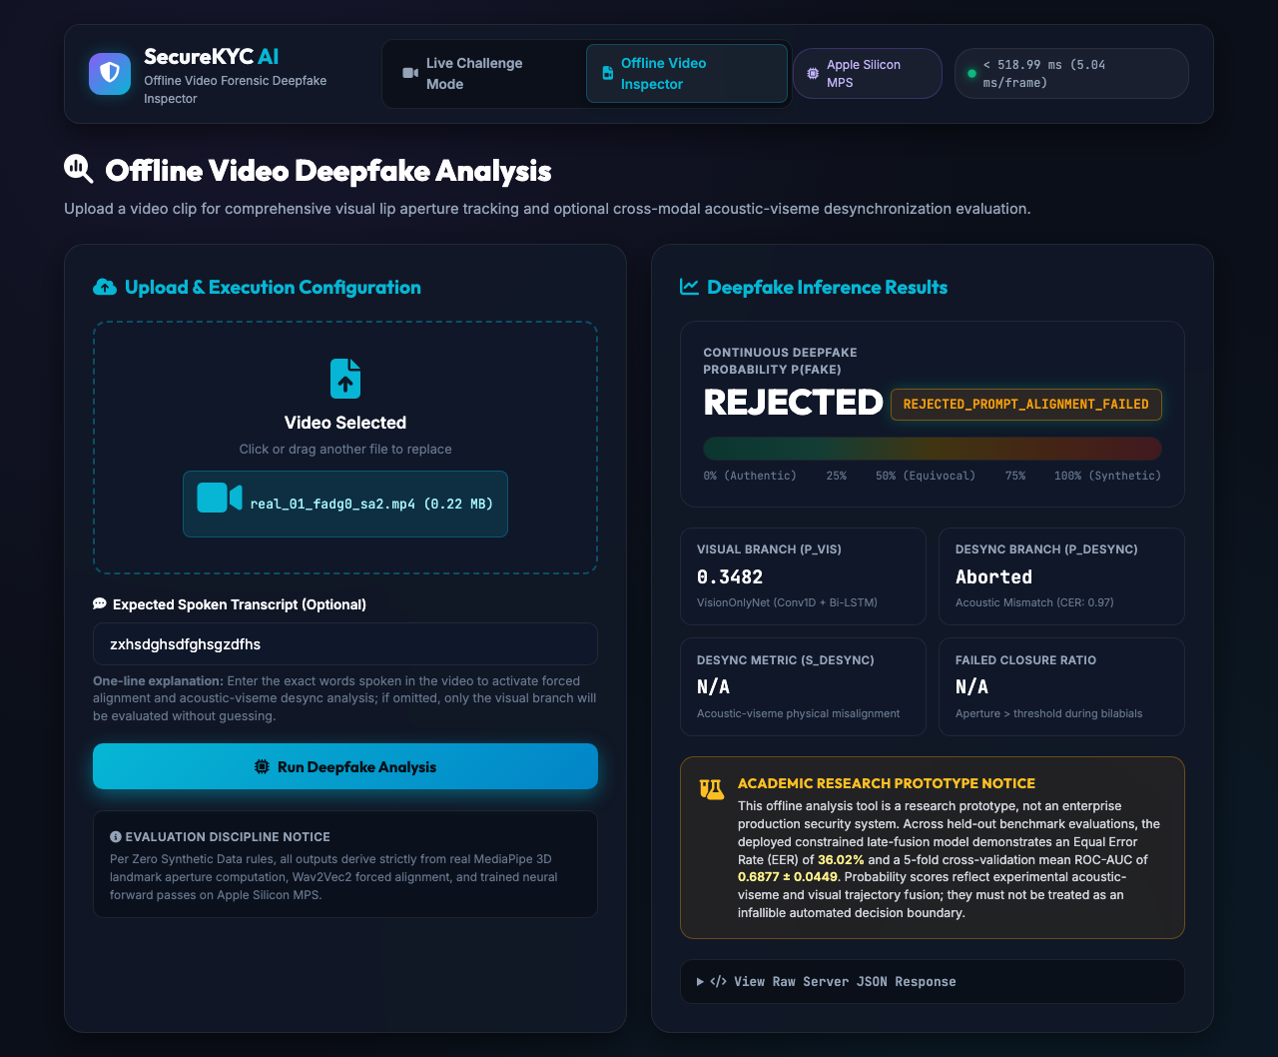
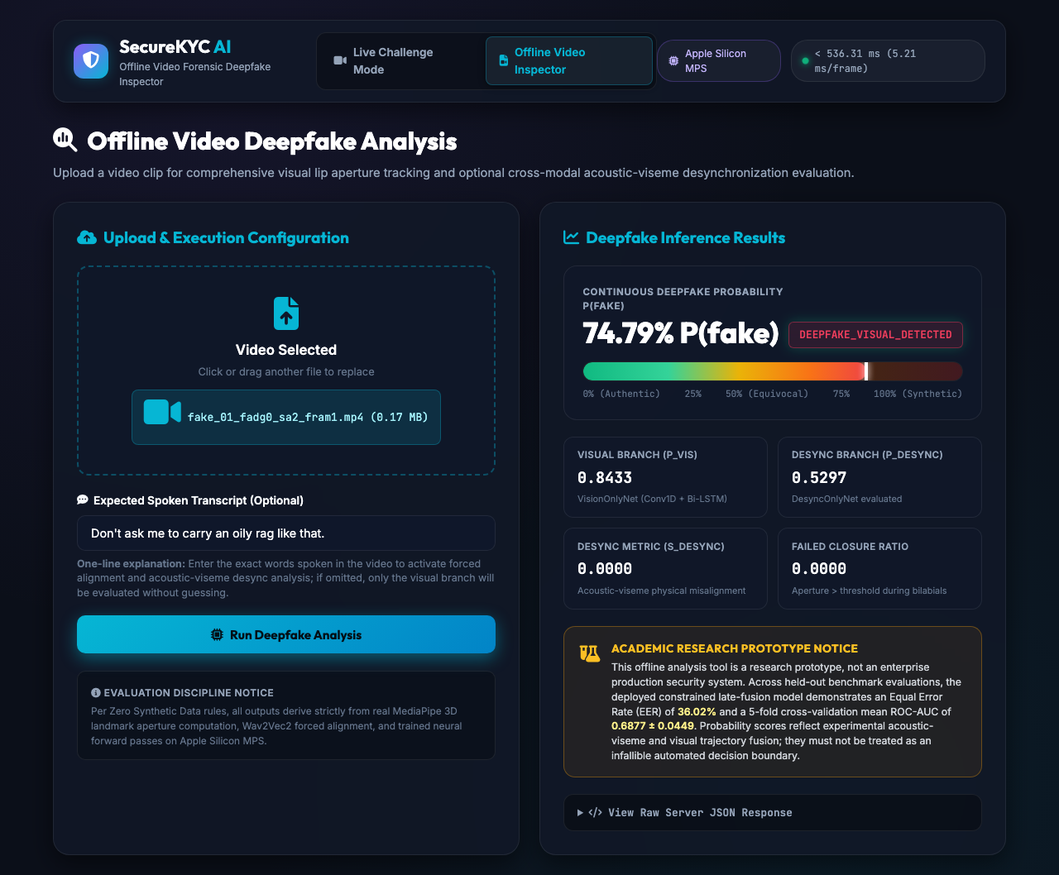
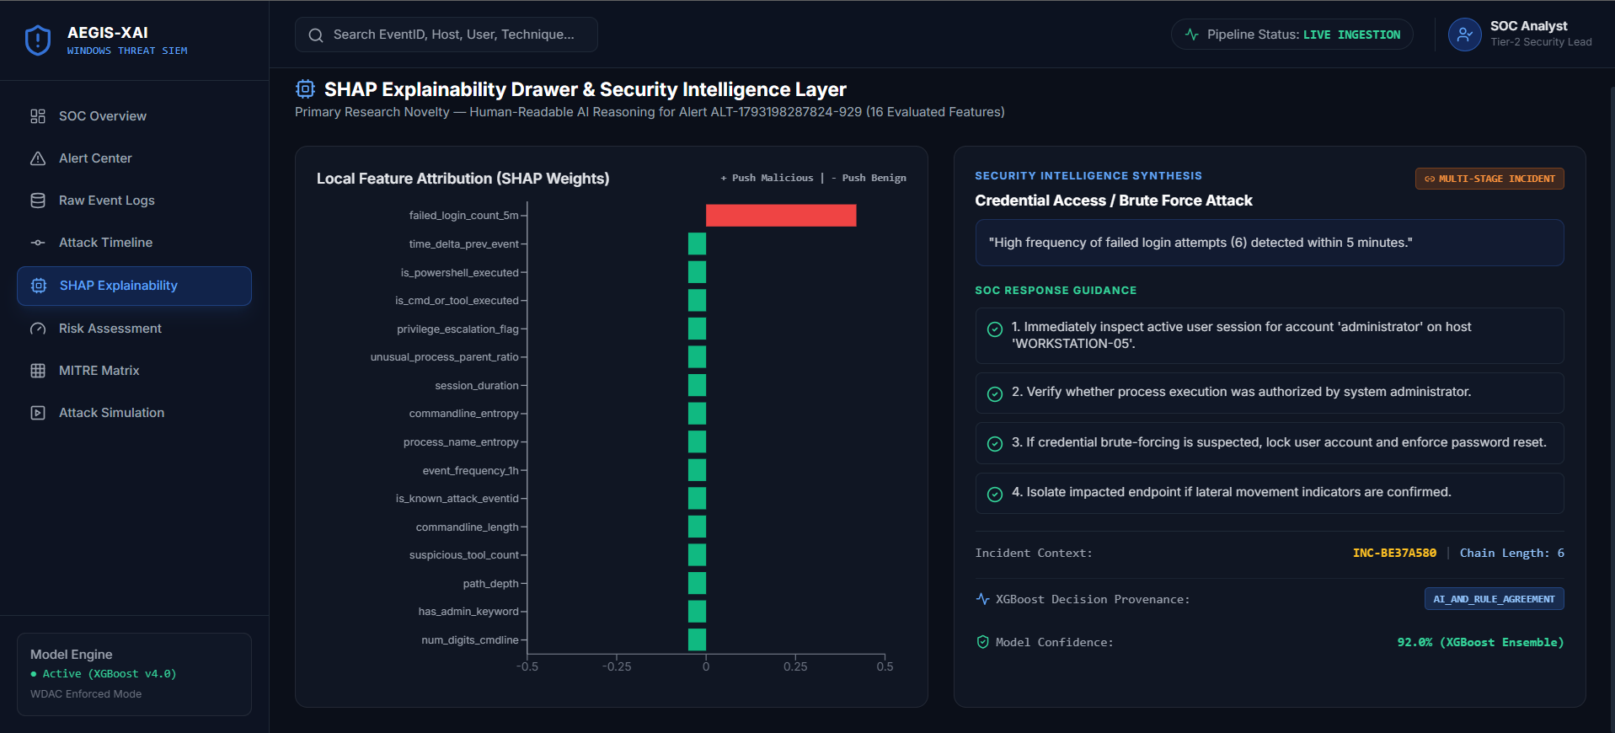
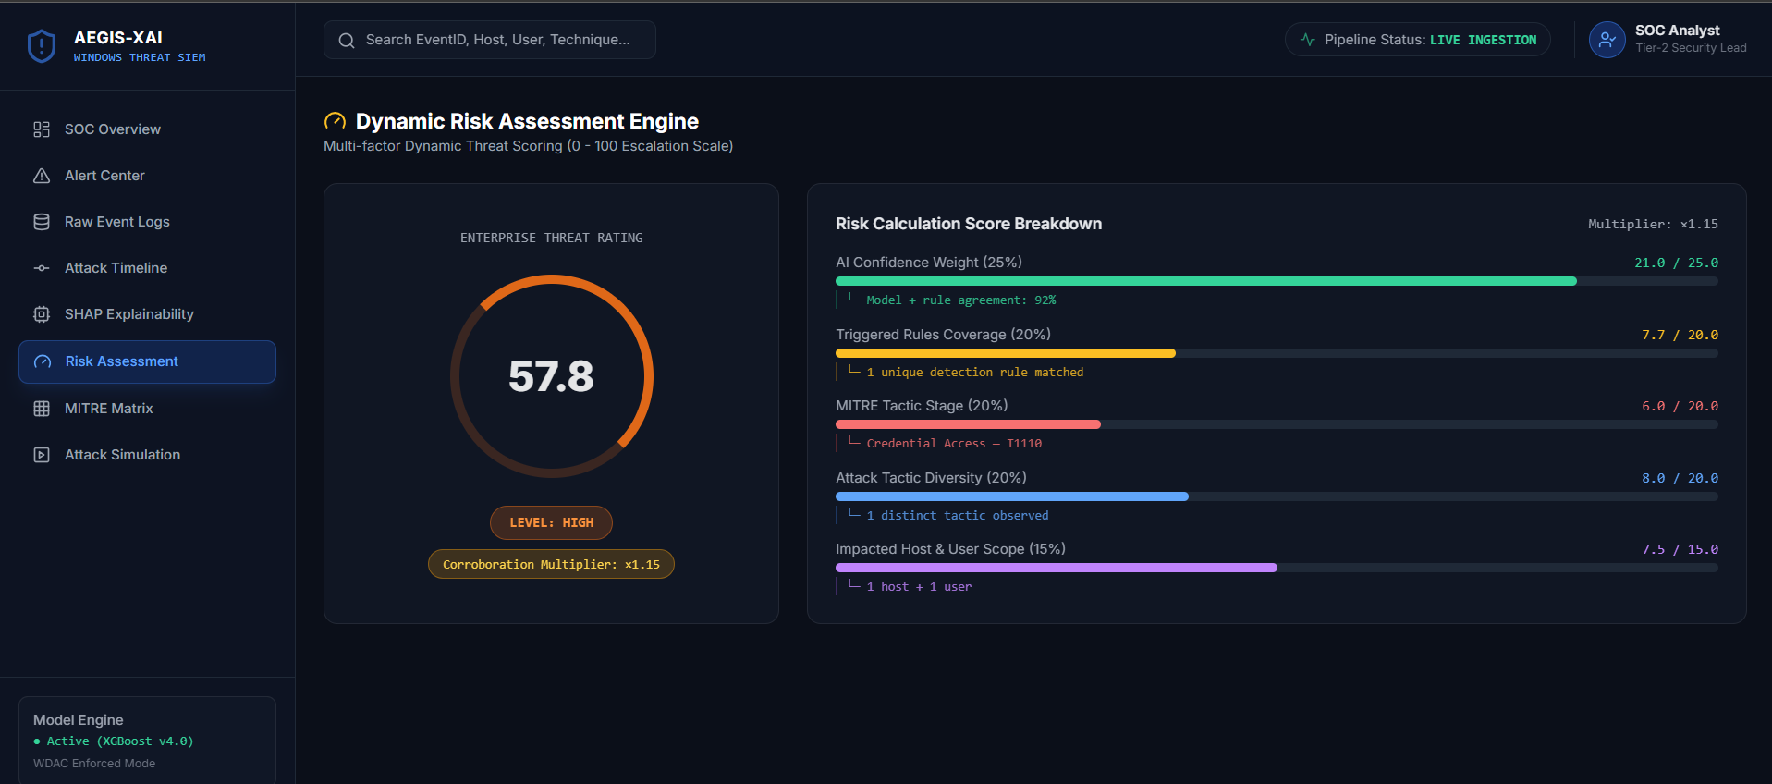
Prompt Gate and Visual-Only Detection
Same console: transcript mismatch is rejected; a visual-branch-only detection
Mismatched Speech Rejected
Visual Branch Detection (No Desync Signal)
Gate: A nonsense transcript for a real clip returns REJECTED_PROMPT_ALIGNMENT_FAILED (CER 0.97); the desync branch is aborted.
Result: In the evaluation, 0 of 1,675 mismatched pairs were accepted, at the cost of rejecting 15.2% of genuine clips.
Detection: fake_01 is flagged at 74.79% P(fake) by the visual branch alone (P_vis 0.8433).
Honesty: S_desync is 0.0000 for this clip, so the closure-failure override did not fire.
Prompt gate: CER between decoded speech and the issued phrase, threshold 0.60
Notes:
Shows the gate and a case where only the visual branch caught the fake. The CER gate threshold of 0.60 is a preliminary choice, not a validated security boundary.

Slide 11
Dataset and Experimental Setup
Windows-APT 2025 Dataset
Split | Clips | Real | Fake
Training (25 IDs) | 484 | 172 | 312
Validation (9 IDs) | 104 | 46 | 58
Test (9 IDs) | 103 | 57 | 46
Total (43 IDs) | 691 | 275 | 416
691 audio-visual clips from 43 identities: VidTIMIT (275 genuine) and DeepFakeTIMIT (416 autoencoder face swaps)
Identity-disjoint split: 25 / 9 / 9 identities, so Train and Test share no person
No synthetic data: only real recordings and real face-swap videos
tau = 0.0242 from 320 genuine bilabial events (15 speakers)
Setup: identity-disjoint split (Train ∩ Test = ∅); test set held out until final evaluation; 25 fps video and 16 kHz mono audio; PyTorch on Apple Silicon MPS. Caveat: two calibration speakers (fadg0, fcmr0) also appear in the test set.
Sources: [1], [2], [13]
Notes:
Viva: why identity-disjoint? Random splits leak identities and let a classifier memorise faces. Caveat to state ourselves: the threshold calibration speakers overlap with two test speakers.

Slide 12
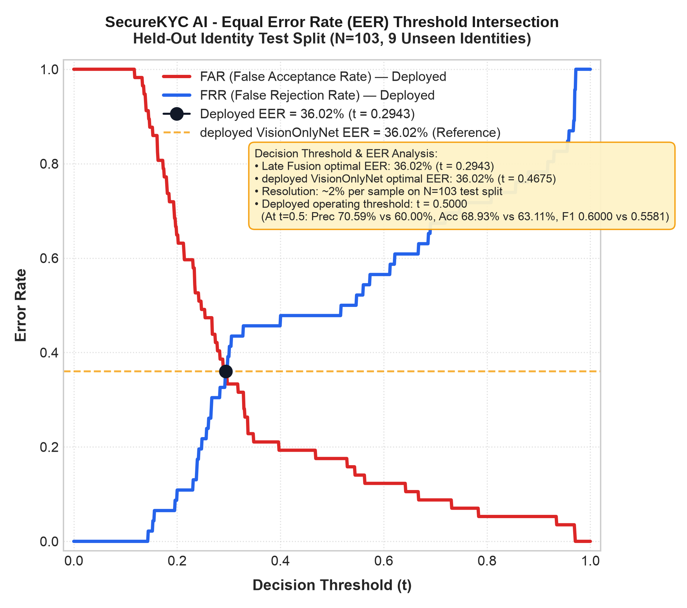
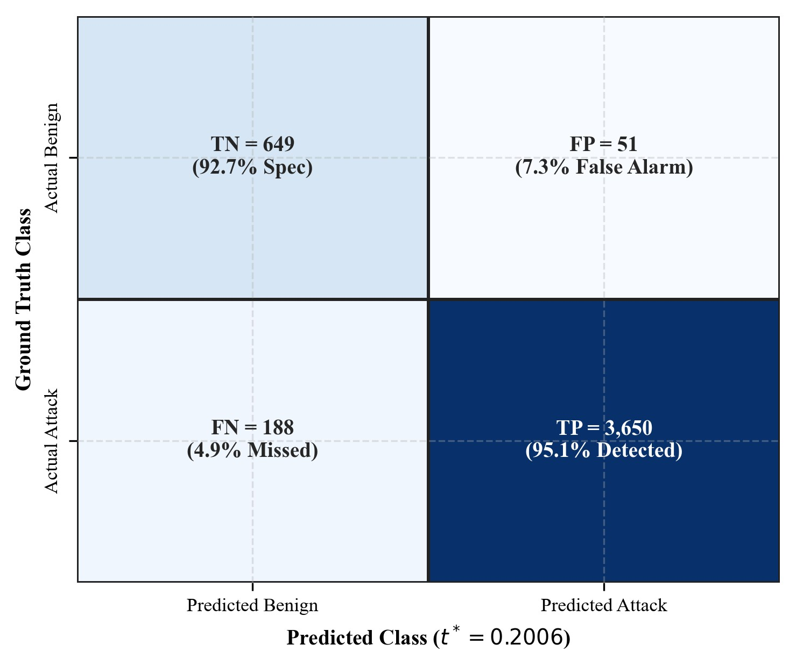
Results: Held-Out Test Performance
68.93%
Test accuracy
70.59%
Precision (vs 60.00%)
52.17%
Recall (24 of 46)
0.7197
ROC-AUC
F1 = 0.6000; EER = 36.02% (t = 0.2943); 5-fold CV AUC 0.6877 +/- 0.0449
Late fusion cuts false alarms from 16 to 10 of 57 real clips (95% CI [0, 12])
Misses 22 of 46 attacks at t = 0.5 (APCER 47.83%)
Closure-failure ratio: 4.49% authentic vs 41.63% reenacted (Cohen's d 0.66 per clip, 1.10 per subject)
Held-out test, N = 103 (9 unseen identities). Moderate, in-distribution performance.
Notes:
Be direct: this is moderate performance. Accuracy 68.93%, AUC 0.7197, EER 36.02%. Recall is 52.17%, so about half of the deepfakes are missed at the default threshold. The gain from fusion is fewer false alarms, not more detections.

Slide 13
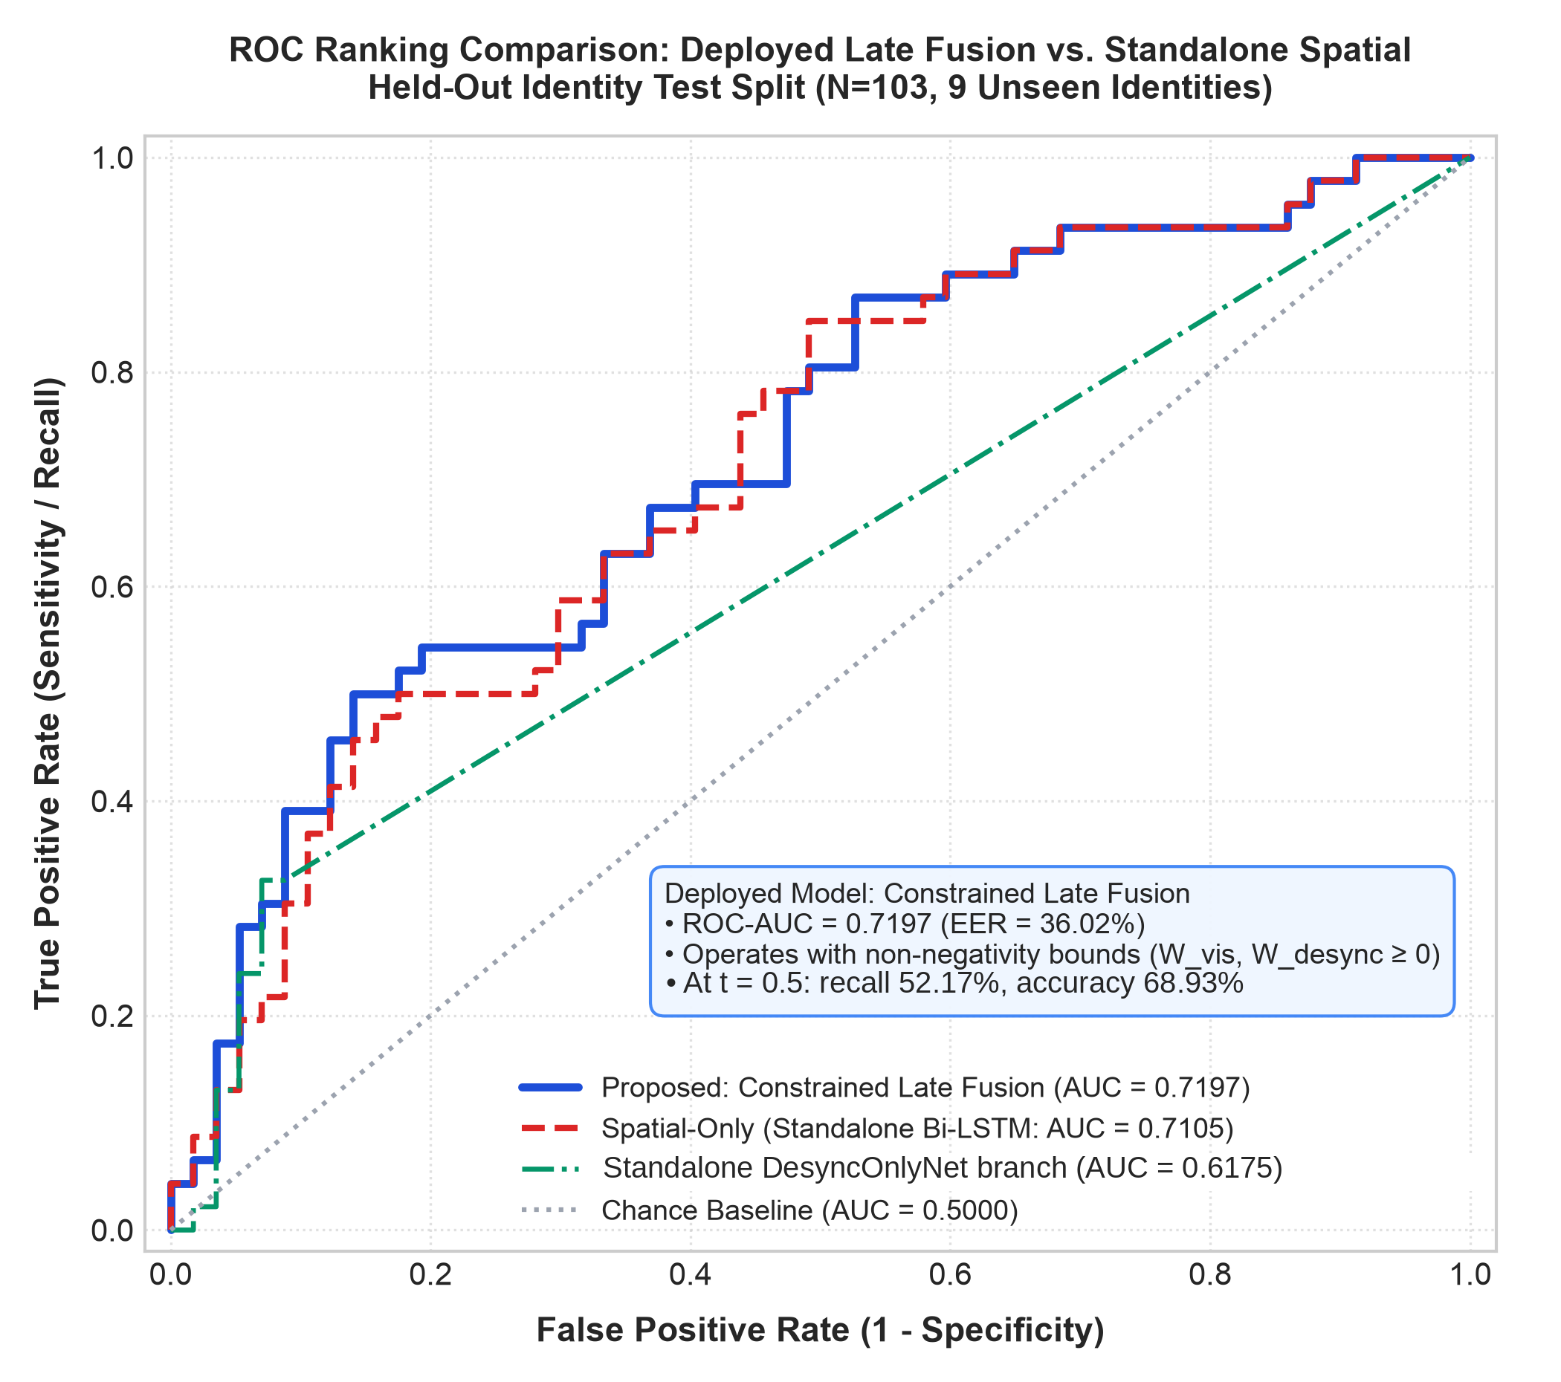
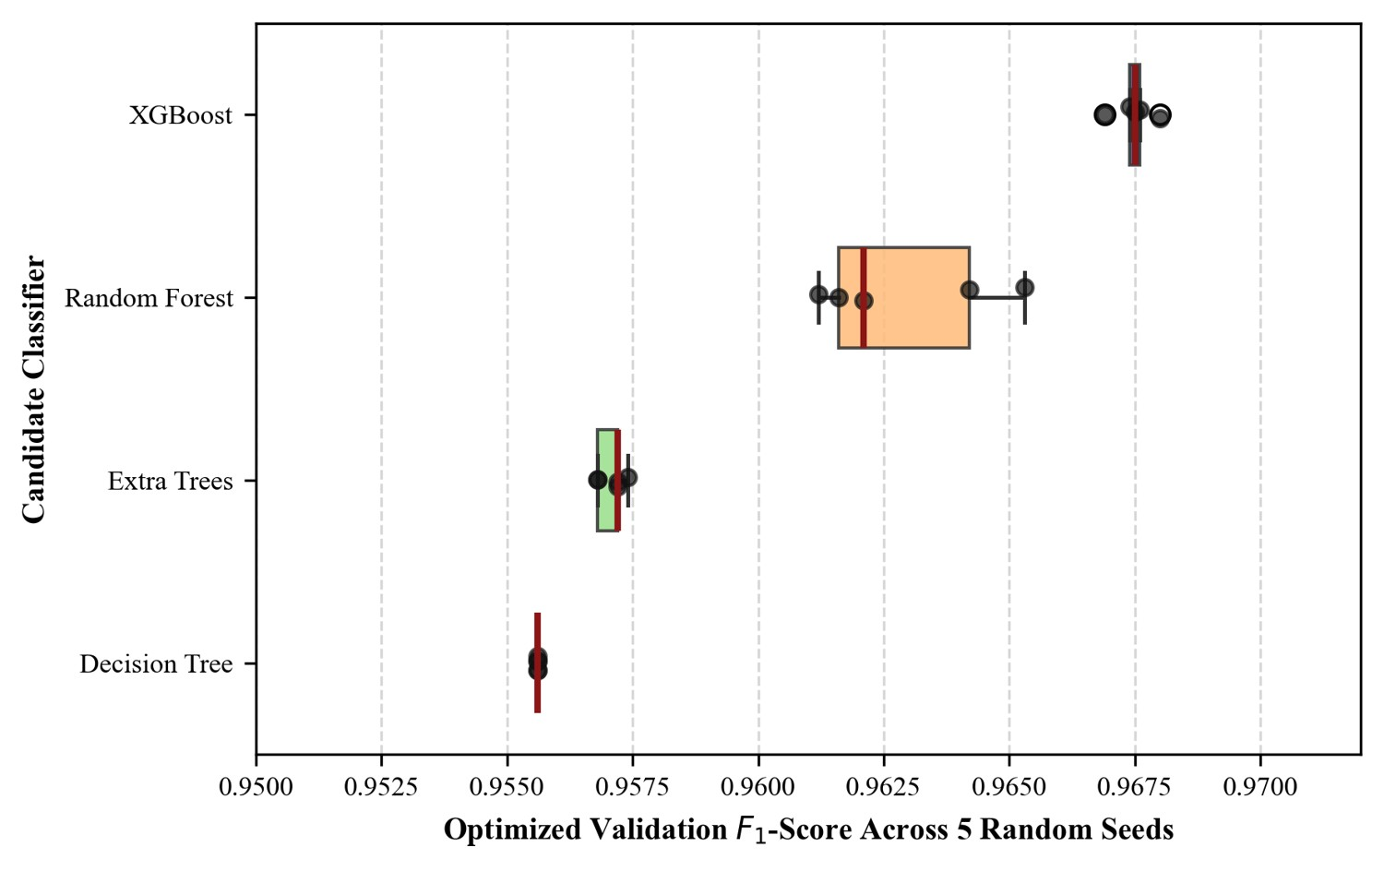
Model Comparison (Held-Out Test, N = 103)
Model | Accuracy (%) | F1 at 0.50 | ROC-AUC | Recall (%)
VisionOnlyNet | 63.11 | 0.5581 | 0.7105 | 52.17
DesyncOnlyNet | 44.66 | 0.6174 | 0.6175 | 100.00
Early fusion (concat.)† | 65.05 | 0.5135 | 0.6423 | 41.30
Late fusion (deployed) | 68.93 | 0.6000 | 0.7197 | 52.17
Best AUC and accuracy: constrained late fusion (0.7197, 68.93%)
DesyncOnlyNet alone flags every clip (recall 100%, BPCER 100%), so it is not usable by itself
Late fusion matches the visual branch on recall but removes 6 false alarms
GOTCHA reports 0.8010 AUC on live streams, a different setting and reference only
† Logged ablation from the 4 September run
Notes:
Viva: DesyncOnlyNet at 0.5 predicts everything as fake - 100% recall but 100% BPCER - so its F1 of 0.6174 is misleading; AUC 0.6175 is the fair number. GOTCHA numbers are from a different setup.

Slide 14
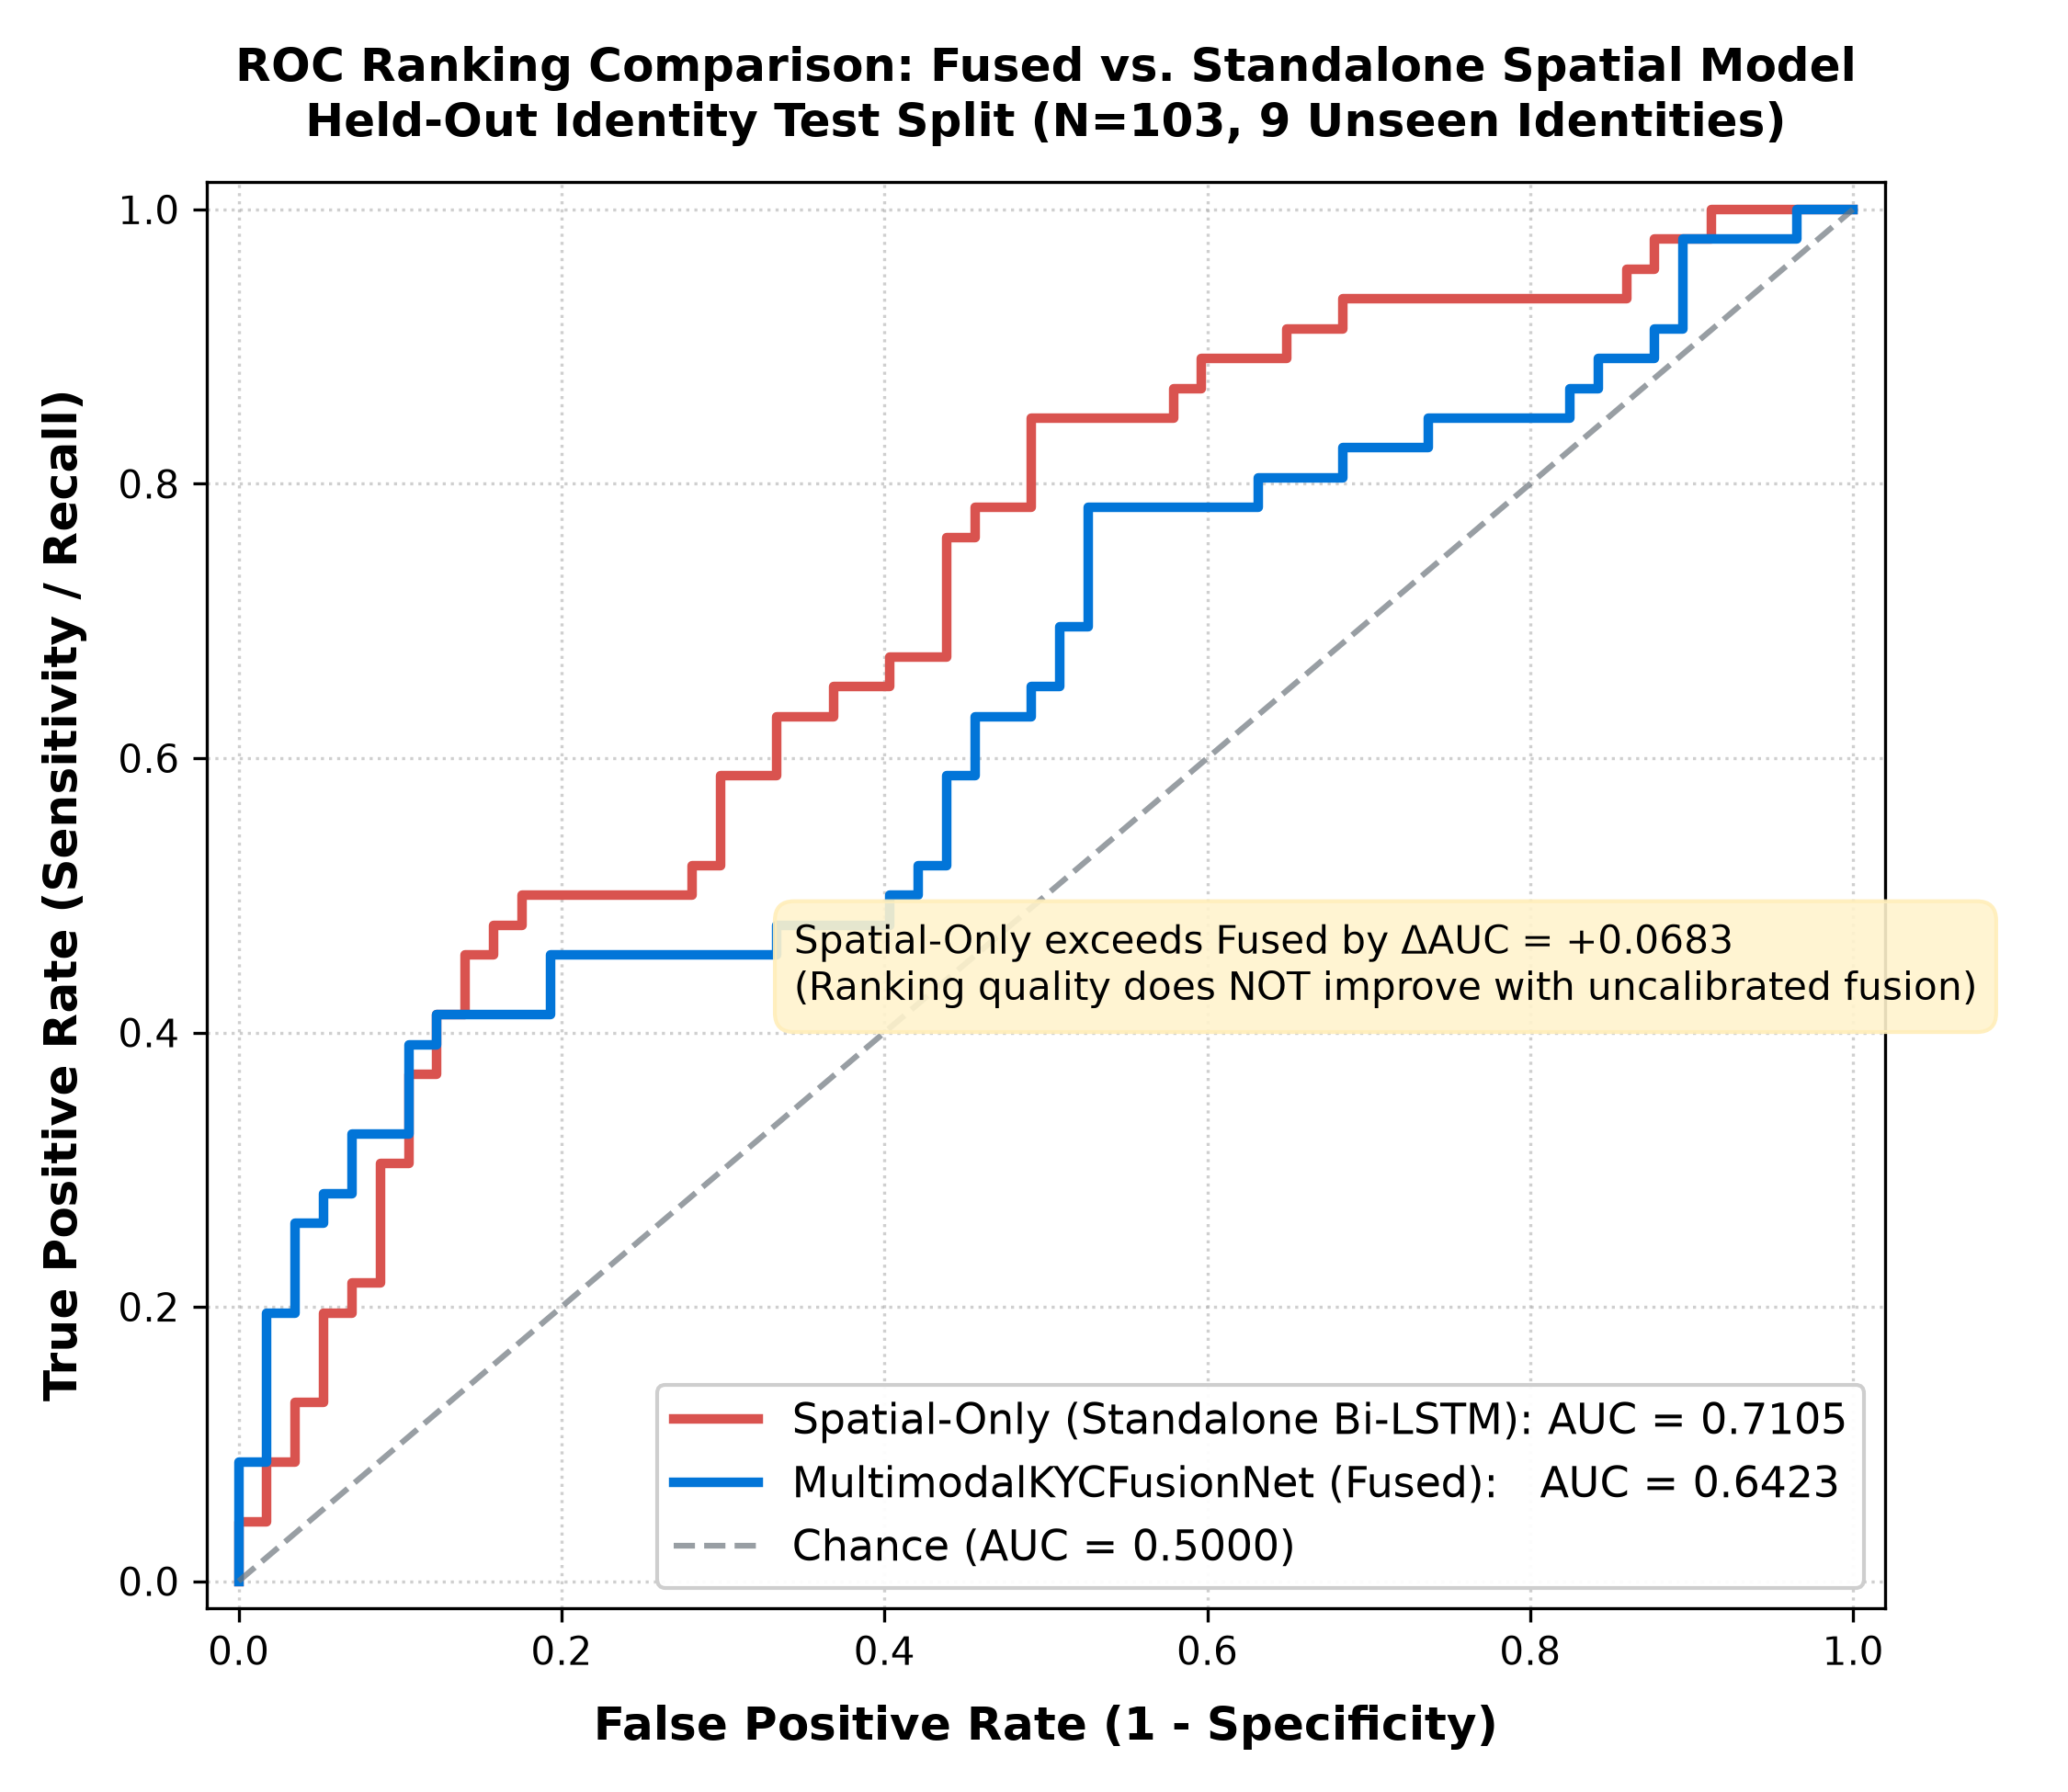
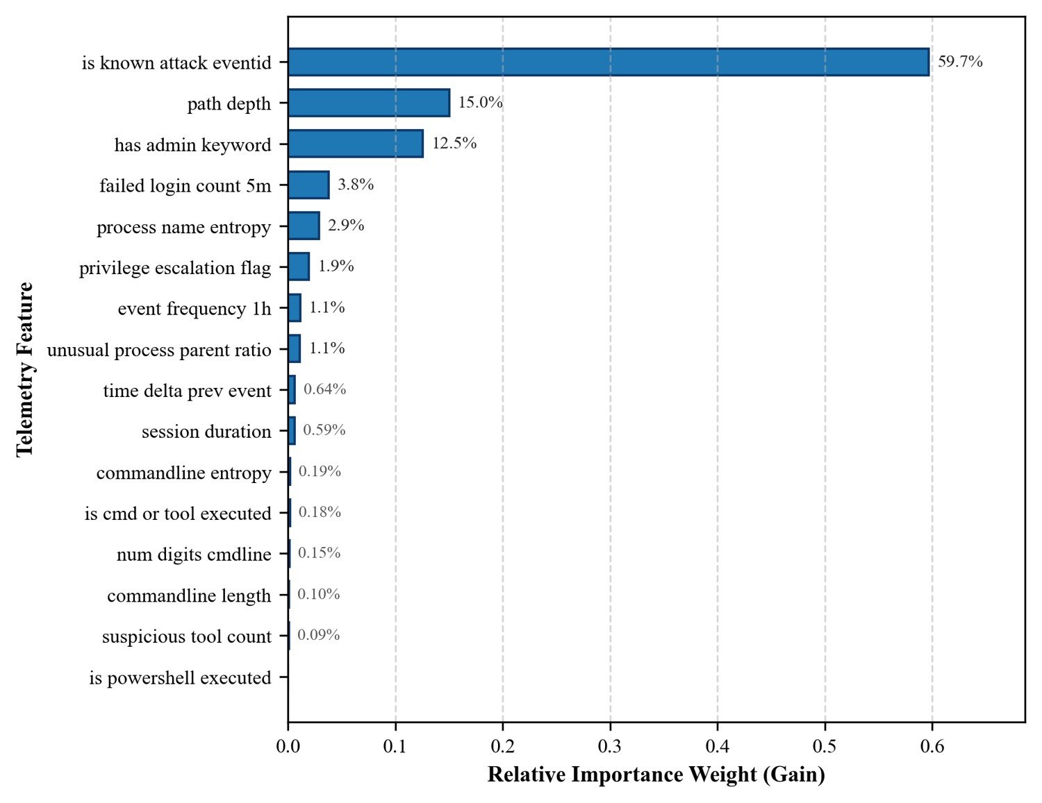
Fusion Ablation: Why Late Fusion
Variant | Test ROC-AUC
Visual branch only | 0.7105
Early fusion (concat.) | 0.6423
Unconstrained late, fold 1 | 0.4613 (W_vis < 0)
Constrained late, fold 1 | 0.6175 (W_vis = 0)
Constrained late, deployed | 0.7197
Early fusion fails: S_desync ~ 1e-2 versus r_fail ~ 1 makes the r_fail pre-activation 60-100x larger.
Non-negative weights prevent a sign inversion but do not guarantee gains: 5-fold CV late-fusion AUC 0.6877 +/- 0.0449 vs 0.7104 for spatial alone.
On the test split fusion adds +0.0092 AUC over the visual branch; this is small.
Notes:
The most important negative result: naive concatenation dropped AUC from 0.7105 to 0.6423. The figure shows spatial-only AUC 0.7105 vs early-fusion 0.6423. Late fusion with non-negative weights fixes the sign-inversion failure seen in fold 1, but the CV mean (0.6877) is slightly below the spatial-only CV mean (0.7104).

Slide 15
Robustness and Validation Checks
0.6877 ± 0.0449
5-fold identity-grouped CV ROC-AUC
4.49% vs 41.63%
Closure-failure ratio: authentic vs reenacted
224.3 ± 21.7 ms
Post-utterance decision latency (local client)
0 / 1,675
Mismatched prompts accepted by the CER gate
Negative results and limits: FakeAVCeleb gave a reversed effect (d = -0.426), InsightFace swaps only d = 0.27, and Celeb-DF has no audio (AUC 0.5111). All results are in-distribution (VidTIMIT / DeepFakeTIMIT); live DeepFaceLive injection was not validated.
Notes:
These checks show stability and honesty, not strength. CV AUC has a std of 0.0449. We tested other datasets and they did not provide a desync signal; we report that instead of hiding it.

Slide 16
Attainment of Defined Objectives
Objective | Status | Evidence
1. Ground liveness in speech aerodynamics | Achieved | Closure-failure ratio 4.49% (authentic) vs 41.63% (reenacted); Cohen's d 0.66 per clip, 1.10 per subject
2. Forced alignment to the known prompt | Achieved | MMS_FA trellis alignment; CER gate accepts 0 / 1,675 mismatched pairs
3. 3D aperture metric and desync score | Achieved | D_lip with tau = 0.0242; v_desync = [S_desync, P_max, r_fail]
4. Stable late-fusion model | Achieved | Non-negative weights; test AUC 0.7197, 5-fold CV 0.6877 +/- 0.0449
5. Honest measurement incl. negative results | Achieved | EER 36.02%, recall 52.17%, 224.3 ms latency; 3 negative-result datasets
Stretch: live DeepFaceLive injection test | Not done | Deferred to future work
Notes:
Objectives 1-5 are about building and honestly measuring the method, and they are met. We state that detection performance is moderate and that the live injection test was not completed.

Slide 17

Publication
Submission Details
Format and Checks
Title: Active Challenge-Response Biometric Verification for Video KYC via Speech Aerodynamics and Trellis Forced Alignment
Authors: Jatin Dhawad, Param Rawal
Conference: 3rd International Conference on Computer, Communication and Control (IC4'27)
Submitted: 30 Oct 2026 via CMT, Paper ID 1611, track CSE
Status: Under review - not yet accepted or published
IEEE A4 two-column, 8 pages (conference allows 6 and up to 8 with extra-page fee)
Word (.docx) submission; double-blind anonymised copy prepared
Turnitin on the final paper: 11% similarity (limit 15%), AI indicator below 20%
Code and data remain private until the paper is published
Notes:
Be precise: the paper is SUBMITTED, not accepted or published. Paper ID 1611, under review. The repository is kept local until publication.

Slide 18
Limitations and Future Scope
Limitations
Future Scope
In-distribution only: VidTIMIT / DeepFakeTIMIT; accuracy 68.93%, EER 36.02%
Misses about half: 22 of 46 attacks missed at t = 0.5 (APCER 47.83%)
Live injection not validated: DeepFaceLive and OBS Virtual Camera test not done
Negative results elsewhere: FakeAVCeleb d = -0.426, InsightFace d = 0.27, Celeb-DF no audio
CER gate: threshold 0.60 is preliminary; rejects 15.2% of genuine clips
Letter-based bilabials: reliable only for the controlled prompt pool
Live injection testbed with OBS Virtual Camera and DeepFaceLive
Per-subject resting-aperture calibration at enrolment
Broader validation on more speakers and scripted-prompt datasets
Multilingual prompt pool using multilingual MMS models
Text-independent speaker verification to tie the voice to the customer
Quantised on-device deployment for mobile
Notes:
Lead with the biggest limitations: results are in-distribution, about half of the deepfakes are missed, and live injection is untested. Future work addresses each of these.

Slide 19
Conclusion
Key Takeaways
SecureKYC AI is an active, conversational challenge-response framework that grounds Video KYC liveness in speech aerodynamics: lips must seal on /m/, /b/, /p/.
A known challenge phrase, MMS_FA trellis alignment and a normalised 3D lip aperture metric replace open-vocabulary transcription.
On an identity-disjoint benchmark (691 clips, 43 identities) the deployed late-fusion model reaches 68.93% accuracy, 70.59% precision, 52.17% recall, ROC-AUC 0.7197 and EER 36.02%.
The decision follows 224.3 +/- 21.7 ms after the utterance on Apple Silicon MPS. Early fusion failed, and non-negative late fusion is the stable alternative.
This is a validated research prototype with moderate accuracy; live injection and out-of-distribution validation remain future work.
Notes:
Closing message: a physically grounded, fast challenge with honest, moderate results - a good base for the live-injection testbed and broader validation.

Slide 20
References
[1] P. Korshunov and S. Marcel, "DeepFakes: a new threat to face recognition?," arXiv:1812.08685, 2018.
[2] A. Rossler et al., "FaceForensics++," in Proc. ICCV, 2019.
[3] J. Frank et al., "Leveraging frequency analysis for deep fake image recognition," in Proc. ICML, 2020.
[4] R. Durall et al., "Watch your up-convolution," in Proc. CVPR, 2020.
[5] S. Agarwal et al., "Protecting world leaders against deep fakes," in Proc. CVPRW, 2019.
[6] U. A. Ciftci et al., "FakeCatcher," arXiv:1901.02212, 2019.
[7] J. Hernandez-Ortega et al., "DeepFakesON-Phys," in Proc. ICASSP, 2021.
[8] I. Perov et al., "DeepFaceLab," arXiv:2005.05535, 2020.
[9] G. Mittal, C. Hegde, and N. Memon, "GOTCHA," in Proc. IEEE EuroS&P, 2024.
[10] L. Li et al., "Face X-ray for more general face forgery detection," in Proc. CVPR, 2020.
[11] S. Agarwal et al., "Detecting deep-fake videos from phoneme-viseme mismatches," in Proc. CVPRW, 2020.
[12] K. R. Prajwal et al., "A lip sync expert is all you need," in Proc. ACM MM, 2020.
[13] A. Haliassos et al., "Lips don't lie," in Proc. CVPR, 2021.
[14] W. Liu et al., "Lips Are Lying," in Proc. NeurIPS, 2024.
[15] S. K. Datta et al., "PIA: phoneme-temporal and identity-dynamic analysis," arXiv:2510.14241, 2025.
[16] H. Chen and J. Xu, "BioLip," arXiv:2604.16808, 2026.
[17] G. Fant, Acoustic Theory of Speech Production, Mouton, 1960.
[18] K. N. Stevens, Acoustic Phonetics, MIT Press, 1998.
[19] A. Baevski et al., "wav2vec 2.0," in Proc. NeurIPS, 2020.
[20] V. Pratap et al., "Scaling speech technology to 1,000+ languages," arXiv:2305.13516, 2023.
[21] C. Lugaresi et al., "MediaPipe," arXiv:1906.08172, 2019.
[22] A. Sureshkumar et al., "Secure facial biometric authentication in smart cities using multimodal methodology," Sci. Rep., vol. 15, 2025.
[23] A. B. Badade and R. K. Dhanaraj, "Continuous person authentication using behavioral biometrics," in Proc. ICTQCEBT, 2024.
[24] P. S. Metkewar et al., "Facial expression recognition in the wild using artificial rabbits optimizer based ResNet," in Proc. ICAICCIT, 2023.
Notes:
References [22]-[24] are the three Scholar-listed works integrated into the related-work discussion.

Slide 21
THANK YOU
Notes:
Thank the panel and invite questions.

