Slide 1
Strategic Ad-Hoc Data Insights and Reporting for AtliQ Hardwares
Consumer Goods Domain — SQL Analytics Challenge
August 2026

Slide 2

AtliQ Hardwares needs faster data-driven decisions to sustain its growth across global markets
The Company
AtliQ Hardwares (fictitious corporation) is one of India's leading computer hardware producers, with operations expanding across multiple international markets.
The Challenge
AtliQ Hardware is facing challenges in making quick and data-driven business decisions due to limited actionable insights from its existing data.The SQL challenge is designed to assess candidates’ technical and analytical abilities, along with their understanding of real-world business problems.
The Response
The data analytics team is delivering answers to 10 ad-hoc business requests from top-level management, spanning product portfolio analysis, customer behavior, sales trends, discount patterns, channel contribution, and cost structures.
This analysis transforms raw transactional data into actionable intelligence that empowers AtliQ's leadership to make faster, smarter decisions.

Slide 3
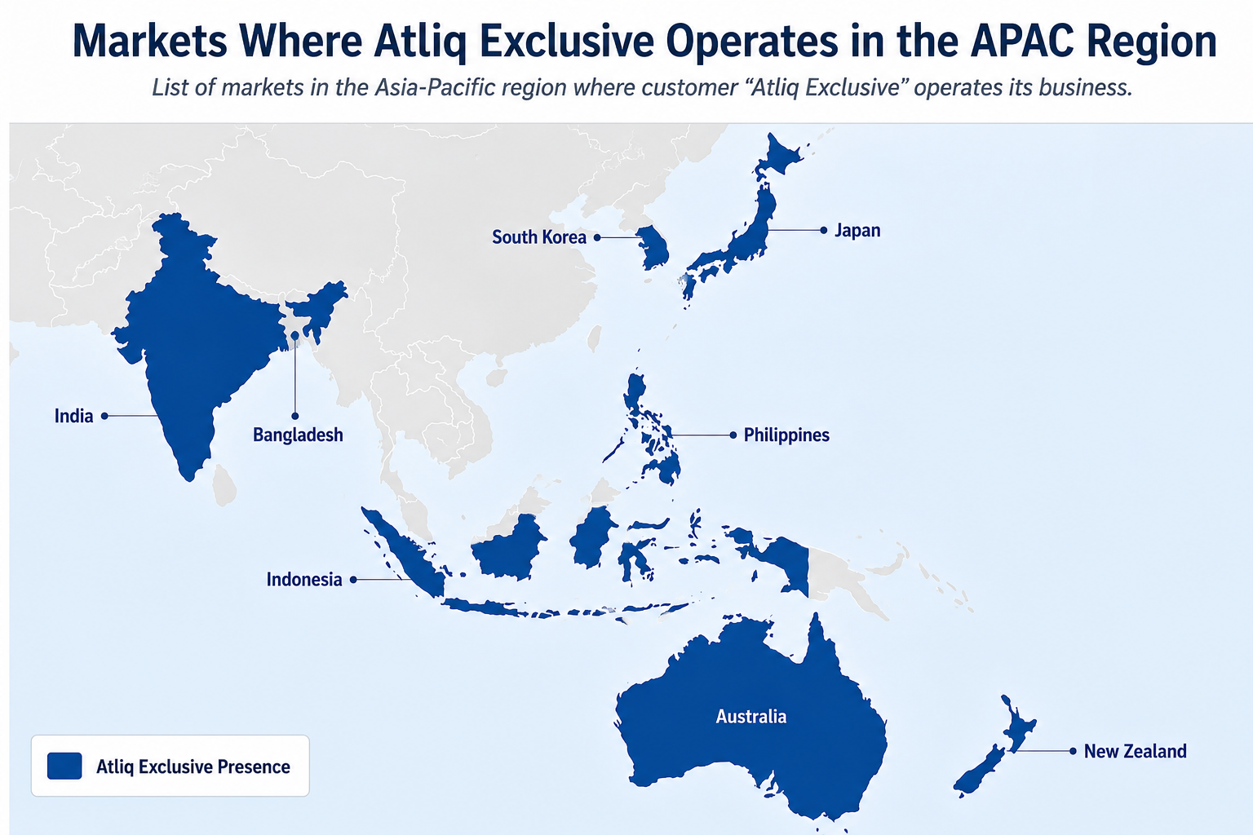
1. Provide the list of markets in which customer "Atliq Exclusive" operates its business in the APAC region.
AtliQ Exclusive has a strong presence in the APAC region, operating across 8 markets, accounting for half of its presence across the 16 listed markets.

Slide 4
2. What is the percentage of unique product increase in 2021 vs. 2020?
+36.3%
portfolio growth YoY
245 → 334 unique products
Accessories alone: 38% of new additions
Notebook & Peripherals tied at 18% each
The 36% product portfolio expansion is heavily skewed toward Accessories — management should evaluate whether this concentration aligns with demand signals or reflects supply-side opportunism.

Slide 5
3. Provide a report with all the unique product counts for each segment and sort them in descending order of product counts.
62% of portfolio
9% of portfolio
The portfolio is top-heavy — Notebook and Accessories together hold 62% of all products, while Storage and Networking remain underdeveloped at just 9%, signaling potential white-space opportunities.
Source: AtliQ Hardwares database — dim_product table.

Slide 6
4. Which segment had the most increase in unique products in 2021 vs 2020?
Accessories experienced the greatest absolute increase, adding 34 new unique products in 2021. Although Desktop had the highest percentage growth of 214.3 %, Notebook remained the segment with the highest number of unique products in 2021, at 108.

Slide 7
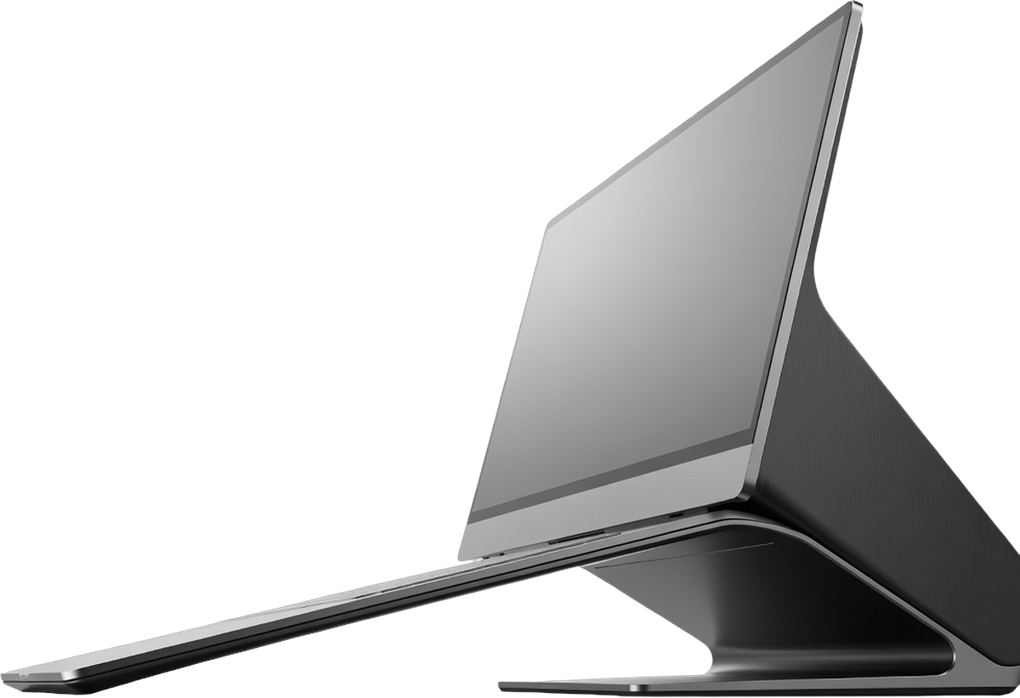
5. Get the products that have the highest and lowest manufacturing costs.
product_code | product | manufacturing_cost
A6121110208 | AQ HOME Allin1 Gen 2 | 263.42
A2118150101 | AQ Master wired x1 Ms | 0.8654
₹263.4 per unit (AQ HOME Allin1 Gen 2) vs. ₹0.86 per unit (AQ Master wired x1 Ms) — one desktop costs as much to manufacture as 263 accessories.

Slide 8
6. Generate a report which contains the top 5 customers who received an average high pre invoice discount pct for the fiscal year 2021 and in the Indian market.
Flipkart offers the highest average discount at 30.83%, making it the most discount-heavy customer among the listed customers.
Vivek's ranks second with an average discount of 30.38%.
Ezone and Croma have very similar average discounts of 30.28% and 30.25%, respectively.
Amazon has the lowest average discount among the top 5, at 29.33%.
Overall, the average discounts are closely clustered around 29–31%, indicating relatively consistent discounting across these major customers.
Key Observations
Pre-invoice discounts above 30% for top retailers compress margins significantly — AtliQ should evaluate whether volume commitments from these customers justify the discount levels or if renegotiation is warranted.

Slide 9
7. Get the complete report of the Gross sales amount for the customer “Atliq Exclusive” for each month
Key Patterns & Implications
November consistently records the highest gross sales across every fiscal year, peaking at 259.11M in FY2022.
April is generally the weakest month, recording the lowest sales in FY2018, FY2019, and FY2021.
Gross sales show a strong year-over-year growth trend, increasing significantly from FY2018 to FY2022.
FY2020 shows a major disruption, with sales plunging from 15.17M in February to 1.42M in March.
Sales follow a recurring seasonal pattern, typically increasing from September to November and declining after the November peak.
Gross sales demonstrate strong year-over-year growth with a recurring November peak, while April tends to be a weaker month. The FY2020 disruption temporarily broke the trend, but sales recovered strongly, culminating in a record-high ₹259.11M in November FY2022.

Slide 10
8. In which quarter of 2020 got the maximum total sold quantity?
Quarterly Sold Quantity Breakdown — FY2020 (Sep 2019 – Aug 2020)
Q1 (Sep–Nov 2019): Maximum total sold quantity — highest volume quarter across FY2020
Q2 (Dec 2019–Feb 2020): Second highest quarter, sustaining strong momentum
Q3 (Mar–May 2020): Sharp decline — impacted by COVID-19 lockdowns beginning March 2020
Q4 (Jun–Aug 2020): Partial recovery but remained below Q1/Q2 levels
Q1 recorded the peak due to the convergence of festive season demand (Diwali, Dussehra in October–November) and back-to-school/college IT procurement cycles in September. Subsequent quarters saw demand erosion as pandemic disruptions took hold from March 2020 onward.
Q1's dominance confirms festive-season demand as AtliQ's primary volume driver — supply chain and production planning should treat September–November as the critical fulfillment window.

Slide 11
9. Which channel helped to bring more gross sales in the fiscal year 2021 and the percentage of contribution?
Key Insights – Gross Sales by Channel (FY2021)
Retailer is the dominant channel, contributing 73% of total gross sales (3,708.46), making it the primary revenue driver.
Direct sales contribute 16% (784.14), representing the second-largest channel but significantly trailing Retailers.
Distributors account for 11% of gross sales (572.86), making them the smallest contributor among the three channels.
Retailer sales are more than 4× higher than Distributor sales, highlighting a strong dependence on the Retailer channel.
Channel diversification is an opportunity: strengthening Direct and Distributor channels could reduce reliance on Retailers and create additional avenues for revenue growth.
Retailers are the primary revenue driver, contributing 73% of total gross sales in FY2021, highlighting both the channel’s strength and the need to diversify through Direct and Distributor channels.

Slide 12
10. Get the Top 3 products in each division that have a high total sold quantity in the fiscal year 2021?

Slide 13
What we have achieved
10 Business Questions. Clear, Actionable Answers.
Market Visibility: We mapped AtliQ Exclusive’s presence across 8 APAC markets, giving leadership a clear view of regional reach and diversification.
Portfolio Growth Products grew 36% year-on-year (245 → 334). Accessories led the way with 34 new additions, while Storage and Networking remain untapped opportunities.
Cost Transparency: We uncovered a huge spread in manufacturing costs — from ₹0.86 to ₹263 per unit — paving the way for smarter, margin-aware pricing.
Discount Oversight: Top Indian customers like Flipkart, Amazon, and Croma received average discounts above 29%. Finance now has the data to renegotiate.
Sales Rhythm: Sales consistently peak in November and dip in March–April. Supply chain can now plan around September–November as the critical window.
Channel Clarity: Retail dominates with 73% of sales, compared to Direct (16%) and Distributor (11%). Diversification is clearly needed.
Volume Leadership Q1 is the strongest quarter with 7M+ units sold. Pen Drives lead Storage, while AQ Gamers Ms and Maxima Ms dominate Peripherals.
From raw data to real decisions — every insight here translates into concrete business action.

