Slide 1
Flight Booking System for Airlines

Slide 2
TEAM
2110030212 – Jatin Mishra
2110030218-Gundannagari Navya
2110030233-Chirumani Rishika

Slide 3
Contents
Introduction
Objectives and Scope
Literature review
Use case and activity diagram
Software Requirements Specification-Functional and Non Functional Requirements
Software and Hardware Requirements
System Architecture
Implementation-Methodology
Results
References

Slide 4
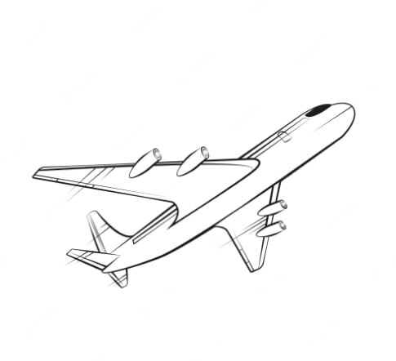
INTRODUCTION
A fully responsive web-based Flight Booking System for Turkish Airlines based on the Model View Controller (MVC) Architecture made using Java Servlets, Java Server Pages (JSPs). Moreover authentication and authorization for users is implemented using Tomcat Roles. The web-application is also secured against SQL Injection and Cross-Site Scripting attacks.

Slide 5
INNOVATION
Ticket reissue is a hassle for travelers and agencies due to complex processes, leading to delays and financial losses. Existing methods lack flexibility and responsiveness, causing frustration. Our startup aims to simplify this process with an innovative solution, automating and expediting rebooking while reducing costs and enhancing customer satisfaction for both travelers and agencies.
Link:- https://www.google.com/search?q=is+ticket+transfer+available+in+today%27s+airline&oq=&gs_lcrp=EgZjaHJvbWUqCQgHEEUYOxjCAzIJCAAQRRg7GMIDMgkIARBFGDsYwgMyCQgCEEUYOxjCAzIJCAMQRRg7GMIDMgkIBBBFGDsYwgMyCQgFEEUYOxjCAzIJCAYQRRg7GMIDMgkIBxBFGDsYwgPSAQoxNTQ4NDNqMGoxqAIIsAIB&sourceid=chrome&ie=UTF-8

Slide 6
Objectives and scope
The flight management system (FMS) helps to view available seats and to book, cancel seats accordingly.
Objective:-
To help customer to reserve and cancel seats with easy through our site from anywhere in the world.
Scope:-
Through this the customer can atleast reserve the seat for which they can pay later but have a assurance for having a seat for themselves.

Slide 7
Literature Review
E-Ticket reservation and cancelation:-
Checking the available seats in the flight and accordingly selecting the preferred seats and reserving them. Later cancelling if there is change in plans.
Through this there is no loss for the customer as there is no payment done for last moment change in plans. The customer gets to cancel anytime before the scheduled flight time.

Slide 8
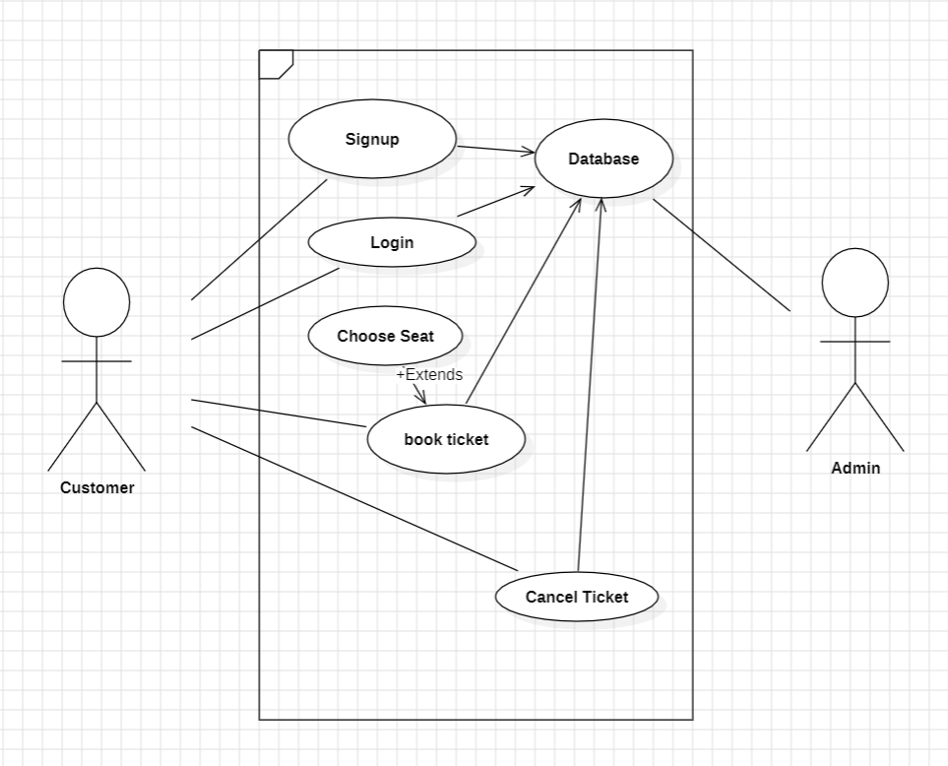
Use Case diagram

Slide 9
Activity diagram

Slide 10
Technologies Used
Frontend: HTML, CSS, JavaScript, jQuery, Bootstrap, Java Server Pages (JSPs), AJAX (for a Flight Search Widget)
Backend: Java Servlets, Java Models, Microsoft Access (Database)
Webservices: SOAP Web Services (to get price and number of seats)
Security Features: SQL Injection, Cross-Site Scripting (XSS), Tomcat Roles

Slide 11
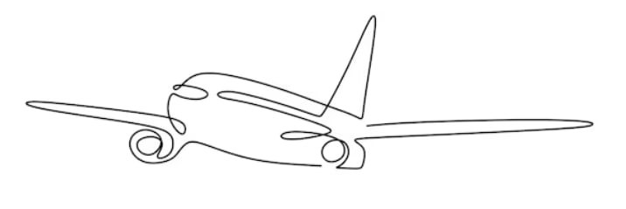
Workflow
This is for just one airline who wants to sell seats to their customers via internet.
Following are the steps of work flow:
Airline Admin will set the prices of the seats. There should be three types of seats:
First Class
Business
Economy
The Airline Admin should be able to create and update the features of each type of seat.
The Airline Admin should be able to set the total number of seats for each flight.
Airline Manager should see a list of seats which the Admin has added or edited when he/she logs in.
Airline Manager then needs to approve the new price or updates.

Slide 12
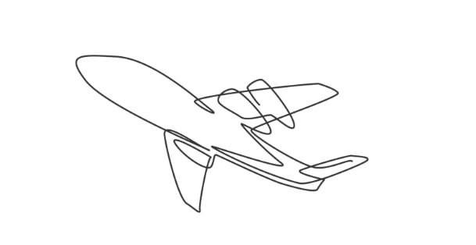
When the price and update is approved by the manager only then it should be available for the customer to buy.
The Customer should be able to buy seats based on availability.
When a customer buys a ticket the system should be able to calculate how many seats are left. If all seats are bought the application should not let the customers buy more seats.
The Customer should be able to select the following, to select a seat:
origin and destination cities
dates of travel
number of people traveling
When the customer selects the seat and confirms the booking flight Itinerary should be shown to the customer.
When the customer approves the itinerary the customer should be taken to a payment page where the total price should be shown. When the customer presses the pay button consider the transaction done and mark the seat sold.
Once the seat is sold, send out an email to the customer with the flight itinerary.

Slide 13
THANK YOU

