Slide 1
PHYSICAL AID

Slide 2
INTRODUCTION
Hand sign project to help physically challenged or special abled people to get their work done. This will read your hand signs and convert it into the text or speech and vice versa. This will help blind, deaf and dumb people to communicate with us like, if we want to communicate with deaf people we need know the hand signs and only 10-12% people know hand signs so this app will help you to get through it.

Slide 3
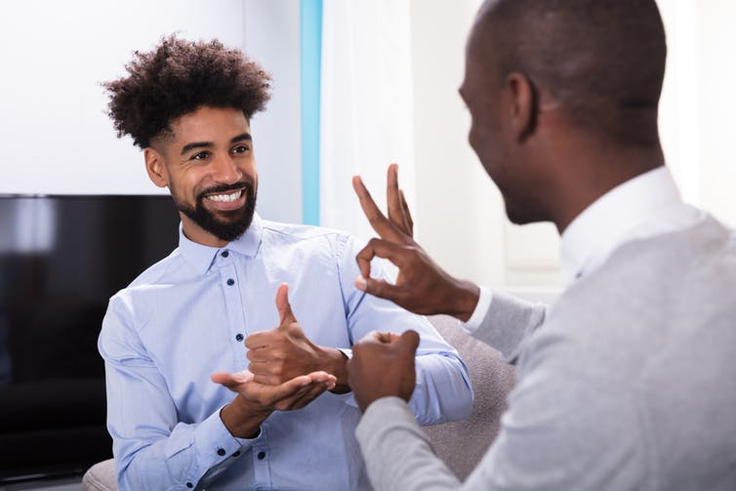
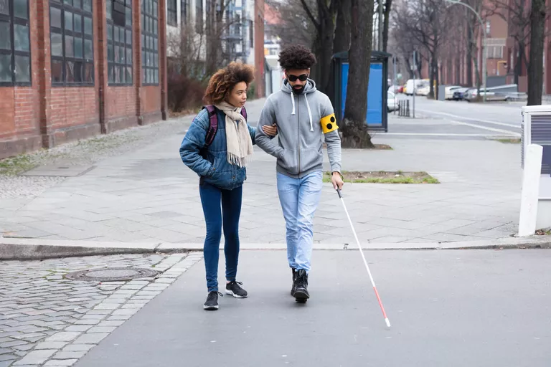
Various Physical Challenges and Communication Barriers is one of biggest concern in modern world

Slide 4
