Slide 1
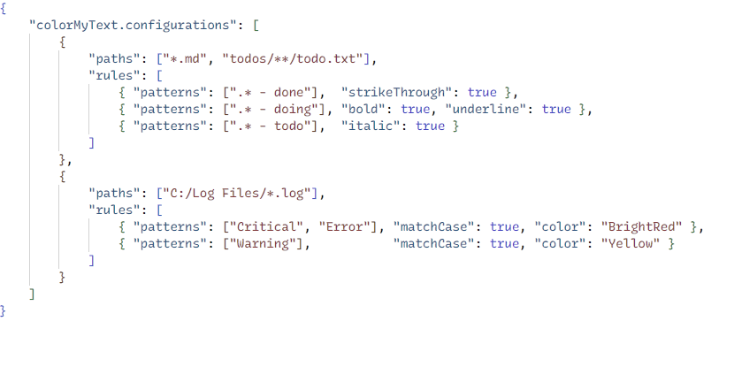
Glob-style patterns to select files
Decoration rules for the matching files
Text decorations for the matching text
Regex patterns to select text

