Slide 1
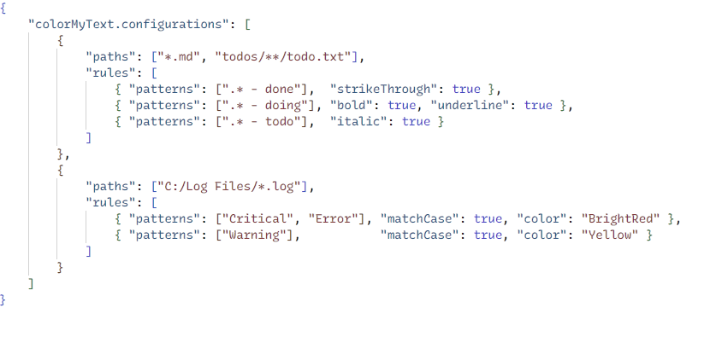
Glob-like patterns for file selection
Decoration rules for matching files
Text decorations for matching text
Regex patterns for text selection

