Slide 1
Path-Conditioned Next-Best-View Planning for
Cooperative Aerial-Ground Mars Scouting
on a 3D Gaussian Splatting Substrate
Jatin Satyam | SES 598 Space Robotics and AI
School of Manufacturing Systems and Networks · Arizona State University

Slide 2
Motivation
The problem with Ingenuity
The natural question
Perseverance moves meters per sol. Each traverse requires hours of human-in-the-loop planning. Ingenuity flew on commanded waypoints — not as an autonomous teammate.
When the drone is given agency: how should it pick its next viewpoint, what should it be looking for, and how should that decision be informed by the rover's plan?
Three converging lines of work
① Active 3DGS: per-Gaussian uncertainty as a usable view-selection signal (ActiveGS, FisherRF, RT-GuIDE)
② Cooperative aerial-ground IPP: path-conditioning as the standard coupling mechanism (Traversing Mars, Seeker-Supporter)
③ Planetary traversability: uncertainty-aware rover planning (LSRC field-deployed at NASA Ames + White Sands, 2026)
This work sits at the intersection of all three lines.
2 / 12

Slide 3
Problem Statement
Cooperative aerial-ground scouting on Mars-analog terrain
A drone surveys terrain ahead of a rover, building a 3DGS representation. The rover consumes a traversability costmap derived from the splat field. Cells with high per-Gaussian reconstruction uncertainty → high traversability uncertainty → rover prefers to avoid or request re-survey.
The view-selection objective
Which candidate viewpoint maximises expected reduction in traversability uncertainty along the rover's planned path?
v* = argmax u(v) = Σ P(c ∈ r) · Δσ²_c(v)
Cross-agent: the path r belongs to the rover, not the drone selecting the view.
3 / 12

Slide 4
Related Work — Four Clusters, One Gap
Active 3DGS NBV
Cross-Agent 3DGS
ActiveGS (RA-L 2025)
FisherRF (ECCV 2024)
AG-SLAM, RT-GuIDE
Per-Gaussian uncertainty methods
RaEM (arXiv 2024)
Khass et al. (Oct 2025)
Gap: UAV outdoor demos; coverage-driven gain; no traversability semantics
Gap: Indoor, collision-risk; discrete-waypoint masking; single-agent path, not rover's path
Cooperative Mars IPP
Planetary Traversability
Traversing Mars (RA-L 2025)
Seeker-Supporter cluster
Endo et al. (RA-L 2024)
LSRC (Feb 2026, real hardware)
Gap: Follower-path-aware utility; occupancy/GP map substrate, not 3DGS
Gap: Uncertainty-aware rover planning; no 3DGS, no aerial visual scout, no active NBV
Each cluster closes one piece. The specific combination — 3DGS + aerial scout + traversability + Mars-analog — remains open in the surveyed literature.
4 / 12

Slide 5
The Contribution: A Targeted Specialisation
What this work is
Applying recently published methods to a substrate + sensing modality + task semantics combination not yet covered in the surveyed literature.
3DGS Substrate
Aerial Visual Scout
RaEM + Khass apply this
New: with traversability semantics
Traversing Mars does this
New: on a 3DGS map, with active NBV
Traversability Semantics
Mars-Analog Setting
LSRC does this on real hardware
New: per-Gaussian uncertainty routed in
HiRISE DTM of Jezero Crater
Established methodology (MARTIAN, Bland)
Each ingredient is precedented. The recipe — as far as we can tell — is not.
5 / 12

Slide 6
System Design (Full Architecture)
Drone Survey & Control
Online 3DGS Front-End
X500 quadrotor · MulticopterVelocityControl · adaptive survey pattern driven by NBV planner
MonoGS or DUSt3R/MASt3R · pilot uses offline COLMAP + splatfacto as stand-in
Per-Gaussian Uncertainty
Path-Conditioned NBV
Predictive Photometric Uncertainty (plug-and-play) · pilot uses opacity + scale proxy
Gain function (Sec. V) · inputs: 3DGS field + rover path + candidate viewpoints
Traversability Projection
Uncertainty-Aware Rover
Per-Gaussian uncertainty → 2.5D height-map grid · bridge from splat domain to rover costmap
A*/D* with per-cell uncertainty as soft cost · wait-for-more-info when path is uncertain
Drone → 3DGS → Uncertainty → Gain → NBV → Rover
Pilot experiment exercises the Gain function + Per-Gaussian Uncertainty layers. Remaining components are described and treated as future work.
6 / 12

Slide 7
Path-Conditioned Gain Function
Soft path-likelihood prior
Path-conditioned gain
P(c ∈ r) = exp( −d(c,r)² / 2τ² )
d(c,r) = perpendicular distance from cell c to rover trajectory r
τ = corridor width ≈ rover safety envelope + replanning slack
u(v) = Σ_c P(c ∈ r) · Δσ²_c(v)
Δσ²_c(v) = expected uncertainty reduction if drone observes from v
Drone selects v* = argmax_v u(v)
RaEM (special case)
Khass (related)
Our generalisation
P(c) = 𝟙[min_k ‖c−w_k‖ < R]
Hard sphere around each waypoint
→ our Eq. (2) recovers this with degenerate τ→0
Weight per-Gaussian along same agent's path using Fisher information
Our work: cell domain, rover's path, traversability semantics
Soft corridor prior
Cross-agent: rover path → drone gain
Traversability uncertainty, not Fisher info
GP-UCB extension: u_UCB(v) = Σ_c P(c ∈ r)·[μ_c(v) + β^½·σ_c(v)] — future work.
7 / 12

Slide 8
Pilot Experiment — Setup
Terrain
Reconstruction pipeline
HiRISE Digital Terrain Model · Jezero Crater
(same source as JPL Perseverance operations pipeline)
40 m patch · 1 m/pixel resolution
MOLA+HiRISE fused DTM · 513×513 heightmap
Blender-rendered Gazebo world with:
· Mars-analog rock obstacles
· Mars solar irradiance lighting
· DARTSim physics backend
COLMAP sparse SfM → Nerfstudio splatfacto trainer
~14,000 Gaussians covering the area of interest
Pilot scope
① Per-Gaussian uncertainty visualisation
② Path-conditioned vs uniform viewpoint gain
Offline counterpart of online front-end — deliberately scoped
14k
10
50×50
10
Gaussians reconstructed
Survey waypoints
(8m AGL)
Grid resolution
for gain eval
Candidate
viewpoints
8 / 12

Slide 9
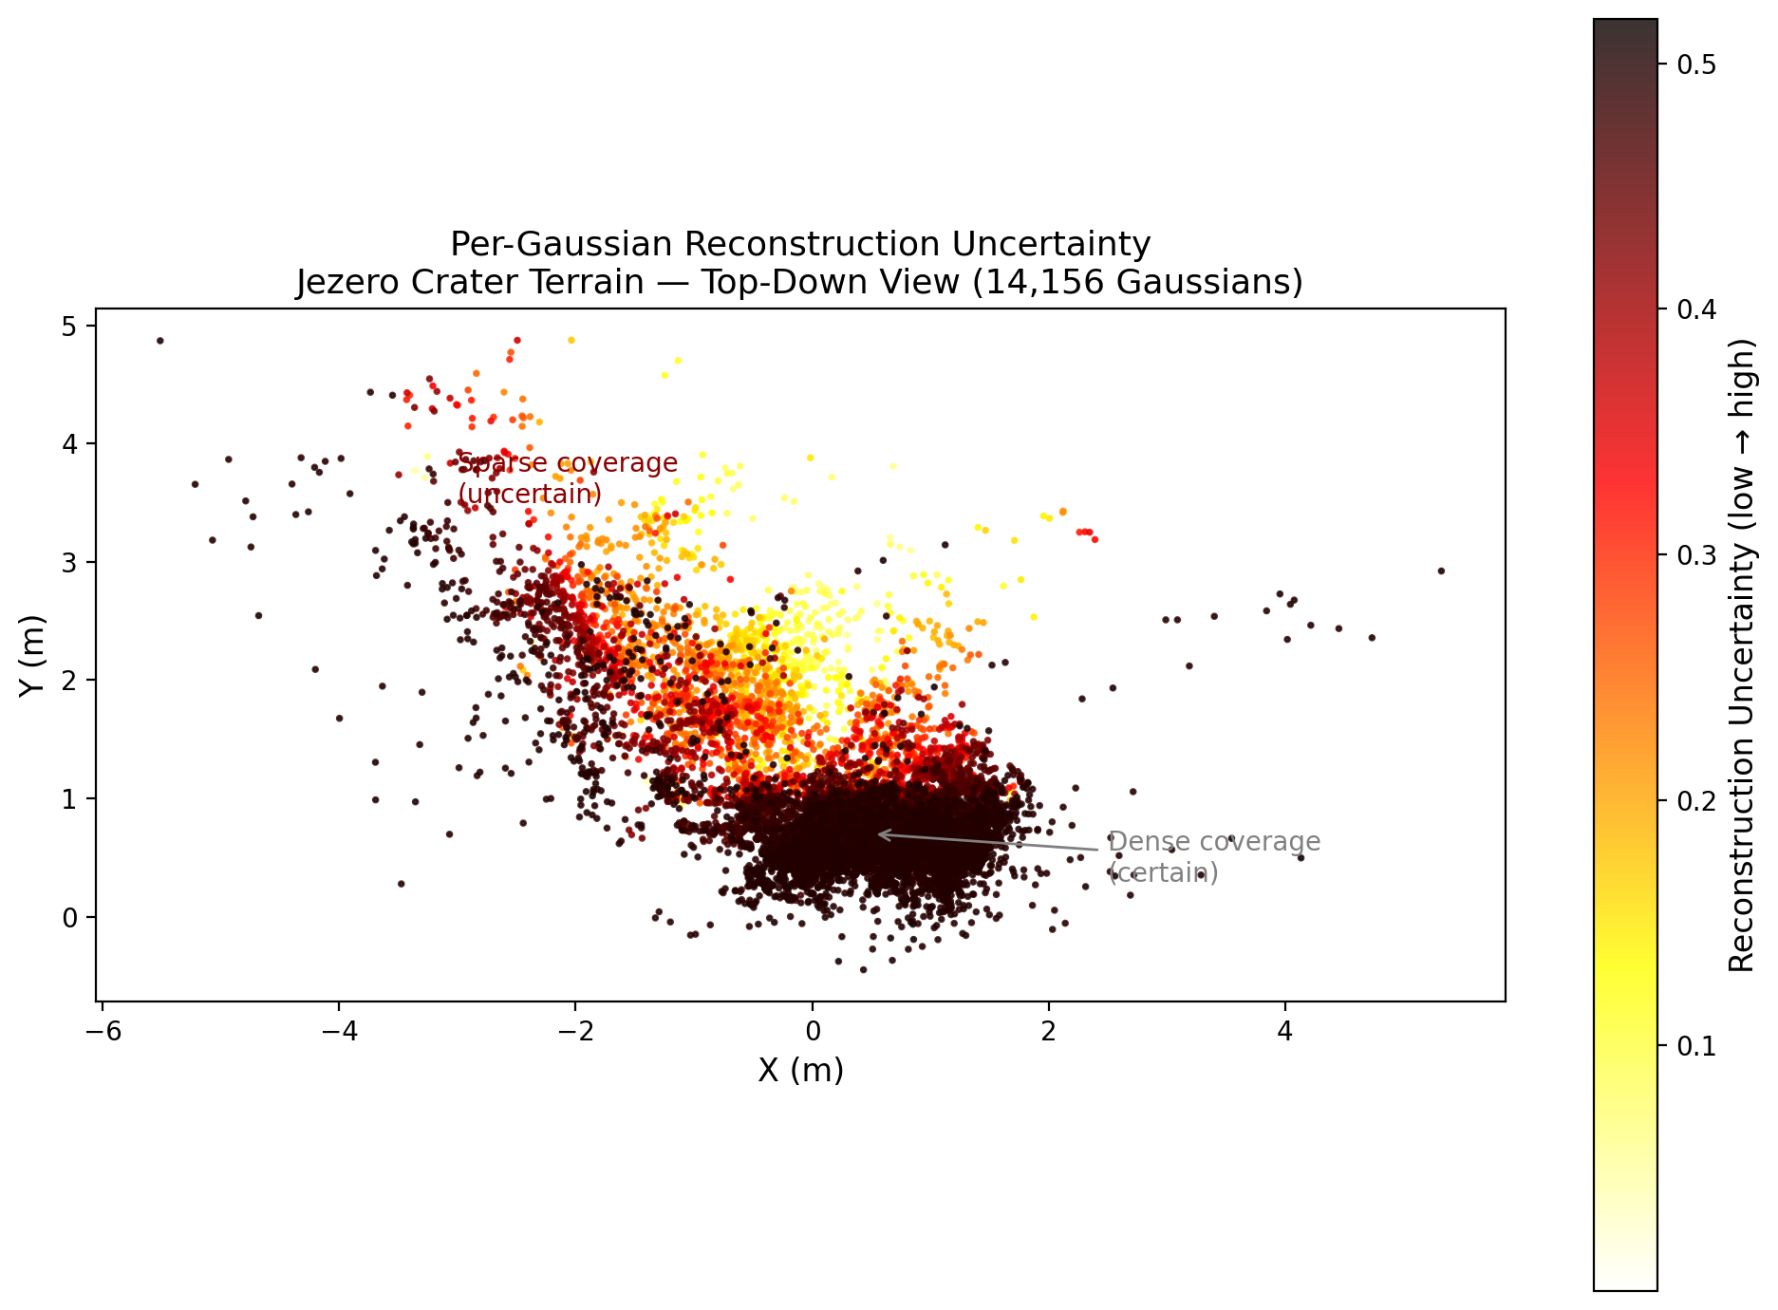
Pilot Result 1 — Per-Gaussian Uncertainty
Uncertainty proxy
Combined opacity-based + covariance-volume proxy
Low opacity → high uncertainty
Large scale → under-constrained
What the figure shows
Dense core (center-right) = certain
Sparse periphery (edges, turn-arounds) = uncertain
Pattern directly reflects survey coverage geometry
Upgrade path
Predictive Photometric Uncertainty is plug-and-play — post-hoc, no retraining
9 / 12

Slide 10
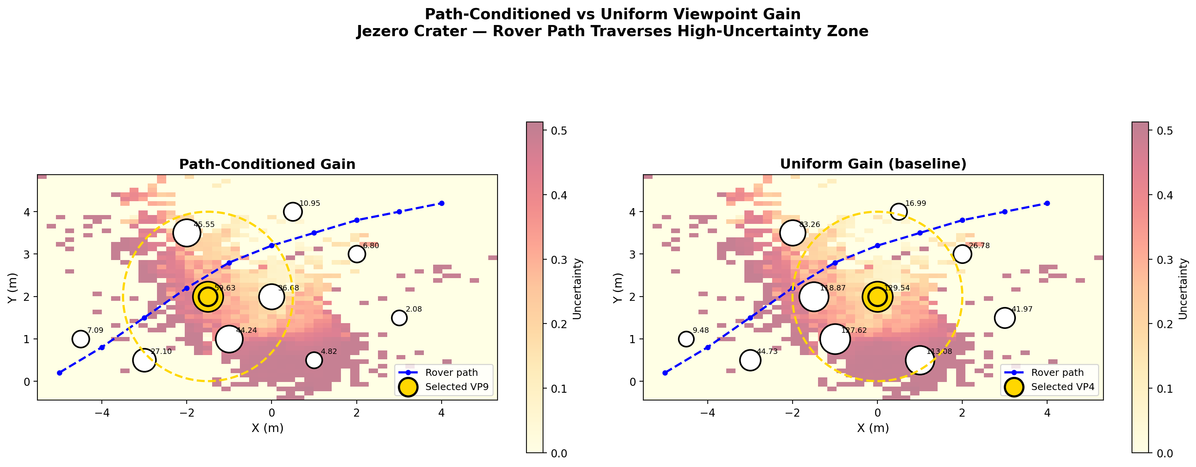
Pilot Result 2 — Path-Conditioned vs Uniform Gain
VP09
VP04
DIFFER
Path-conditioned
selects → (-1.5, 2.0)
Uniform baseline
selects → (0, 2.0)
Selection differs = TRUE
Path-conditioning is not a reparameterisation
10 / 12

Slide 11
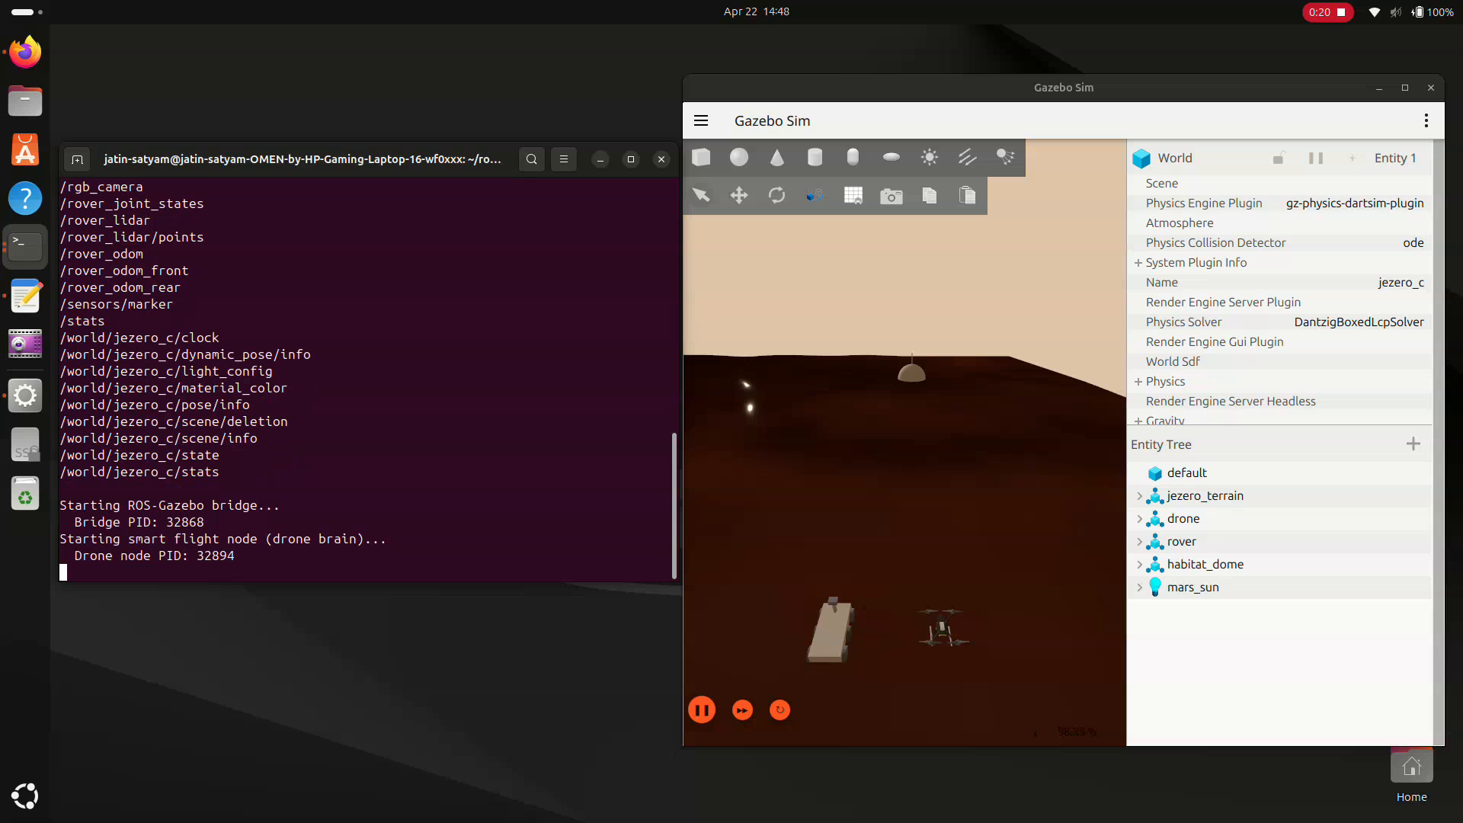
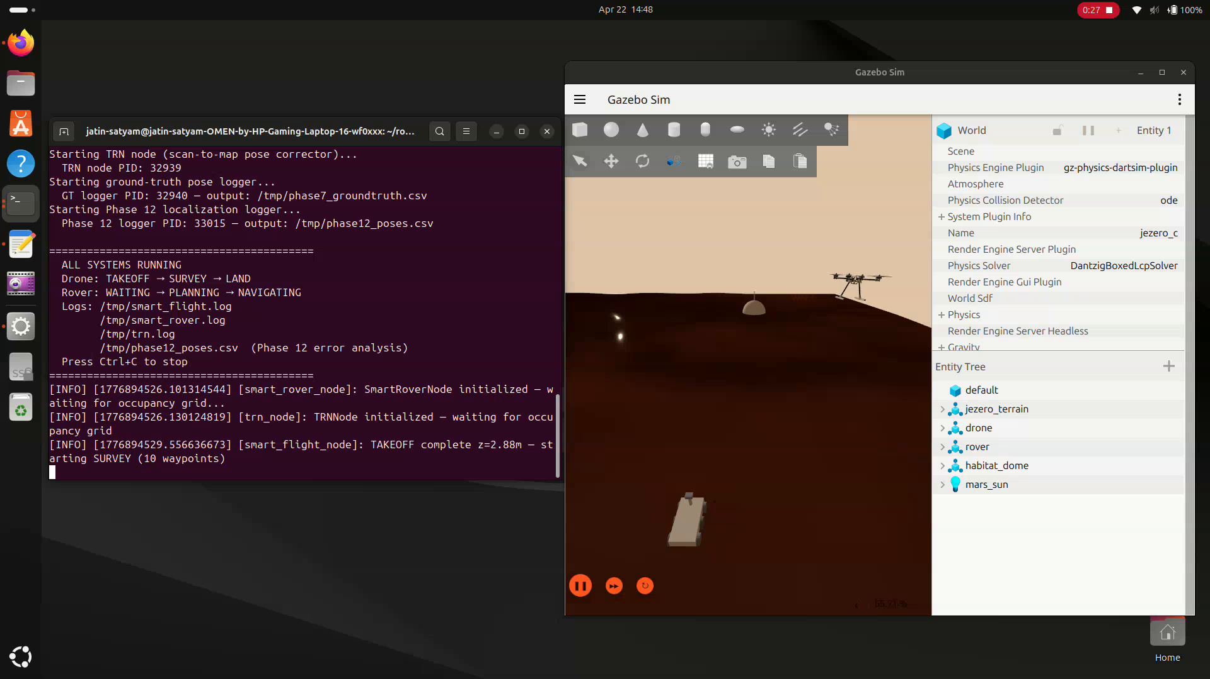
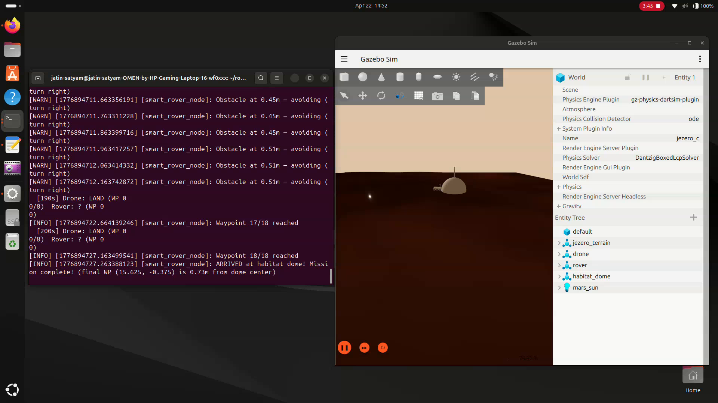
Simulation Environment & Demonstration
Mission start: X500 drone +
Mars rover on Jezero terrain
ALL SYSTEMS RUNNING:
Drone SURVEY · Rover NAVIGATING · TRN active
Mission complete:
WP 18/18 · 0.73m from dome center
Path to real deployment via PX4 Autopilot
Drone control layer uses uXRCE-DDS — identical bridge used in PX4 production hardware stack.
Replacing SITL with Pixhawk 6C preserves same DDS namespace + mission_config.yaml.
Offboard mode arming + 10 Hz TrajectorySetpoint sequence is identical between SITL and hardware.
11 / 12

Slide 12
Conclusion
What was demonstrated
A path-conditioned gain function that generalises RaEM's discrete-waypoint masking to a soft path-likelihood prior, applied to a HiRISE-derived 3DGS reconstruction of Jezero Crater. Path-conditioning shifts the selected viewpoint relative to a uniform-weight baseline — the pilot shows the specialisation is grounded in something concrete.
Honest scope
Future work
· Sim-only — no real hardware (LSRC, ActiveGS, Traversing Mars all have real demos)
· Offline 3DGS pipeline — online front-end not implemented
· Single fixed rover trajectory — probabilistic plans not exercised
· Per-Gaussian proxy is weak — calibrated UE is plug-and-play upgrade
· Stream MonoGS / MASt3R front-end on RTX 4060
· Upgrade to Predictive Photometric Uncertainty
· Wrap NBV planner in ROS2 node + integrate with flight loop
· Crazyflie / Tello + TurtleBot tabletop real-hardware demo
· Multi-drone extension
35%
29
7pp
TRUE
Confidence cap —
honest specialisation
References
cited
IEEE-format
report
Selection
differs
12 / 12
Each ingredient is precedented. The recipe, as far as we can tell, is not.

