Slide 1

ELECTRICITY BILL MANAGEMENT
JATIN SHARMA KATIAN​​

Slide 2
INTRODUCTION
Online Billing System is an Executive Information System(EIS) that determines the bill of consumed power per unit time and performs computation based on the sale rate of power per unit time .
It provides an environment to maintain the consumer details.
In this system Customers can pay their bills just by logging into system.
It is well organized software solution for billing.

Slide 3
SCOPE OF PROJECT:
TO make the existing billing system more efficient.
To minimize the time.
Easy to pay the bill of electricity.
The main objective of Electricity Bill system is to manage the details of Electricity , Bill, Connections, Customer.

Slide 4
PROJECT AND OBJECTIVE:
To design a user friendly graphical user interface
It takes very less time.
We don’t have to remember the last month bill, it automatically saves in system.
User friendly and environment friendly.
We don’t need to stand in long lines.

Slide 5
Non functional Objective
Speed: The system should be fast to access and should not slow down.
Reliability: The system should be reliable to use all time.
Performance: The system should be able to perform good all times.
Security: The system should be secure to give the user of sense of security.
f

Slide 6
System Requirements
Windows 10 or more
Front end –Visual Studio Code
Backend –Intelli j
Database –MY SQL workbench

Slide 7
REQUIREMENTS
The Electricity Bill System shall be required to maintain information about its Admin and User.
It needs user credentials.
After Login, it needs New User’s data like name, Id, Password, Address, etc.
And also needs some validation
We also need for Database to store our data.
ELECTRICITY BILL MANAGEMENT

Slide 8
HTML ,CSS ,JavaScript (React) My SQL workbench Java/Spring Boot Internet Connection
Development tools and techniques

Slide 9
Task of ADMIN:
Admin Login
Reference Id
Add User
View all Bill
Add Bill
Show Users
Logout

Slide 10
Customer Functionalities
Sign Up: The user should be able to sign up to setup a new account.
Login: All users should be able to login into the system.
View Bill: User should be able to view their electricity bill.
Pay Bill: User should be able to pay their electricity bill online.

Slide 11
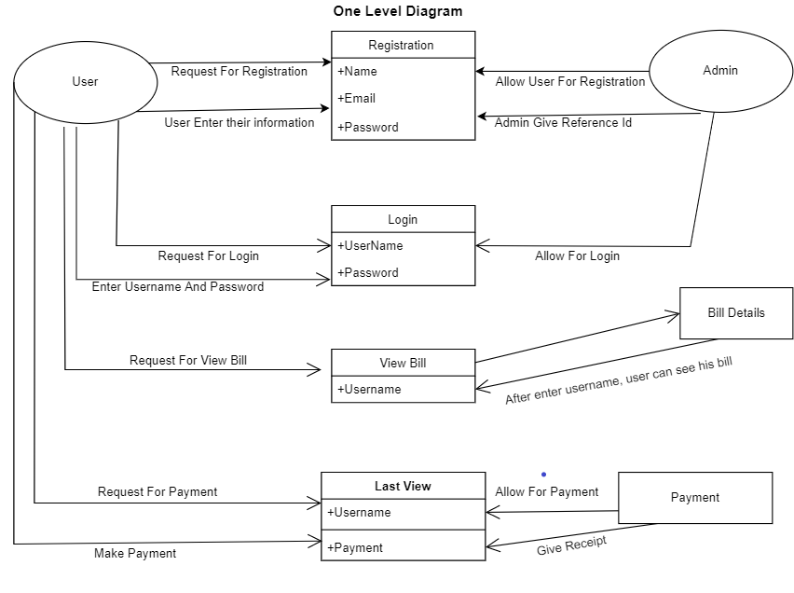
Project Flow

Slide 12
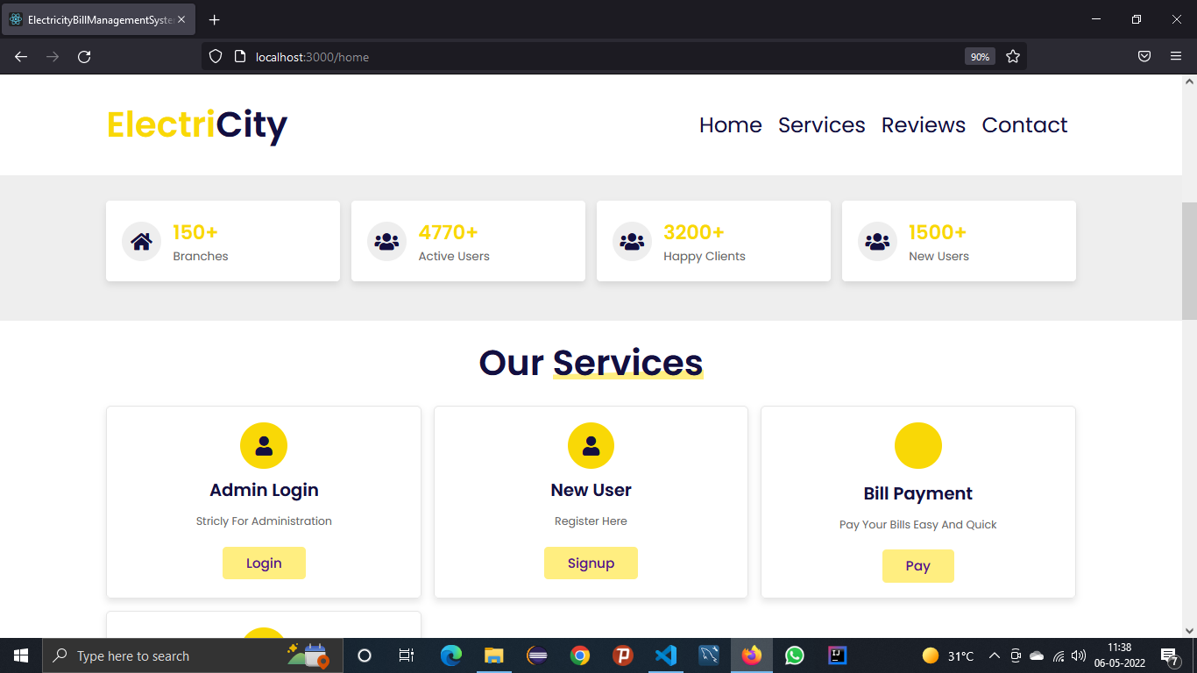
Screenshots

Slide 13
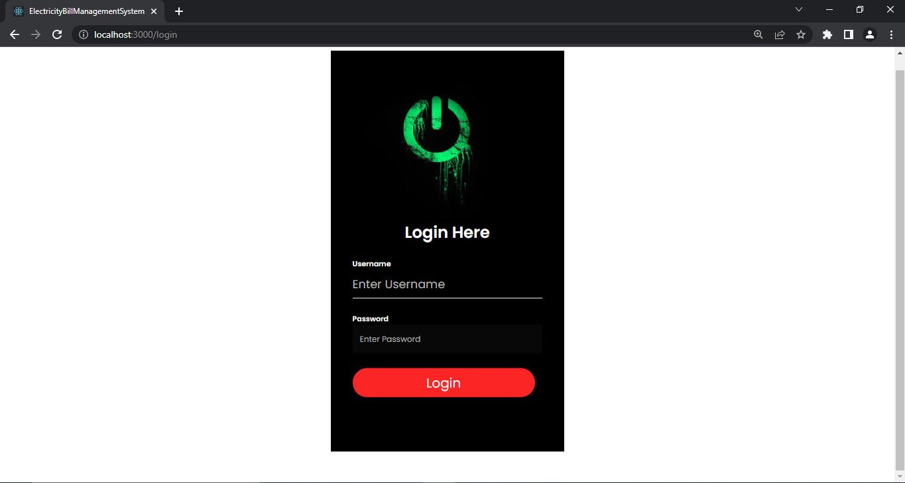

Slide 14
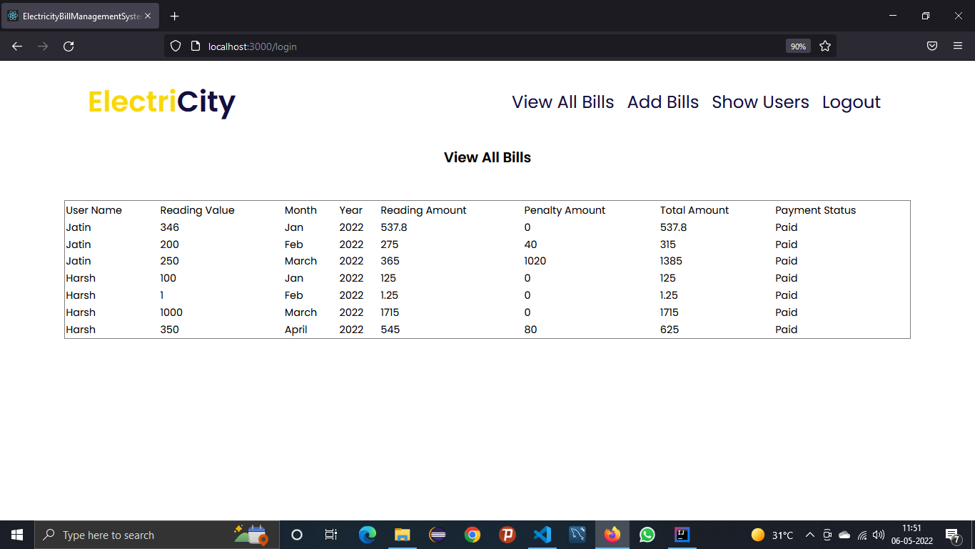

Slide 15
Future Scopes
- Developing security features
- Developing Feedback and Complaint section
- Developing Database editors
- Developing Bill Generation Scheme

Slide 16
Summary
We have left very much options open so that if there is any other future requirement in the system by the user for the enhancement of the system then it is possible to implement them .
In the last I would like to thanks all the persons involved in the development of system directly or indirectly. I am also thankful to Chitkara University, to provide us a fruitful training.
I hope that the project will serve its purpose for which it is develop there by underlining success of process.

Slide 17
THANK YOU
JATIN SHARMA KATIAN
1911985009

