Slide 1


Predicting Customer Churn in Telecommunication Company
Team members:
Jitender Dhariwal : R2142201723
Jatin Wadhwa : R214220562
Kartikay Tyagi : R214220603
Jatin Joshi : R214220559
Karan Taneja : R214220587
Guided by : Mr. Sumit Shukla

Slide 2
Content
Introduction
Literature Review
Objectives
Methodology
Working Model
Results
Conclusion
References

Slide 3
Introduction
Motivation
In the competitive telecom sector, curbing customer churn is vital. Our project's essence is enabling predictive insights through data analysis, enhancing customer retention strategies. By decoding hidden patterns, we empower companies to proactively engage customers, fostering lasting loyalty and reshaping the industry landscape.
Problem Statement
In the telecom world, losing customers is a big problem. The company wants to stop this from happening by figuring out which customers might leave. We will use past customer information to build models that predict who might leave. This will help the company take actions to keep those customers happy and stay with them.
Area of application
The application of our project extends to the entire telecommunication industry. Companies facing customer churn issues can benefit from our predictive insights. Whether it's mobile, internet, or other telecom services, our models offer actionable strategies to retain customers. By enhancing customer satisfaction and loyalty, our project's outcomes can reshape how telecommunication services are delivered and received.

Slide 4
Technical background of project
Our project employs Logistic Regression, Support Vector Machines (SVM), and Random Forest, crucial algorithms for predicting customer churn.
Logistic Regression calculates the likelihood of churn based on customer attributes.
SVM optimally separates churned and non-churned customers.
Random Forest combines decision trees for robust predictions.
Data preprocessing handles missing values, normalization, and dataset splitting. We optimize each algorithm's parameters for accurate predictions.
Metrics like accuracy, precision, recall, and F1-score evaluate model performance.
In summary, our technical approach blends these algorithms to predict churn, enhancing customer retention strategies.

Slide 5
Dataset
The data set includes information about:
Customers who left within the last month – the column is called Churn
Services that each customer has signed up for – phone, multiple lines, internet, online security, online backup, device protection, tech support, and streaming TV and movies
Customer account information – how long they’ve been a customer, contract, payment method, paperless billing, monthly charges, and total charges
Demographic info about customers – gender, age range, and if they have partners and dependents
Each row in the dataset represents a customer, each column contains customer’s attributes described on the column Metadata.
The raw data contains 7043 rows (customers) and 21 columns (features).
The “Churn” column is our target.
N

Slide 6
Literature Review
Existing research underscores the paramount importance of predicting customer churn in the dynamic telecom sector. Various studies accentuate the economic advantages of retaining existing customers as opposed to acquiring new ones. Leveraging data-driven techniques, notably machine learning, unveils concealed patterns within customer data, significantly enhancing the accuracy of churn prediction models. Furthermore, the significance of feature selection, sentiment analysis integration, and the role of predictive analytics cannot be understated in constructing precise models and crafting personalized retention strategies. Collectively, the literature review emphasizes that effective churn prediction plays a pivotal role in ensuring sustainable growth within the telecommunications industry. These insights have the potential to reshape customer-centric approaches and foster transformative outcomes for businesses in this domain.

Slide 7
SWOT analysis
Strengths:
Data-Driven Insights: Our project can provide deep insights into customer behavior and patterns.
Competitive Advantage: Having accurate churn prediction models grants the company a competitive edge in the market by tailoring strategies for individual customer needs.
Weaknesses:
Data Quality: Accuracy of predictions heavily relies on the quality and completeness of historical customer data.
Complexity: Developing predictive models and integrating them into the company's operations might require technical expertise and time.
Opportunities:
Market Leadership: Successful churn prediction can position the company as an industry leader in customer-centric services and strategies.
Threats:
Privacy Concerns: Analyzing customer data might raise privacy concerns, necessitating adherence to stringent data protection regulations.

Slide 8
Objective
Main Objective
To develop an accurate and effective customer churn prediction model for a telecommunication company, enhancing customer retention strategies and contributing to business growth.
Sub Objective
Data Preparation and Exploration:
Gather historical customer data.
Clean and organize data for analysis.
Model Development and Validation:
Build predictive models using machine learning.
Validate models with real-world data.
Insight Generation:
Extract patterns and trends from customer behavior data.
Provide actionable insights for retention strategies.
Integration and Communication:
Integrate the model into company systems.
Communicate results to stakeholders effectively.

Slide 9
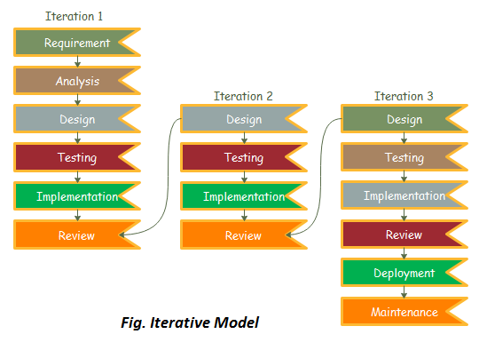
Methodology
Reference Software model
We have used the Iterative Model to implement our project. The iterative method begins with a basic implementation of a limited set of software requirements in the iterative model, then repeatedly improves the evolving versions until the entire system is built and prepared for deployment. ​

Slide 10
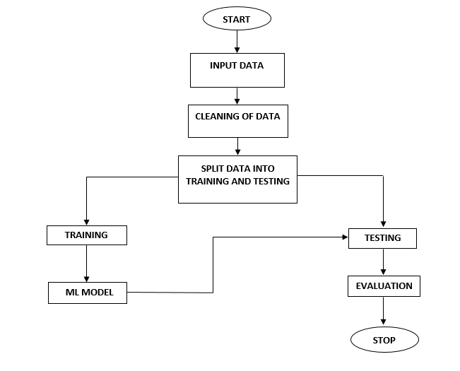
FLOWCHART

Slide 11
Deliverable of each steps or phase
Data Collection:
Collecting cleaned and organized historical customer data ready for analysis.
Data Preprocessing:
The next step is to preprocess the collected data. The collected data should be cleaned, processed, and formatted before using it for model training. The data cleaning process may involve removing missing values, handling outliers, and encoding categorical variables.
Feature Selection:
After data preprocessing, we need to select the most relevant features for churn prediction

Slide 12
Model Selection:
The next step is to select an appropriate machine learning model for churn prediction We can use various machine learning models such as decision trees, random forest, support vector machine (SVM), Naïve bayes and KNN.
Model Training:
Once we have selected the appropriate model, we need to train the model on the preprocessed data. The dataset has been splitted into training and testing sets. The training set is used to train the model, and the testing set is used to evaluate the performance of the model.
Model Evaluation:
After training the model, we need to evaluate the performance of the model using various metrics such as accuracy

Slide 13
Our project's use of Logistic Regression, Support Vector Machines (SVM), and Random Forest has yielded valuable insights and predictive capabilities in the context of customer churn prediction for the telecommunication company. Among these algorithms, Support Vector Machines yielded the highest accuracy, making it the optimal choice for accurate churn prediction.
Results

Slide 14
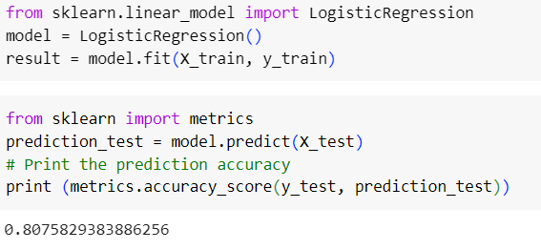
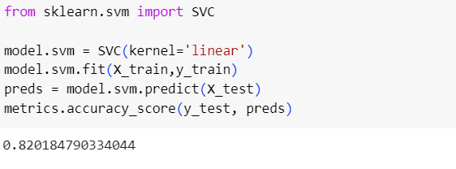
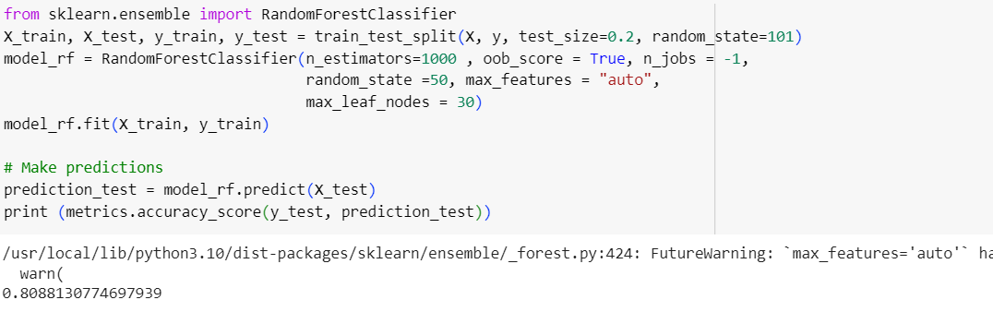
Working Model
SVM
Logistic Regression
Random forest

Slide 15
Conclusion
Our project's focus on predicting customer churn in the telecommunication industry holds immense promise for boosting customer retention and overall business success. Through data analysis, model development, and actionable insights, we equip the company to proactively address churn. By leveraging predictive analytics, we empower the company to anticipate customer behavior and implement personalized retention strategies. This project's significance lies in its potential to reshape customer interactions, fostering loyalty, satisfaction, and market standing. Ultimately, embracing advanced analytics and predictive modeling showcases the path to customer-centric growth and sustained achievement.

Slide 16
Future Scope
Enhanced Personalization: Incorporate more granular customer data, such as browsing behavior and customer feedback, to refine predictive models and tailor strategies even further.
Real-time Insights: Develop a system that provides real-time churn predictions, enabling immediate action and interventions to prevent customer attrition.
External Data Sources: Integrate external data sources like social media trends or economic indicators to enrich predictive models and capture a broader view of customer behavior.

Slide 17
Reference
Iris Figalist, Christoph Elsner, Jan Bosch, Helena Holmstrom Olsson. “Customer Churn Prediction in B2B Contexts” [2019]
Pallav Routh, Arkajyoti Roy, Jeff Meyer. “Estimating customer churn under competing risks”. August 2020 Journal of the Operational Research Society.
Ahmad Hammoudeh, Malak Fraihat, Mahmoud Almomani. Selective Ensemble Model for Telecom Churn Prediction.[2019]
Debjyoti Das Adhikary, Deepak Gupta. “Applying over 100 classifiers for churn prediction in telecom companies.” Multimedia Tools and Applications[2020]
Ullah, B. Raza, A. K. Malik, M. Imran, S. U. Islam and S. W. Kim, "A Churn Prediction Model Using Random Forest: Analysis of Machine Learning Techniques for Churn Prediction and Factor Identification in Telecom Sector," in IEEE Access, vol. 7, pp. 60134-60149, 2019.
Ahmet Tuğrul Bayrak, Asmin Alev Aktaş, Orkun Susuz, Okan Tunalı. ”Churn Prediction with Sequential Data Using Long Short Term Memory”[2021]

Slide 18
Thank You

