Slide 1

Note: The data and information in this document is reflective of a hypothetical situation and client. This document is to be used for KPMG Virtual Internship purposes only.
Sprocket Central Pty Ltd
Data analytics approach
Junior Consultant: Jatinder Singh Malhi

Slide 2
Note: The data and information in this document is reflective of a hypothetical situation and client. This document is to be used for KPMG Virtual Internship purposes only.
Agenda
Introduction
Data Exploration
Model Development
Interpretation

Slide 3

Note: The data and information in this document is reflective of a hypothetical situation and client. This document is to be used for KPMG Virtual Internship purposes only.
Introduction
Data Cleaning
Missing values dropped
Columns formatted for analysis
Datasets joined for the better investigation process
Place any supporting images, graphs, data or extra text here.

Slide 4
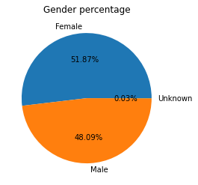
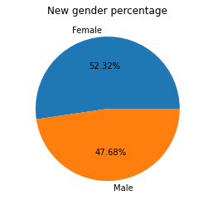
Note: The data and information in this document is reflective of a hypothetical situation and client. This document is to be used for KPMG Virtual Internship purposes only.
Data Exploration
Gender Percentage

Slide 5
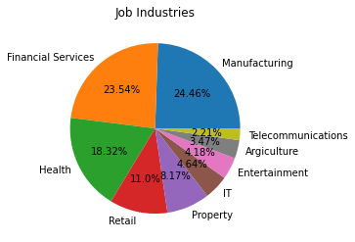
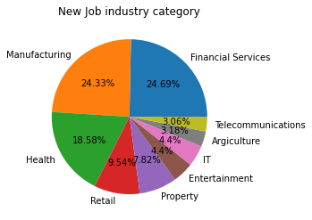
Note: The data and information in this document is reflective of a hypothetical situation and client. This document is to be used for KPMG Virtual Internship purposes only.
Data Exploration
Job Industry Category Percentage

Slide 6
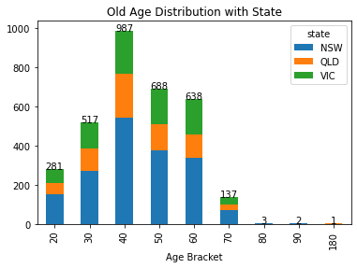
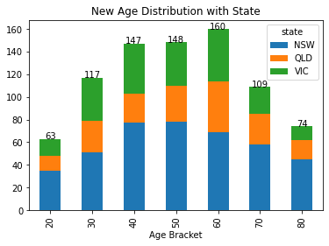
Note: The data and information in this document is reflective of a hypothetical situation and client. This document is to be used for KPMG Virtual Internship purposes only.
Data Exploration
State with Age Distribution

Slide 7
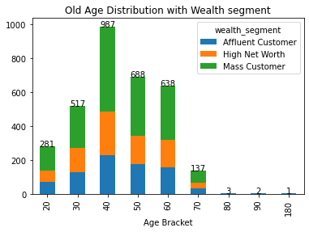
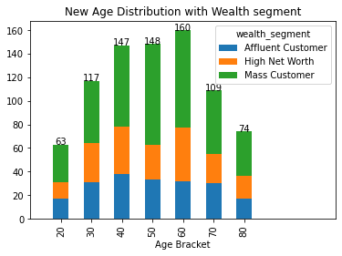
Note: The data and information in this document is reflective of a hypothetical situation and client. This document is to be used for KPMG Virtual Internship purposes only.
Data Exploration
Wealth Segment with Age Distribution

Slide 8
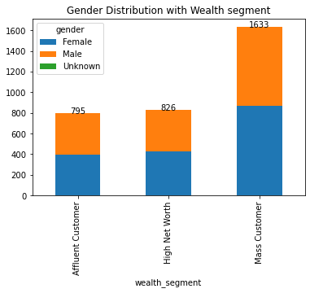
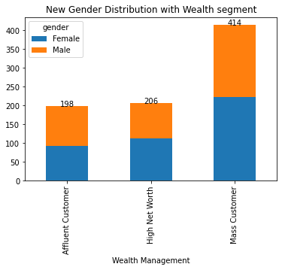
Note: The data and information in this document is reflective of a hypothetical situation and client. This document is to be used for KPMG Virtual Internship purposes only.
Data Exploration
Gender Distribution with Wealth Segment

Slide 9
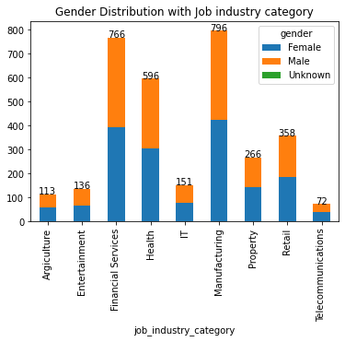
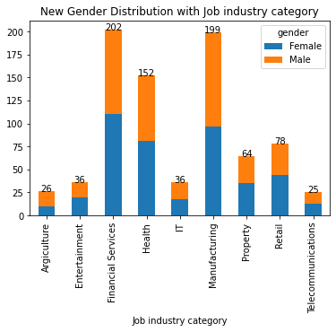
Note: The data and information in this document is reflective of a hypothetical situation and client. This document is to be used for KPMG Virtual Internship purposes only.
Data Exploration
Gender Distribution with Job Industry Category

Slide 10
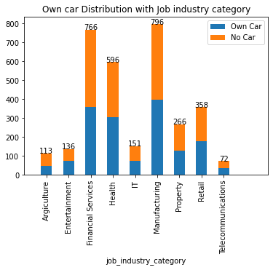
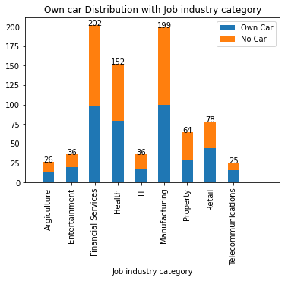
Note: The data and information in this document is reflective of a hypothetical situation and client. This document is to be used for KPMG Virtual Internship purposes only.
Data Exploration
Car Owner Distribution with Job Industry Category

Slide 11
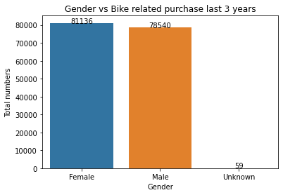
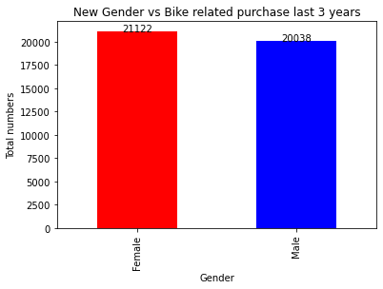
Note: The data and information in this document is reflective of a hypothetical situation and client. This document is to be used for KPMG Virtual Internship purposes only.
Data Exploration
Gender Distribution with Last 3 Years Bike Purchase

Slide 12

Note: The data and information in this document is reflective of a hypothetical situation and client. This document is to be used for KPMG Virtual Internship purposes only.
Model Development
Target Customers
  (GENDER) Female
  (AGE) Aged between 40 –60.
  (WEALTH SEGMENT) Mass customers
  (SECTOR) Financial Service, Manufacturing and Health.
  (AREA) New South Wales and Victoria.

Slide 13
Note: The data and information in this document is reflective of a hypothetical situation and client. This document is to be used for KPMG Virtual Internship purposes only.
Interpretation
Valuable Customers
Customer ID | Bike Related Purchases for the last 3 years | Age | Job Industry | Wealth Segment | Own Cars | State
272 | 99 | 45 | Manufacturing | Mass Customer | No | NSW
546 | 99 | 50 | Financial Services | Mass Customer | No | NSW
683 | 98 | 44 | Health | Mass Customer | Yes | NSW
685 | 95 | 42 | Entertainment | Mass Customer | Yes | NSW
253 | 91 | 41 | IT | Mass Customer | No | NSW

Slide 14
Note: The data and information in this document is reflective of a hypothetical situation and client. This document is to be used for KPMG Virtual Internship purposes only.
Thank You

