Slide 1


PIZZA SALES
ANALYsis
Using MySQL
Jatindra Patel

Slide 2
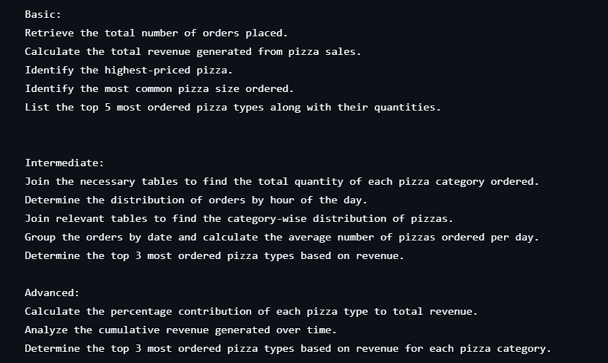
Jatindra Patel

Slide 3
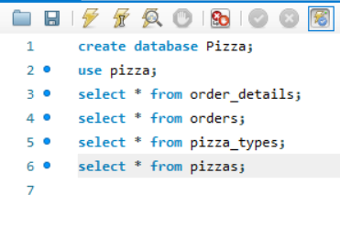
General Queries :-
Database Name and Table name
Jatindra Patel

Slide 4
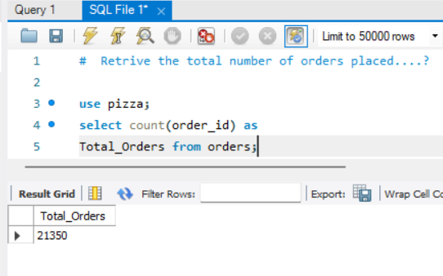
Q :- Retrive the total number of orders placed....?
Jatindra Patel

Slide 5
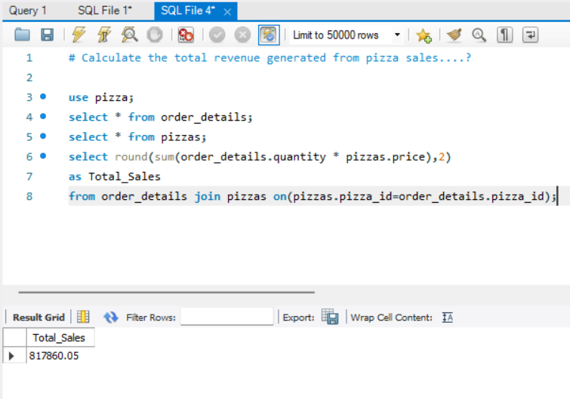
Q :- Calculate the total revenue generated from pizza sales....?
Jatindra Patel

Slide 6
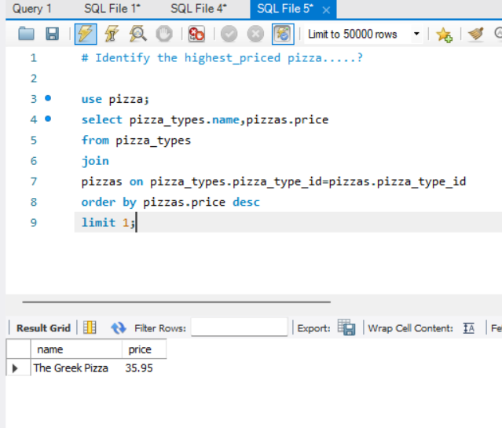
Q :- Identify the highest_priced pizza.....?
Jatindra Patel

Slide 7
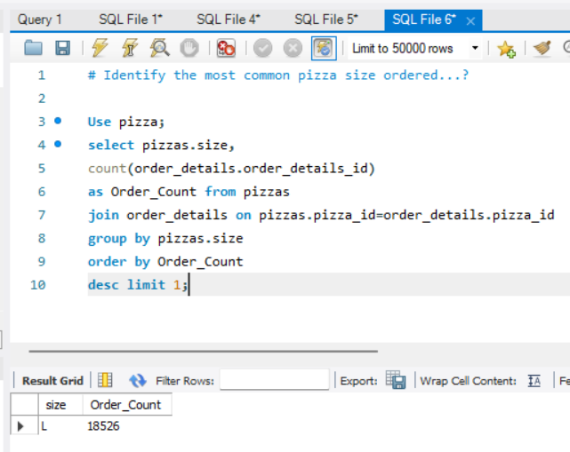
Q :- Identify the most common pizza size ordered...?
Jatindra Patel

Slide 8
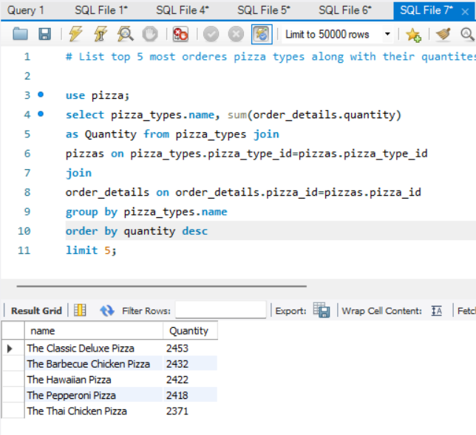
Q :- List top 5 most orderes pizza types along with their quantites....?
Jatindra Patel

Slide 9
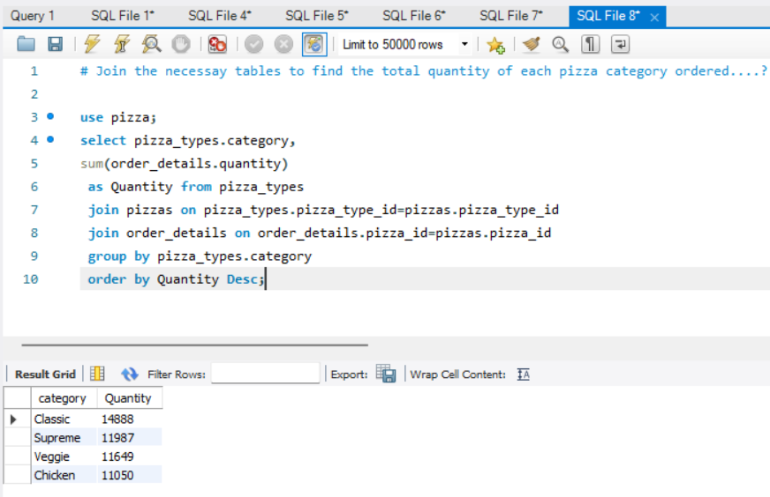
Q :- Join the necessary tables to find the total quantity of each pizza category ordered....?
Jatindra Patel

Slide 10
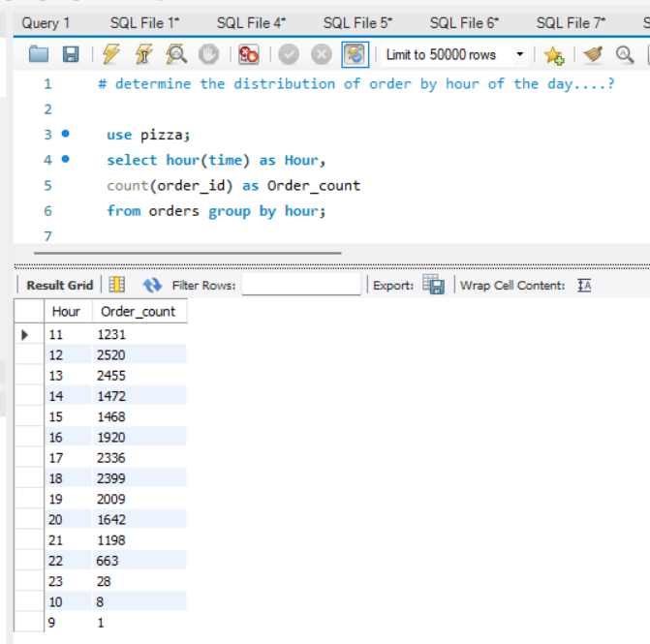
Q :- Determine the distribution of order by hour of the day....?
Jatindra Patel

Slide 11
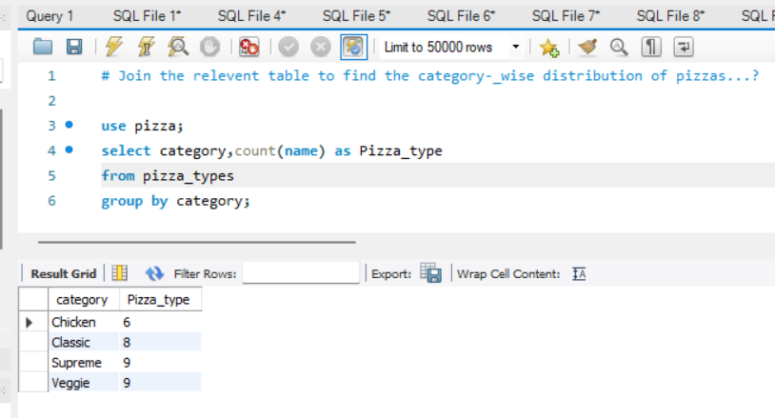
Q :- Join the relevent table to find the category-_wise distribution of pizzas...?
Jatindra Patel

Slide 12
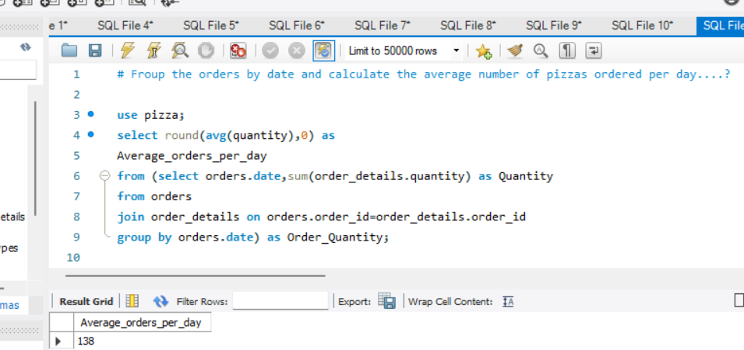
Q :- Group the orders by date and calculate the average number of pizzas ordered per day....?
Jatindra Patel

Slide 13
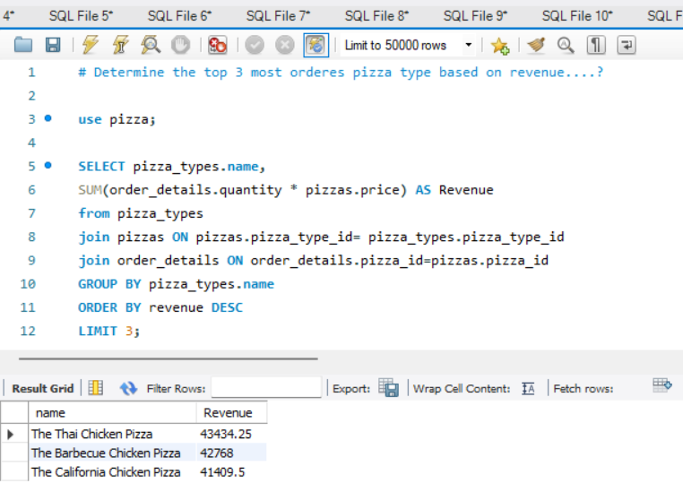
Q :- Determine the top 3 most orderes pizza type based on revenue....?
Jatindra Patel

Slide 14
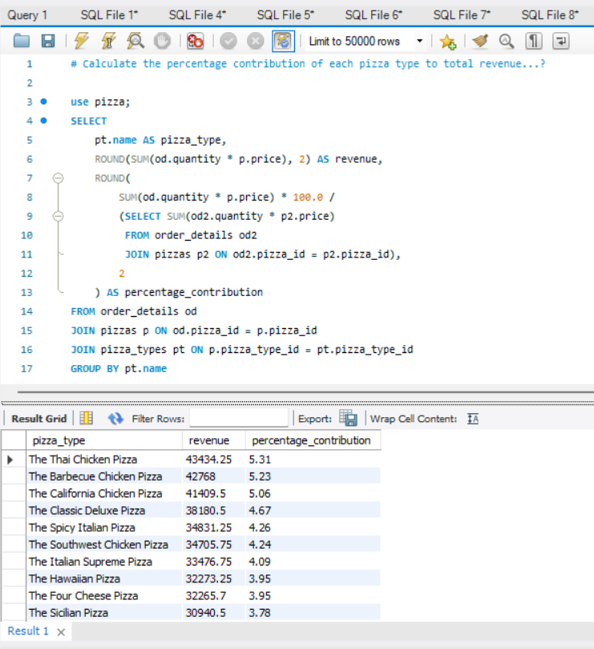
Q :- Calculate the percentage contribution of each pizza type to total revenue...?
Jatindra Patel

Slide 15
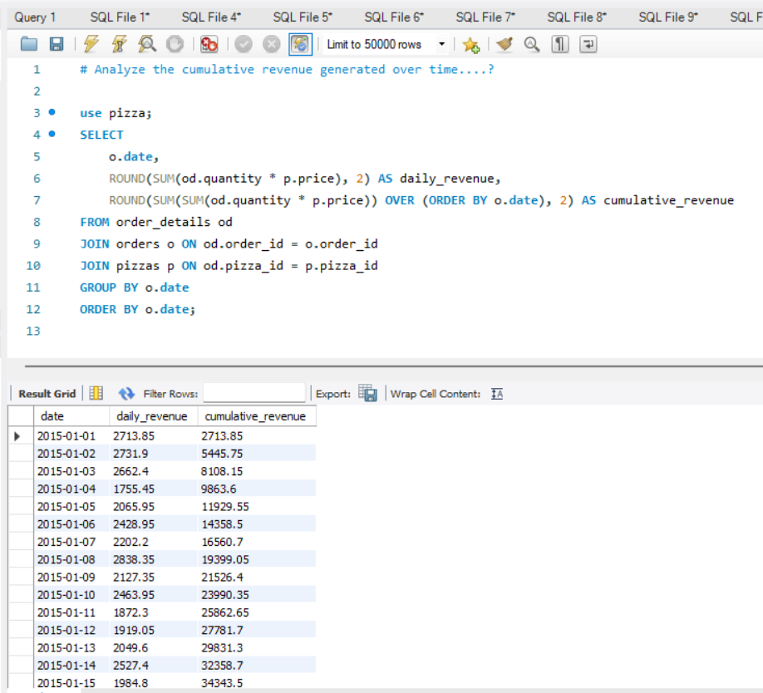
Q :- Analyze the cumulative revenue generated over time....?
Jatindra Patel

Slide 16
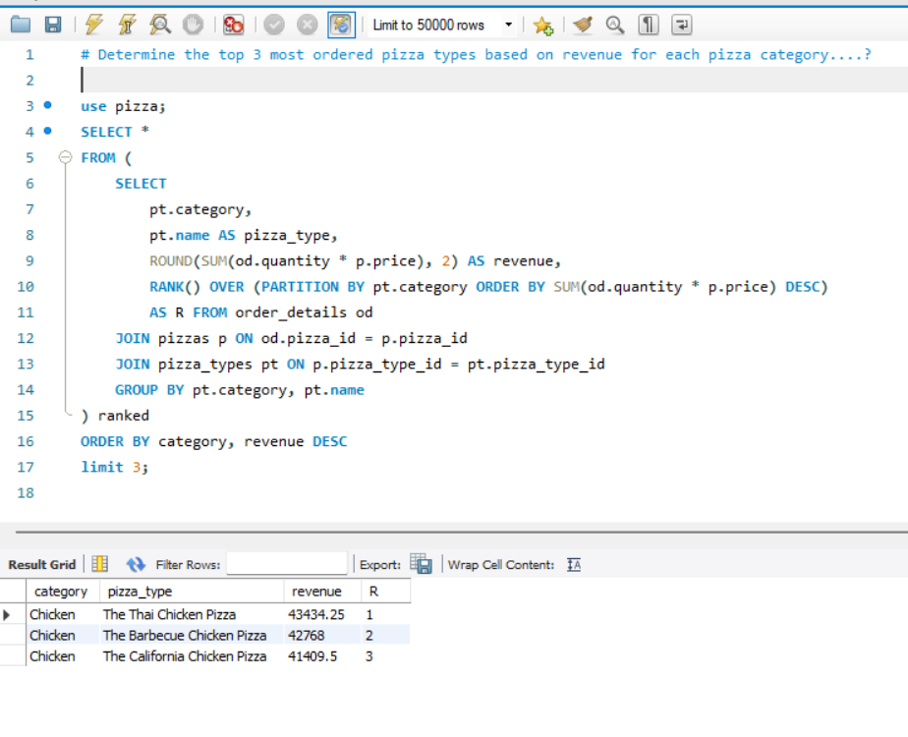
Q :- Determine the top 3 most ordered pizza types based on revenue for each pizza category....?
Jatindra Patel

Slide 17
Pizza Sales Analysis Summary :-
This analysis uses SQL queries to uncover key insights from pizza sales data. It covers total orders, revenue, top-selling pizzas, popular sizes, and category-wise trends. Advanced metrics like hourly order patterns, daily averages, and revenue contributions were also calculated to support strategic decision-making in menu optimization and customer targeting.
Jatindra Patel

