Slide 1
DATA ANALYTICS PROJECT
Retail Sales &
Customer Analysis
Dashboard
An End-to-End Business Intelligence Project
From Data Collection to Interactive Dashboard
Prepared by: Jatindra Patel | Domain: Retail Analytics | Tools: Kaggle · Excel · AWS · SQL · Python · Power BI

Slide 2
PROJECT OVERVIEW
Table of Contents
01
Business Problem & Objectives
06
Star Schema Design
02
Data Sources & Architecture
07
SQL Analysis & KPIs
03
Data Pipeline & Workflow
08
Exploratory Data Analysis (Python)
04
Data Cleaning (MS Excel)
09
Power BI Dashboard
05
ETL Process & AWS Cloud Setup
10
Key Insights & Recommendations

Slide 3
BUSINESS CONTEXT
Business Problem & Objectives
⚠ BUSINESS CHALLENGES
✓ PROJECT OBJECTIVES
✗ Limited visibility into product performance
✓ Understand overall sales performance & trends
✗ No centralized reporting for sales trends
✓ Identify top-performing products & categories
✗ Difficulty identifying high-value customers
✓ Analyze customer purchasing behavior
✗ Inefficient decisions due to scattered data
✓ Track monthly & regional sales patterns
✗ Manual, error-prone data handling processes
✓ Build KPI dashboard for data-driven decisions
"Transform raw retail data into actionable business intelligence for smarter decision-making"

Slide 4
DATA FOUNDATION
Data Sources & Dataset Architecture
📦 Source: Kaggle Platform
Dataset: Northwind Retail Database | Format: CSV | Time Period: 2013 – 2015
📋 orders.csv
👥 customers.csv
📦 products.csv
OrderID, CustomerID, Dates, Freight
CustomerID, Company, City, Country
ProductID, Name, UnitPrice, Category
830 records
91 records
77 records
🧾 order_details.csv
🏷️ categories.csv
🚛 shippers.csv
OrderID, ProductID, Qty, Discount
CategoryID, CategoryName, Description
ShipperID, CompanyName
2,155 records
8 records
3 records
TOTAL: 6 Tables | ~3,164 Records | 10 Attributes across Fact & Dimension tables

Slide 5
PROJECT METHODOLOGY
End-to-End Data Pipeline & Workflow
1
2
3
4
5
6
☁️
📊
⚙️
🔍
🐍
📈
▶
▶
▶
▶
▶
Kaggle
MS Excel
AWS RDS
SQL
Python
Power BI
Data Collection
Data Cleaning
ETL & Upload
Analysis
EDA
Dashboard
Extract
Clean
Transform
Analyze
Explore
Visualize
Download CSV files from Kaggle retail dataset repository
Remove duplicates, handle nulls, standardize formats in Excel
ETL design, schema creation, load to AWS-hosted SQL database
SQL queries for KPIs, aggregations, JOINs, CTEs
Python EDA — distributions, correlations, trend analysis
Interactive Power BI dashboard with filters and drilldowns

Slide 6
STEP 1 › DATA CLEANING
Data Cleaning & Preprocessing in MS Excel
🗑️ Duplicate Removal
🔧 Null Value Handling
📅 Date Standardization
Identified and removed duplicate OrderIDs and CustomerIDs to prevent double-counting in analysis.
Missing values imputed, removed, or replaced based on context (dates, freight, customer info).
Ensured consistent DD/MM/YYYY format across OrderDate, ShippedDate, and RequiredDate columns.
🔡 Text Normalization
🏗️ Column Standardization
💱 Data Type Validation
Standardized text case, trimmed whitespace, and corrected misspellings in category/product names.
Renamed columns for SQL compatibility — removed spaces, special characters, ensured unique keys.
Converted UnitPrice, Freight, Quantity to numeric; validated referential integrity across tables.
✓ Result: Clean, validated, SQL-ready dataset exported from Excel into structured CSV format

Slide 7
STEP 2 › ETL & CLOUD SETUP
ETL Pipeline & AWS Cloud Database Setup
EXTRACT
☁ AWS CLOUD ENVIRONMENT
Read cleaned CSV files from Excel
Validate structure & record counts
Prepare for transformation stage
🗄️ Database: AWS RDS / MySQL hosted instance
▼
🔐 Secure connection via credentials & endpoint
TRANSFORM
Define Star Schema relationships
Create dimension & fact table keys
Apply data type casting & constraints
📡 Remote SQL access from local workstation
📁 Tables: orders, customers, products, categories, shippers, order_details, Fact_Sales
▼
LOAD
Provision AWS RDS / SQL database
Import transformed data via SQL
Verify row counts & integrity
🔑 Primary Keys & Foreign Keys established for all tables
✅ Data validation queries ran post-load to verify integrity
☁ Cloud Advantage: Scalable, secure, accessible database infrastructure on AWS

Slide 8
STEP 3 › DATA MODELING
Star Schema Design — Fact & Dimension Tables
DIM_ORDERS
DIM_PRODUCTS
OrderID (PK)
ProductID (PK)
OrderDate
⭐ FACT_SALES
ProductName
Freight
UnitPrice
ShipperID
OrderID (PK)
CategoryID
ProductID (FK)
CustomerID (FK)
ShipperID (FK)
Quantity
DIM_CUSTOMERS
UnitPrice
DIM_CATEGORIES
Discount
CustomerID (PK)
SalesAmount
CategoryID (PK)
CompanyName
CategoryName
City
Description
Country
★ Created Fact_Sales by combining order_details with orders, customers & products using SQL JOINs and Python — used as the central table for both SQL analysis and Power BI Star Schema

Slide 9
STEP 4 › SQL ANALYSIS
Data Analysis Using SQL Queries
Aggregate Functions
GROUP BY / ORDER BY
📊 KEY KPIs DERIVED FROM SQL
SUM, AVG, COUNT, ROUND
Category & product ranking
▸ Total Revenue: $1.27M
JOINs
CTEs
▸ Total Orders: 830
INNER, LEFT across 5 tables
Common Table Expressions for sub-queries
▸ Total Customers: 89
Window Functions
HAVING Clause
▸ Top Product: Côte de Blaye
Running totals & monthly trends
Filter aggregated results
▸ Top Category: Beverages
▸ Best Month: April 2014
▸ Avg Order Value: ~$1,525
▸ Growth Rate: YoY trend analyzed
$1.27M
830
89
77
Total Revenue
Total Orders
Customers
Products

Slide 10
STEP 5 › PYTHON EDA
Exploratory Data Analysis — Python (Google Colab)
🐍 PYTHON LIBRARIES USED
🔍 ANALYSIS PERFORMED
Pandas
Data manipulation, merging, groupby aggregations
◆ Sales distribution by category & product
◆ Monthly revenue trend analysis (time series)
NumPy
Numerical computations and array operations
◆ Customer order frequency & value segmentation
Matplotlib
Static visualizations — bar, line, pie charts
◆ Discount impact on revenue & profit
◆ Top 10 customers by total purchase value
Seaborn
Statistical plots — heatmaps, boxplots, distributions
◆ Correlation heatmap — price, quantity, discount
Plotly
Interactive charts and trend visualizations
◆ Geographical sales distribution by country
◆ Shipper performance & freight cost analysis
📓 Delivered as Google Colab (.ipynb) with inline charts, markdown explanations & code comments

Slide 11
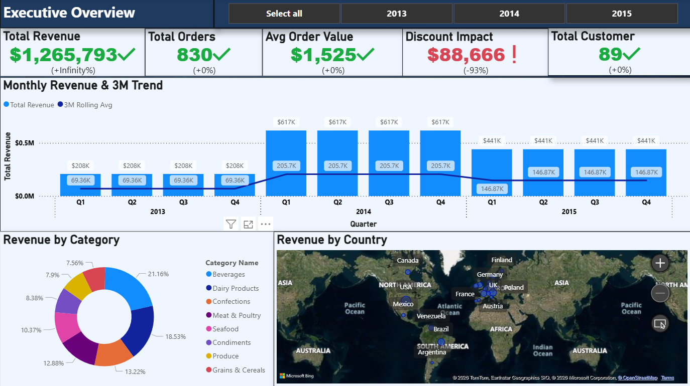
STEP 6 › VISUALIZATION
Power BI Interactive Dashboard
⚡ POWER BI | Retail Sales & Customer Analysis Dashboard {Executive Summary}
⚡ Final .pbix file published with interactive filters, drill-through, and KPI cards for management reporting

Slide 12
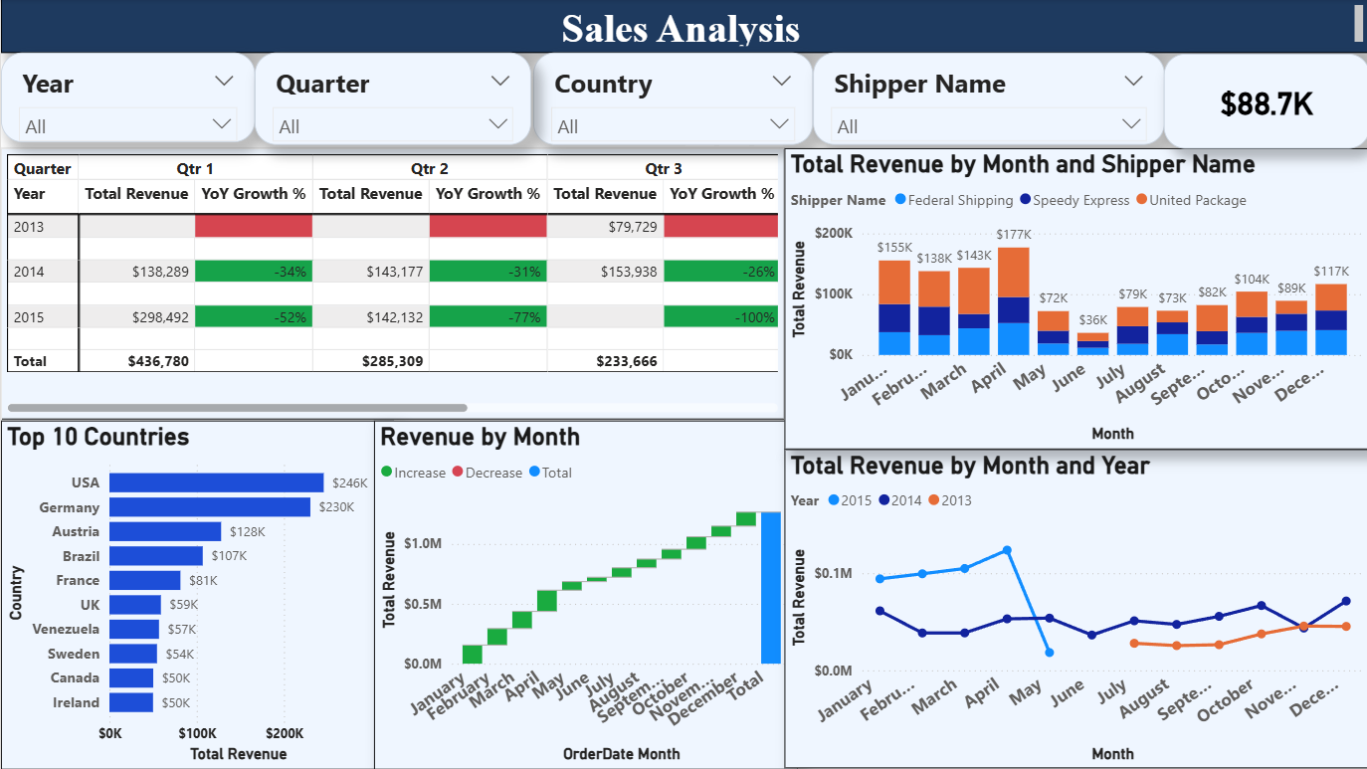
STEP 6 › VISUALIZATION
Power BI Interactive Dashboard
⚡ POWER BI | Retail Sales & Customer Analysis Dashboard {Sales Analysis}
⚡ Final .pbix file published with interactive filters, drill-through, and KPI cards for management reporting

Slide 13
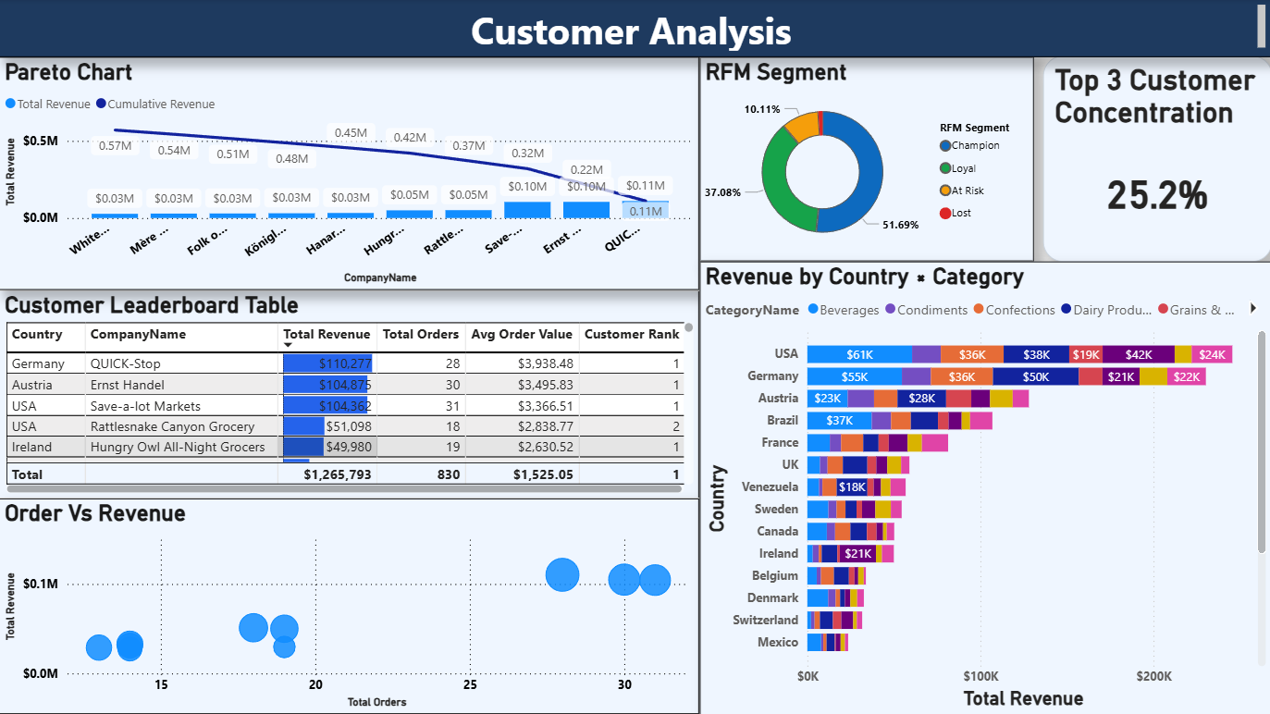
Shows overall KPIs like revenue, orders, customers
Provides quick business performance overview
STEP 6 › VISUALIZATION
Power BI Interactive Dashboard
⚡ POWER BI | Retail Sales & Customer Analysis Dashboard { Customer Analysis }
⚡ Final .pbix file published with interactive filters, drill-through, and KPI cards for management reporting

Slide 14
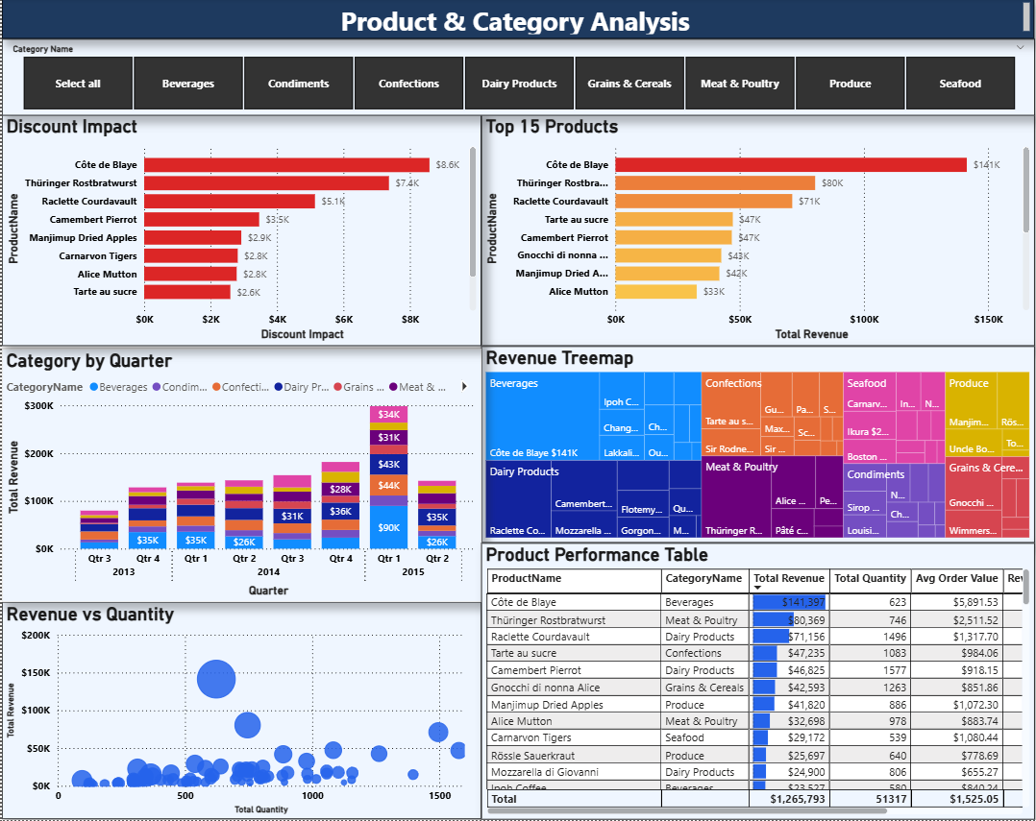
STEP 6 › VISUALIZATION
Power BI Interactive Dashboard
⚡ POWER BI | Retail Sales & Customer Analysis Dashboard {Product & Category Analysis}
⚡ Final .pbix file published with interactive filters, drill-through, and KPI cards for management reporting

Slide 15
FINDINGS & INSIGHTS
Key Business Insights Discovered
01
Beverages Lead Revenue
02
Top Customer Concentration
Beverages is the top-grossing category, contributing the highest share of total sales across all periods.
Top 10 customers account for a disproportionate share of revenue — key accounts need dedicated retention strategies.
03
Seasonal Revenue Peaks
04
Discount Impact
Sales peak in Q1 and Q4, with noticeable mid-year dips — inventory & promotions should align with seasonality.
High discount rates do not always correlate with higher quantity sold — some discounts erode margins without boosting volume.
05
Geographic Concentration
06
Speedy Express Dominates
Europe (Germany, USA, France) drives majority of orders — international expansion opportunities exist in Asia-Pacific.
Shipper #1 (Speedy Express) handles the largest freight volume — over-dependence poses a supply chain risk.

Slide 16
STRATEGIC RECOMMENDATIONS
Actionable Business Recommendations
🎯
Customer Retention Program
📦
Inventory Optimization
💰
Smart Discount Strategy
HIGH
HIGH
MEDIUM
Launch loyalty programs targeting top 10 customers. Personalized offers for high-LTV accounts to reduce churn risk.
Align stock levels with Q1/Q4 seasonal peaks. Reduce overstock during mid-year slow periods to cut holding costs.
Review discount policies — limit deep discounts that reduce margins without proportional volume gains.
🌍
Market Expansion
🚛
Diversify Logistics Partners
📊
Real-Time Dashboard Adoption
MEDIUM
MEDIUM
LOW
Explore growth in Asia-Pacific and emerging markets where order density is currently low despite global potential.
Reduce dependence on Speedy Express by qualifying backup shippers to mitigate supply chain disruption risk.
Roll out Power BI dashboard across sales & management teams for ongoing monitoring and self-service analytics.

Slide 17
TECHNOLOGY STACK
Tools & Technologies Used
☁️ Kaggle
📊 MS Excel
⚙️ AWS RDS
Data Source & Collection
Data Cleaning
Cloud Database
Open-source retail dataset downloaded in CSV format
Preprocessing, deduplication, format standardization
Hosted MySQL/SQL database for ETL and storage
🔍 SQL
🐍 Python
📈 Power BI
Analysis & Queries
Exploratory Analysis
Dashboard & Reporting
JOINs, CTEs, aggregations, KPI calculations
Pandas, Matplotlib, Seaborn, Plotly in Google Colab.
Interactive .pbix file with Star Schema model

Slide 18
PROJECT SUMMARY
Project Delivered!
Retail Sales & Customer Analysis Dashboard
📊
🗄️
📓
📈
Excel Workbook
AWS SQL DB
Jupyter Notebook
Power BI Dashboard
Cleaned & validated data
Star Schema + queries
Python EDA (.ipynb)
Interactive .pbix file
From raw Kaggle CSV → Cleaned Excel → AWS ETL → SQL Analysis → Python EDA → Power BI Dashboard
A complete, industry-standard data analytics pipeline built end-to-end
Prepared by: Jatindra Patel | Retail Sales & Customer Analysis Dashboard | 2026

