Slide 1


Code-PAD
Code-PAD is an online platform for developers to build and test their code without installing any software in their systems.

Slide 2
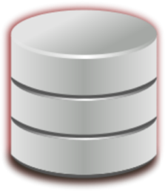
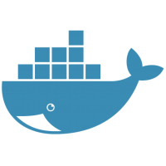
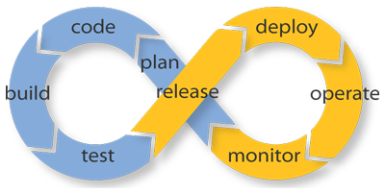




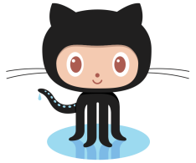
Now don’t worry with storing data on local system. Use the
RackStack-SS to store the data on the cloud.

Slide 3

Code-PAD
Code-PAD is an online platform for developers to build and test their code without installing any software in their systems.

Slide 4




RackStack
C l o u d S e r v i c e s

Slide 5


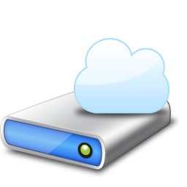
RackStack-SS
RackStack Storage Service is an object based storage service which provides you with a Storage Drive mounted on your system.
RackStack-RSS
RackStack Storage Service is an object based storage service which provides you with a Storage Drive mounted on your system.

Slide 6


Nomad-OS
Nomad-OS is an IAAS provided by RackStack which provides you a full fledged OS of your configuration on a single click and can be accessed from any desktop/mobile.

Slide 7

Agile-Soft
Agile-Soft is a software as a service by RackStack which provides you access of different softwares which are not even downloaded in your system.

Slide 8

Instance-Engine
Instance-Engine is a container as a service by RackStack. Using this you launch as many or as few
virtual instances as you need and configure and maintain them as per your own requirements.
You can use launch as many or as few virtual servers as you need, configure security and networking, and

Slide 9

