Slide 1
FIFA WORLD CUP DATA ANALYSIS
BY – Jatin Goel

Slide 2
INTRODUCTION
FIFA World Cup is a global football competition contested by the various football-playing nations of the world.
It is contested every four years and is the most prestigious and important trophy in the sport of football.

Slide 3
OBJECTIVE
To calculate the number of FIFA World Cup winners.
To calculate how many times the Country win the FIFA World Cup.
To calculate the outcome of wins by home or away teams.
To calculate the goals scored by teams.
To calculate the attendance present to watch the matches.

Slide 4
THE PROCESS
Data Collection
Data Cleaning
Data Analysis
Insights
Summary

Slide 5
DATA COLLECTION
The Data has been collected in the form of multiple CSV files named “WorldCupMatches.csv”, “WorldCupPlayers.csv” and “WorldCups.csv”.
The CSV files has the data of the World Cup during the timespan of 1938 and 2014.

Slide 6
DATA CLEANING
There were Null values in the file “WorldCupMatches.csv”. So we have to delete the data that contains null rows.
Some values in ‘DateTime’ are in String datatype. So we have to convert them to datetime datatype using Python.
There are some symbols in the Names of the Coaches and Players. So we have to correct them using Python.

Slide 7
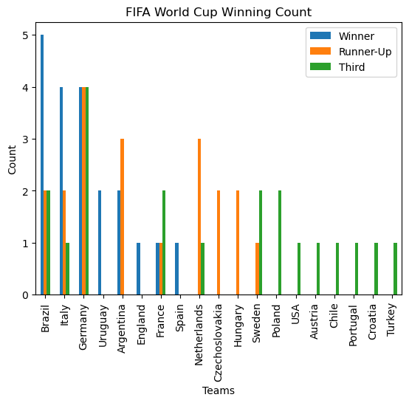
DATA ANALYSIS

Slide 8
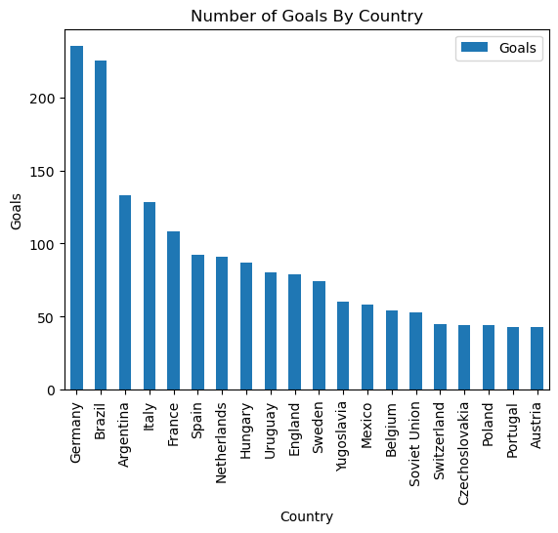
DATA ANALYSIS

Slide 9
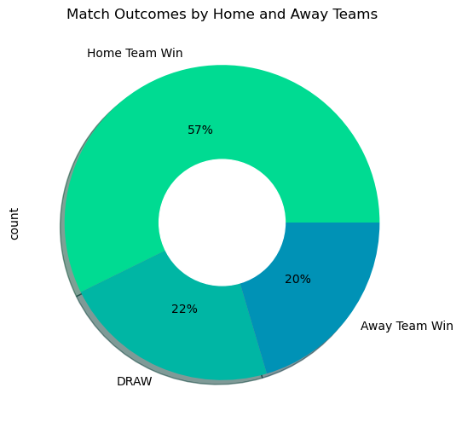
DATA ANALYSIS

Slide 10
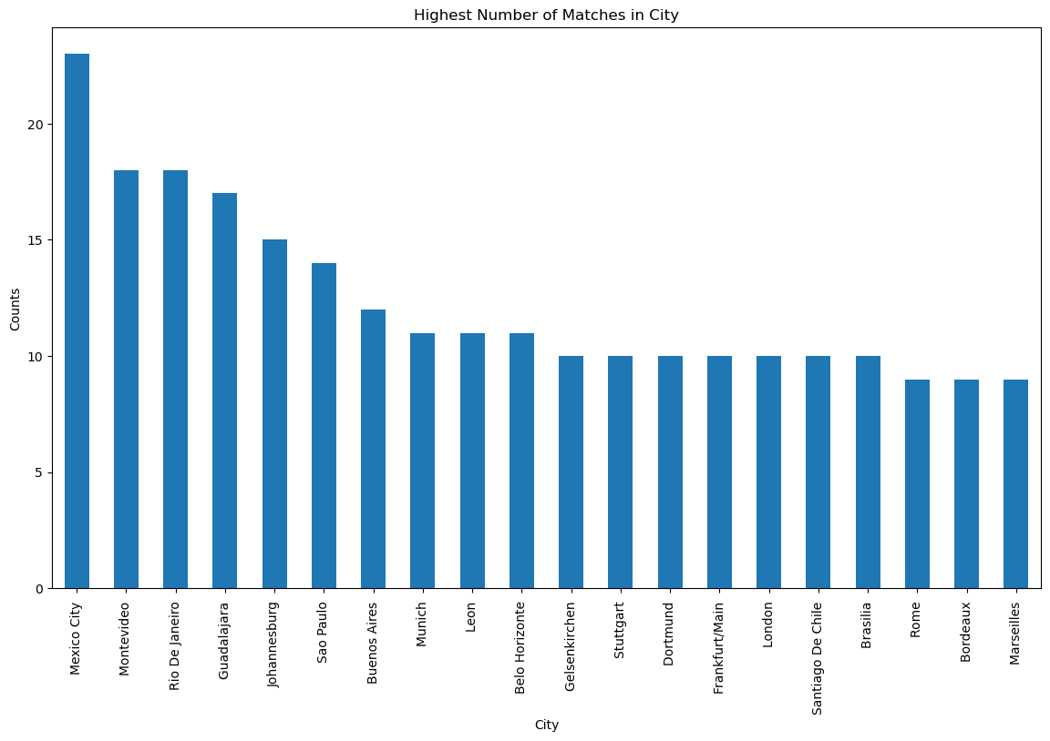
DATA ANALYSIS

Slide 11
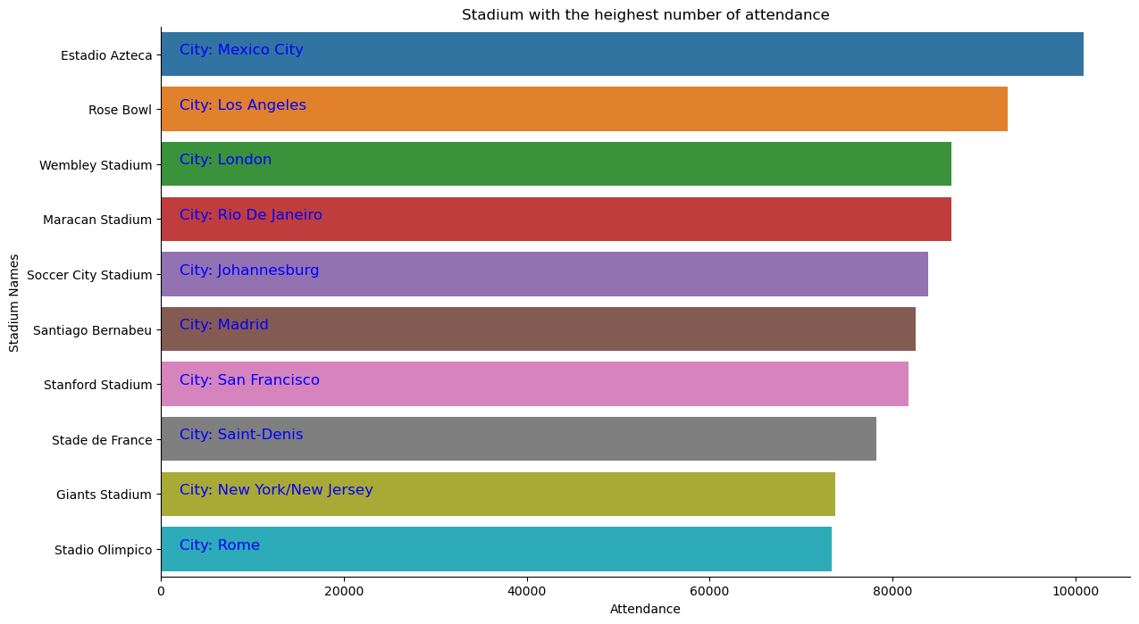
DATA ANALYSIS

Slide 12
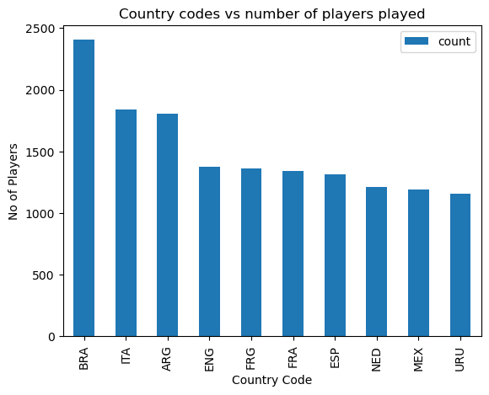
DATA ANALYSIS

Slide 13
INSIGHTS
Brazil has won the tournament most number of times.
The First winner of FIFA World Cup is Uruguay.
There are 8 distinct times that won the FIFA World Cup.
There are 15 distinct nations that Hosted the World Cup.
Most goals are scored by Germany.

Slide 14
SUMMARY
Brazil has won the tournament most number of times.
A complete depiction of number of world cups won, first runner-up, and third positions by various participating teams.
Germany scored the most number of goals throughout the history of world cup followed by Brazil and Argentina.
Brazil has again scored a majority of total goals playing as home team whereas Spain scored more goals playing as away country rather than home country.

Slide 15
SUMMARY
Mexico City Stadium have Maximum number of matches of World Cup.
Most Team won their home matches.
73.6 % of the matches were won by home team while 26.4 % were won by away team.
Brazil has played the most number of players followed by Italy and Argentina.

Slide 16


