Slide 1
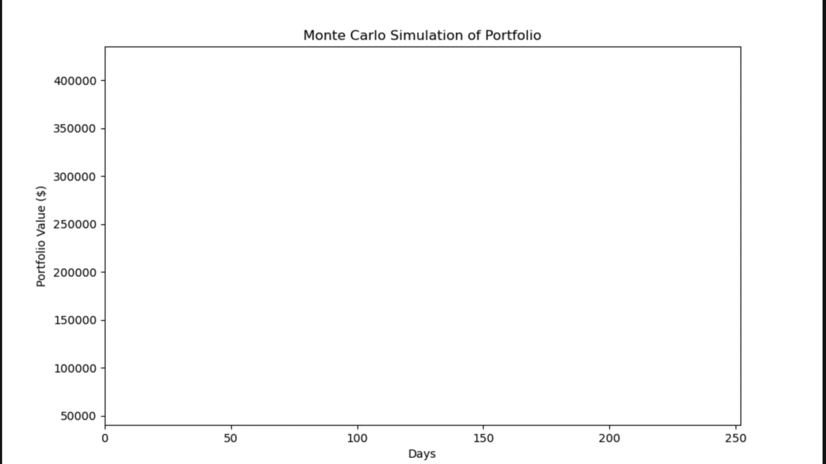

Slide 2
MONTE CARLO
QUANTITATIVE
FINANCE
PORTFOLIO SIMULATION
PROJECT
A Quantitative Analysis of US Equity Portfolio Risk & Return
5
10,000
252
5 YEARS
STOCKS
ITERATIONS
TRADING DAYS
HISTORICAL DATA
TSLA · GOOGL · MSFT · NVDA · META
March 2026 | Confidential · Academic Use Only

Slide 3
PROJECT OVERVIEW
OBJECTIVE
Quantify plausible portfolio outcomes, estimate probability of gain or loss relative to the initial investment, and visualise uncertainty through distributional and path-based analytics.
Initial Investment
$100,000 USD
Simulation Horizon
252 Trading Days (≈ 1 Year)
Iterations
10,000 Monte Carlo Paths
Historical Window
5 Years of Daily Closing Prices
Universe
TSLA · GOOGL · MSFT · NVDA · META
Weighting
Equal-Weighted Portfolio
KEY FINDING:~88% probability of positive return after 252 trading days Mean terminal value ≈ $152,000

Slide 4
DATA & METHODOLOGY
Data Collection
Cholesky Decomposition
01
Daily adjusted closing prices for 5 US tech equities from Yahoo Finance via yfinance Python library — 5 years of trading sessions, adjusted for splits and dividends.
03
Covariance matrix Σ decomposed via Cholesky factorisation (Σ = L·Lᵀ). Correlated innovations generated by multiplying standard normal shocks by L.
Statistical Characterisation
Geometric Brownian Motion
02
Log daily returns computed per asset. Mean return vector (μ), standard deviation (σ), and covariance matrix (Σ) estimated for multivariate simulation.
04
Each asset evolved using GBM: S(t+1) = S(t) · exp( (μ − σ²/2)·Δt + σ·√Δt·ε ) where Δt = 1/252 and ε ~ N(0,1).
Portfolio value calculated as weighted sum of simulated asset returns, normalized to $100,000 initial capital.

Slide 5
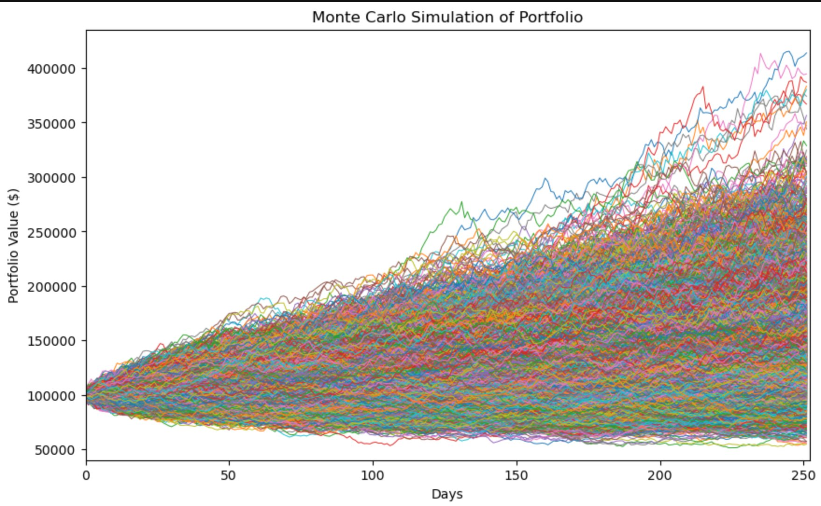
SIMULATED PORTFOLIO PATHS
Starting Value
$100,000
Day 0
Upper Bound
≈ $420,000
Best-case path
Lower Bound
≈ $50,000
Worst-case path
Dominant Trend
Upward Drift
Positive μ
The characteristic fan shape — narrow at inception, widening over time — reflects compounding of daily uncertainty

Slide 6
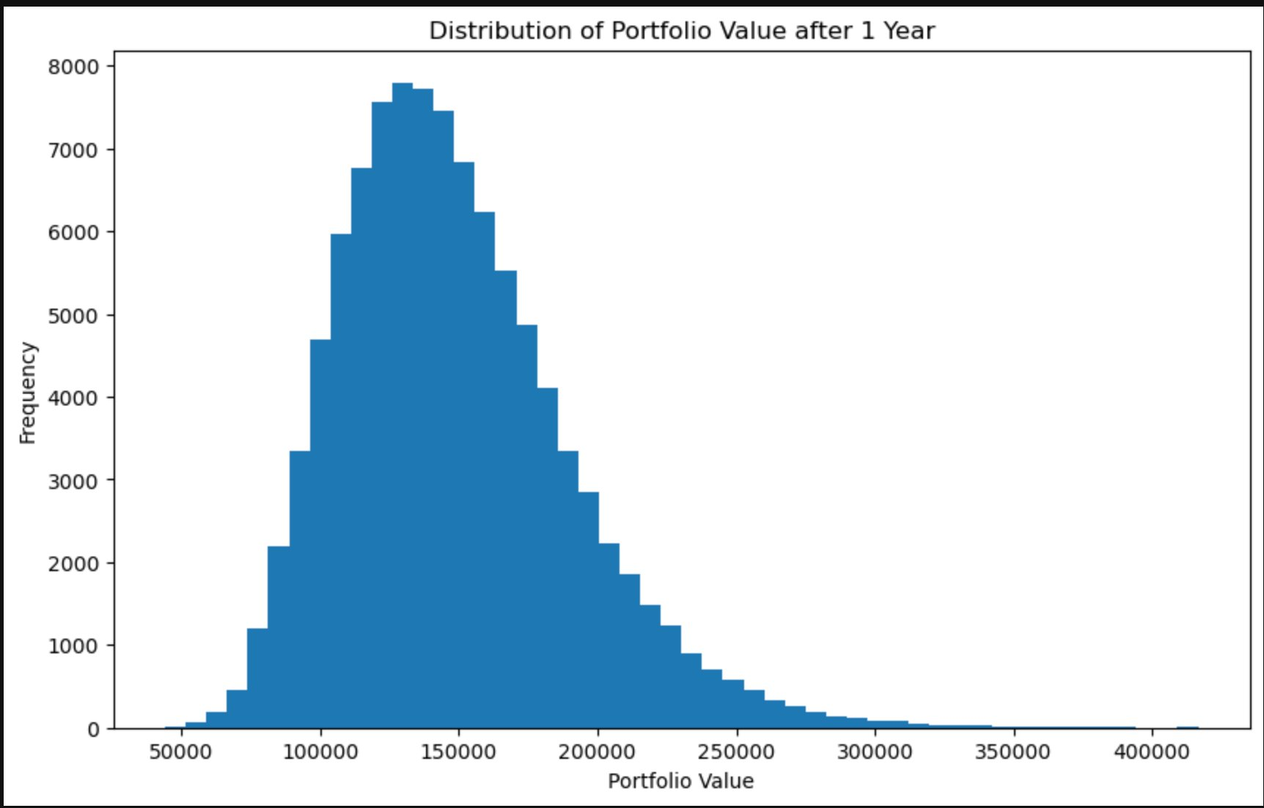
TERMINAL VALUE DISTRIBUTION
Modal Range
$120k – $140k
Highest frequency
Distribution
Right-Skewed
Log-normal shape
Left Tail
< $60,000
Rare extreme losses
Right Tail
> $300,000
Rare extreme gains
Majority of paths cluster near $120k–$160k with a long right tail from compounded geometric returns

Slide 7
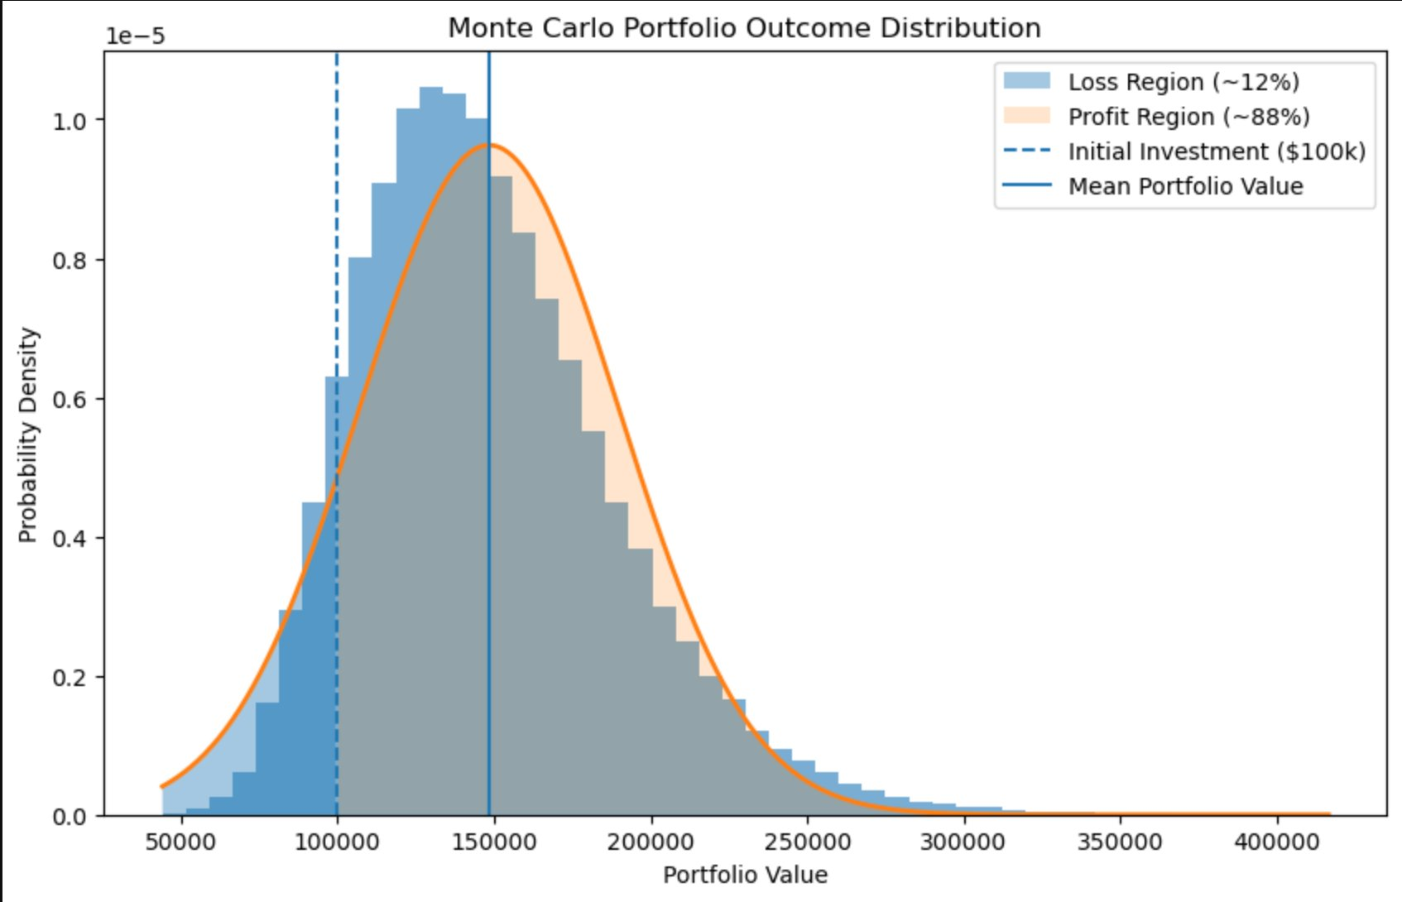
PROBABILITY & NORMAL DISTRIBUTION ANALYSIS
PROFIT REGION
~88%
LOSS REGION
~12%
Initial Investment
Mean Portfolio Value
Expected Return
Z-Score at $100k
$100,000
≈ $152,000
≈ +52%
Negative

Slide 8
KEY RISK METRICS
VALUE AT RISK (VaR 5%)
~$25,000
Portfolio loses more than ~$25,000 in 5% of scenarios
Probability of Loss
Probability of Profit
Mean Terminal Value
≈ 12%
≈ 88%
≈ $152,000
Terminal value < $100,000
Terminal value > $100,000
Expected portfolio value
Median Terminal Value
Skewness
Standard Deviation
$138k–$145k
Positive
Wide Spread
50th percentile outcome
Right-skewed distribution
Reflects tech-sector volatility

Slide 9
CONCLUSION
✦
Favourable risk-return profile for an equal-weighted US tech portfolio over a one-year horizon
✦
88% probability of positive return with mean expected gain of ~$52,000 on $100,000 investment
✦
12% probability of loss and wide spread underscore concentration risk in single-sector tech portfolio
✦
Long right tail (outcomes >$400k) arises from asymmetric nature of compounded returns under GBM
Investors should consider position sizing and rebalancing strategies to manage downside exposure.
Disclaimer: For academic and educational purposes only. Past performance does not guarantee future results. Not financial advice.

