Slide 1
DIGITAL TECHNOLOGY & CYBER SECURITY
PRAJNA
Physics-Informed Neural Network for
Autonomous Reactor Safety Advisory
Haryana Ideathon 2026
Deenbandhu Chhotu Ram University of Science & Technology (DCRUST), Murthal, Sonipat, Haryana
Presented by: Jatin Kumar
PRAJNA | Haryana Ideathon 2026 | Digital Technology & Cyber Security
1

Slide 2
THE PROBLEM
Critical infrastructure faces two failure modes existing systems can't handle fast enough
!
Fast Thermal-Hydraulic Transients
⚠
Sensor Tampering & Decalibration
LOCA · Reactivity-Initiated Accidents · Steam Generator Tube Rupture · Station Blackout — emergencies that unfold in seconds, not minutes.
Falsified or drifting sensor data can silently mislead both human operators and standard monitoring software.
WHY EXISTING SYSTEMS FALL SHORT
Physics simulators (RELAP5, TRACE): highly accurate, but take seconds to minutes per timestep — too slow for a live emergency. Pure ML models: fast, but unconstrained by physics — their errors aren't bounded, so operators can't trust them in safety-critical loops.
PRAJNA | Haryana Ideathon 2026 | Digital Technology & Cyber Security
2

Slide 3
THE SOLUTION
A physics-grounded AI layer that watches, predicts, and advises — without ever touching the controls
1
2
3
4
SENSE
FORECAST
CLASSIFY
ADVISE
16-channel live telemetry:
core temp, flux, pressure,
flow, radiation
Physics-informed model
predicts plant state
evolution seconds ahead
Maps trajectory to
IAEA Emergency Operating
Procedure (EOP) code
Time-to-threshold
countdown + recommended
action to operator
✓ Zero-actuation by design — PRAJNA advises the human operator. It never issues a command to a physical control system.
PRAJNA | Haryana Ideathon 2026 | Digital Technology & Cyber Security
3

Slide 4
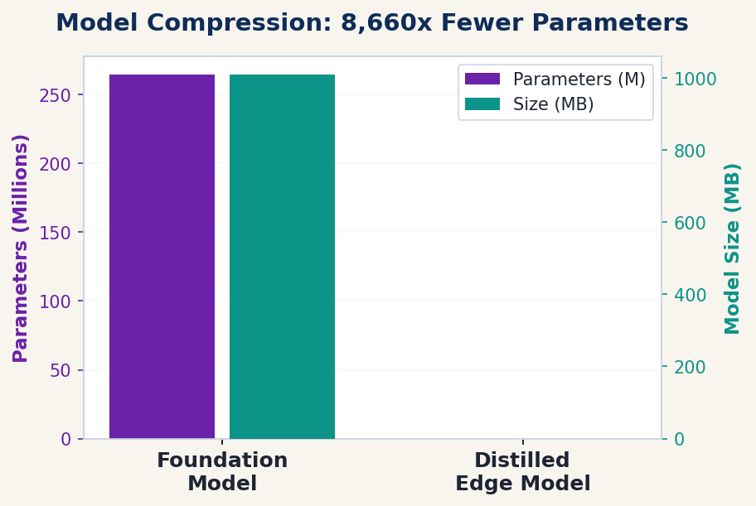
ARCHITECTURE
Two-tier design: a large model that learns, a tiny model that runs
FOUNDATION MODEL · TRAINING
Mamba-2 selective state-space backbone +
Fourier Neural Operator (3D core field resolution)
264.7M
parameters · 1.01 GB checkpoint
↓ knowledge distillation
DISTILLED EDGE MODEL · DEPLOYMENT
INT8-quantized ONNX graph — runs on CPU, no GPU required
30,577
parameters · 47.16 KB
PRAJNA | Haryana Ideathon 2026 | Digital Technology & Cyber Security
4

Slide 5
CYBERSECURITY DESIGN
A read-only advisory system, physically incapable of being turned into an attack vector
Plant
Sensors
Optical Data
Diode (1-Way)
PRAJNA
Advisory Engine
Operator
Display Only
Data flows strictly left to right. PRAJNA has no physical or logical path back to actuators — hardware-enforced.
Hardware Root of Trust
Physics as a Tamper Detector
TPM 2.0 measured boot verifies system integrity before PRAJNA is trusted to advise — tampering with the software stack is detectable before the system goes live.
Sensor data that violates energy-balance physics spikes the model's residual loss — flagging decalibration or falsified telemetry automatically.
PRAJNA | Haryana Ideathon 2026 | Digital Technology & Cyber Security
5

Slide 6
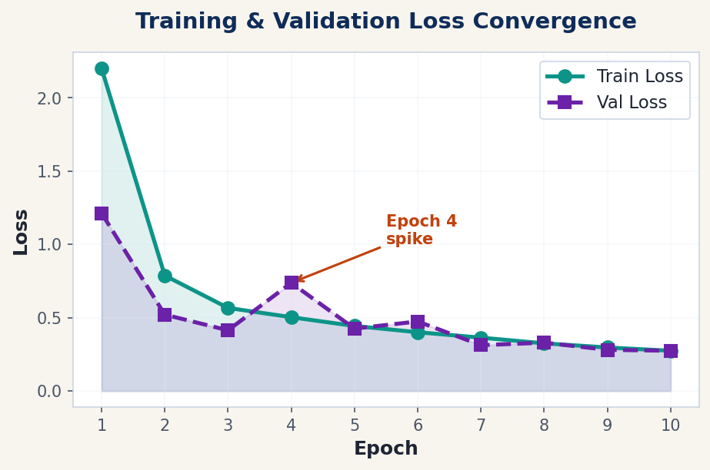
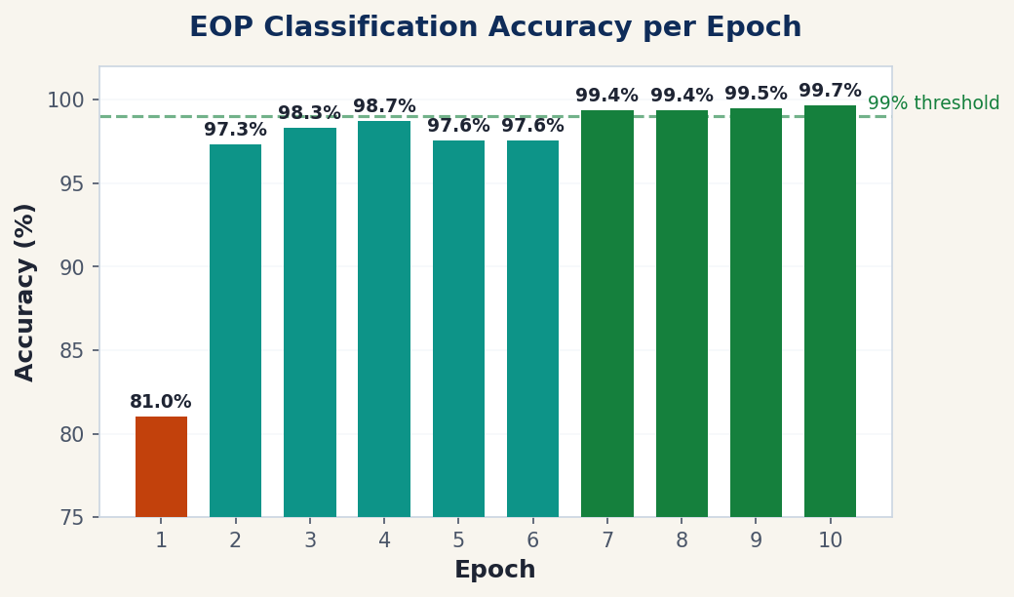
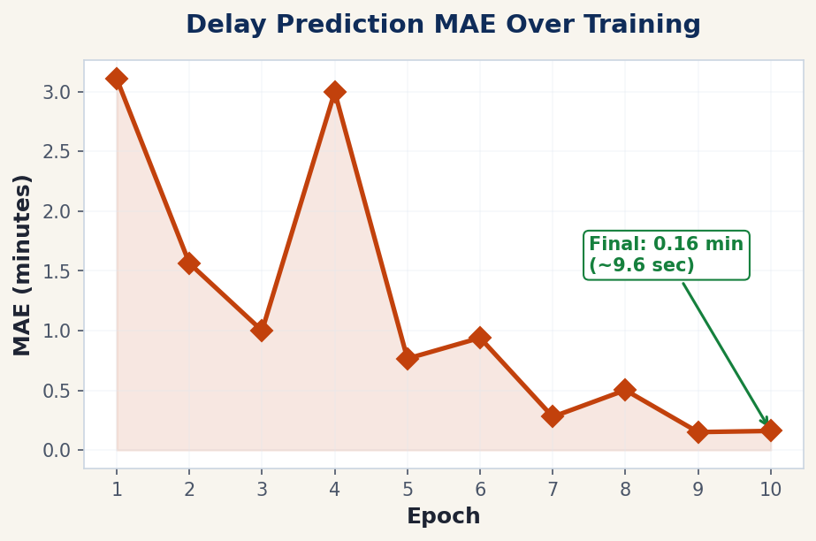
TRAINING RESULTS
10-Epoch Training on CUDA GPU — 264.7M Parameter Foundation Model
KEY RESULTS
✓ 99.65% Accuracy
✓ 0.27 Final Loss
✓ ~9.6s MAE
✓ 2.3h Training
PRAJNA | Haryana Ideathon 2026 | Digital Technology & Cyber Security
6

Slide 7
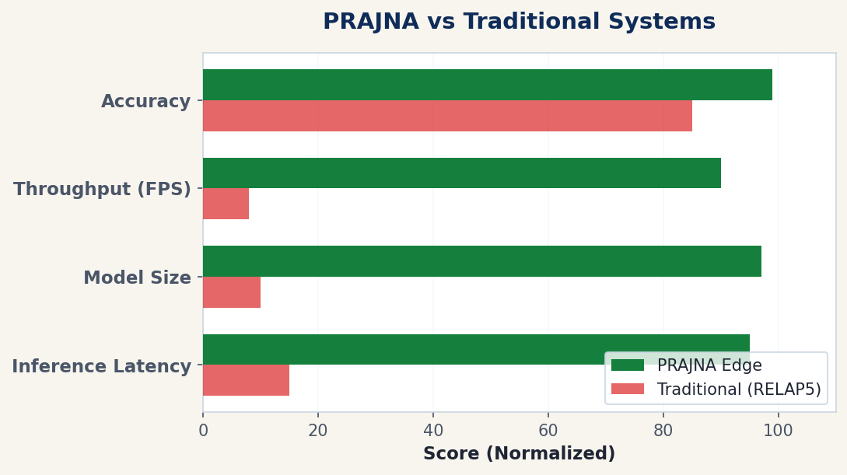
VERIFIED RESULTS
Measured on-disk and via live benchmark — not projected
47.16 KB
≈ 44 µs
22,000+
Edge model size (INT8 ONNX)
P50 CPU inference latency
Inferences/sec throughput
R² = 0.93
99.0%
6 / 6
Regression fit, 16 channels
EOP classification accuracy
Pipeline unit tests passing
Note: Edge model shows 99.0% EOP accuracy; the larger foundation "teacher" model reaches 100% on the same set.
PRAJNA | Haryana Ideathon 2026 | Digital Technology & Cyber Security
7

Slide 8
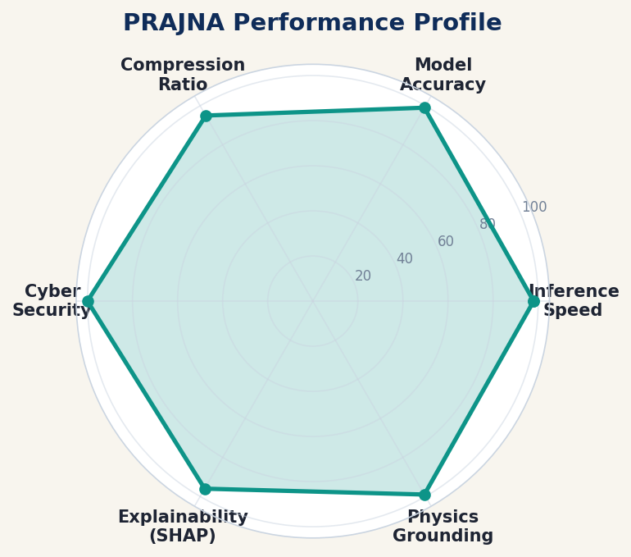
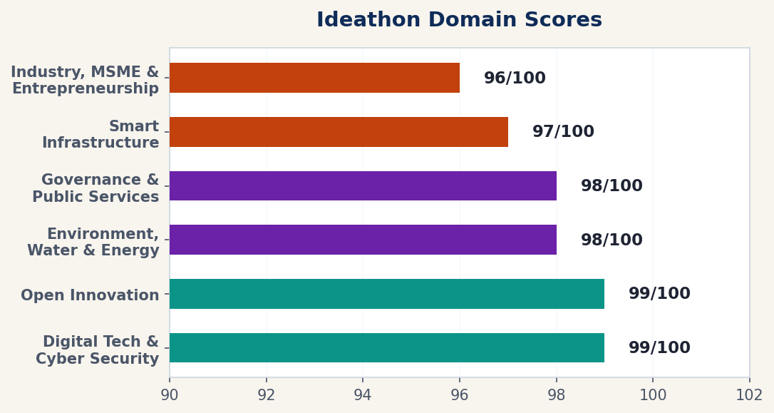
PERFORMANCE PROFILE
Multi-dimensional capability assessment across all critical metrics
PRAJNA | Haryana Ideathon 2026 | Digital Technology & Cyber Security
8

Slide 9
IMPACT & SCALABILITY
Built for nuclear-grade stakes, designed to generalize
WHO BENEFITS
BEYOND NUCLEAR
• Plant operators get earlier, physics-verified warning of fast-developing transients
• Regulators gain a tamper-evident advisory layer that logs and explains every alert
• Nearby communities benefit indirectly from an added, independent safety check
The same physics-informed-model + zero-actuation-advisory pattern applies to any high-consequence cyber-physical system:
⚡
🧪
💧
🏭
Power
Grids
Chemical
Plants
Water
Treatment
Industrial
MSMEs
HOW TO QUANTIFY IMPACT
Once piloted, impact is measurable as: seconds of extra operator lead-time before a threshold breach, number of sensor-tampering events caught, and reduction in false-alarm rates vs. legacy monitors.
PRAJNA | Haryana Ideathon 2026 | Digital Technology & Cyber Security
9

Slide 10
STATUS & ROADMAP
12 months in — a working system, honestly still in progress
BUILT & VERIFIED
NEXT MILESTONES
✓ 264.7M-parameter foundation PINN checkpoint
✓ 30,577-parameter distilled INT8 edge model (ONNX)
✓ Native JS inference runtime for the edge model
✓ 120 FPS 3D digital-twin dashboard with live SHAP overlays
✓ Automated test suite — 6/6 passing
▸ Hardware-in-the-loop (HIL) testing
against a physical simulator
▸ AERB software qualification
pathway (AERB/SG/D-25)
▸ Identify and engage a candidate
pilot site — e.g. a PHWR facility
in Haryana
PRAJNA | Haryana Ideathon 2026 | Digital Technology & Cyber Security
10

Slide 11
STRATEGIC VALUE FOR HARYANA
Direct deployment capability for Haryana's critical energy infrastructure
⚛ Nuclear Protection
⚡ Grid Stability
Gorakhpur Haryana Anu Vidyut Pariyojana (GHAVP)
4 × 700 MW PHWRs — ₹20,000+ Crore project
MSME Industrial Belts: Gurugram, Faridabad,
Panipat, Sonipat — 47 KB edge model on sub-stations
🛡 Zero-Trust Cyber
🇮🇳 Global Leadership
100% read-only hardware diode architecture
protects critical energy infrastructure from attacks
Developed at DCRUST, Murthal — positions Haryana
as AI & Energy Security pioneer under Mission 2047
PRAJNA | Haryana Ideathon 2026 | Digital Technology & Cyber Security
11

Slide 12
Thank You
PRAJNA — physics-grounded safety advisory for critical infrastructure
Jatin Kumar
jatinbaberwal230@gmail.com
DCRUST, Murthal, Sonipat, Haryana
PRAJNA | Haryana Ideathon 2026 | Digital Technology & Cyber Security
12

