Slide 1


Project Review-2
(Semester VII)
Vivekanand Education Society's Institute of Technology
An Autonomous Institute Affiliated to University of Mumbai
Smart Umbrella Stand
Group Name: TECHNOPHILE
Jatin Vaity (23/D19B)
Chirag Naskar (39/D19B)
Parul Pritamwani (43/D19B)
Piyush Tambe (63/D19B)
Name of Mentor : Mrs. Anuradha Jadiya

Slide 2
Contents to be covered
Problem Statement
Literature Survey
Research Gaps
Proposed Solution
Complete Block Diagram of Proposed System
Methodology
Components requirement
Time Chart
Observations/Results
Conclusion
References

Slide 3
Problem Statement
Managing wet umbrellas and staying prepared for sudden rain can be inconvenient, often leading to prolonged drying times and forgetting to carry an umbrella when needed. Wet umbrellas can create a mess and take a long time to dry, while unexpected rain can catch people unprepared, causing discomfort and inconvenience.

Slide 4

Literature Survey
Sr No | Title of Technical paper | Name of Author | Year of publication | Name of Journal | Methodology | Results/ Conclusions | Drawbacks/ Limitations
1 | Design and Implement a Smart Umbrella Stand System with Instant Message Application | Yi-Shiun Lee, Yong-Yi Fanjiang, Chi-Huang Hung, Chiu-Yen Huang | September 2021 | 2021 IEEE International Conference on Consumer Electronics-Taiwan (ICCE-TW) | A Traditional umbrella stand with a hot air drying feature and a sensing element to measure temperature and humidity. It uses instant messaging and remind users to take an umbrella when they are about to leave. | provide weather forecast updates. Efficient drying of umbrellas | Complexity. Dependence on internet connectivity.

Slide 5
Sr. No | Title of Technical paper | Name of Author | Year of publication | Name of Journal | Methodology | Results/ Conclusions | Drawbacks/ Limitations
2. | Research on a New Type of Self-adaptive and High-efficiency Umbrella Dryer | Zijun Long | November 2022 | International Conference on Mechanical, Electronic, Control and Automation Engineering (MECAE) | An Adaptive umbrella dryer using upper and lower conveyor belts, wind pressure, and temperature control to efficiently dry umbrellas during rotation and translation. | Material Acquisition and Cost Efficiency. Control System Implementation. | Energy Consumption Setup is costly.

Slide 6
Sr No | Title of Technical paper | Name of Author | Year of publication | Name of Journal | Methodology | Results/ Conclusions | Drawbacks/ Limitations
3. | An IoT based Weather Information Prototype Using WeMos | Ravi Kishore Kodali and Archana Sahu | 2016 | IEEE | Obtain API keys from weather services. Implement HTTP requests to fetch real-time weather data. Connect WeMos D1 board to OLED display. | Displayed real-time weather data from weather services Accurate and Real-time Data | Dependence on Internet Connectivity Maintenance and Updates.

Slide 7
Research Gaps and Target Customers/Applications
Limited Scope of Application
There is no exploration on its potential application in larger public venues such as shopping malls, airports, or public transportation hubs. Understanding the device's adaptability and effectiveness in different settings would broaden its practical utility.[1]
Complexity in Design and Maintenance
Mechanical systems often involve intricate designs and components, which can increase the complexity of construction, assembly, and maintenance. This complexity may lead to higher costs and longer development times.[2]

Slide 8
Proposed Solution
Automatic Drying System:
Develop an efficient drying mechanism within the umbrella stand.
Activate the drying system upon insertion of a wet umbrella.
Ensure the umbrella is dry and ready for use for the next time.
Real-Time Weather Notification System:
Place a sensor at the door to detect when users are going out.
NodeMCU checks the weather forecast for the next two hours.
If rain is expected, notify the user via Telegram to carry an umbrella.

Slide 9


Complete Block Diagram of Proposed System
Ultrasonic Sensor
Openweathermap API
Cloud
Rotating Motor
Fans
WiFi
Module
NodeMCU
Heating element
12v Power Supply (Adaptor)
Telegram Notification
Power Supply

Slide 10
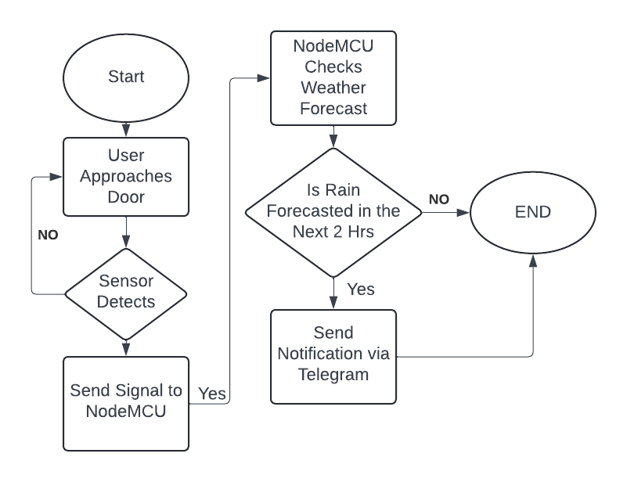
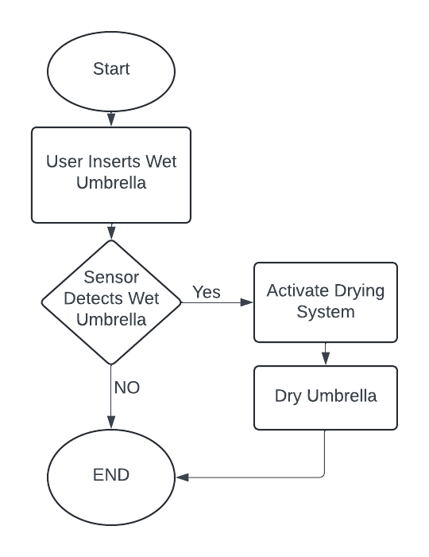
Flow Diagram
Weather Forecasting
Umbrella Dryer

Slide 11
Proposed Project Components and Expenditure
Sr. no | Name of Component | Quantity | Cost in Rupees | Reference(datasheet of boards/processors)
1. | ESP8266- Board | 1 | 600/- | https://www.espressif.com/sites/default/files/documentation/esp32_datasheet_en.pdf
2. | Cooling Fan | 3 | 100/- | https://www.titan-cd.com/en/product/TFD-12025KW-Series.html
3. | PTC Ceramic Heating Element | 5-6 | 150/- | https://pdf.indiamart.com/impdf/22677713788/MY-1071431/ptc-ceramic-heating-element.pdf
4. | Ultrasonic Sensor | 2 | 61/- | https://components101.com/sensors/ultrasonic-sensor-working-pinout-datasheet
5 | 12v adaptor 220 AC to 12v | 1 | 600/- | https://www.amazon.in/DVM-Adapter-Charger-12V-Size/dp/B0B6PQDP7C

Slide 12
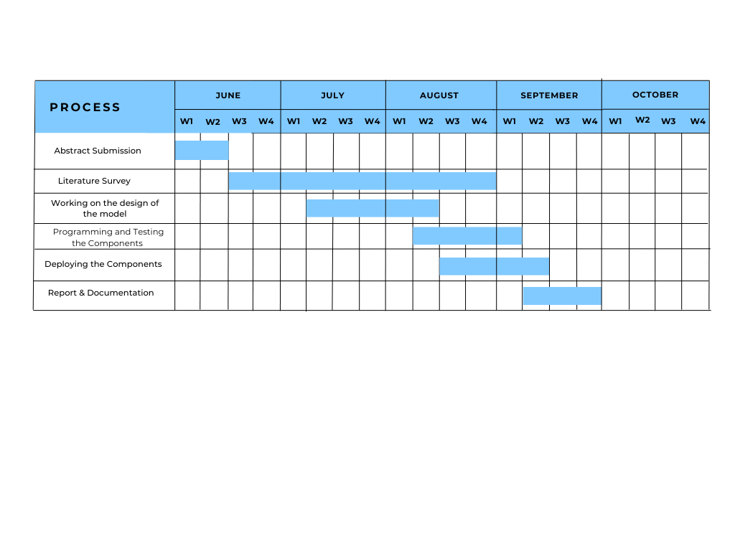
Time Chart

Slide 13
Observations / Results
The drying fans ensure a safe and energy-efficient solution for drying umbrellas. Automation through ultrasonic sensor, NodeMCU, and real-time weather notifications enhances the system's user-friendliness and practicality. With minimal energy consumption, the smart umbrella stand is both eco-friendly and cost-effective.
The design achieves efficient drying while reducing power consumption and simplifying the system. Real-time weather updates improve user preparedness for rain, making the overall system practical, low-energy, and easy to maintain for managing wet umbrellas.

Slide 14
References
1] Y. -S. Lee, Y. Y. Fanjiang, C. -H. Hung and C. -Y. Huang, "Design and Implement a Smart Umbrella Stand System with Instant Message Application," 2021 IEEE International Conference on Consumer Electronics-Taiwan (ICCE-TW), Penghu, Taiwan, 2021, pp. 1-2, doi: 10.1109/ICCE-TW52618.2021.9602908
2] Long, Zijun. (2022). Research on a New Type of Self-adaptive and High-efficiency Umbrella Dryer. Highlights in Science, Engineering and Technology. 15. 53-60. 10.54097/hset.v15i.2203
3] Kodali, Ravi & Sahu, Archana. (2016). An IoT based weather information prototype using WeMos. 612-616. 10.1109/IC3I.2016.7918036
4] K. Jayamani, O. I. Al-Sanjary, M. N. Mohammed and J. S. M. Alneamy, "Design and Development of Smart Umbrella Based on Iot Technology," 2022 IEEE 18th International Colloquium on Signal Processing & Applications (CSPA), Selangor, Malaysia, 2022, pp. 210-213, doi: 10.1109/CSPA55076.2022.9782035.

Slide 15
References
5] Nguyen Vu Lan, "Improvement of conventional solar drying system," 2017 International Conference on System Science and Engineering (ICSSE), Ho Chi Minh City, Vietnam, 2017, pp. 690-693, doi: 10.1109/ICSSE.2017.8030964.
6] A. Shaji, A. R. Amritha and V. R. Rajalakshmi, "Weather Prediction Using Machine Learning Algorithms," 2022 International Conference on Intelligent Controller and Computing for Smart Power (ICICCSP), Hyderabad, India, 2022, pp. 1-5, doi: 10.1109/ICICCSP53532.2022.9862337.
7] https://openweathermap.org/api.

