Slide 1
Breast Cancer Prediction Utilising Logistic Regression , Decision Tree and Random Forest
Jatin Pant Computer Science and Engineering Graphic Era Hill University

Slide 2
Outline
Introduction
Related Works
Proposed Methodology
Results and discussion
Conclusion and Future Works

Slide 3
Introduction
Breast cancer occurs when cells in the breast tissue grow uncontrollably and form tumors. It can spread throughout your whole body.
Cancer cells can begin inside the milk ducts and lobules of breast that cause lumps or thickening.
Three models are used for predicting breast cancer are Decision Tree, Random Forest and Logistic Regression.
The main objective of this model is to tell a person has infected with breast cancer or not and gives its accuracy.
X- rays are used to diagnose breast cancer but recently, mammography images are begun to used.

Slide 4
Related Works
Various studies have been done for prediction of breast cancer using Logistic Regression, Decision Tree and Random Forest.
In 2024,Wang Sheng Jie conducted a study on Breast Cancer Prediction using machine learning algorithms like decision tree, gradient lift trees,SVM, neural networks, randomforest and cross-Validation.
In 2023 , Chitra Saini study introduced using various machine learning algorithms Naive Bayes, Decision Tree, Gradient Boosting,Logistic Regression, SVM,Random Forest, Extreme Gradient Boosting, Categorical Boosting, LGBM,KNN,Multi-Layer Perceptron and Adaptive Boosting to predict Breast Cancer.
In 2022, Reza Rabiei conducted a study aimed to predict breast cancer applying with 24 features of laboratory demographic and mammographic on each data using machine learning techniques like gradient boosting trees, neural network, Random Forest and genetic algorithm which includes K-Fold validation.
In 2022,Marion Olubunmi Adebiyi aims to predict the breast cancer using the Random Forest and SVM with feature extraction method of LDA.

Slide 5
Proposed Methodology
Collecting Data
A dataset compromising 569 medical data values out of which 357 data values are of benign cells and remaining 212 data values are of malignant cells.
Preprocessing and Data cleaning
Removal of all the collection of null values from the dataset, removal of columns from the dataset which are not relevant for the research and describing the dataset on the basis of mean, standard deviation, minimum and maximum values.
Classification Models
Classification of models is based on the machine learning techniques such as decision tree, logistic regression, random forest.
Decision Tree: A tree like structure starts with the root nodes and splits the data into groups with similar subsets on different conditions till it reaches the final leaf nodes. The decision trees can be large and complex.

Slide 6
Random Forest: It works by combing multiple decision trees it gives an accurate result. The output is generated based on the majority of regression and classification.
Logistic Regression: It gives the probabilistic values between 0 and 1.It uses Logistic function which is called sigmoid function. The prediction may be “yes” or “no”.
Training and Testing Model
After data preprocessing, machine learning models are trained and tested using a split, with 80% of dataset for training and 20% of dataset for testing.
Evaluating Model
We evaluate the model using metrices such as F1-score, accuracy, precision, recall which allows for more complete assessment of the model’s performance.

Slide 7
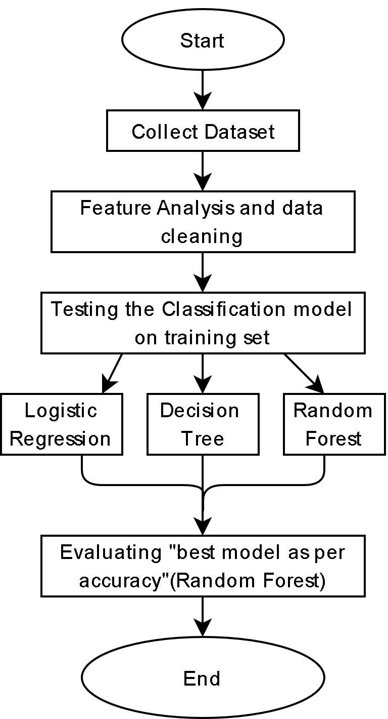
Flow Diagram

Slide 8
Results and Discussion
The model's performance was evaluated using a range of parameters, including accuracy, training accuracy, Precision, Recall and F1 score.
The accuracy of Random Forest reached 97.3%, indicating the model's proficiency in correctly classifying breast cancer data samples.
With a precision of 96% and a recall of 100%, our model demonstrates accurately in identifying and classifying data samples.
The computed F1 score is 98%
Discussion:-
The achieved precision, recall, and F1 score of the machine learning algorithms approach in breast cancer prediction which helps in diagnosis of cancer.

Slide 9
Conclusion and Future works
In conclusion, this study presents a machine learning model for breast cancer prediction using Random Forest, Logistic Regression, and Decision Tree. Machine learning algorithms are used so that models will work accurately through data collecting, processing, training and testing the datasets. The highest accuracy amongst all algorithms is Random Forest.
Future Works:-
Using machine learning approaches, it is required to make more improvement for future beneficial in medical science for making decision. They are likely to focus on several key areas to improve accuracy, early detection, and personalized treatment.
Machine Learning Algorithms: Exploring deep learning and ensemble methods to analyze complex datasets, leading to more precise and early prediction models.

Slide 10
AI and Radiomics: Enhancing imaging techniques with AI to better detect and classify breast cancer from mammograms, MRIs and other imaging modalities.
Real-time Monitoring: Implementing technology and Exploring model using Internet of Things (IoT) devices for breast cancer continuous monitoring and classification.
Public Awareness and Education: Develop educational programs and outreach initiatives to raise public awareness about the benefits and importance of advanced breast Cancer technologies like Logistic Regression , Decision Tree and Random Forest based classification systems.

Slide 11
THANK YOU

