Slide 1
Department of Information Science and Engineering
Mini Project Presentation Review – 1
Title: “Student Micro-Learning Hub”
Presented By
Jatin Sharma USN: 1BY23IS258
Kalpitha Naik USN: 1BY23IS259
Saksham Agrawal USN: 1BY23IS260
Under the guidance of
Prof. Sanjana VH
Asst. Professor

Slide 2
Contents
Problem Identification and Objectives
Literature Survey
Proposed Methodology
Expected Outcomes
Future Enhancements & Roadmap

Slide 3
Problem Identification
Traditional e-learning platforms often present a "one-size-fits-all" approach, leading to significant challenges for modern students.
Problem with Traditional E-Learning:
Information Overload: Too much content, hard to focus on key points.
Passive Learning: Less interaction → low retention and motivation.
No Personalization: Same path for everyone → knowledge gaps remain.
Poor Progress Tracking: Hard to find weak areas for improvement.
Our Solution:
Create a dynamic, intelligent learning environment that adapts to each student.

Slide 4
Project Objectives
Goal: Build an AI-powered platform for personalized, engaging, and efficient learning.
Key Features:
AI Content Pipeline: Auto-process notes (PDFs, images) → create summaries, flashcards, quizzes.
Adaptive Learning: Analyze student performance → adjust learning path to fix weak areas.
Gamification: Add XP, leaderboards, streaks, and quiz battles to boost motivation.
Real-Time Collaboration: Enable multiplayer quizzes and group study sessions.

Slide 5
Literature Survey
S.No | Paper Title with Authors Name, Journal name and Year | Methodology/ Algorithm / Technology used | Measurable Parameters | Outcomes in terms of Efficiency, Accuracy.. Etc. (in terms of Quantitative Results) | Limitations
1 | "Adaptive learning and reinforcement modeling in education systems," Tang et al. (2021), IEEE | Reinforcement Learning (RL) to model student paths and recommend activities. | Learning gain, time-on-task, student performance. | Showed that RL-based adaptive systems significantly improve learning efficiency over static curricula. | Computationally complex; faces a "cold start" problem requiring substantial initial data.
2 | "Does gamification work? — A literature review of empirical studies on gamification," Hamari et al. (2014), IEEE | Systematic Literature Review of empirical studies on gamification's effects. | User engagement, motivation, behavioral change. | Found that gamification generally yields positive effects, but success is highly context-dependent. | Effectiveness of specific mechanics (points, badges) varies greatly; poor design can be demotivating.

Slide 6
Literature Survey
S.No | Paper Title with Authors Name, Journal name and Year | Methodology/ Algorithm / Technology used | Measurable Parameters | Outcomes in terms of Efficiency, Accuracy.. Etc. (in terms of Quantitative Results) | Limitations
3 | "Automated Question Generation from Educational Text Using Text-to-Text Transformers," Kumar et al. (2022), IEEE | Fine-tuned a T5 (Text-to-Text Transfer Transformer) model for Question Generation (QG). | BLEU, ROUGE scores for linguistic quality; human evaluation. | Achieved high performance in generating contextually relevant questions, automating quiz creation. | Can occasionally generate factually incorrect or ambiguous questions, requiring human validation.
4 | "Exploring the limits of transfer learning with a unified text-to-text transformer," Raffel et al. (2020), JMLR | Proposed the T5 framework, treating all NLP tasks (summarization, QG) as text-generation problems. | Performance on NLP benchmarks (GLUE, SuperGLUE). | Established state-of-the-art results on many NLP tasks, proving the framework's power and flexibility. | Large models are computationally expensive to fine-tune and deploy, posing a challenge for small-scale projects.

Slide 7
Literature Survey
S.No | Paper Title with Authors Name, Journal name and Year | Methodology/ Algorithm / Technology used | Measurable Parameters | Outcomes in terms of Efficiency, Accuracy.. Etc. (in terms of Quantitative Results) | Limitations
5 | "A systematic review of AI-powered adaptive learning systems in higher education," El-Sabagh (2021), Springer | Systematic Literature Review focusing on AI techniques in adaptive learning platforms. | Personalization accuracy, student satisfaction, learning outcomes. | Identified key AI techniques (expert systems, ITS, machine learning) and confirmed their positive impact on personalized education. | Many existing systems are domain-specific and lack the flexibility to handle user-uploaded, unstructured content.
6 | "BERT-Based Unsupervised Question Generation," Shan et al. (2021), ACM | An unsupervised approach using BERT to generate questions by identifying key sentences and using cloze-style prompts. | Fluency, relevance, and answerability scores evaluated by humans. | Demonstrated the ability to generate meaningful questions without requiring large labeled question-answer datasets. | The quality of questions is highly dependent on the structure and clarity of the source text.

Slide 8
Literature Survey
S.No | Paper Title with Authors Name, Journal name and Year | Methodology/ Algorithm / Technology used | Measurable Parameters | Outcomes in terms of Efficiency, Accuracy.. Etc. (in terms of Quantitative Results) | Limitations
7 | "The critical role of retrieval practice in long-term retention," Roediger & Butler (2011), Trends in Cognitive Sciences | Cognitive Psychology Review of studies on the "testing effect." | Long-term memory retention, transfer of learning. | Concluded that active recall (testing/quizzing) is a significantly more effective study method than passive review. | The paper focuses on the "why," not the "how," leaving a gap for technology to implement this at scale.
8 | "An overview of the Tesseract OCR engine," Smith et al. (2007), IEEE | A detailed overview of the Tesseract OCR engine's architecture, including layout analysis and character recognition. | Character recognition accuracy, processing speed. | Provided a robust, open-source OCR engine that has become a standard for text extraction from images. | Struggles with complex layouts, handwritten text, and low-quality images, which can lead to errors.

Slide 9
Literature Survey
S.No | Paper Title with Authors Name, Journal name and Year | Methodology/ Algorithm / Technology used | Measurable Parameters | Outcomes in terms of Efficiency, Accuracy.. Etc. (in terms of Quantitative Results) | Limitations
9 | "Weakness Detection in Programming Education Using Code Metrics and Machine Learning," Lu et al. (2022), IEEE | Used static code analysis and Machine Learning (Decision Trees) to identify student weaknesses in programming assignments. | Accuracy in predicting failing grades or specific misconceptions. | Successfully identified patterns in student code that correlate with specific conceptual weak points. | The approach is domain-specific (programming) and requires adaptation for general-purpose subjects.
10 | "Micro-Learning: A Modernized Education System," Jomah et al. (2016), Springer | Conceptual analysis of the micro-learning paradigm. | Engagement time, completion rates, knowledge retention. | Argued that short, focused learning units are better suited for modern learners' attention spans and improve retention. | Lacks a technical implementation blueprint; focuses on educational theory rather than AI-driven execution.

Slide 10
Literature Survey
S.No | Paper Title with Authors Name, Journal name and Year | Methodology/ Algorithm / Technology used | Measurable Parameters | Outcomes in terms of Efficiency, Accuracy.. Etc. (in terms of Quantitative Results) | Limitations
11 | "Firebase for real-time collaborative applications," Singh & Ahuja (2021), IEEE | Explored the use of Firebase Realtime Database and WebSockets for building collaborative applications. | Data sync latency, scalability, developer effort. | Showcased Firebase as a highly effective BaaS for developing apps with real-time features like live quizzes and chats. | Over-reliance on a third-party service; complex queries can be less efficient than traditional SQL databases.
12 | "Personalized Gamification: A Literature Review on Objectives, Methods, and Outcomes," Krath et al. (2021), ACM | Systematic Literature Review on adapting gamification to individual user preferences. | User motivation, system adoption, task performance. | Concluded that personalized gamification (adapting mechanics to the user) is more effective than a one-size-fits-all approach. | Research in this area is still emerging; there is no single, agreed-upon framework for implementation.

Slide 11
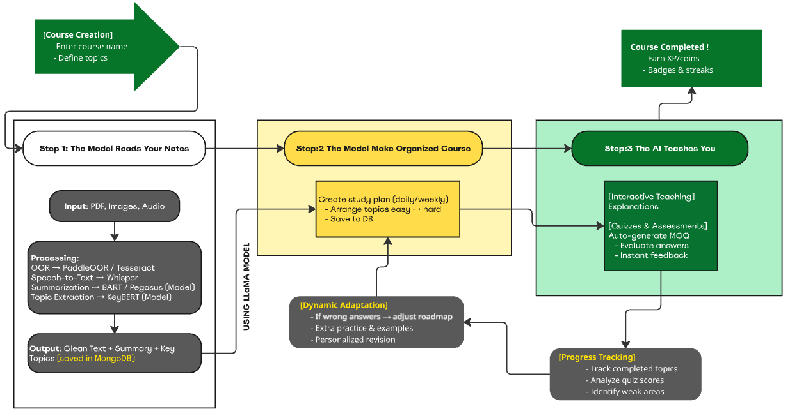

Slide 12
Proposed Methodology - System Architecture
Our platform follows a 3-stage intelligent workflow to turn static notes into an interactive learning experience:
Content Ingestion & Processing:
Users upload PDFs/images.
AI pipeline extracts text (OCR), summarizes it, and identifies key topics.
AI-Powered Course Generation:
LLM (e.g., LLaMA) organizes topics and creates a personalized study plan (easy → hard).
Plan is saved for ongoing access.
Adaptive Learning & Assessment:
AI provides explanations and auto-generated quizzes.
Tracks scores, detects weak areas, and adjusts the plan with extra examples and revision tasks.

Slide 13
Proposed Methodology - Technology Stack
Our platform uses a microservice-based architecture for scalability and easy maintenance:
Frontend – User Interface
React.js + Vite + TailwindCSS – Fast, responsive UI.
Firebase SDK – Real-time data sync for dashboards and quizzes.
Backend – Application & AI Logic
Node.js (NestJS) + Socket.IO – Core logic, APIs, user management, and real-time "Quiz Battle."
Python (FastAPI) – Dedicated microservice for AI/ML tasks (OCR, summarization, quiz generation).
AI/ML Models
OCR & Summarization – Pytesseract, EasyOCR, HuggingFace (BART, T5).
Quiz Generation – LLaMA with RAG (Retrieval-Augmented Generation).
Weakness Detection – Pandas + Scikit-learn.
Databases
MongoDB – Stores user profiles, content, and analytics.
Firebase Firestore – Manages real-time data (quiz states, leaderboards).

Slide 14
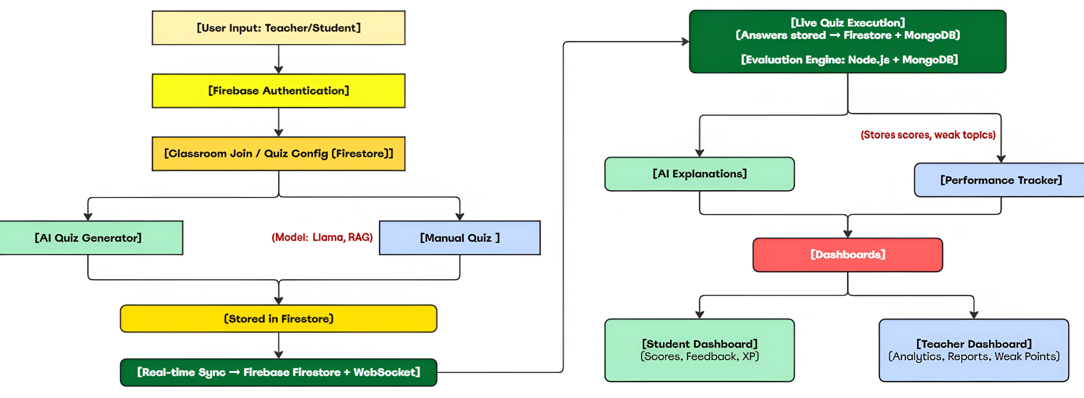

Slide 15
Expected Outcomes
Upon completion, this project will provide:
AI-Driven Micro-Learning Platform – A fully functional web-based solution delivering a personalized and adaptive learning experience.
Automated Content Transformation – Converts unstructured notes (PDFs/images) into structured study plans, summaries, flashcards, and quizzes.
Intelligent Weakness Detection – Identifies knowledge gaps and recommends targeted practice for maximum improvement.
Gamified Learning Environment – Leaderboards, real-time "Quiz Battles," and interactive elements to boost motivation and knowledge retention.

Slide 16
Future Enhancements & Roadmap
After building the main features, we plan to add:
Voice Support – Convert lecture audio and voice notes into text for easier learning.
Teacher Dashboard – A special dashboard for teachers to see student progress and find students who need extra help.
More Content Options – Let students bring in study material directly from websites or learning apps.
Better Personalization – Use smarter AI to customize both lessons and game features to keep students motivated.

