Slide 1
Index
This PPT will Give you basic Idea about ReactJS and version and way that we are using in QBA application
JSX
BabelJS
ReactJS
Virtual DOM javascript vs React
Virtual DOM JQuery vs React
React Library
Upgrade Notes
How we can generate html tag using react
React Class Vs Component
First React Component
Bootstrap Button Component
Sample Project folder structure

Slide 2
JSX
You will be writing XML with your React code.
What is JSX?
JSX is a preprocessor step that adds XML syntax to JavaScript. You can definitely use React without JSX but JSX makes React a lot more elegant. Just like XML, JSX tags have a tag name, attributes, and children. If an attribute value is enclosed in quotes, the value is a string. Otherwise, wrap the value in braces and the value is the enclosed JavaScript expression.
Lets take small example: Visit: https://es6console.com/
JSX Examples | The left side code gets compiled to the following without JSX. I hope you will agree JSX syntax reads more naturally.
<div className="red">Children Text</div>; <MyCounter count={3 + 5} />; // Here, we set the "scores" attribute below to a JavaScript object. var gameScores = { player1: 2, player2: 5 }; <DashboardUnit data-index="2"> <h1>Scores</h1> <Scoreboard className="results" scores={gameScores} /> </DashboardUnit>; | React.createElement("div", { className: "red" }, "Children Text"); React.createElement(MyCounter, { count: 3 + 5 }); React.createElement( DashboardUnit, { "data-index": "2" }, React.createElement("h1", null, "Scores"), React.createElement(Scoreboard, { className: "results", scores: gameScores }) );
Why className?
You'll notice that React uses className instead of the traditional DOM class. From the docs, "Since JSX is JavaScript, identifiers such as class and for are discouraged as XML attribute names. Instead, React DOM components expect DOM property names like className and htmlFor, respectively."

Slide 3
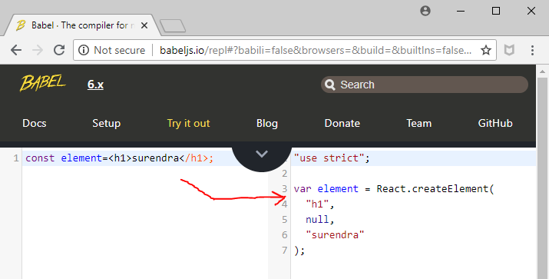
BabelJS
What is Babel?
Babel is a JavaScript compiler
Babel is a toolchain that is mainly used to convert ECMAScript 2015+ code into a backwards compatible version of JavaScript in old browsers or environments.
Lets take small example: Visit: http://babeljs.io/repl
Visit for more compiler for ECMAScript 6
http://ccoenraets.github.io/es6-tutorial-data/babel-webpack/

Slide 4
ReactJS
What Is React?
React is a declarative, efficient, and flexible JavaScript library for building user interfaces. It lets you compose complex UIs from small and isolated pieces of code called “components”.
React has a few different kinds of components, but we’ll start with React.Componentsubclasses:
Lets take small example: Visit: https://reactjs.org/docs/getting-started.html
class ShoppingList extends React.Component {
render() {
return ( <div className="shopping-list">
<h1>Shopping Liist for {this.props.name}</h1>
<ul>
<li>Instagram</li>
<li>WhatsApp</li>
<li>Oculus</li>
</ul>
</div> );
}
} // Example usage: <ShoppingList name="Mark" />

Slide 5
Virtual DOM javascript vs React
What is the virtual Dom in react?
Like the actual DOM, the Virtual DOM is a node tree that lists elements and their attributes and content as objects and properties. React's render() method creates a node tree from React components and updates this tree in response to mutations in the data model, caused by actions
“Hello, world!” example that uses native JavaScript DOM manipulation | here’s how you would do the same thing in React
<!DOCTYPE html> <html> <head> <meta charset="UTF-8" /> <title>Hello JavaScript!</title> </head> <body> <div id="example"></div> <script> document.getElementById("example").innerHTML = "<h1>Hello, world!</h1>"; </script> </body> </html> | <!DOCTYPE html> <html> <head> <meta charset="UTF-8" /> <title>Hello React!</title> <script src="build/react.js"></script> <script src="build/react-dom.js"></script> <script src="https://cdnjs.cloudflare.com/ajax/libs/babel-core/5.8.23/browser.min.js"></script> </head> <body> <div id="example"></div> <script type="text/babel"> ReactDOM.render( <h1>Hello, world!</h1>, document.getElementById('example') ); </script> </body> </html>

Slide 6
Virtual DOM JQuery vs React
What is the virtual Dom in react?
Like the actual DOM, the Virtual DOM is a node tree that lists elements and their attributes and content as objects and properties. React's render() method creates a node tree from React components and updates this tree in response to mutations in the data model, caused by actions
“Hello, world!” example that uses Jquery DOM manipulation | here’s how you would do the same thing in React
<!DOCTYPE html> <html> <head> <meta charset="UTF-8" /> <title>Hello jQuery!</title> <script type="text/javascript" src="scripts/vendor/jquery-1.12.3.min.js"></script> </head> <body> <div id="example"></div> <script> $(document).ready(function(){ $("#example").html("<h1>Hello, world!</h1>"); }); </script> </body> </html> | <!DOCTYPE html> <html> <head> <meta charset="UTF-8" /> <title>Hello React!</title> <script src="build/react.js"></script> <script src="build/react-dom.js"></script> <script src="https://cdnjs.cloudflare.com/ajax/libs/babel-core/5.8.23/browser.min.js"></script> </head> <body> <div id="example"></div> <script type="text/babel"> ReactDOM.render( <h1>Hello, world!</h1>, document.getElementById('example') ); </script> </body> </html>

Slide 7
React Library
ReactJS have multiple version ( current version 16.0), here I am giving brief about version that QBA application using.
The release candidate is available for download from the CDN:
React
Dev build with warnings: https://fb.me/react-0.9.0-rc1.js Minified build for production: https://fb.me/react-0.9.0-rc1.min.js
React with Add-Ons Dev build with warnings: https://fb.me/react-with-addons-0.9.0-rc1.js Minified build for production: https://fb.me/react-with-addons-0.9.0-rc1.min.js
In-Browser JSX transformer https://fb.me/JSXTransformer-0.9.0-rc1.js
Note : For sample application and QBA application we are using React With Add-Ons.
You can either use developer version or minified version.

Slide 8
Upgrade Notes
In addition to the changes to React core listed below, they have made a small change to the way JSX interprets whitespace to make things more consistent. With this release, space between two components on the same line will be preserved, while a newline separating a text node from a tag will be eliminated in the output. Consider the code:
JSX | In v0.8 and below, it was transformed to the following: | In v0.9, it will be transformed to this JS instead:
<div> Monkeys: {listOfMonkeys} {submitButton} </div> | React.DOM.div(null, " Monkeys: ", listOfMonkeys, submitButton ) | React.DOM.div(null, "Monkeys:", listOfMonkeys, " ", submitButton )

Slide 9
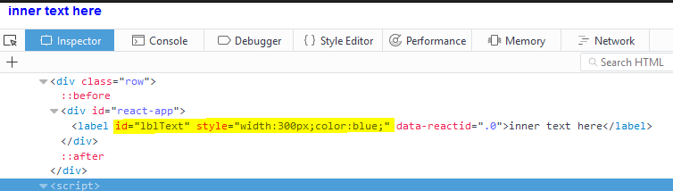
How we can generate html tag using react
HTML page | Detail
<!DOCTYPE html> <html> <head> <script src="Scripts/lib/React/react-with-addons-0.9.0.js"></script> </head> <body> <div class="row"> <div id="react-app"></div> </div> <script> var rootElement = React.DOM.label({ id: "lblText", style : { width: 300 ,color:'blue' } }, "inner text here"); React.renderComponent( rootElement , document.getElementById('react-app')); </script></body></html> | React.DOM.label method will create label tag React.renderComponet method will take two argument variable that you want to render e.g. rootElement Javascript object inside that you wan to generate tag (div that have “react-app” id. )

Slide 10
React Class Vs Component
React.createClass versus extends React.Component
Two ways to do the same thing. Almost. React traditionally provided the React.createClass method to create component classes, and released a small syntax sugar update to allow for better use with ES6 modules by extends React.Component, which extends the Component class instead of calling createClass.:
Visit link
https://toddmotto.com/react-create-class-versus-component/
https://reactjs.org/docs/react-without-es6.html
https://codepen.io/danbuda/post/react-js-getdefaultprops-proptypes
Component and class here is a peace virtual DOM that will become the part of you page
In Next slide you can see example of actual component that used in QBA Application.
You can refer my sample application

Slide 11
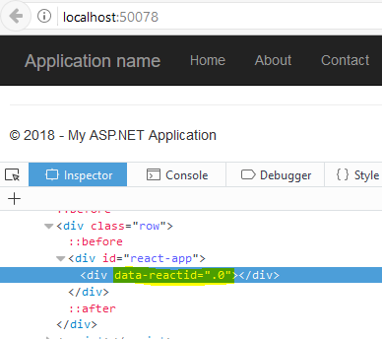
First React Component
HTML | JS File : basic-Component.js
<html><<head> <link href="Content/bootstrap.css" rel="stylesheet" /> <link href="Content/Site.css" rel="stylesheet" /> <script src="Scripts/bootstrap.js"></script> <script src="Scripts/lib/React/react-with-addons-0.9.0.js"></script> <script src="Scripts/example/basic-Component.js"></script> </head> <body> <div class="row"> <div id="react-app"></div> </div> <script> React.renderComponent( rootElement(), document.getElementById('react-app')); </script> </body> </html> | var rootElement = React.createClass({ render: function () { return React.DOM.div(null ); } }); /* Here rootElement is component (Class) have render function that return some html. Note: each component must have render method that will return some html */
Note: if html generated using ReactJS then one extra attribute/property will associate with tag “data-reactid” and its value automatically mange by ReactJS. Please do not use that id to manipulate DOM

Slide 12
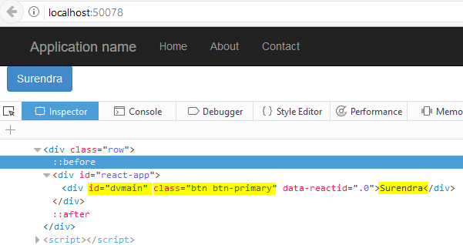
Bootstrap Button Component
HTML | JS File : button.js
<html><<head> <link href="Content/bootstrap.css" rel="stylesheet" /> <link href="Content/Site.css" rel="stylesheet" /> <script src="Scripts/bootstrap.js"></script> <script src="Scripts/lib/React/react-with-addons-0.9.0.js"></script> <script src="Scripts/example/button.js"></script> </head> <body> <div class="row"> <div id="react-app"></div> </div> <script> React.renderComponent( rootElement(), document.getElementById('react-app')); </script> </body> </html> | var rootElement = React.createClass({ render: function () { return React.DOM.div({ id: 'dvmain', className: "btn btn-primary" }, ‘Surendra' ); } }); /* Here rootElement is component (Class) have render function that return some html. In render function we try to create div with id=“dvMain” and className=“btn btn-primary” and button test “Surendra” Note: each component must have render method that will return some html */
Note: Since we are using bootstrap css library and there is class “btn btn-primary” to generate beautiful button. Here we are using that class in div.

Slide 13
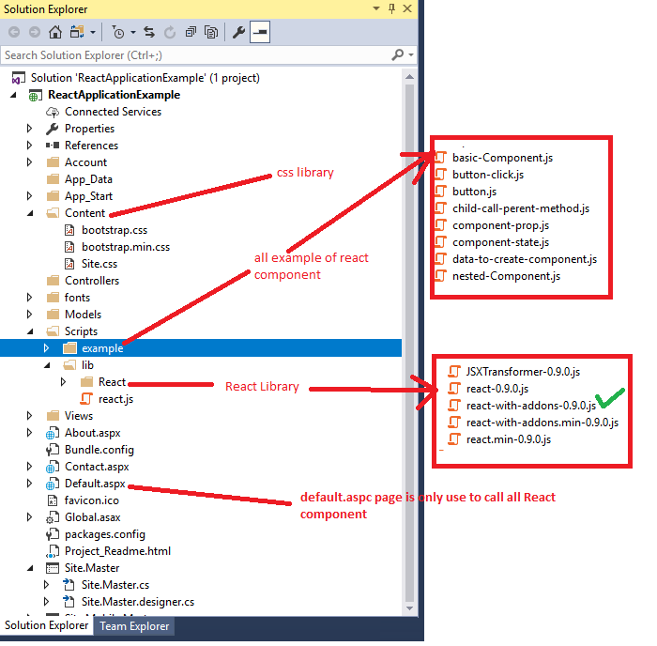
Sample Project folder structure

