Slide 1
COMP 225-hybrid: Software Engineering Methodologies Software Requirements Specification (SRS)
Name of project : VASDP: The Voice Activated Speaker for Disabled People
Presented by: Name Student #
Davi Volpi Takata Zevallos 301372653 Jaturaput Jongsubcharoen 301391425 Kripa Acharya 301432879 Ratthapat Apichaikunlanit 301275267 Date : 08/06/2024
Section #: 005
Semester : 2
Notes:
Instructions:
Customize the black text. Be sure to include the names of all team members.

Slide 2
Introduction
Purpose
This new software product will address the problem of Disabled with the
voice activated speaker and will be integrated into the infrastructure of
Canada, this is version 1.0.0.
Project scope
The Voice Activated Software Speaker for Disabled People (VASDP) aims to
enhance accessibility for individuals with disabilities (excluding the deaf) by
providing a voice-controlled interface for various tasks. This software will
integrate seamlessly into Canada’s existing technological infrastructure,
offering a user-friendly solution to improve independence and quality of life
for the disabled community.
Notes:
Instructions:
Keep it direct to the point, take onboard any feedback you got from Part A

Slide 3
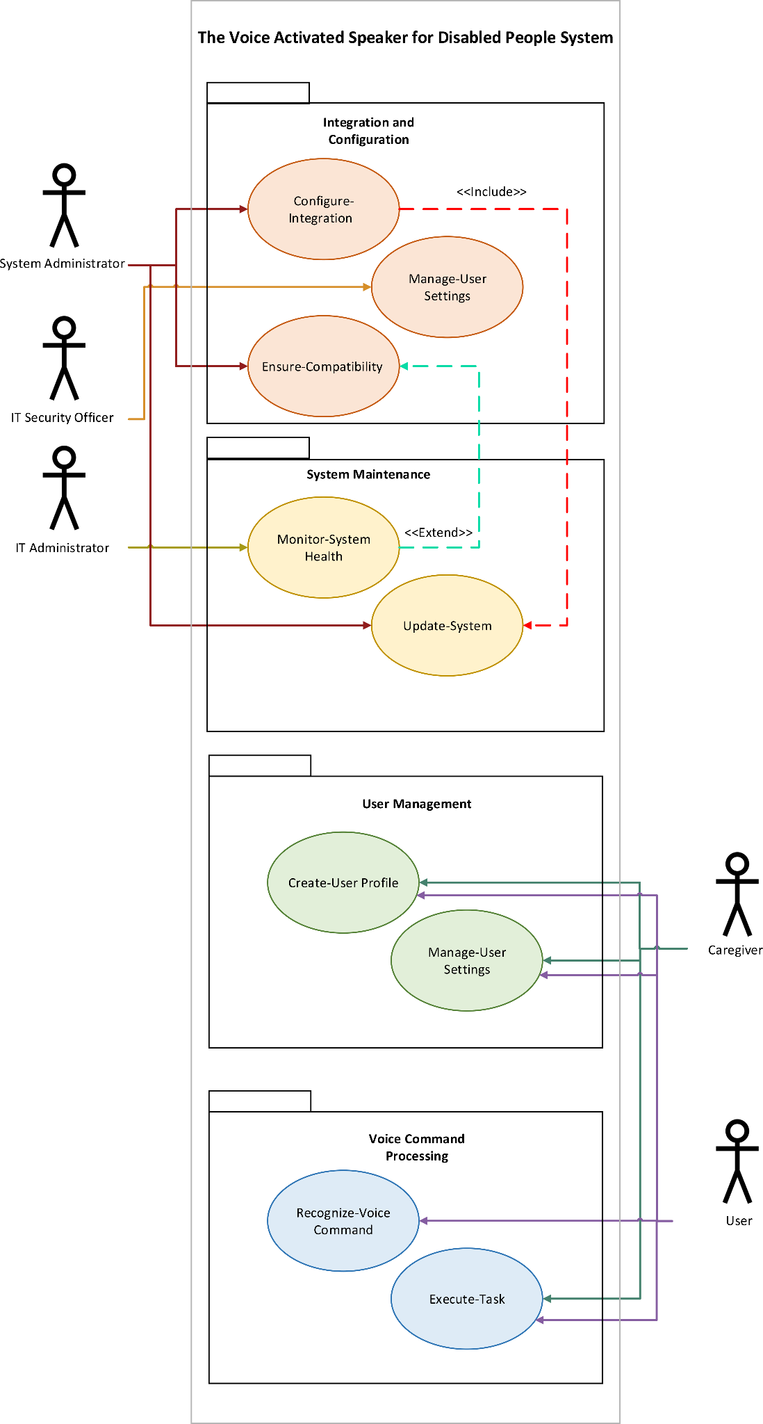
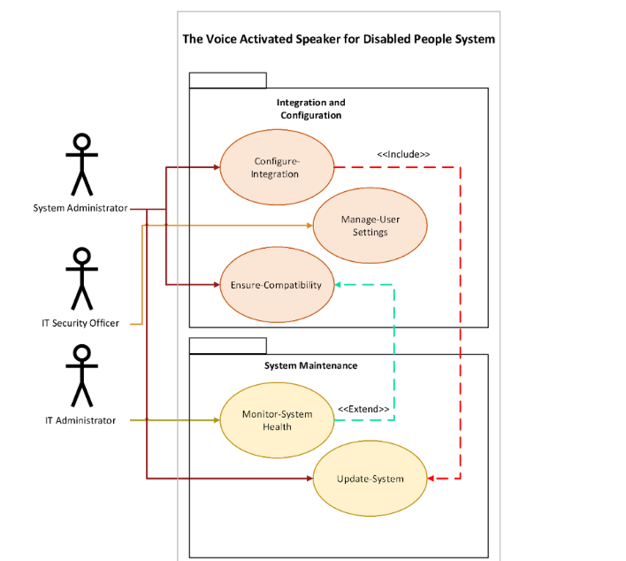
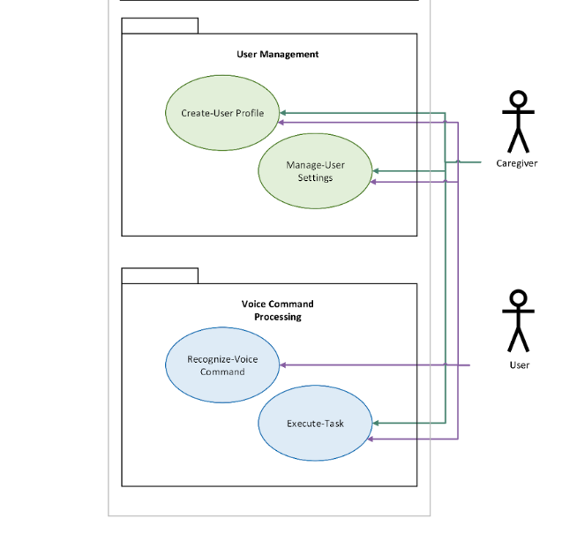
Packaged Use Case Diagram
Notes:
Instructions:
The use case diagram should show all the actors and the sub-systems

Slide 4
Use Cases Brief Descriptions only 6
Goal Use Case name | Actors | Use Case Brief Description
1) Create-User Profile | User, Caregiver | The actor creates a new user profile with personalized settings, including visual adjustments and voice command preferences.
2) Manage-User Settings | User, Caregiver | The actor updates user settings such as voice command preferences, color themes, and accessibility options.
3) Recognize-Voice Command | User | The system accurately recognizes and processes voice commands issued by the user, translating them into actions or responses.
4) Execute-Task | User, Caregiver | The system performs tasks such as setting reminders, controlling home devices, and accessing information based on recognized voice commands.
5) Configure-Integration | System Administrator | The actor configures the system to integrate with various external devices and services such as smart home systems and other assistive technologies.
6) Manage-Security | IT Security Officer | The actor ensures that all user data is encrypted and secure, configuring necessary security measures such as authentication and authorization protocols.
Notes:
Instructions:
List the top six use cases. In your brief description focus on what system response is to user actions

Slide 5
Use Cases Brief Description
Goal Use Cases | Use Case Brief Description
Ensure-Compatibility | The actor verifies and manages the system's compatibility with different hardware platforms, operating systems, and third-party services.
Monitor-System Health | The actor monitors system performance and uptime, ensuring the system is available and scales according to user demand.
Update-System | The actor updates the system with new features, security patches, and performance improvements to ensure continuous improvement in accessibility and functionality.
Notes:
Instructions
In your description focus on what system response is to user actions

Slide 6
Use Case Full Description (present one)
Use Case Name: Recognize-Voice Command
Primary Actor: User (Disable people)
Stakeholders and Interests:
User (Disable people) : Wants to interact with the system using voice commands for ease of use.
Caregiver: Wants to ensure the system accurately recognizes commands to assist the user.
System Administrator: Needs to ensure the system's voice recognition functions reliably and efficiently.
Preconditions:
The user is logged into the system.
The voice recognition system is initialized and running.
The microphone is functioning and properly configured.
The camera is properly set up and functioning if required.
Postconditions:
The system correctly interprets the user's voice command.
An appropriate response or action
Notes:
Instructions:
Present one formal use case description, Clarify how scenario and triggering event applies to your case in addition to system flow with the user.

Slide 7
Use Case Full Description (present one)
Main Success Scenario:
The user issues a voice command.
The system captures the voice input via the microphone.
The system processes the captured voice input using the voice recognition engine.
The system interprets the voice command accurately.
The system provides feedback to the user, either confirming the command or executing the requested action
Extensions (Alternative Flows):
2a. Microphone is not functioning:
2a1. The system notifies the user of the microphone issue and prompts to check the device.
3a. Camera is required for additional input but not functioning:
3a1. The system notifies the user of the camera issue and prompts to check the device.
3a2. The system offers to proceed with audio-only mode if camera input is optional.
4a. Voice command is not recognized:
4a1. The system requests the user to repeat the command.
4a2. The system processes the repeated command.
4a3. If the command is still not recognized, the system offers alternative input methods (e.g., text input).

Slide 8
Use Case Full Description (Continued)
Special Requirements:
The system must process voice commands with high accuracy, even with various accents and speech patterns.
The system should provide real-time feedback to ensure seamless interaction.
Technology and Data Variations List:
Voice recognition engine can be cloud-based (e.g., Google Cloud Speech-to-Text) or locally hosted.
Microphone can be built-in or external.
Camera can be built-in or external and used for optional visual input.
Frequency of Occurrence:
Frequently, as it is the primary method for user interaction with the system.
Open Issues:
Ensuring privacy and data security for voice and visual data.
Handling variations in speech, environmental noise, and lighting conditions for camera input.
Notes:
Instructions:
Discuss pre-conditions and post conditions of system.

Slide 9
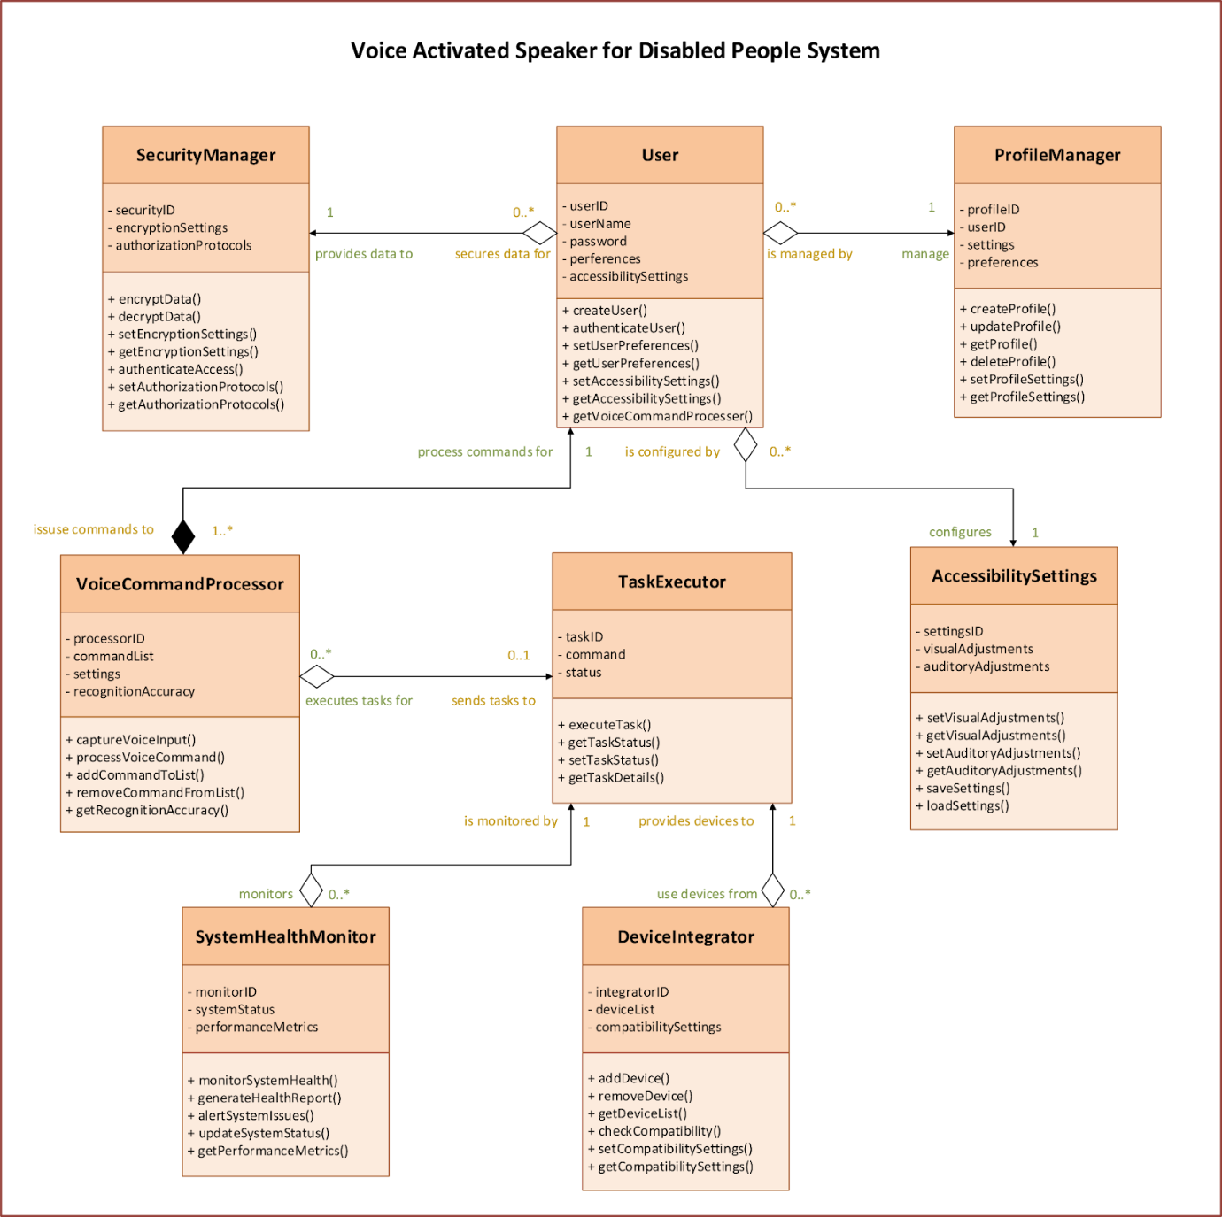
Domain Class Diagram with methods
Notes:
Instructions:
Discuss why you think these classes are relevant and the methods you chose per class, also why you chose these types of associations

Slide 10
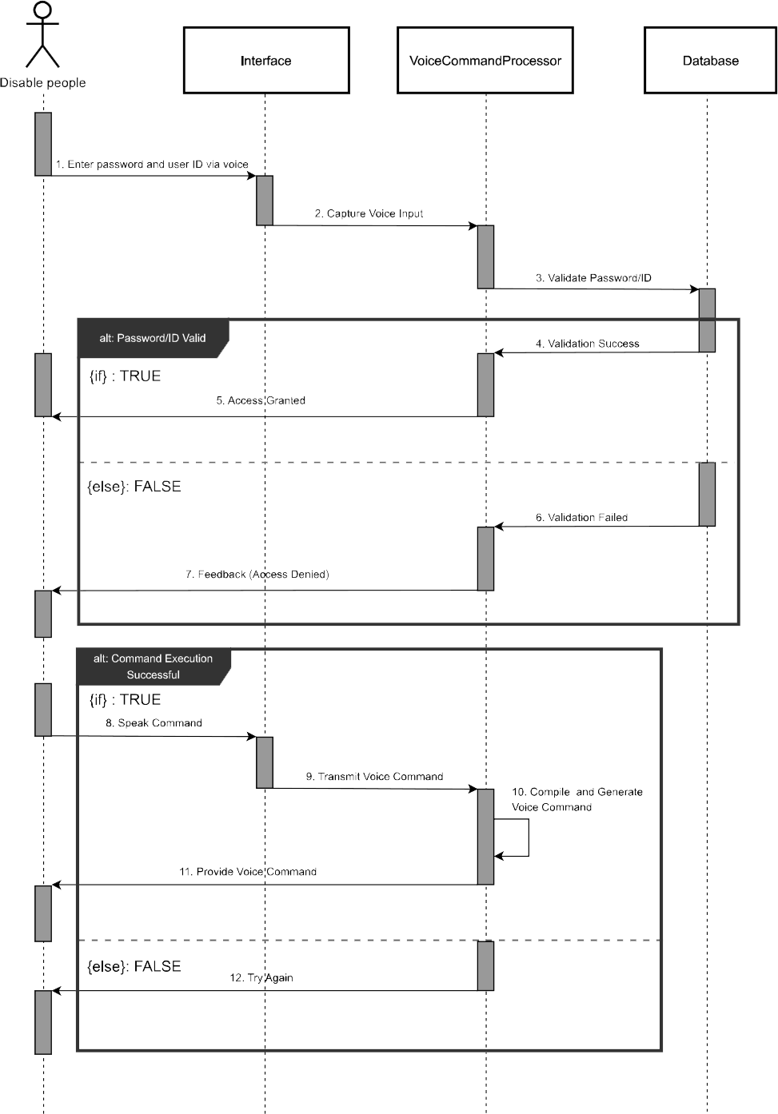
Sequence diagram (present one)
Notes:
Instructions : Mention the use case name
Set a Hyper link to launch your SD if two large
Show Input / Output messages to and from the system
Discuss why you chose it and what value does it add to the project when developers read it

Slide 11
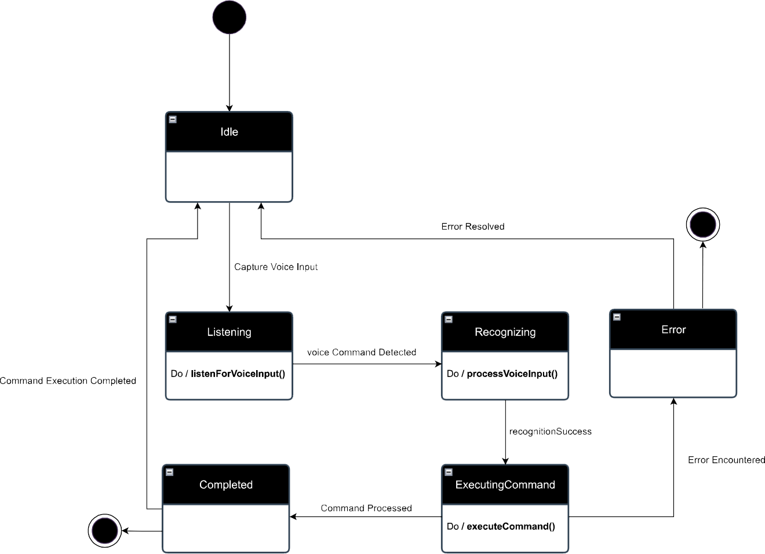
State machine diagram
Notes:
Instructions:
Mention which object you chose.
Discuss why you chose this object and what value does the state machine diagram bring

Slide 12
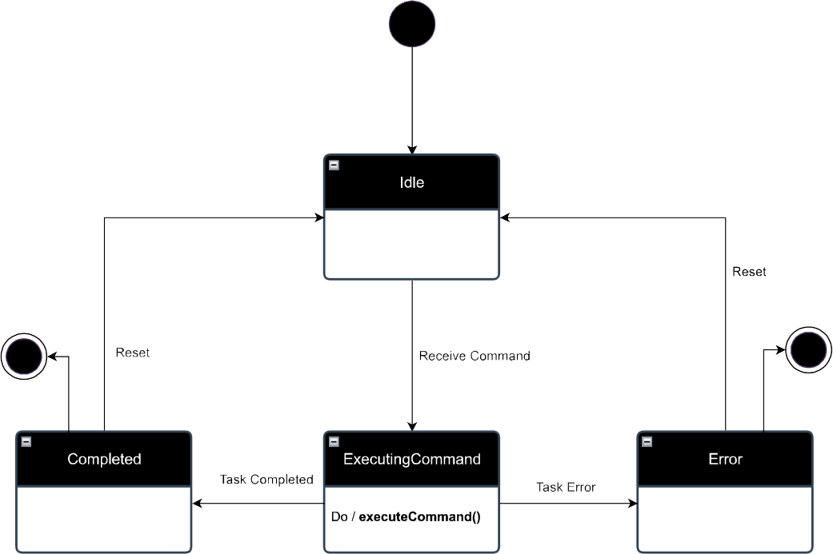
State machine diagram
Notes:
Instructions:
Mention which object you chose.
Discuss why you chose this object and what value does the state machine diagram bring

