Slide 1

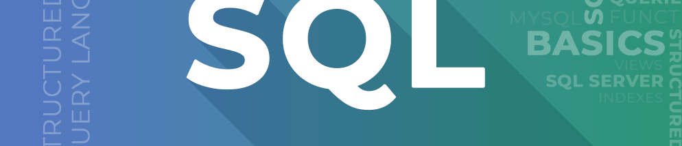
ISCG 6425
TEAM 1
Jau-Chian Pan (1564921)
HANNAH (1534249)

Slide 2
INTRODUCTION
This report was created at the request of 'Models Sales Company', and a database was developed that allows sales department managers to centralize access to all data and perform data analysis.
This data warehouse includes the values of Total Price, Total Profit, and Total Possible Profit, and data calls were set up lightly and quickly through Star Schema. Existing data and clean data were extracted and merged through DQLog.
Notes:
Advantages of star schema
Simplified Queries
Simple structure with a central fact table and a related dimension tables, making it easier for analysis to write
Improved query performance
The non-normalized nature of the star schema implies that fewer joining are required between tables compared to the normalized schema, which reduces query complexity and significantly improves query performance.
Improved Readable and comprehension
A central fact table surrounded by dimension tables and a clear and intuitive layout of the star schema make data models easy to understand.
Effective Aggregation
Well suited for aggregating large amounts of data. The structures supports efficient roll-up and drill-down operations, making it easier for users to aggregate data at different levels of segmentation.
Disadvantages of star schema
Data redundancy
The inherent de-standardization of the star schema can lead to data redundancy.
Maintenance Complexity
Changing data requires careful updates across multiple tables, which can complicate data management and increase the likelihood of errors.
Limited flexibility for complex relationships
Star schemas are not suitable for representing complex relationships between data objects. Many-to-Many relationship can be challenging in star schema.
Slowly Changing Dimension(SCD) Handling difficulties
Managing slowly changing dimensions whose dimensional properties change over time can be complex in star schemas. These changes often require special skills and additional structures (e.g., Type 2 SCD), adding complexity to the schema.
Compex ETL processes
The processes required to extract, transform and load data into the star schema can be complex and time consuming. Careful planning and robust processes are required to ensure data quality and consistency during ETL operations.

Slide 3

Motivation
The report is designed to quickly and easily compare and analyse
Monthly sales and profit/loss reports
Employees' monthly profit/loss reports
City-specific gross sales reports
Most purchased customer reports
Monthly gross sales and total available profit sales
Sales departments can quickly analyse data and read data briefly, reducing the time invested in comparative analysis, enabling active work.
This report will help the team learn about the products and regions in which "Models Sales Company" should invest.

Slide 4

DataSet of OLTP
Product(productCode, productName, productLine*, productScale, productVendor, productDescripion, quantityInStock, buyPrice, MSRP)
productLine(productLine, textDescription, htmlDescription, image)
orderDetail( orderNumber*, productCode*, quantityInOrdered, priceEach, orderLineNumber)
productOrder(orderNumber, orderDate, requiredDate, shippedDate, status, comments, customerNumber*)
Payment(customerNumber, checkNumber, paymentDate, amount)
Customer(customerNumbrer, customerName, contractLastName, contractFirstName, phone, addressLine1, addressLine2, city, state, postalCode, country, salesRepEmployeeNumbrer*, creditLimit)
Employee(employeeNumber, lastName, firstName, extension, email, officeCode*, reportsTo*, jobTitle)
Office(officeCode, city, phone, addressLine1, addressLine2, state, country, postalCode, territory)

Slide 5
DataSet of OLAP
Product(productCode, productName, productLine*, productScale, productVendor, productDescripion, quantityInStock, buyPrice, MSRP)
productLine(productLine, textDescription, htmlDescription, image)
orderDetail( orderNumber*, productCode*, quantityInOrdered, priceEach, orderLineNumber)
productOrder(orderNumber, orderDate, requiredDate, shippedDate, status, comments, customerNumber*)
Payment(customerNumber, checkNumber, paymentDate, amount)
Customer(customerNumbrer, customerName, contractLastName, contractFirstName, phone, addressLine1, addressLine2, city, state, postalCode, country, salesRepEmployeeNumbrer*, creditLimit)
Employee(employeeNumber, lastName, firstName, extension, email, officeCode*, reportsTo*, jobTitle)
Office(officeCode, city, phone, addressLine1, addressLine2, state, country, postalCode, territory)

Slide 6
DataSet of OLAP
dimProducts(productKey, productCode, productName, productLine, quantityInStock,buyPrice,MSRP) dimCustomers( customerKey, customerNumber, saleRepEmployeeNumber, customerName,city, country)
dimEmployees(employeeKey, employeeNumber, lastName, firstName, city, country)
dimPayments(paymentKey, customerNumber, checkNumber, paymentDate, amount)
factOrder(productKey, CustomerKey, EmployeeKey, OrderDateKey, RequiredDateKey*, ShippedDateKey*, status, orderNumber, quantityInOrdered, priceEach, TotalPrice, TotalProfit, TotalPossibleProfit)
dimTime(timeKey, Date, Day, DayOfWeek, DayOfMonth, WeekOfYear, Month, MonthOfYear, QuaterOfYear, Year)
Notes:
Advantages of Dataset Of OLAP
Fast Data Analysis
Multidimensional Data Modelling
User Friendly
Efficient Data Summarization
Data Consistency
=Using a dataset for OLAP (Online Analytical Processing) comes with several advantages. It enables fast data analysis due to its optimized structure for complex queries and aggregations. The dataset supports multidimensional data modelling, allowing users to analyse data from different perspectives. It is user-friendly, making it accessible for business users and analysts without extensive technical knowledge. The dataset allows for efficient data summarization, providing quick insights and reports by pre-aggregating data. Furthermore, it ensures data consistency by maintaining a structured and integrated format across different sources.
Disadvantages of Dataset Of OLAP
Complex Data preparation
Cost Issues
Limited Flexibility
Skill Requirements
Performance Issues
Disadvantages to using an OLAP dataset. Data preparation can be complex, requiring significant effort in data cleaning, transformation, and integration. The associated cost issues can be substantial, involving investment in specialized software, hardware, and skilled personnel. OLAP datasets offer limited flexibility, as they are often designed for specific analytical needs and may not adapt easily to new requirements. There are skill requirements, as setting up and managing OLAP systems necessitates expertise in data warehousing and analytics. Additionally, performance issues can arise with very large datasets or highly complex queries, potentially impacting the responsiveness and efficiency of the system.

Slide 7
Data Extraction
Identify Relevant Tables
Customer
Product(+ProductLine)
Employee(+Office)
productOrder + orderDetail = factOrders
Extract Data
SELECT*FROM tables
Join Tables
SELECT*FROM tables a
INNER JOIN tables b ON b.pk = a.fk
Aggregate Data
SELECT (price-buyprice) as [profitability]
FROM saleAU_NZ.dbo.Customer C
INNER JOIN ……
Notes:
For data extraction, we start by identifying the relevant tables. The tables required for our analysis include Customer, Product (along with ProductLine), Employee (and Office), and the combination of productOrder and orderDetail, which together form the fact table factOrders.
We then proceed with data extraction using the SELECT * FROM clause to retrieve data from these tables. If necessary, we employ JOIN clauses to merge data from multiple tables.
Finally, we utilize aggregation functions and calculation formulas within the SELECT statement to compute derived metrics such as profitability. Throughout this process, we ensure that valid primary keys (PKs) and foreign keys (FKs) are properly extracted and maintained.

Slide 8
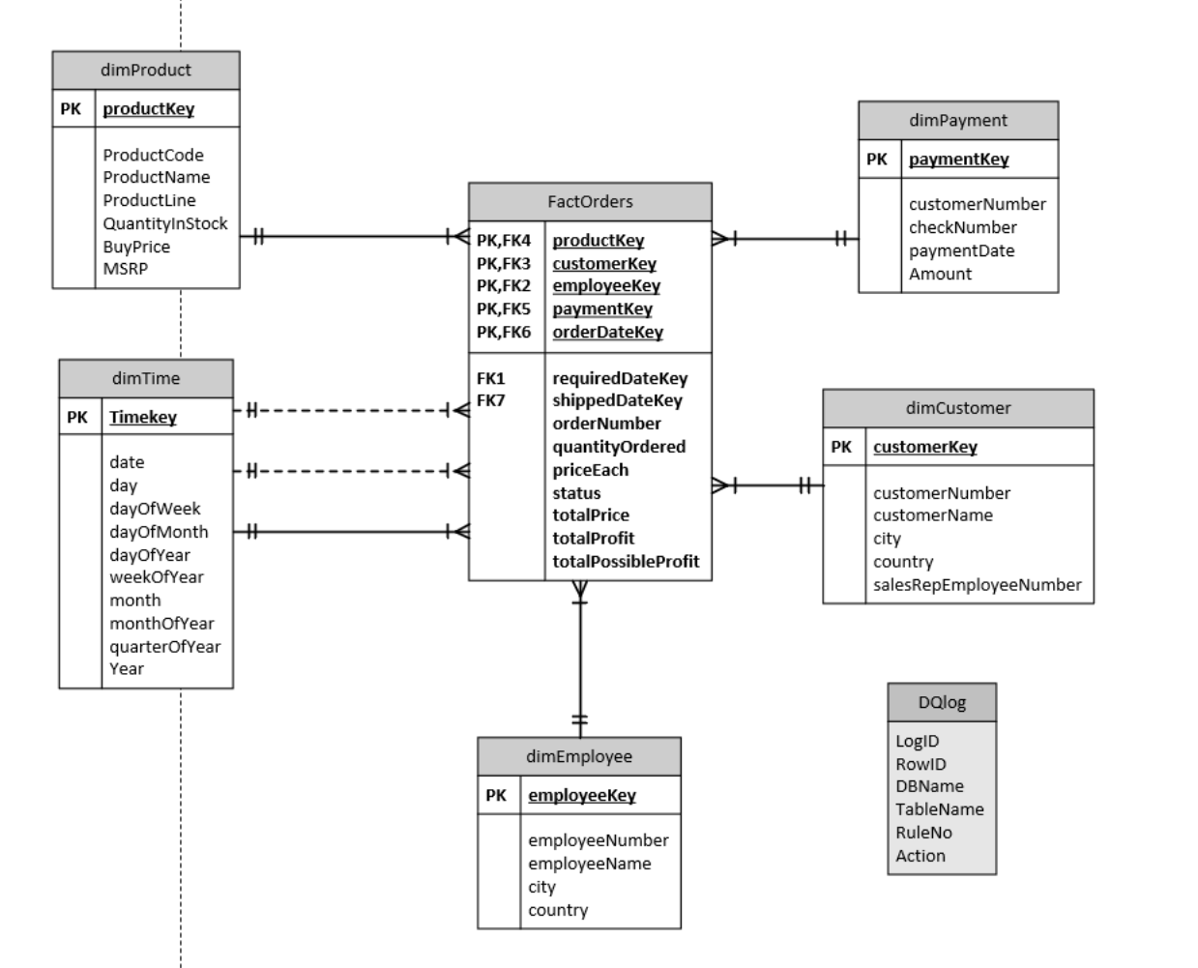
We have opted for a Star schema to record the data, primarily because the client's main focus is 5 Revenue Reporting, without additional descriptions.
In this schema, we have utilized 5 dimensions:
1. Product Table: This dimension is essential
for generating product revenue reports.
2. Customer Table: This dimension is crucial
for understanding customer revenue patterns.
3. Employee Table: This dimension provides insights into employee revenue contributions.
4. Payment Table: We have separated the Payment Table from the Customer Table to prevent data redundancy and loss.
This schema design allows efficient and focused reporting on revenue-related metrics, aligning closely with the client's priorities.
Notes:
Removal of ProductLine Table: The ProductLine Table has been removed along with all its attributes because none of these attributes are required by the clients.
Removal of Unnecessary Attributes: The following attributes have been removed from various tables as they are not required by the clients:
From the Customer Table: contractLastName, contractFirstname, phone, addressLine1, addressLine2, state, postalCode, creditLimit.
From the Product Table: productScale, productVendor, productDescription.
From the Employee Table Extension: email, reportsTo, jobTitle.
From the ProductOrder Table: comments.
Merging of Tables:
Removal of Office Table: The Office Table has been removed, but the city and country attributes have been merged into the Employee Table for the monthly employee report.
Merging of OrderDetail and ProductOrder: These tables have been merged into a factTable because the ProductOrder table contains date attributes and the OrderDetail table contains quantity and priceEach attributes, which are necessary for the main calculations. Additionally, these two tables are at the center of the database and are much shorter to join compared to other tables.
Addition of Tables:
Addition of dimTime Table: This table has been added for reporting time-related information.
Addition of DQLog Table: This table has been added for clear data management purposes.

Slide 9
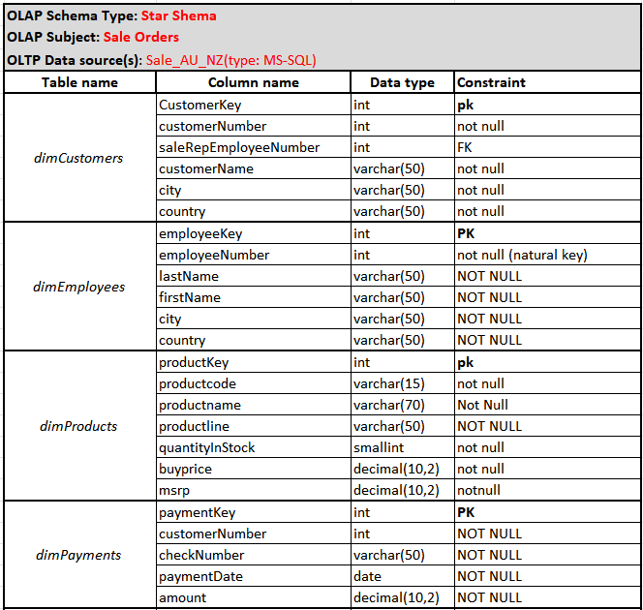
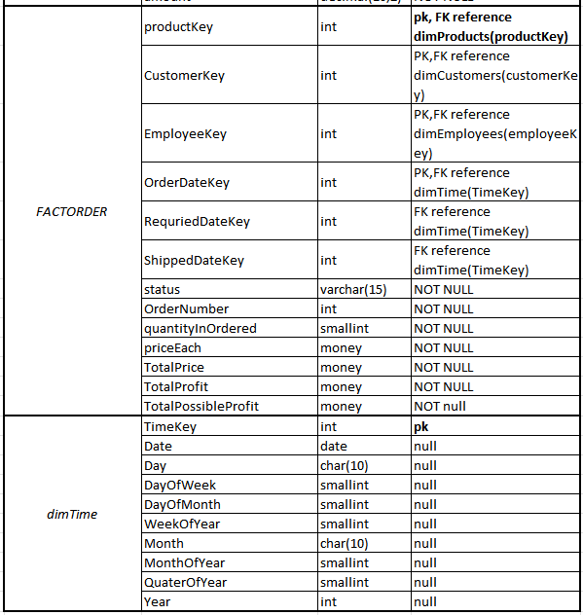
OLAP Schema Data Dictionary

Slide 10
DQlog Rules
No | Attribute | Table | Action | Others
1 | buyPrice | Product | Reject | If buyPrice is 0 or Null
 |  |  | Fix | if buyPrice is negative, need to convert to positive number
2 | priceEach | OrderDetail | Reject | if priceEach is 0 or Null
 |  |  | Fix | if priceEach is negative, need to convert to positive number
3 | QuantityOrdered | OrderDetail | Reject | if QuantityOrdered is 0 or Null
 |  |  | Fix | If QuantityOrdered is negative, need to convert to positive number
4 | MSRP | Product | Reject | if MSRP < buyPrice on a product
5 | Country | Customer and Office | Fix | If Country format regardless capital or non-capital cases
6 | ProdctCode | OrderDetail | Reject | if ProductCode doesn’t exist or is null
7 | CustomerNumber, addressLine1, addressLine2, and City | Customer | Reject | if (CustomerNumber doesn’t exist or is null) and (if any of: addressLine1, addressLine2 and City are null)
8 | requiredDate, shippedDate | ProductOrder | Fix | if orderDate greater than requiredDate or if requiredDate null replace orderDate+7 if orderDate greater than shippedDate or shippedDate null and status is ='Shipped’ replace orderDate+2
9 | amount | Payment | Reject | If buyPrice is 0 or Null
 |  |  | Fix | if paymentDate is negative, need to convert to positive number
10 | paymentDate | Payment | Reject | if paymentDate greater than orderDate, Reject it.
Notes:
"DQLog" stands for Data Quality Log, and it is a crucial tool used to manage data quality within the data warehouse. DQLog helps monitor and manage data to maintain its accuracy, completeness, and consistency. This enables the identification and correction of erroneous data.
The rules from 1 to 8 are common to the assignment, so I will not elaborate on them here. Our team has established two additional rules, 9 and 10.
Firstly, if the amount in the payment table is null or zero, it is rejected, and if it is negative, it is converted to positive. The amount, being money and a measurement value, cannot be null or zero.
Secondly, Rule 10 pertains to the paymentDate. It ensures that payments can only be made after an order has been placed. Therefore, if the paymentDate precedes the orderDate, it is rejected.

Slide 11
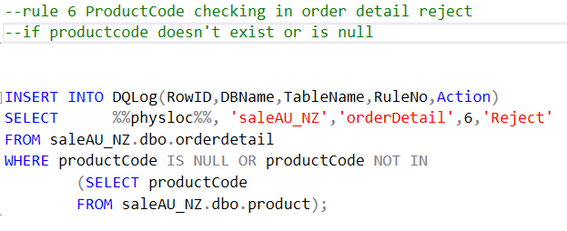
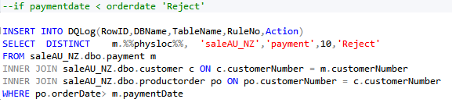
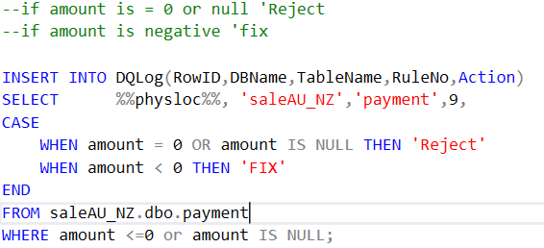
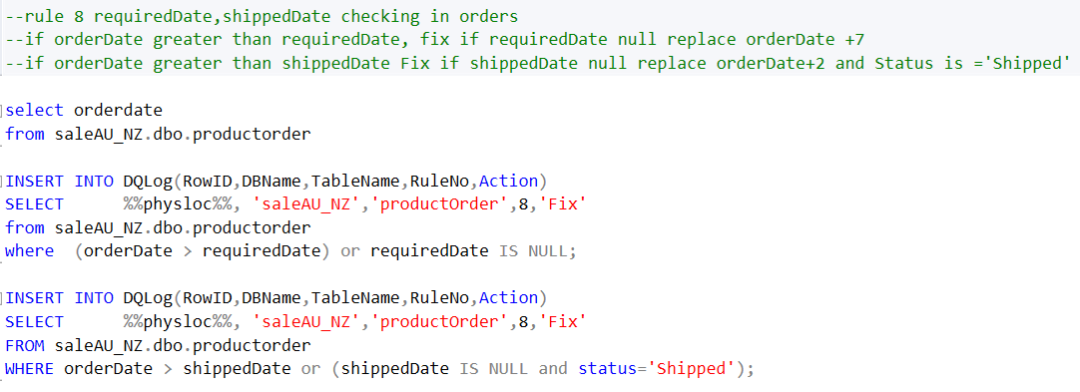
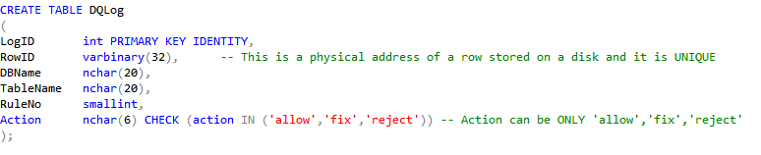
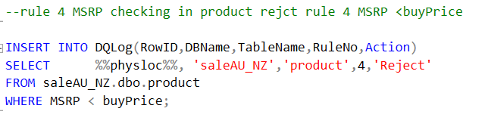
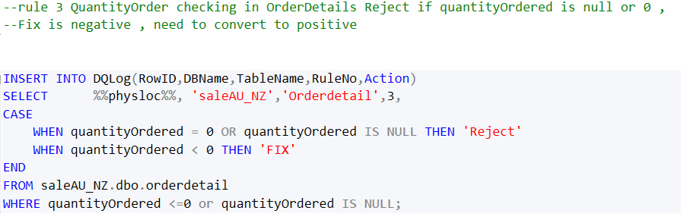
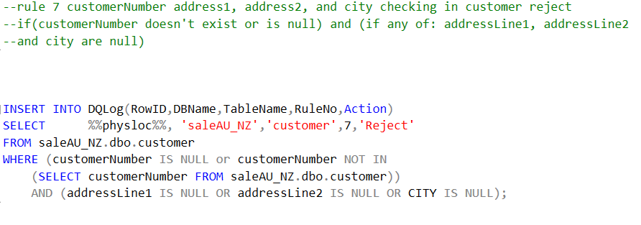
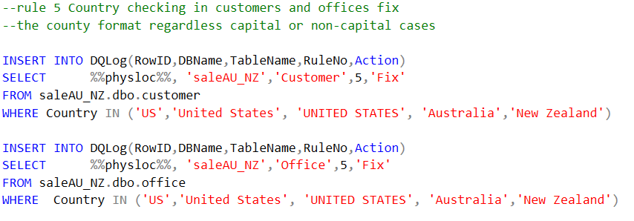
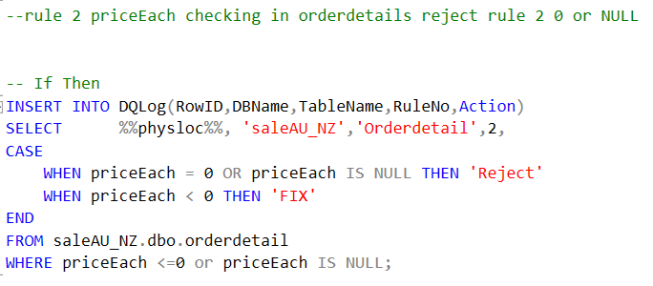
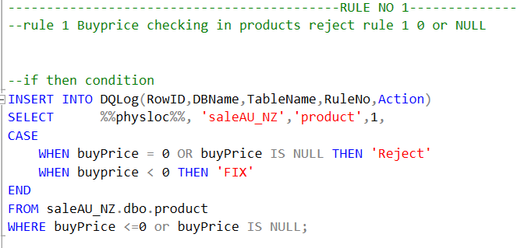
DQ LOG QUERY
Notes:
Includes ‘CREATE TABLE Dqlog’ and how to insert dq log by rule.
If there are two conditions, I used Case and When statement.

Slide 12

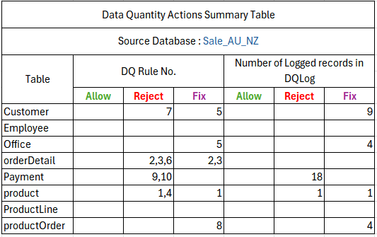
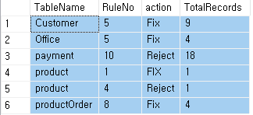
Data Quantity Actions Summary Table

Slide 13
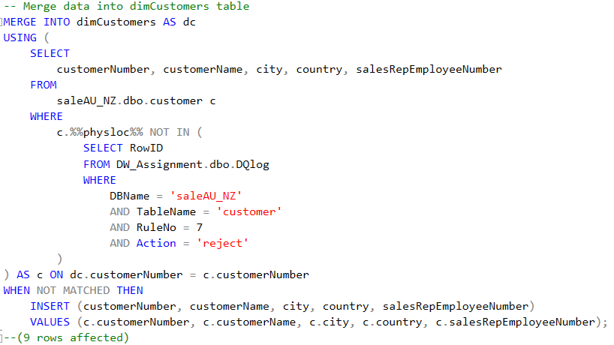
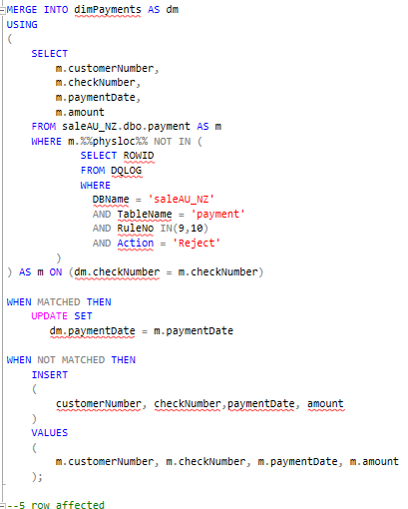
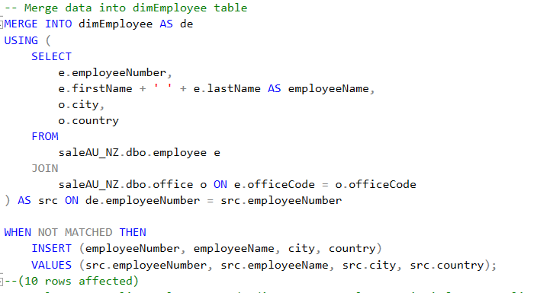
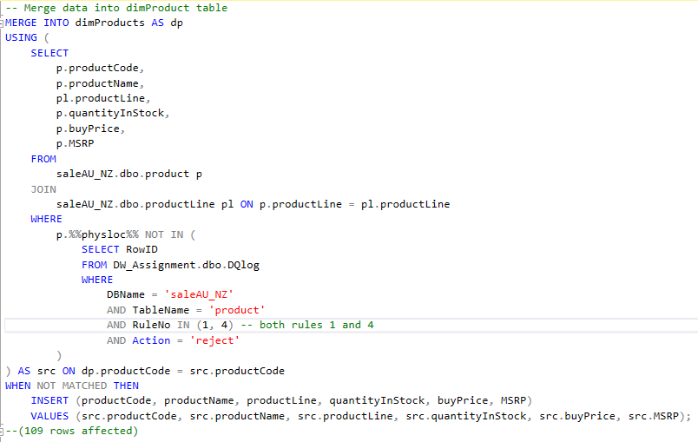
Merge and Update

Slide 14
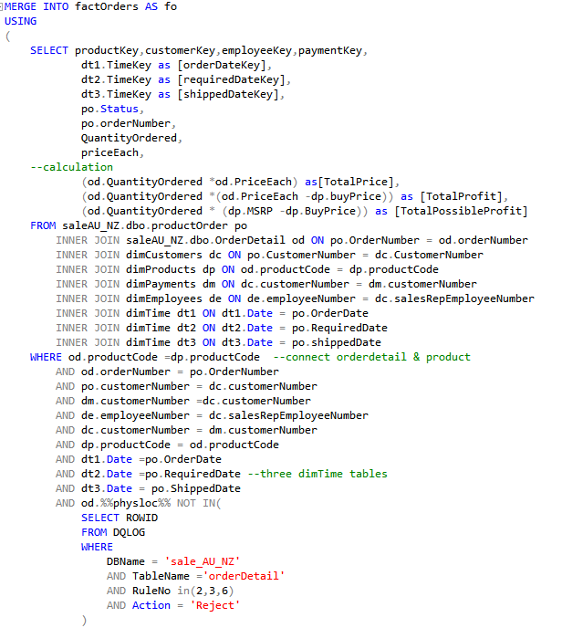
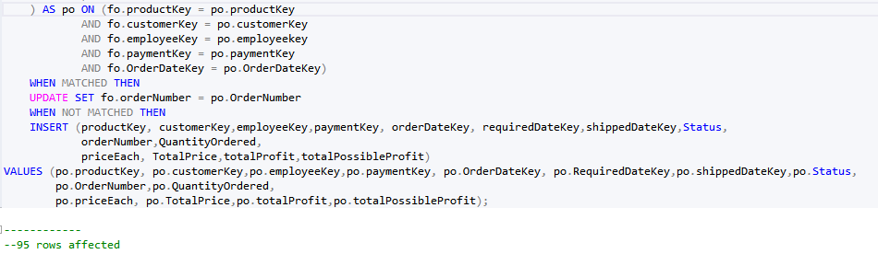

Slide 15
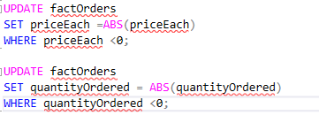
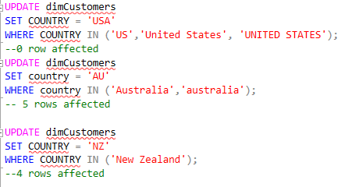
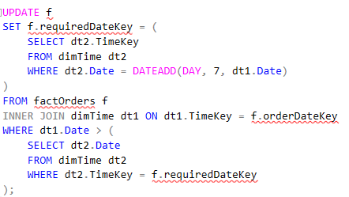
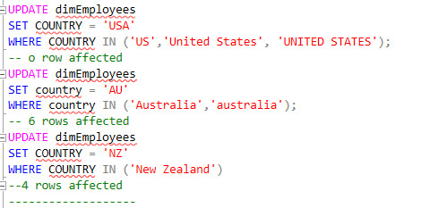
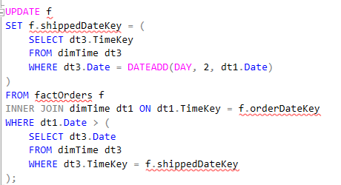


Update

Slide 16
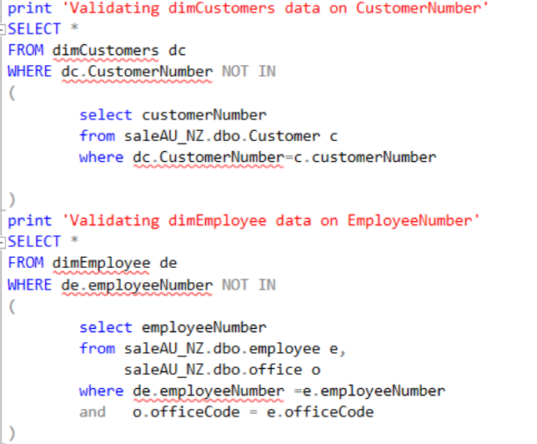
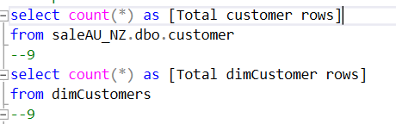
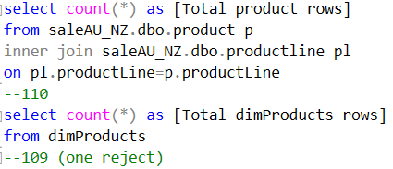
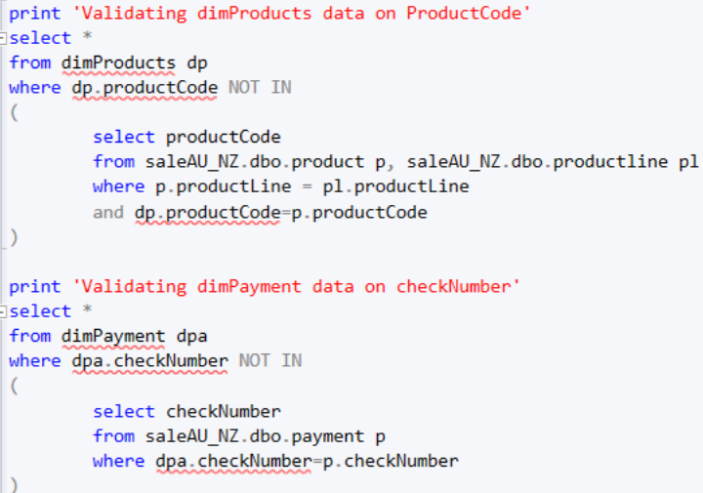
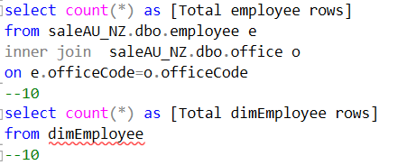
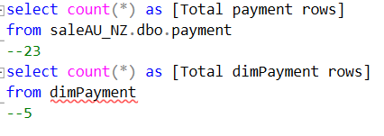
Evaluation
Table Name | Number of rows | Table Name | Number of rows | DQlog reject rows
Customer | 9 | dimCustomer | 9
Employee | 10 | dimEmployee | 10
Product | 110 | dimProduct | 109 | 1 (reject)
Payment | 23 | dimPayment | 5 | 18 (reject)

Slide 17
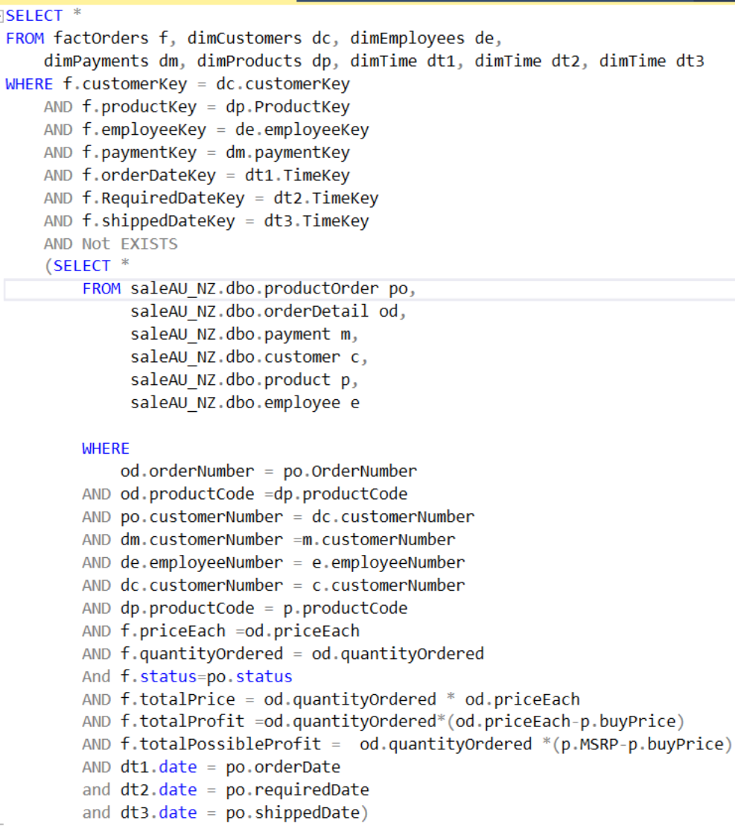
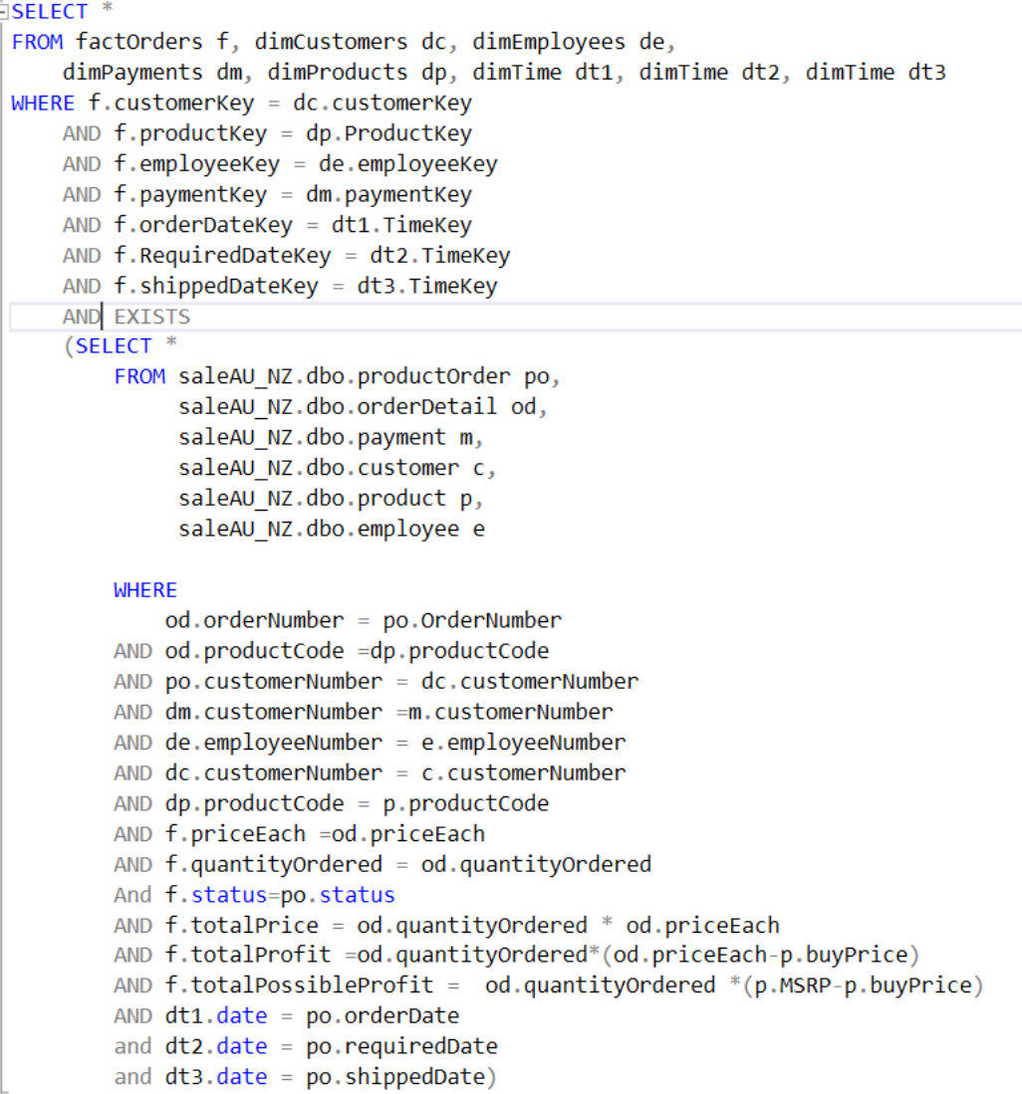
Evaluation
Notes:
NOT EXISIT = 21
EXIST = 74 result due to update requiredDateKey

Slide 18
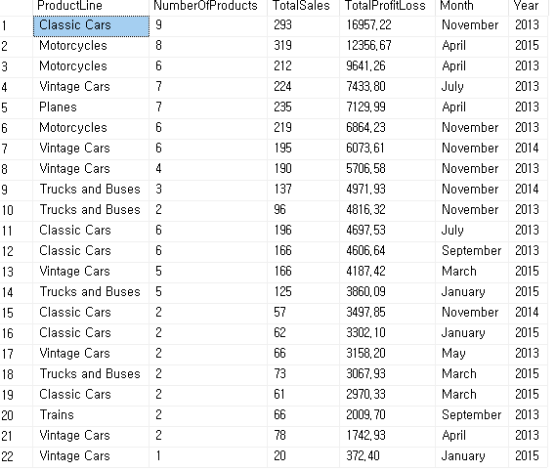
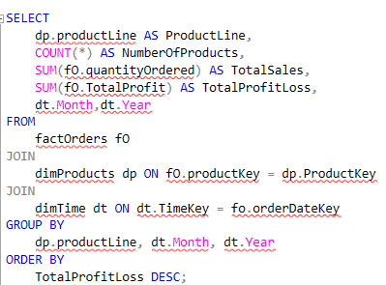
Report
1. Monthly sale and profit/loss report for each productLine
Notes:
Monthly sales and profit/loss report for each product line. For each product line, display its name, the number of products in that category, the total number of sales of all the products in that category, and the total profits/loss generated so far. Rank the line based on the total profits/loss generated in descending order

Slide 19
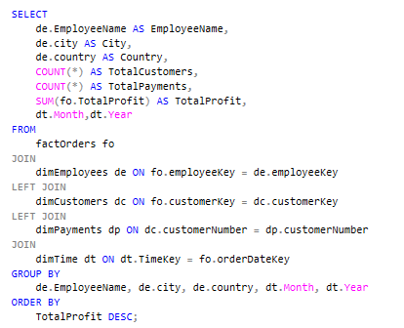
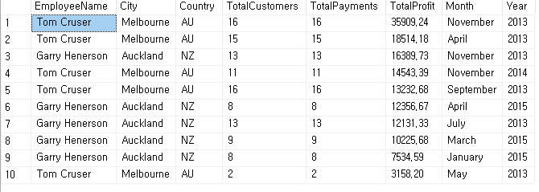
Report
2. Monthly report on the most profitable employees
Notes:
2. Monthly report on the most profitable employees. For each employee, display its name, city, country, the total number of customers he/she supported, the total number of payments from his/her customers processed. Rank the employees based on the number of profits generated in descending order

Slide 20
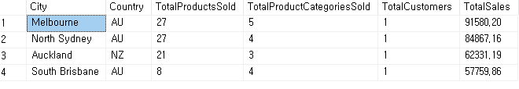
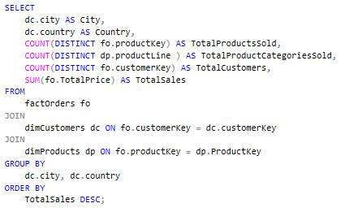
Report
3. Summary report on the total sales based on City
Notes:
3. Summary report on the total sales based on City. For each city, display its name, country, the total number of products sold, the total number of product category sold, the total number of customers who live there and the total sales of product sold. Rank the city based on the total sales of products sold.

Slide 21
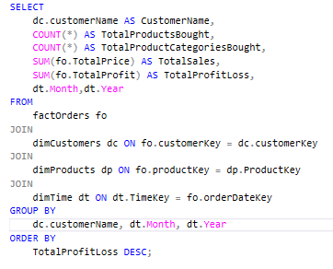
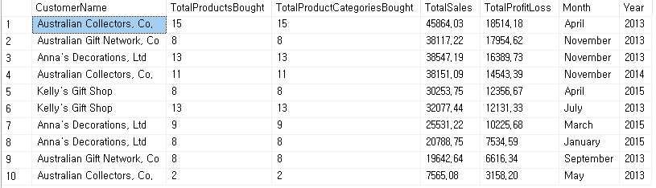
Report
4. Monthly report on the customers who have bought the most
Notes:
4. Monthly report on the customers who have bought the most. For each customer, display the customer’s name, the total number of products bought, the total number of product categories bought, the total sales of products bought and the total profits/loss generated so far. Rank the customer based on the total profits/loss generated in descending order.

Slide 22
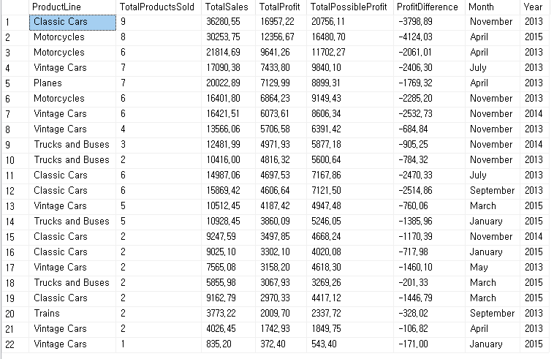
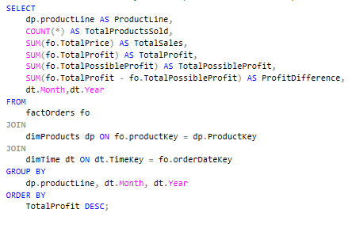
Report
5. Monthly sale report that list and comparer of Total-profit with
total-possible-profit for each product Line
Notes:
5. Monthly sales report that list and comparer of Total-Profit with Total-Possible-Profit for each product line. For each product line, display its name, the total number of sales of all the products in that category, and the total profits, total possible profit and different between last two parameters. Rank the line based on the total profits generated in descending order.

Slide 23
Conclusion
Our transition to an OLAP data warehouse, using a star schema setup, has been seamless. We've ensured a smooth shift of our data from OLTP to OLAP, and by applying Data Quality Log, we've cleaned and verified our data for reliability. After transition, we conducted thorough evaluations, comparing rows between OLTP and new OLAP tables, and validating keys and attributes in the fact table. With this data warehouse, the Sales team can easily access all the data they need and can analyze it to make smart decisions through reports.

Slide 24
Any Question?

