Slide 1
Software testing strategies
Rytis Karpuška
Vilnius

Slide 2
Testing strategy
Different test methods are beginning to cluster themselves into several distinct approaches and philosophies. These “approaches and philosophies” are what we shall call strategy.
A High-level plan for uncovering errors in software system.

Slide 3
Common characteristics for software testing strategies
Testing begins at the component level and works "outward" toward the integration of the entire computer based system
Different testing techniques are appropriate at different points in time
Testing is conducted by the developer of the software and an independent test group
Testing and debugging are different activities, but debugging must be accommodated in any testing strategy

Slide 4
Why developres cannot perform all of the testing?
Developers
  Conflict of interesets problem
Independent testing group

Slide 5
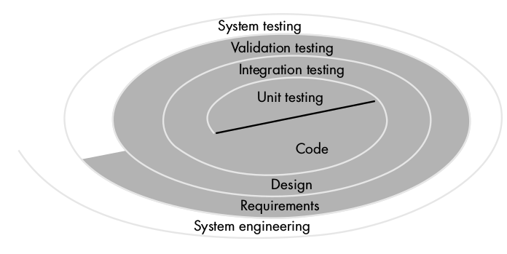
Testing strategy
Relation to software engineering

Slide 6
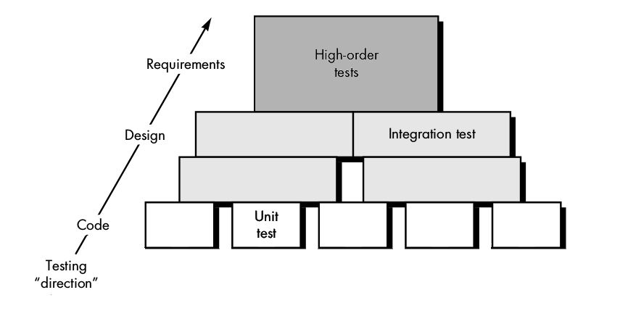
Testing strategy
Abstraction hierarchy

Slide 7
Exercise
Code
Design
Requirements
Validation tests
Unit tests
Integration tests

Slide 8
Exercise answers
Code
Design
Requirements
Validation tests
Unit tests
Integration tests

Slide 9
Criteria for Completion of Testing
No definite criteria:
"You're done testing when you run out of time or you run out of money."
Statistics?

Slide 10
Criteria for Completion of Testing
Musa, J.D. and Ackerman, A.F., 1989
l₀ – Initial software failure intensity
p – Coefficient for reduction in failure intensity as errors are repaired
t - Time

Slide 11
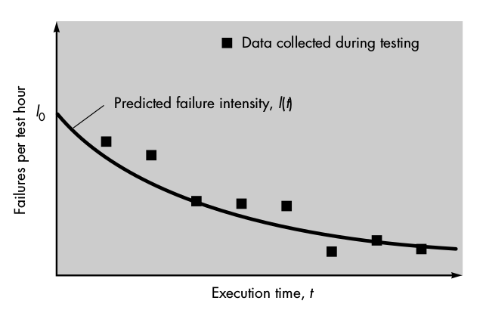
Criteria for Completion of Testing

Slide 12
Exercise
Why there is no definite criteria for test completion?

Slide 13
Exercise
Why there is no definite criteria for test completion?
  We can never be sure that we have found all of the errors

Slide 14
Unit testing
Focuses on smallest unit of software – component or module.
Mostly white-box testing

Slide 15
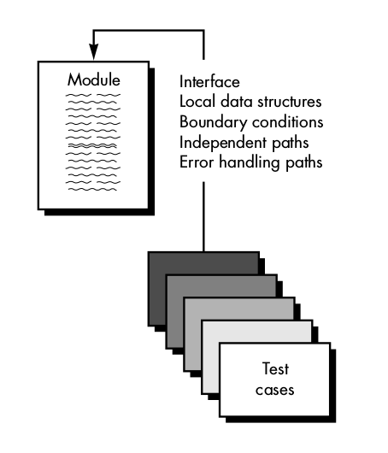
Unit testing

Slide 16
Unit testing
Unit tests should:
  Cover as much of the execution paths as possible
  Check if errors are handled correctly
  Exercise boundary conditions

Slide 17
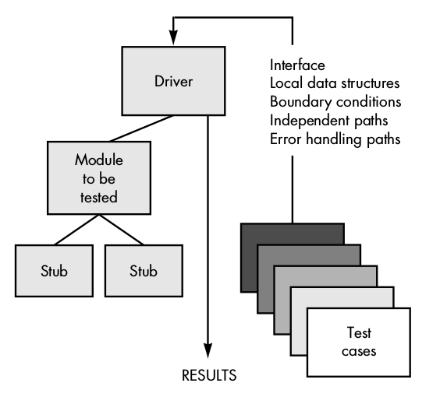
Unit testing
Dependencies

Slide 18
Integration testing
Focuses on constructing the program from modules iteratively while conducting tests to uncover errors
Uses mostly black-box testing although limited amount of white-box tests are OK to exercise certain code paths

Slide 19
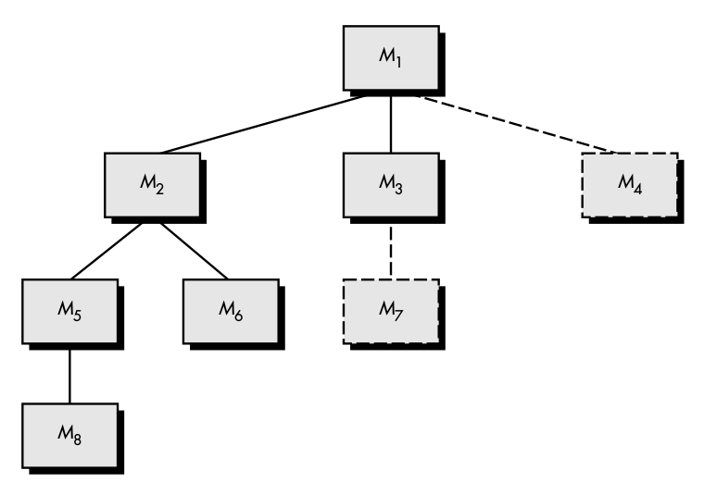
Integration testing
Top-down approach

Slide 20
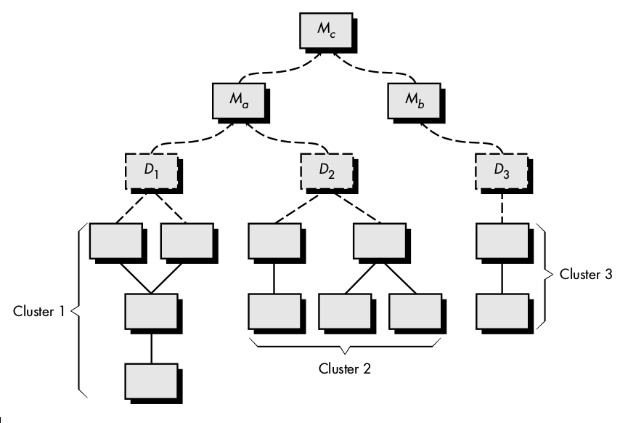
Integration testing
Bottom-up approach

Slide 21
Exercise
What is the advantage of bottom-up approach against top-down?
  Bottom-up approach can be parallelised
  Bottom-up approach avoids the need for stubs (mocks)
  Bottom-up approach uncovers more errors

Slide 22
Exercise
What is the advantage of bottom-up approach against top-down?
  Bottom-up approach can be parallelised
  Bottom-up approach avoids the need for stubs (mocks)
  Bottom-up approach uncovers more errors

Slide 23
Integration testing
Regression testing
Regression testing is reexecution of all or some subset of tests that have already been conducted to ensure that changes have not propagated unintended side effects.

Slide 24
Integration testing
Smoke testing
Smoke testing activities
  Software components are built
  A series of tests are run with the intent to uncover “show stopper” errors
  The procedure is repeated frequently (daily)

Slide 25
Validation testing
Tests software conformity with requirements
Entirely black-box tests
Basis for test cases are defined in Software Requirement Spefication

Slide 26
Validation testing
Alpha and Beta tests
Alpha testing
  The software is used in natural setting by customer at developers site
  Developer is “looking over the shoulder”
Beta testing
  The software is used in natural setting by customer at customers site
  No developer present
  Customer records and reports problems to developer

Slide 27
Exercise
If I let my friend play with my shiny new android app while watching his reaction, this is:
  Alpha testing
  Beta testing

Slide 28
Exercise
If I let my friend play with my shiny new android app while watching his reaction, this is:
  Alpha testing
  Beta testing

Slide 29
System testing
Software is incorporated with other system elements (hardware, people, information) and a series of tests are performed

Slide 30
System Testing
Types of tests
Recovery testing
Security testing
Stress testing
Performance testing

Slide 31
Debugging
Debugging is a process that results in removal of the error uncovered by testing
There is no direct connection between error symptoms (found during testing) and its cause, therefore debugging is considerend to be an art

Slide 32
Debugging
Techinques
Brute-force
  Collecting as much information from the program as we can hoping that this information will provide clue to what the cause of the error is
Backtracking
  Start at the site of symptoms and trace back the source code until the site of the cause is found.
Cause elimination
  A set of cause hypothesis is devised from symptoms. Then hypothesis are either proved or disproved until cause of the error is understood

Slide 33
Klausimai?

Slide 34
Ačiū už dėmesį

