Slide 1

Lab Book 3. Interferometers I – MZI
Student:

Slide 2




Instructions General
SOFTWARE
Python notebook supplied by instructors
SCRIPTS
From Poliformat → download the 030_INTERFEROMETERS_v2025_Student_UPDATE2.ipynb
https://github.com/cccanvas-upv/pic-upv-lab3.git
COMPONENT to be studied: Mach-Zendher Interferometer (MZI)
$β_{u}$, $L_{u}$
In2
Out2
$$k_{a}$$
$$k_{b}$$
In1
Out1
$β_{d}$, $L_{d}$

Slide 3

ASSESSMENT #1 – Recap from theory – MZI configurations
Provide one example of implementation for each one of the configurations studied during MZI lecture:
1. Balanced configuration
2. Unbalanced configuration:
2.1. Phase difference
2.2. Delay imbalance
Compute also some examples with $α≠0$ and $γ≠0$
Document all your results (neff, alpha, gamma, transfer function plots, etc.) and comment on the obtained results (in terms of FSR, amplitude, losses, etc.).

Slide 4
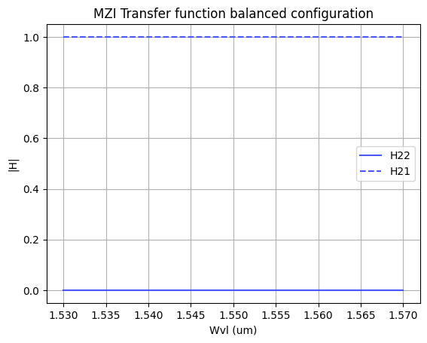
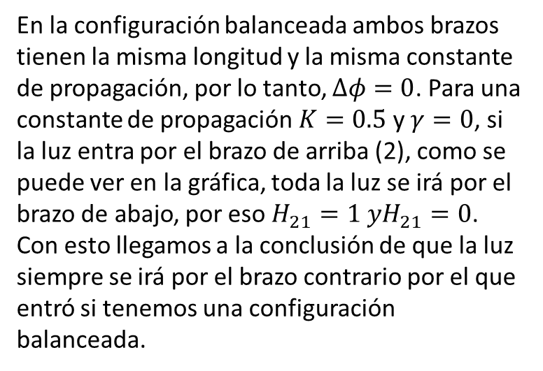
En la configuración balanceada ambos brazos tienen la misma longitud y la misma constante de propagación, por lo tanto, $∆φ=0$. Para una constante de propagación $K=0.5$ y $γ=0$, si la luz entra por el brazo de arriba (2), como se puede ver en la gráfica, toda la luz se irá por el brazo de abajo, por eso $H_{21}=1 yH_{21}=0$. Con esto llegamos a la conclusión de que la luz siempre se irá por el brazo contrario por el que entró si tenemos una configuración balanceada.
Balanced configuration

Slide 5
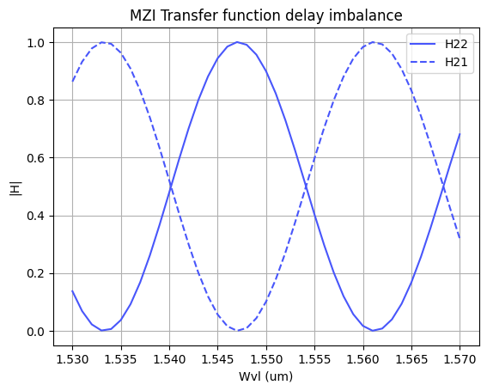
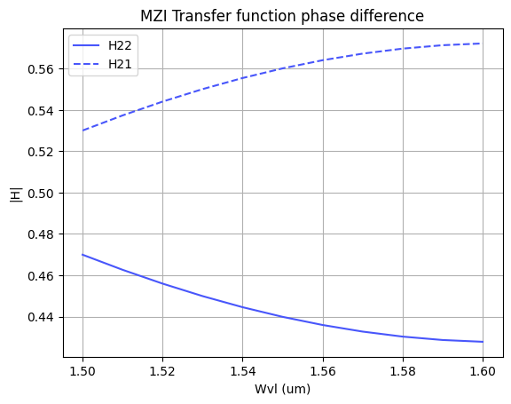
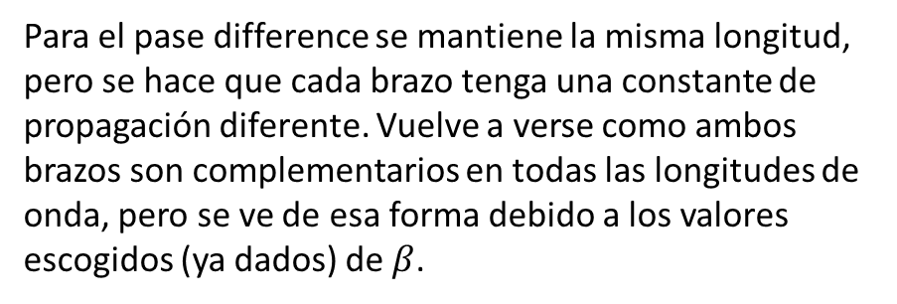
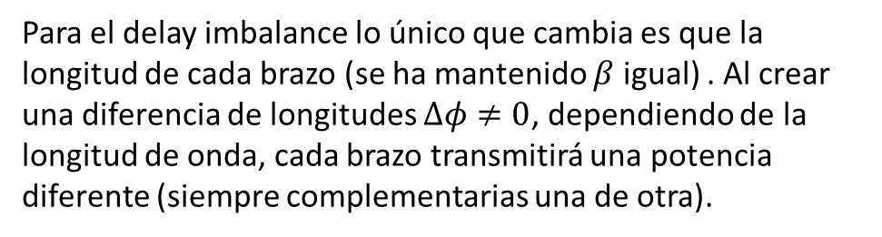
Para el delay imbalance lo único que cambia es que la longitud de cada brazo (se ha mantenido $β$ igual) . Al crear una diferencia de longitudes $∆φ≠0$, dependiendo de la longitud de onda, cada brazo transmitirá una potencia diferente (siempre complementarias una de otra).
Delay imbalance
Para el pase difference se mantiene la misma longitud, pero se hace que cada brazo tenga una constante de propagación diferente. Vuelve a verse como ambos brazos son complementarios en todas las longitudes de onda, pero se ve de esa forma debido a los valores escogidos (ya dados) de $β$.
Phase difference

Slide 6
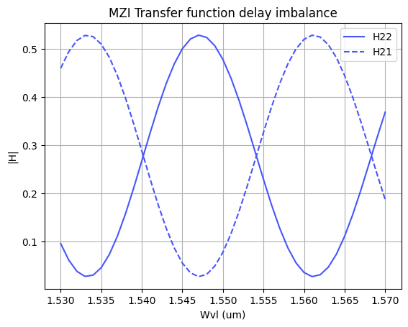
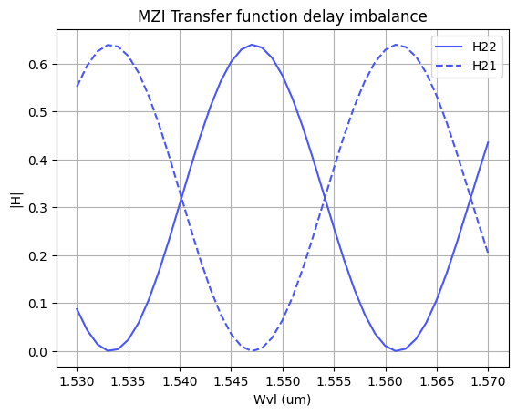


Al aplicar al caso de delay imbalance pérdidas de propagación (0.1 por brazo) podemos observar como el máximo y el mínimo de potencia a la salida de cada brazo ha variado. Ya no hay 1 de máximo ni 0 de mínimo.
Delay imbalance with $α≠0$
Al aplicar excess losses podemos ver que a la salida de los brazos el mínimo se mantiene igual, sin embargo, el máximo ha disminuido bastante, perdiendo bastante potencia por el camino.
Delay imbalance with $γ≠0$

Slide 7
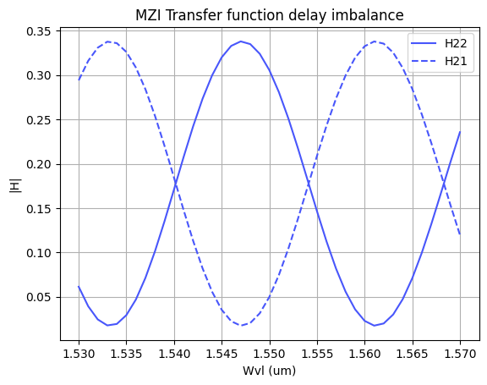

Delay imbalance with $α≠0$and $γ≠0$
Al aplicar tanto pérdidas de propagación como excess losses, como se puede esperar, se acumulan los dos tipos de pérdidas, resultando en máximos de no llega ni a 0.35 y mínimos que no alcanzan el 0.

Slide 8
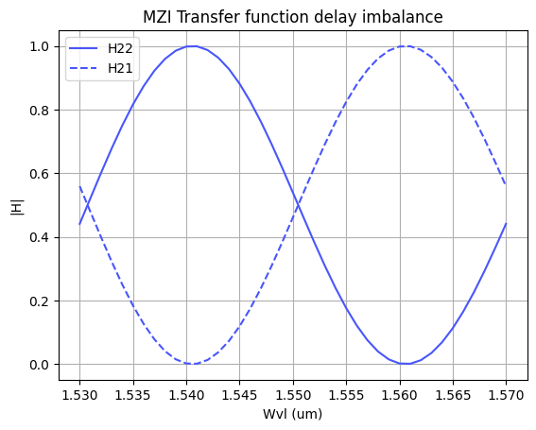

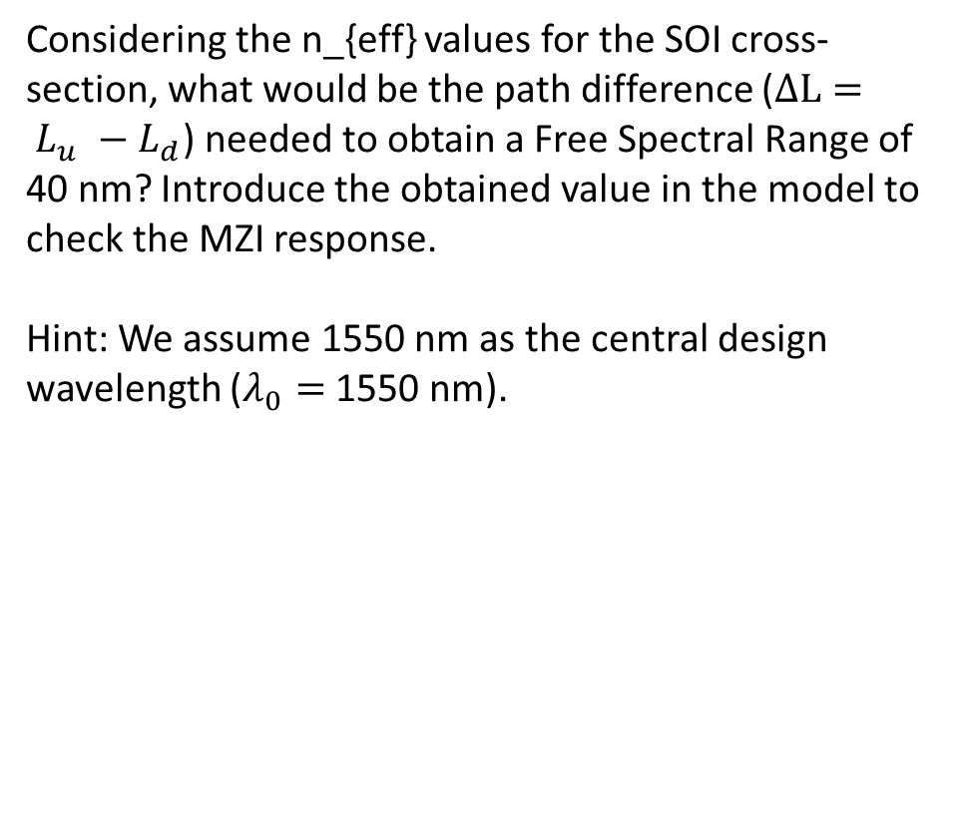
ASSESSMENT #2 – Recap from theory – Calculation of $ΔL$
Considering the n_{eff} values for the SOI cross-section, what would be the path difference ($ΔL= L_{u} −L_{d}$) needed to obtain a Free Spectral Range of 40 nm? Introduce the obtained value in the model to check the MZI response.
Hint: We assume 1550 nm as the central design wavelength ($λ_{0}=$1550 nm).
Group index at 1550 nm: 4.29327
Required Delta L (um): 13.989919105949546
Document all your results (copy here the code employed to obtain the corresponding value)
El Código usado para obtener la diferencia de camino necesaria para conseguir un FSR de 40nm está en el jupyter compartido.
Para ello he obtenido primero el índice de grupo a partir de su fórmula y he usado $FSR=\frac{λ^{2}}{n_{g}ΔL}$, despejando de ahí $ΔL$.

Slide 9
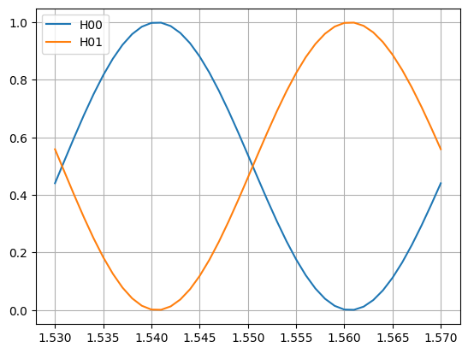
ASSESSMENT #3 – SAX implementation
Now, we are going to implement the design parameters in the MZI model developed in SAX and compare the response obtained with the one simulated by mathematical formulation. This will help us to identify any error in the definition of the SAX model single components.
In order to implement the SAX model, take as example the following lines:
mzi_test = mzi(wl=wl,
coup_a = ...
wvg_d={"length": l_d, "neff": ...},
wvg_u={"length": l_u, "neff": ...},
coup_b = ... )
H00 = mzi_test["in0", "out0"]
Document all your results (copy here the code employed to obtain the transfer function employing SAX modeling and include the comparative plot of the models)
Para ver el Código entrar al jupyter.

Slide 10
Extra assessments
Assessment 4. Design an MZI for filtering at a specific wavelength. Calculate and adjust the arm lengths to configure the MZI to have a maximum transmission at 1550 nm.
Assessment 5. Let's see how the response of the MZI varies with the effective index. Vary the effective index of one of the arms and analyze how the spectrum shifts. To do this, you can use the data provided in the .txt files entitled ‘SiN’. Can you give an example of an application where this configuration is used?
Advanced level assessment. Explore how cascading two MZIs affects the transmission spectrum. To do so, design a system in which two MZIs are cascaded. Simulate and observe the spectrum, explaining how the transmission peaks behave.
Document all your results

Slide 11
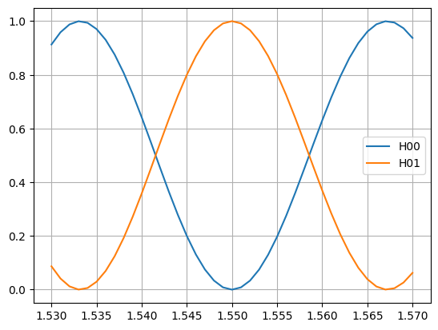
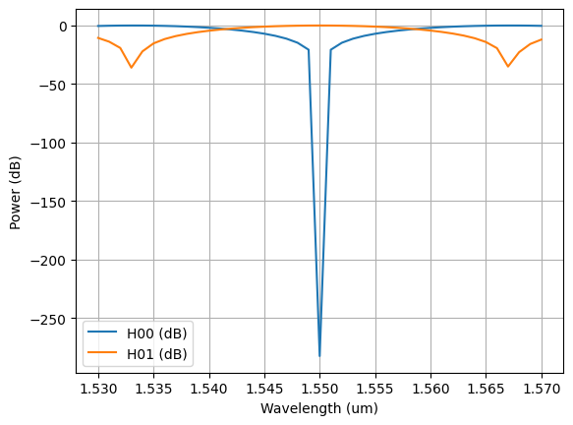
Assessment 4. Designing an MZI for filtering at a specific wavelength. Calculate and adjust the arm lengths to configure the MZI to have a maximum transmission at 1550 nm.

Slide 12
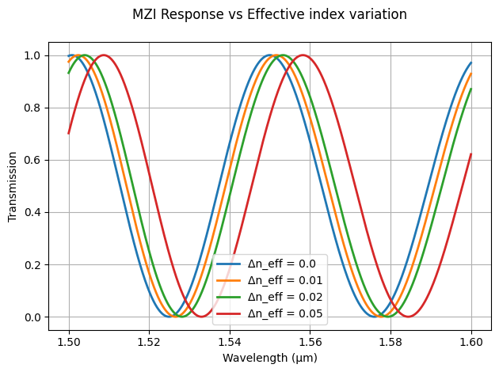
Assessment 5. Let's see how the response of the MZI varies with the effective index. Vary the effective index of one of the arms and analyze how the spectrum shifts. To do this, you can use the data provided in the .txt files entitled ‘SiN’. Can you give an example of an application where this configuration is used?

Slide 13

Thank you

