Slide 1
BUSINESS & CREDIT RISK ANALYTICS
Predicting Interest Rates
with Linear Regression
Model results, key drivers, prediction performance and limitations
Python • Spyder • Statsmodels
Notes:
Opening: This presentation reviews a multiple linear regression model that predicts IntRate using borrower and loan characteristics. The focus is not only on fit, but also on interpretation, validation and responsible use in credit-risk decisions. Add your name, course or organisation before presenting.

Slide 2
1. Business question & model setup
What are we trying to estimate?
TARGET
MODEL INPUTS
To predict the interest rate
• 3 Numerical variables : DTI, HistLen, Age
• 3 Categorical variables: EmpStatus, HomeOwn, Purpose
• Sample: 8004 observations of our train data
and 2001 observation of our test data
• Method: ordinary least squares (OLS)
We want to see if can built a model that can predict the interest rate of our individuels.Before
we use a other model to predict if the wil pay or not
Interpretation is conditional: coefficients describe associations while the other included predictors are held constant.
2
Notes:
Explain that interest rate is the target variable. DTI, HistLen and Age are numerical predictors; EmpStatus, HomeOwn and Purpose are categorical predictors represented by indicator variables. The model uses 8,004 observations.

Slide 3
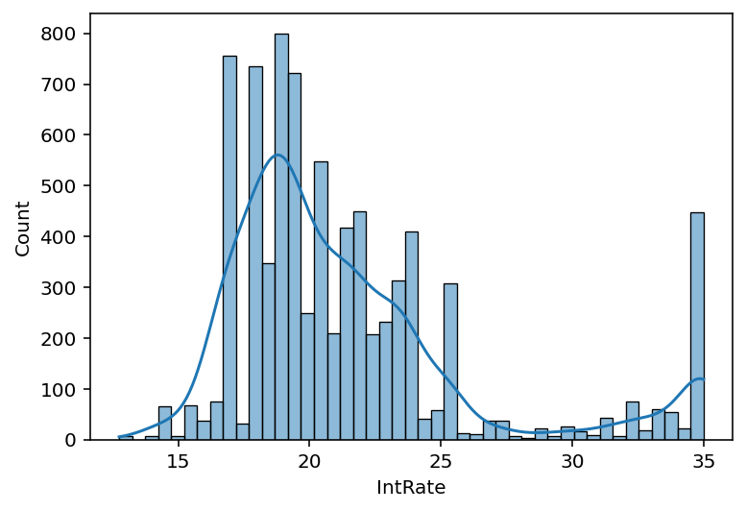
Intrate is it normal
Ho : my interest rate normal distrubite
Statistiek value: 0.8222758572474215
A = 0.05
Ha : my interest rate is not normal distrubite
p.Value is: 3.5617941349737897e-69
Because p<a we reject Ho .Meaning the data is not normally distrubited

Slide 4
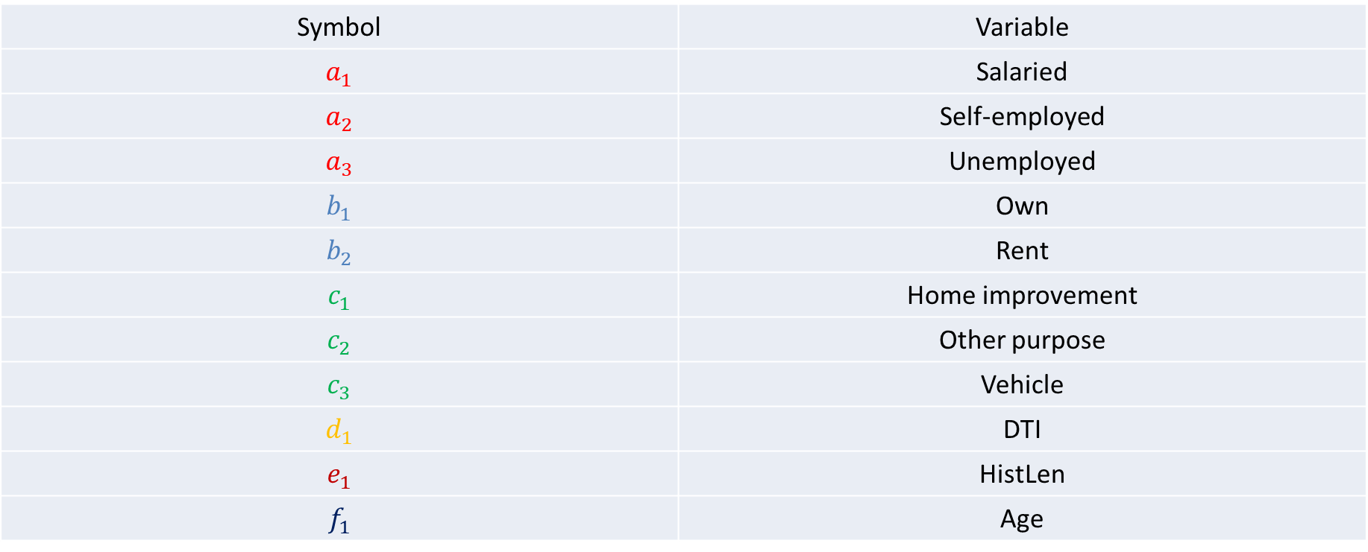
6. How the model will look
Y = $22.6789−3.3470a_{1}−1.4672a_{2}+9.5922a_{3}$ $−0.4335b_{1}+1.1305b_{2}$ $−2.9393c_{1}+0.9234c_{2}−2.0303c_{3}+0.2310d_{1}−0.0507e_{1}+0.0315f_{1}$
Symbol | Variable
$$a_{1}$$ | Salaried
$$a_{2}$$ | Self-employed
$$a_{3}$$ | Unemployed
$$b_{1}$$ | Own
$$b_{2}$$ | Rent
$$c_{1}$$ | Home improvement
$$c_{2}$$ | Other purpose
$$c_{3}$$ | Vehicle
$$d_{1}$$ | DTI
$$e_{1}$$ | HistLen
$$f_{1}$$ | Age

Slide 5
2. Overall model fit of our train data
Strong in-sample fit — not proof of out-of-sample accuracy
91.8%
8,004
8,183
91.8%
Adjusted R-squared
Observations
F-statistic
R-squared
• R² indicates that the fitted model accounts for about 91.8% of the variation in Interest rate in this sample.
• The overall F-test is highly significant (reported p-value rounds to 0.00).
• Use a held-out test set or cross-validation to assess performance on new applicants.
3
Notes:
Say that R-squared is the proportion of observed variation accounted for by the fitted model in this dataset. Adjusted R-squared is similar, which suggests the reported fit remains high after accounting for the number of predictors. The F-statistic tests whether the explanatory variables are jointly useful compared with an intercept-only model. The printed p-value of 0.00 is rounding, not a literal probability of zero. High in-sample R-squared does not establish performance on new borrowers.

Slide 6
2. Overall model fit of our test data
Strong in-sample fit — not proof of out-of-sample accuracy
91.7%
91.7%
2,001
2004
R-squared
Adjusted R-squared
Observations
F-statistic
• R² indicates that the fitted model accounts for about 91.8% of the variation in interest rate in this sample.
• The overall F-test is highly significant (reported p-value rounds to 0.00).
• Use a held-out test set or cross-validation to assess performance on new applicants.
3

Slide 7
4. Prediction performance & diagnostics form our training data
Separate prediction error from model-assumption checks
REPORTED ERROR SUMMARY
DIAGNOSTICS TO SHOW
• Residuals vs fitted: look for random scatter around zero.
• Normal Q–Q plot: assess residual-tail departures.
• Shapiro–Wilk: W = 0.9395, p ≈ 4.83 × 10⁻⁴⁹, if applied to residuals.
≈ 1.043
7.12
Previously reported average error
Previously reported maximum error
5,004 of 8,004 observations were reported below an error of 1 (≈62.5%). Verify this uses absolute error.
Large samples make normality tests sensitive; inspect plots and check unequal residual variance.
5
Notes:
The average error of about 1.043 and maximum error of 7.12 were previously reported, but the exact error definition has not been confirmed. Do not label 1.043 as MAE unless it was calculated as the mean absolute error. The 5,004 count is about 62.5% of 8,004, assuming the count truly refers to absolute errors below one. These figures should be checked against code. The Shapiro–Wilk result is relevant only if it was applied to residuals; if it was applied to the raw target, rerun it on model_sign.resid. With 8,004 cases, use a Q–Q plot and residuals-versus-fitted plot alongside formal tests. No actual diagnostic plot is included here because the residual-level data were not provided.

Slide 8
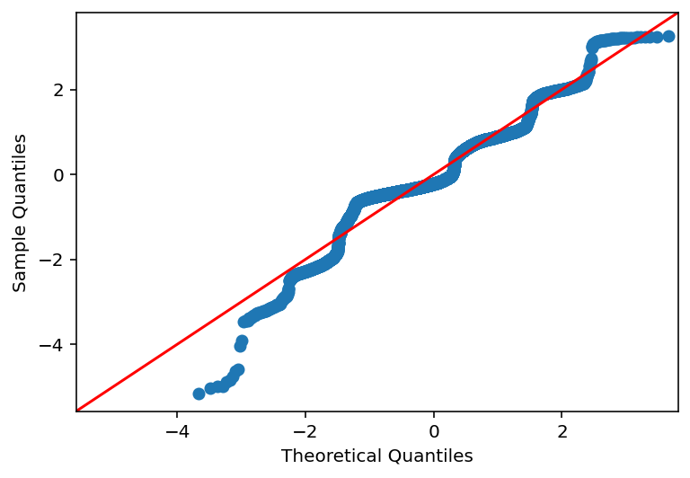
Prediction vs sample to see if linear for training data

Slide 9
4. Prediction performance & diagnostics of our test data
Separate prediction error from model-assumption checks
REPORTED ERROR SUMMARY
DIAGNOSTICS TO SHOW
• Residuals vs fitted: look for random scatter around zero.
• Normal Q–Q plot: assess residual-tail departures.
• Shapiro–Wilk: W = 0. 94875, p ≈ 7.3782× 10⁻²⁹, if applied to residuals.
≈ 1.04
4.94
Previously reported average error
Previously reported maximum error
1249 of 2,004 observations were reported below an error of 1 (≈62.4%). Verify this uses absolute error.
Large samples make normality tests sensitive; inspect plots and check unequal residual variance.
5
Notes:
The average error of about 1.043 and maximum error of 7.12 were previously reported, but the exact error definition has not been confirmed. Do not label 1.043 as MAE unless it was calculated as the mean absolute error. The 5,004 count is about 62.5% of 8,004, assuming the count truly refers to absolute errors below one. These figures should be checked against code. The Shapiro–Wilk result is relevant only if it was applied to residuals; if it was applied to the raw target, rerun it on model_sign.resid. With 8,004 cases, use a Q–Q plot and residuals-versus-fitted plot alongside formal tests. No actual diagnostic plot is included here because the residual-level data were not provided.

Slide 10
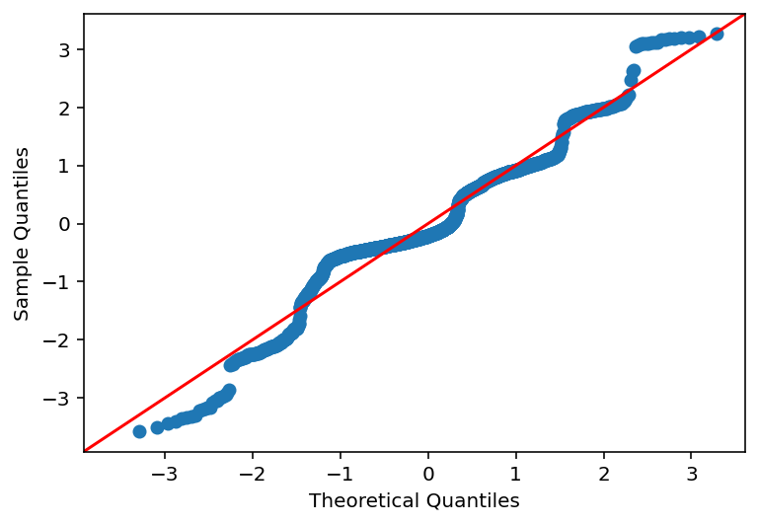
Prediction vs sample to see if linear for test data

Slide 11
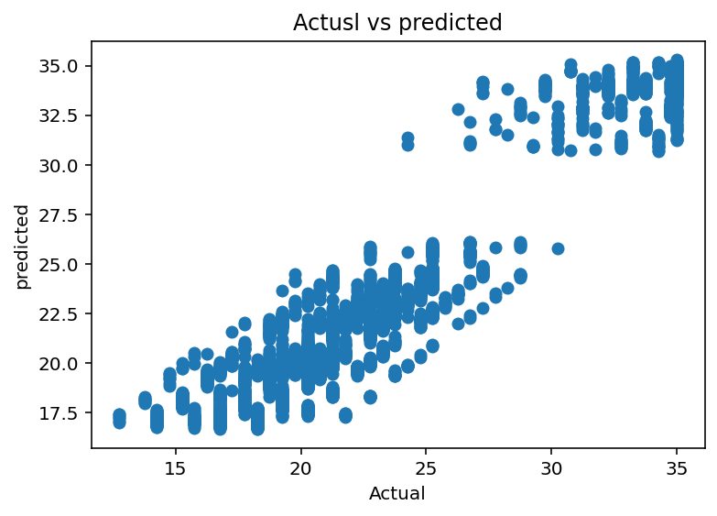
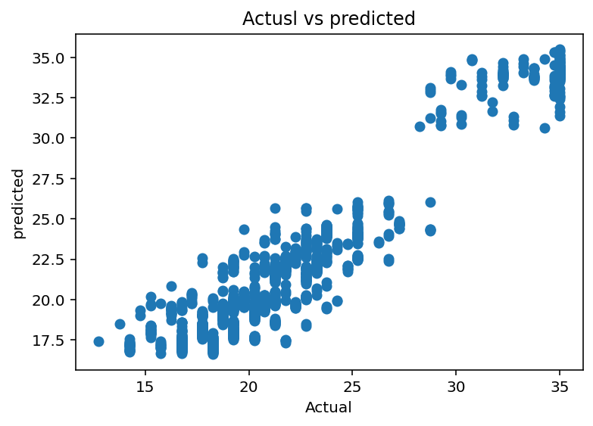

Prediction vs sample to see if linear for test data
Train data
Test data

Slide 12
5. Credit-risk implications
A useful modelling result still needs validation and governance
WHAT WE CAN SAY
• The model has high in-sample explanatory power.
• Several numerical and categorical predictors are statistically significant.
• Results can help explore pricing patterns and relationships in the dataset.
Bottom line: promising fit; validate generalisation and risk controls before operational use.
6
Notes:
Close by distinguishing statistical fit from a production-ready credit-risk model. Before deployment, use a proper train/test split or cross-validation, compare baseline models, report MAE and RMSE on unseen data, inspect residual assumptions and influential cases, and conduct appropriate fairness and governance checks. The model should support—not replace—policy, regulatory, affordability and human review. Avoid making a claim that the model should set actual loan rates without further validation.

Slide 13
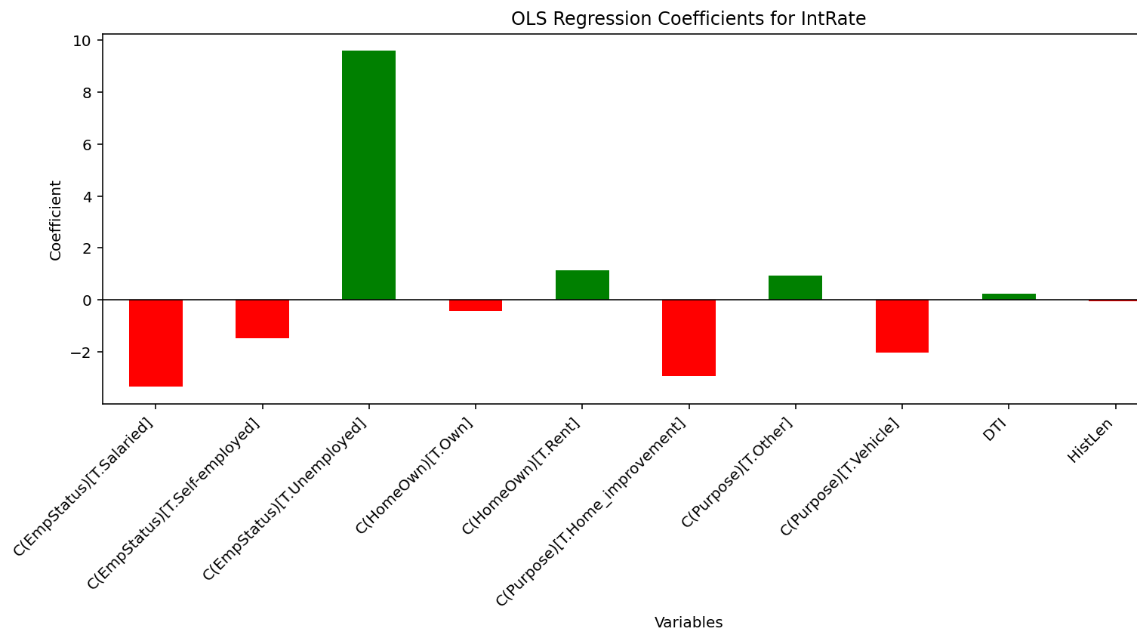
6. How the params work

