Slide 1
Content
Introduction to quality control plots in lipidomics.
Motivation for using Plotly and Trelliscopejs
Lessons learned

Slide 2
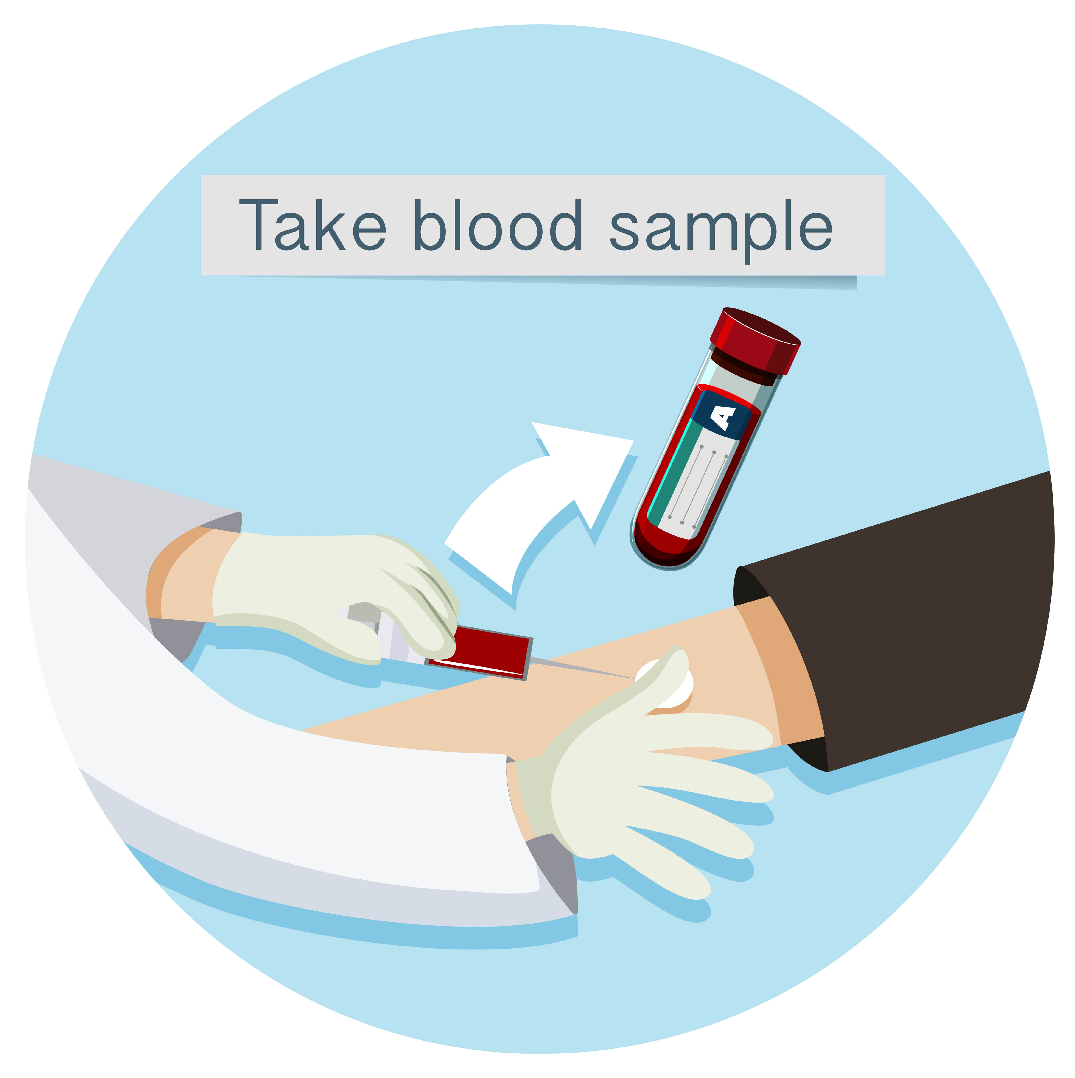
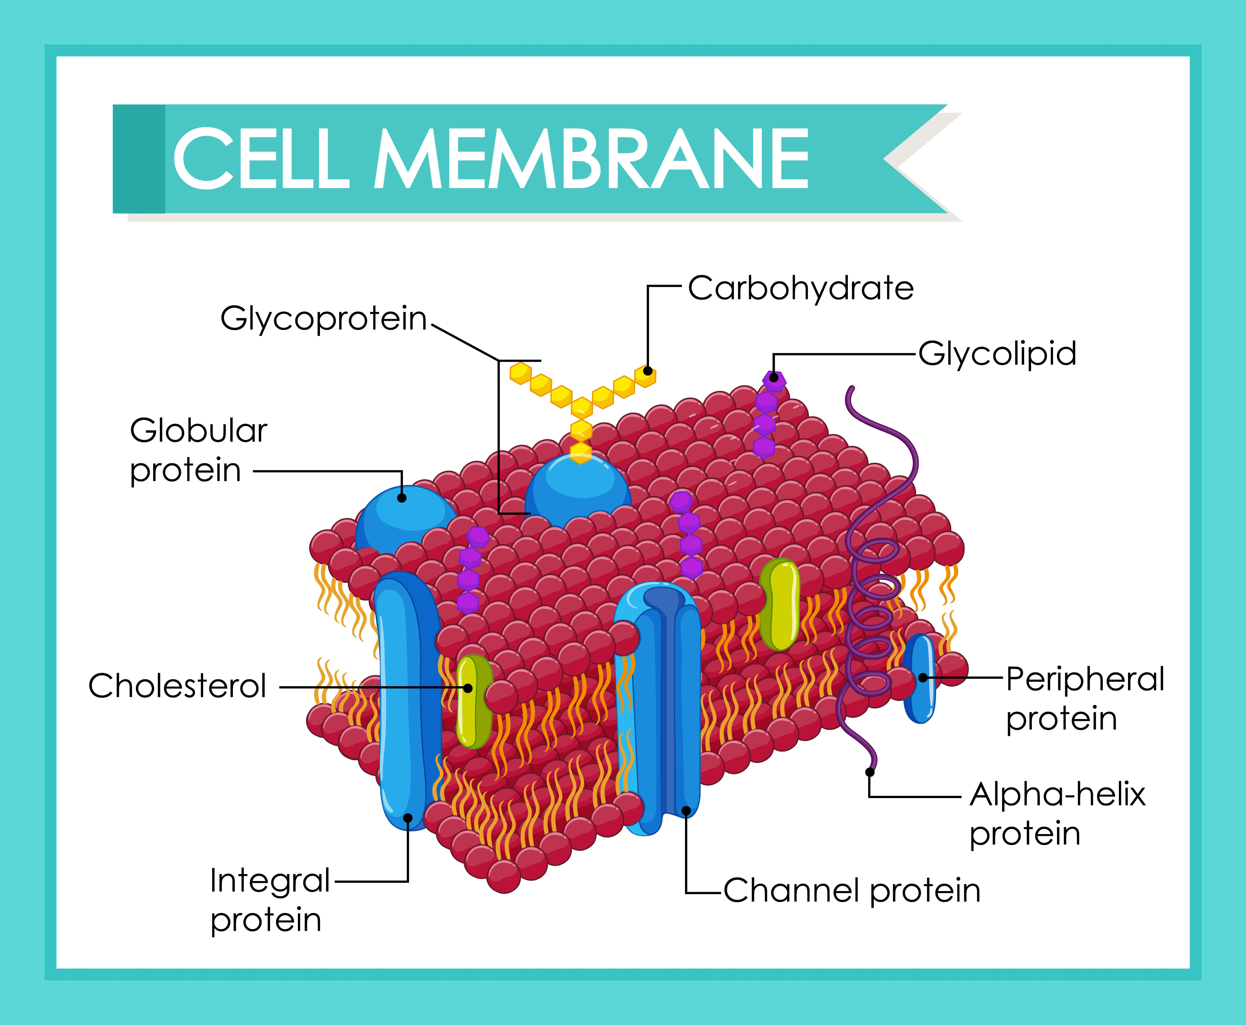
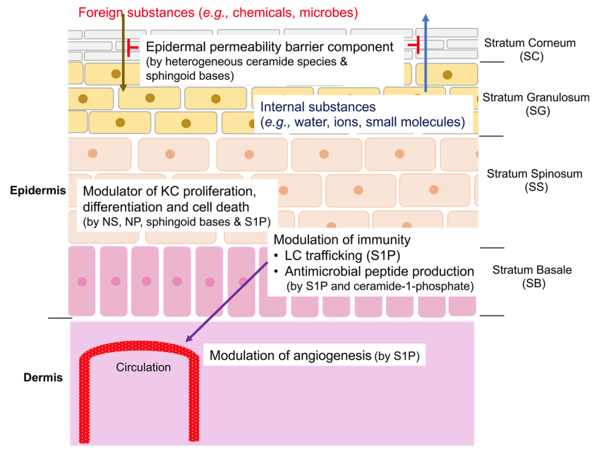
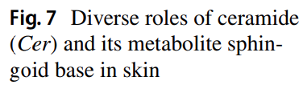

Slide 3
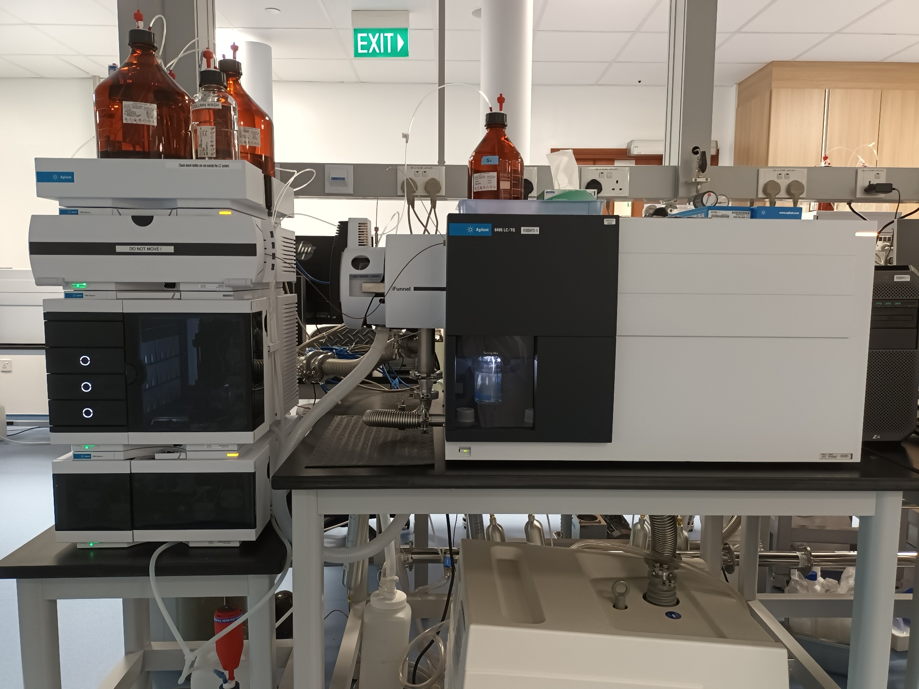

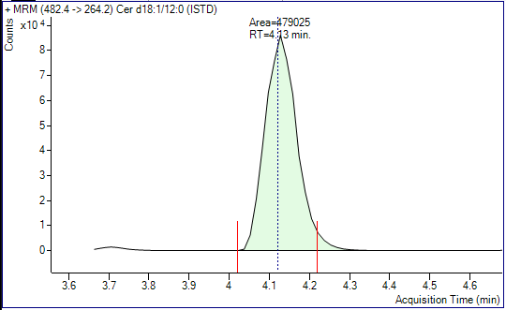
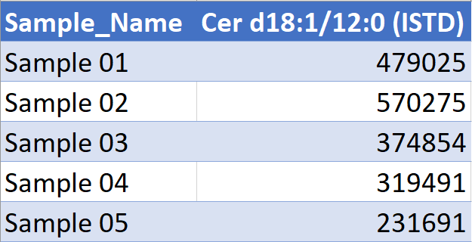
Lipid extraction
Lipid measurement
Sample
Lipid Extract
Liquid Chromatography/Mass Spectrometry
Peak integration
Peak Area Data

Slide 4
Sources of “Unwanted” Peak Area Variation
Lipid Extraction
Different pipettes used to do extraction
Lipid Measurement
Contaminant ions
Lipid extraction
Lipid measurement
Sample
Lipid Extract
Liquid Chromatography/Mass Spectrometry

Slide 5
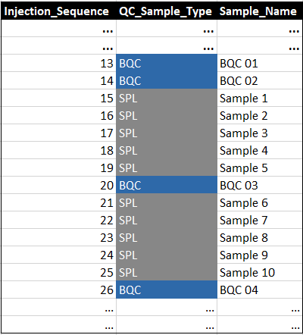
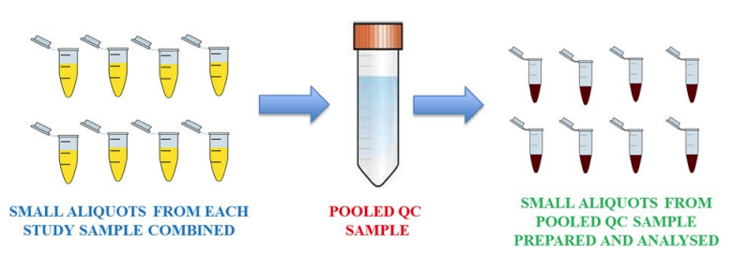
Quality Control samples
Quality control samples helps to understand severity of unwanted variation.
Broadhurst et al. https://doi.org/10.1007/s11306-018-1367-3

Slide 6
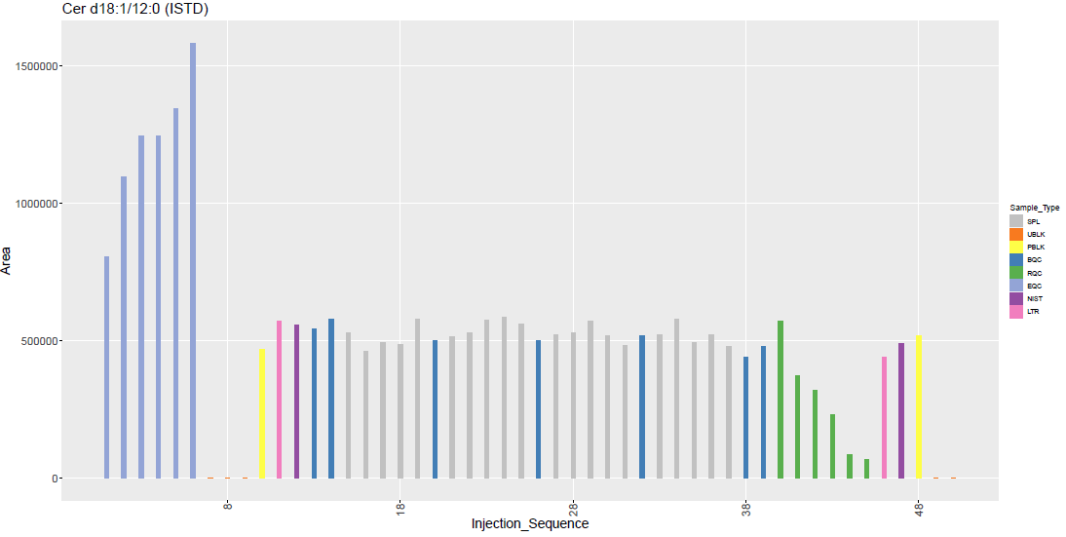
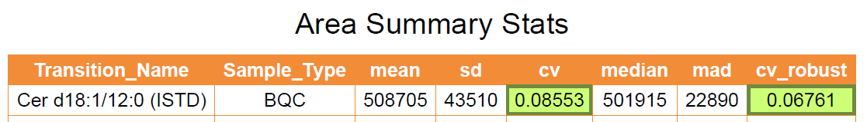
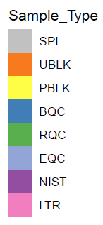

Quality Control plot
Export as pdf file with each transition covering one page
Injection Sequence Plot for Cer d18:1/12:0 (ISTD)

Slide 7
Motivation for using Plotly and Trelliscopejs
Samples are getting larger (increase to few thousands)
Static Bar plots and scatter plots will not work
To a few thousands

Slide 8
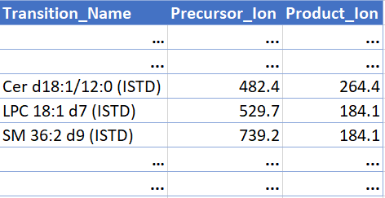
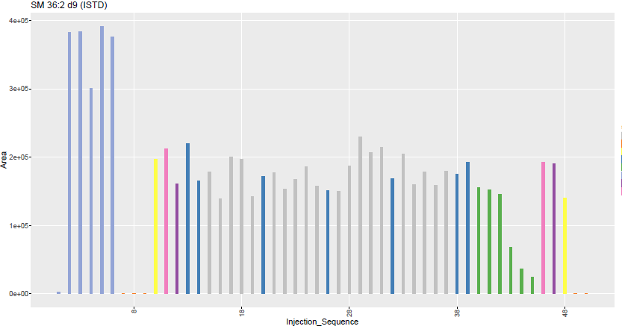
Motivation for using Plotly and Trelliscopejs
Number of transitions have increased to over 500
Leading to > 500-page pdf file full of plots.
> 500 plots
> 500 transition list

Slide 9
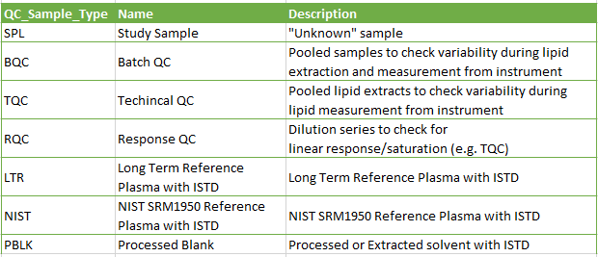


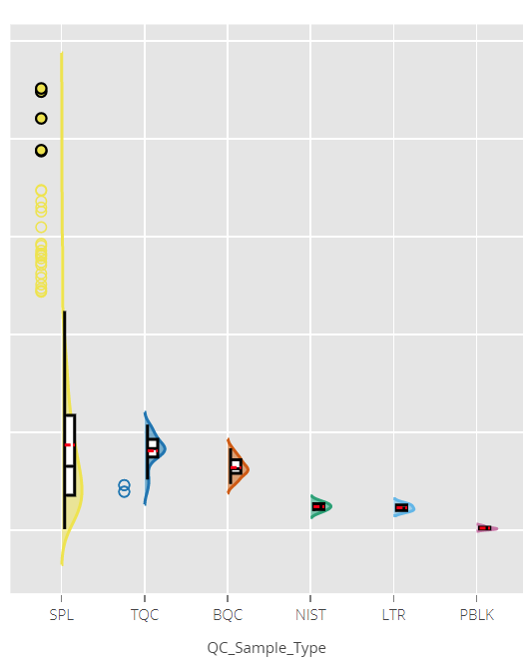
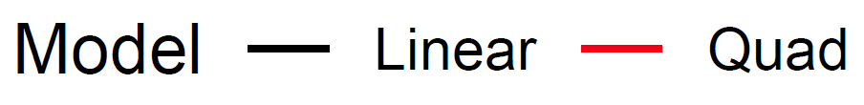
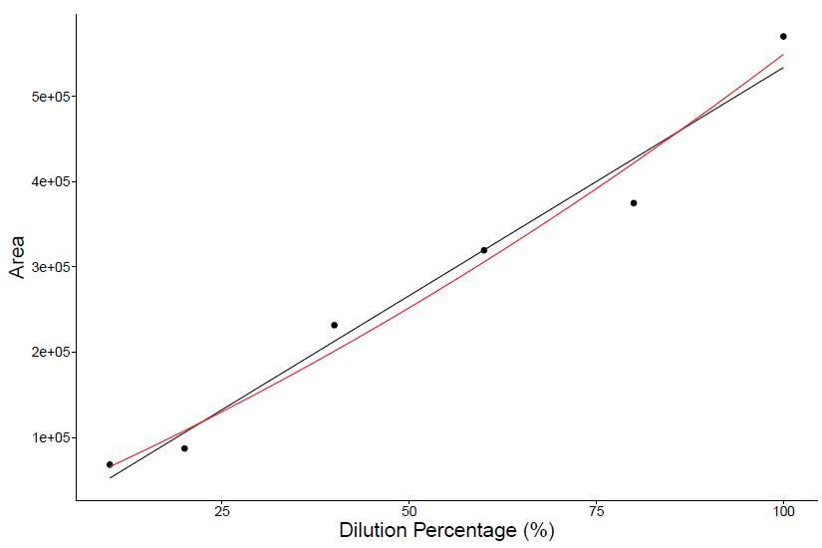
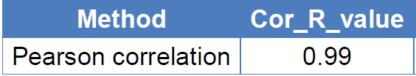
Motivation for using Plotly and Trelliscopejs
New QC sample types, leading to different plot type
Leading to multiple > 500-pages pdf files full of plots.

Slide 10


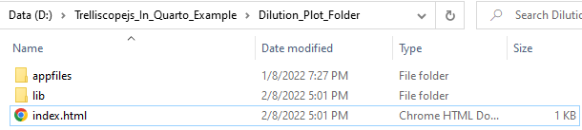
Motivation for using Plotly and Trelliscopejs

Slide 11
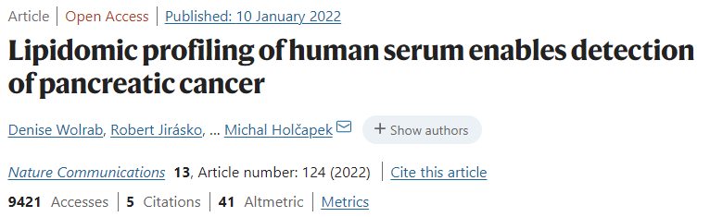
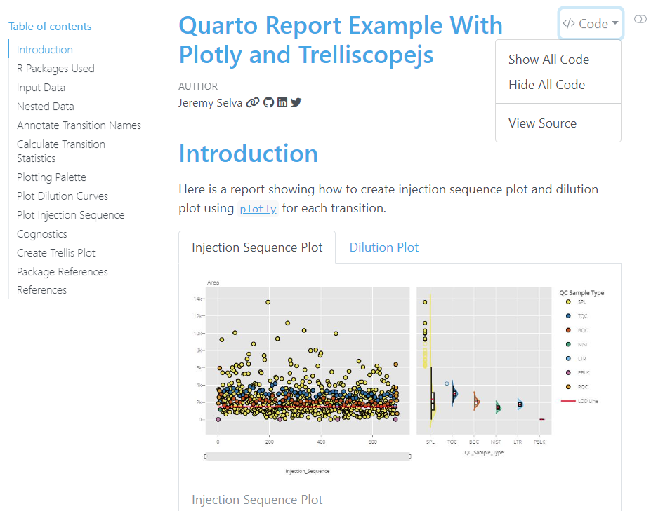
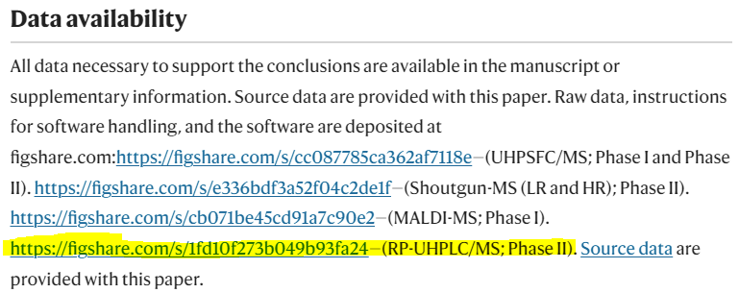
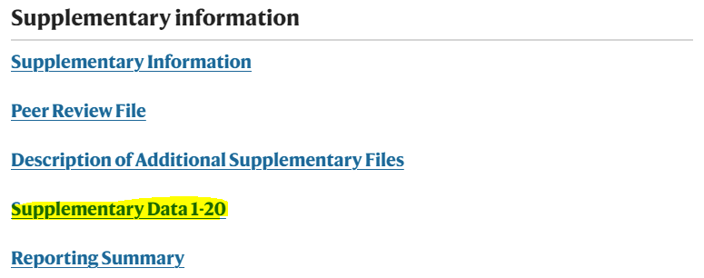

Slide 12
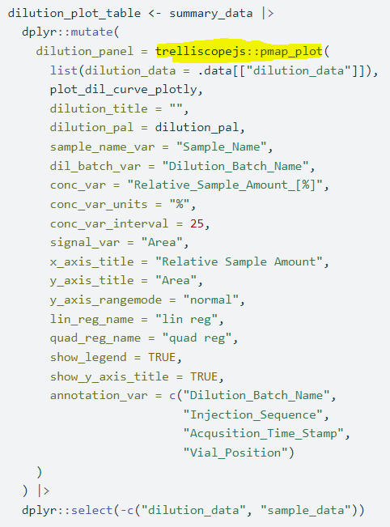
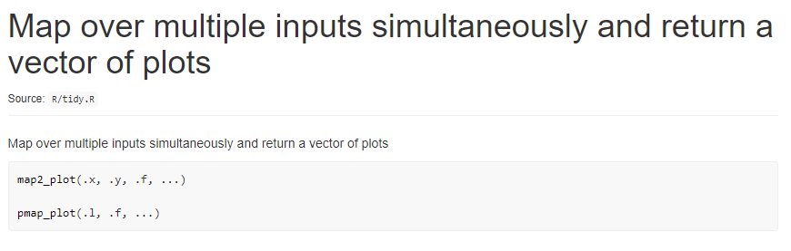
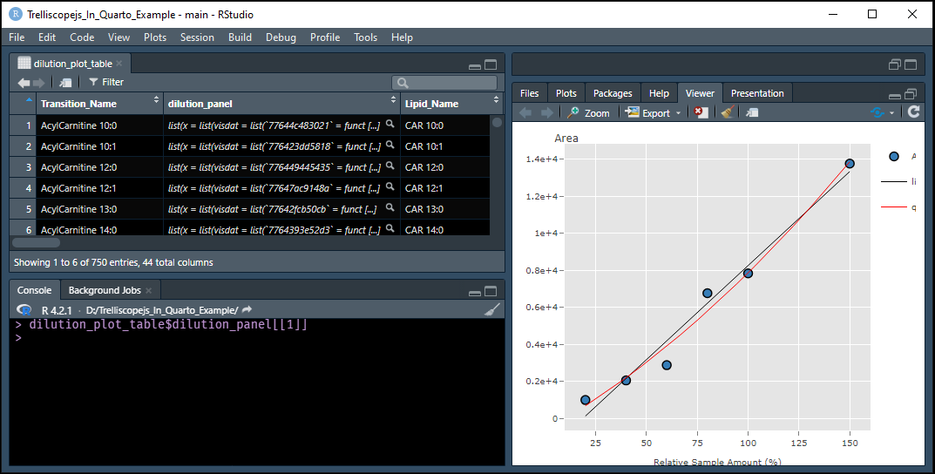
Lessons learned

Slide 13
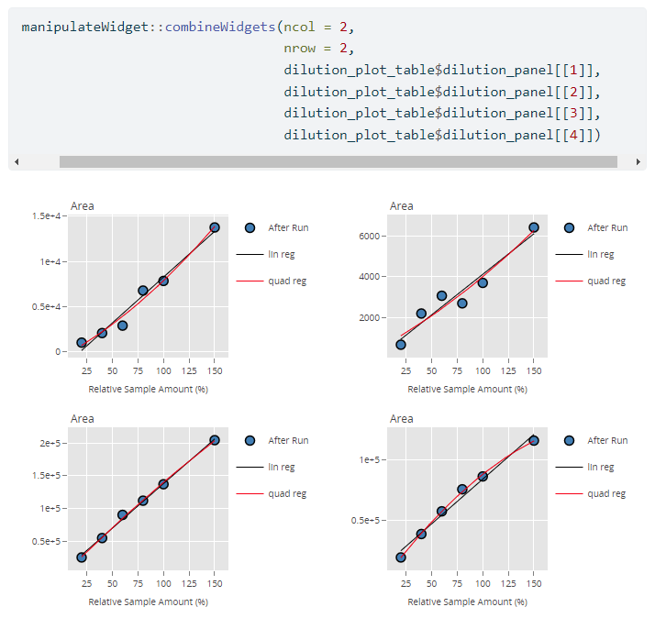
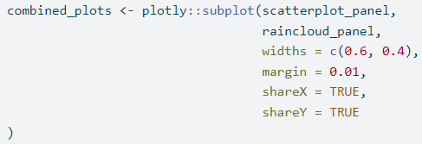
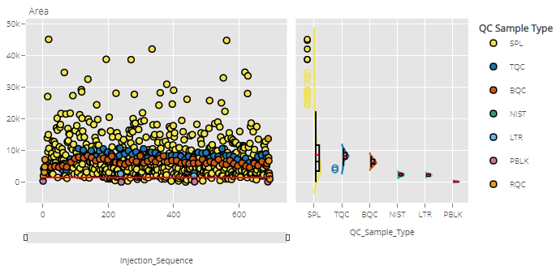
Lessons learned

Slide 14

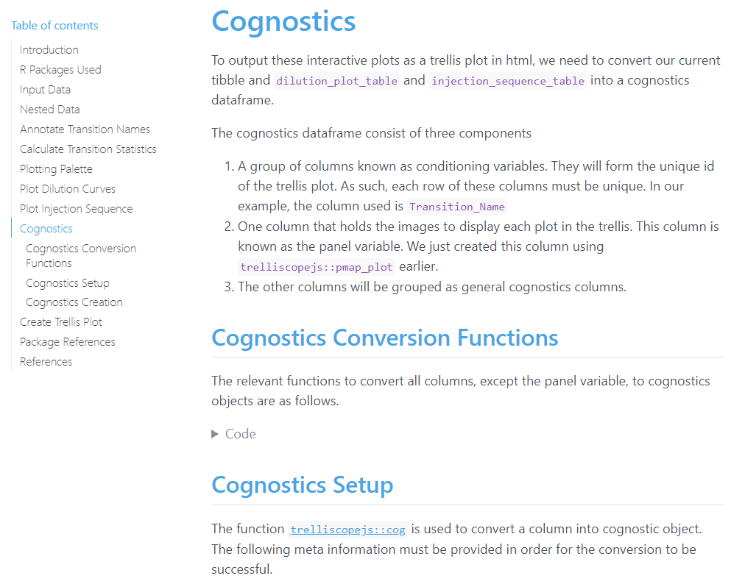
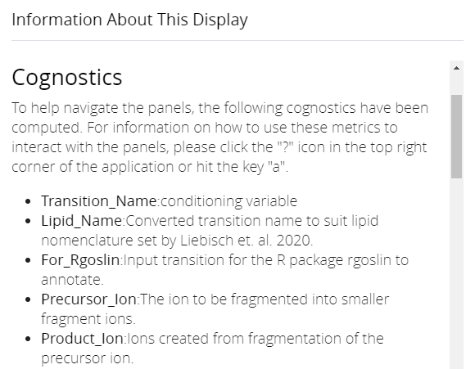
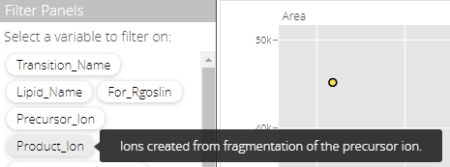
Lessons learned

Slide 15

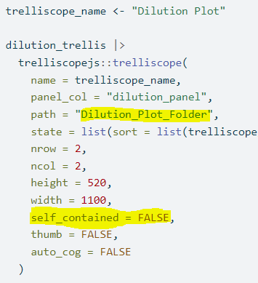
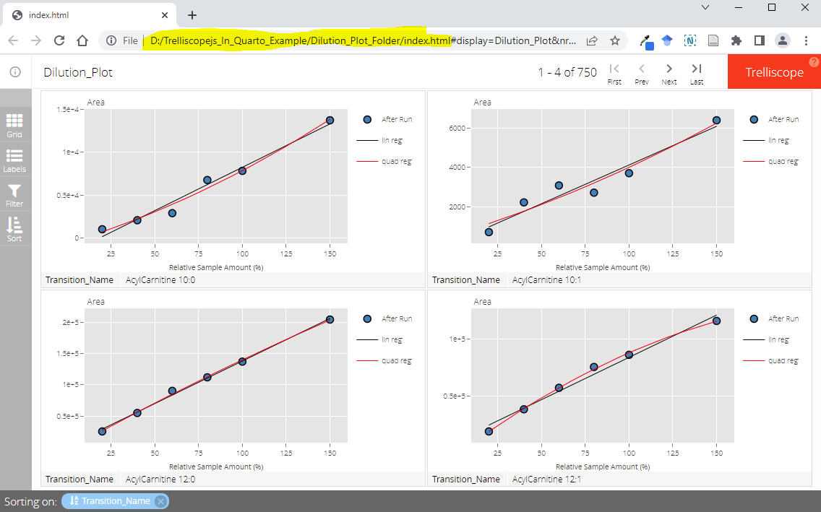
Step 1. Set working directory
Step 2. Call script in console
Step 3. Compress Folder

Slide 16

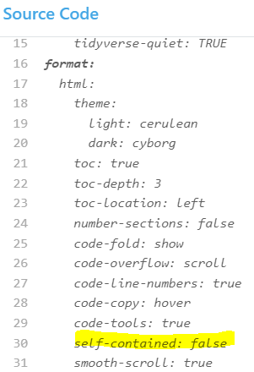
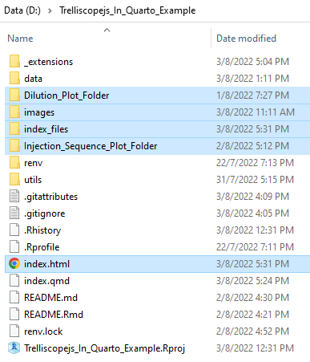
Step 1. Set working directory
Step 2. Render Quarto script
Step 3. Compress Highlighted Files/Folders

Slide 17
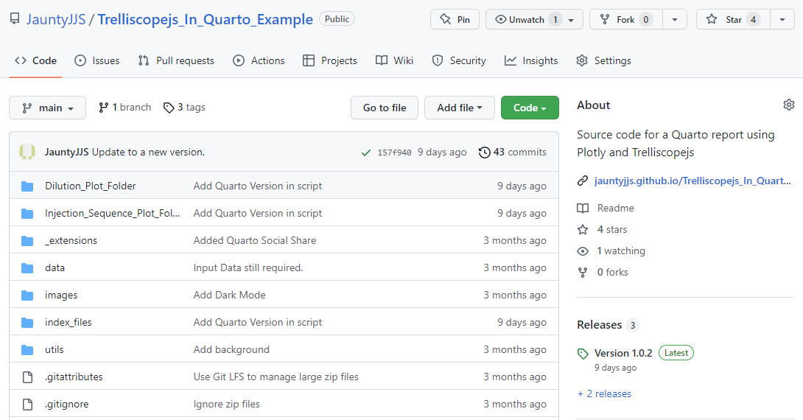
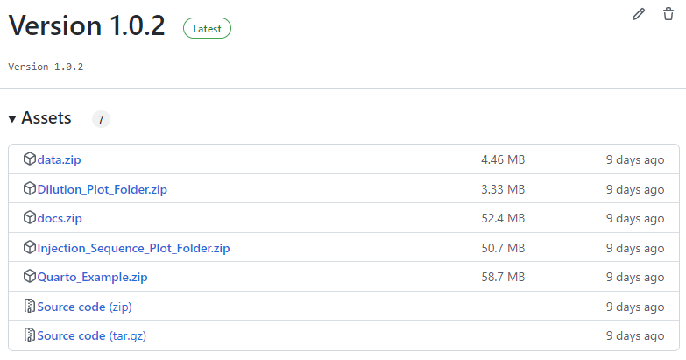

Slide 18


