Slide 1
Content
Introduction to quality control plots in lipidomics.
Motivation for using Plotly and Trelliscopejs
Lessons learned

Slide 2
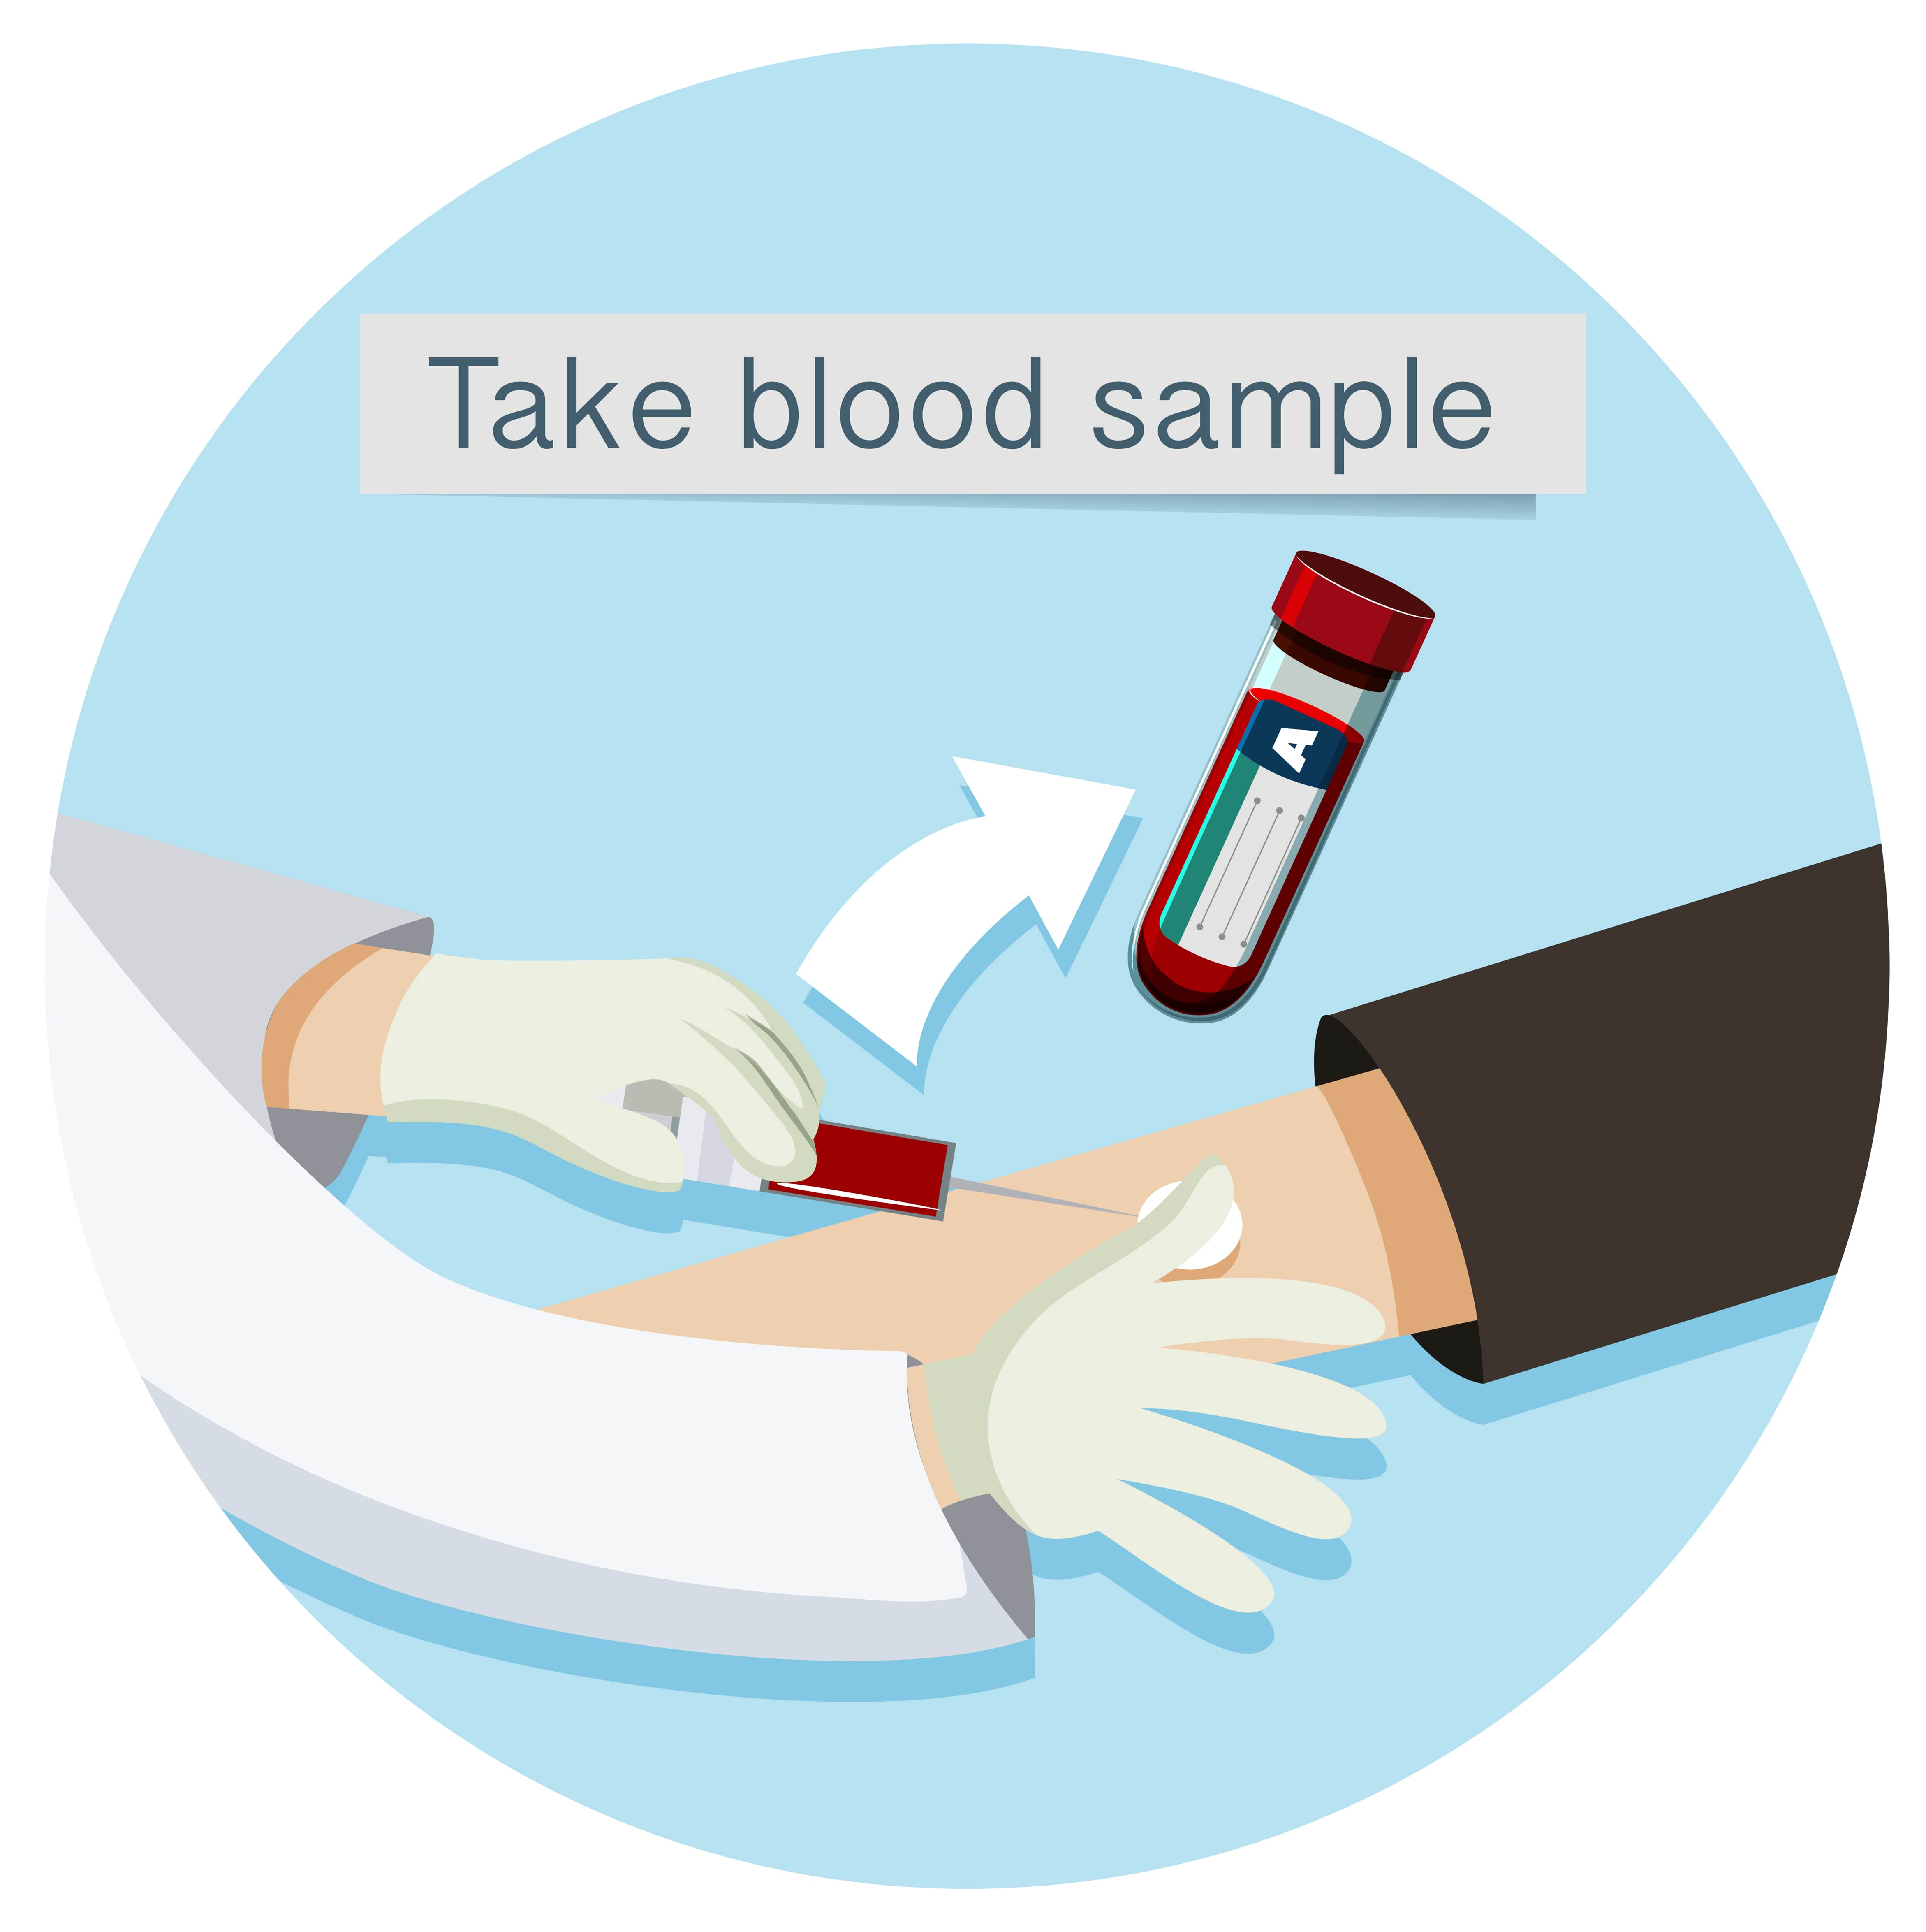

Slide 3
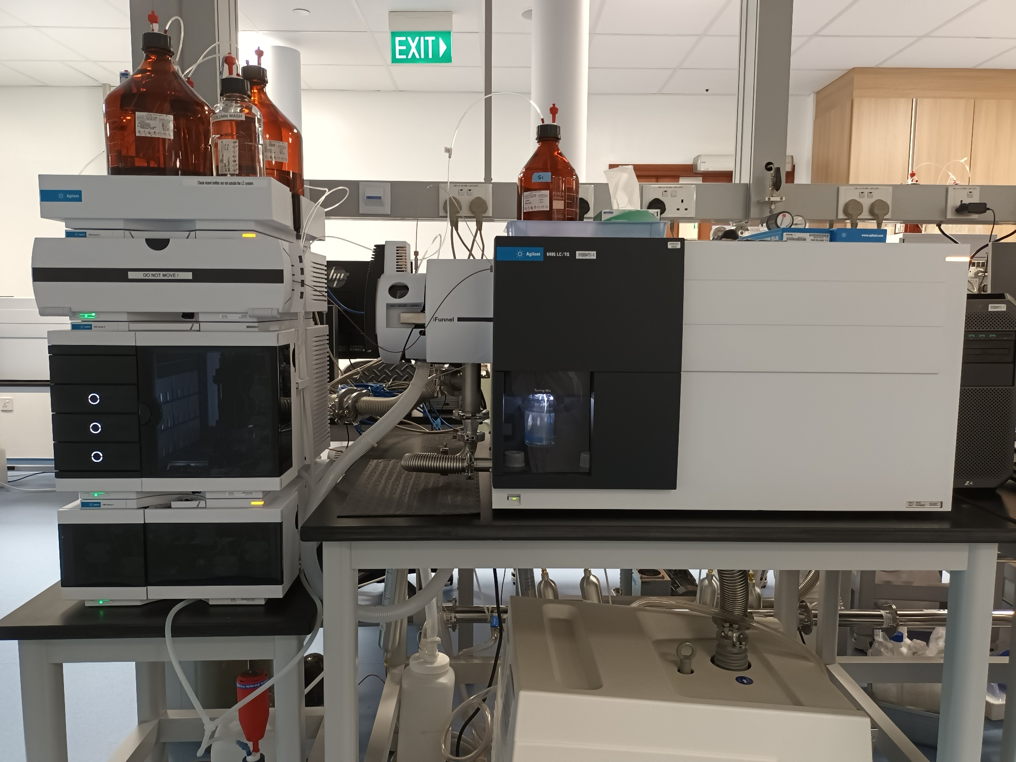

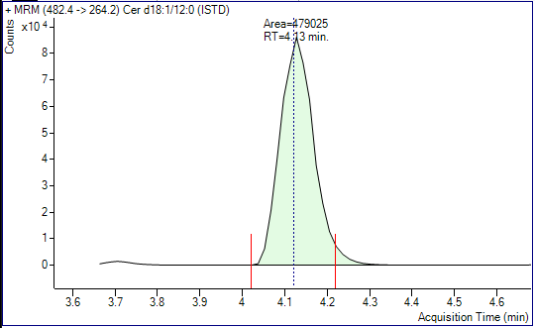
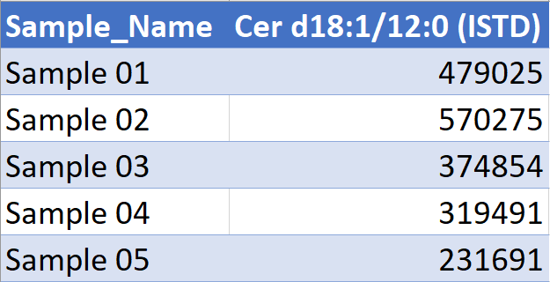
Lipid extraction
Lipid measurement
Sample
Lipid Extract
Liquid Chromatography/Mass Spectrometry
Peak integration
Peak Area Data

Slide 4
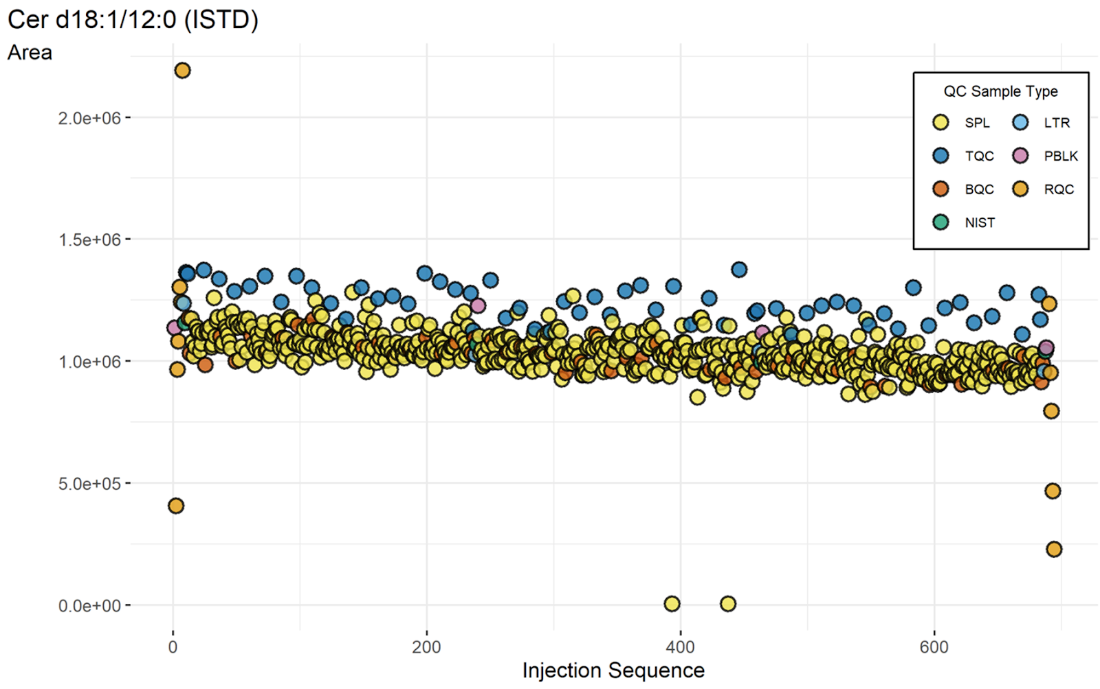
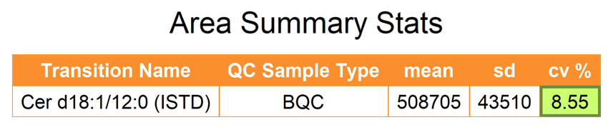


Slide 5

> 500
> 500 Pages

Slide 6

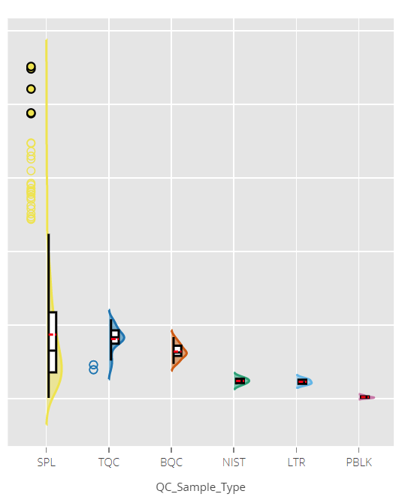

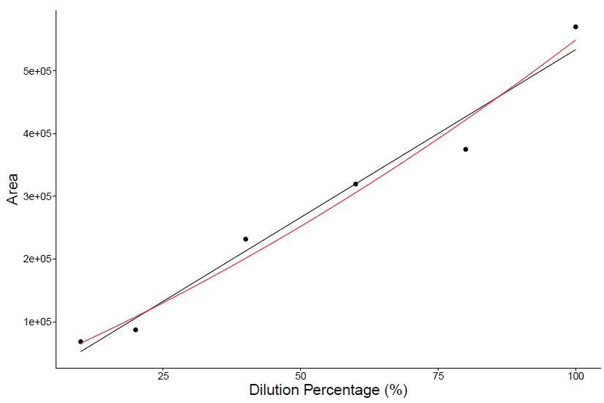
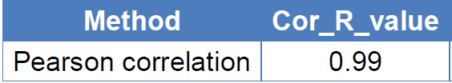

Slide 7
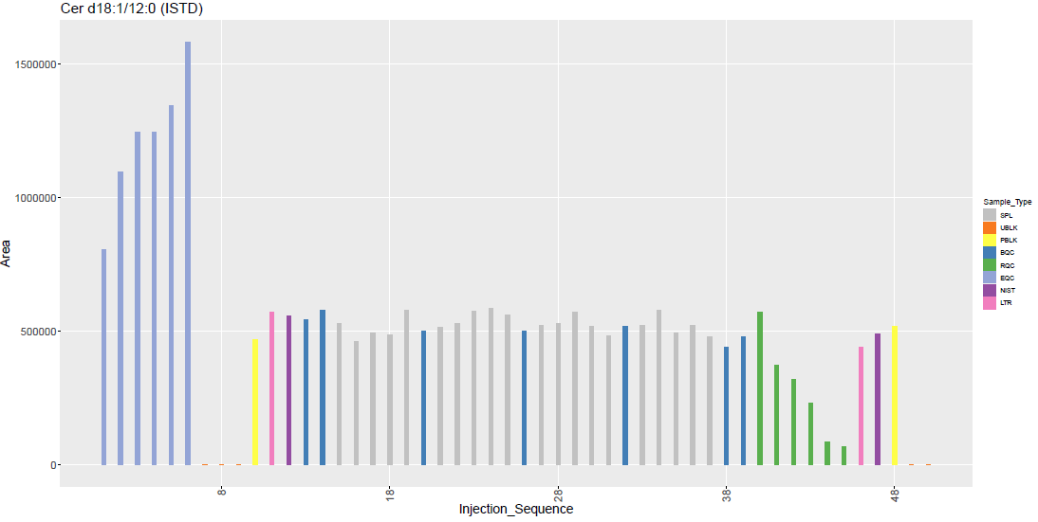
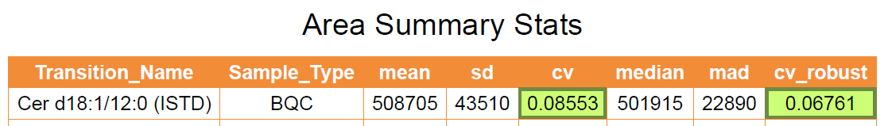
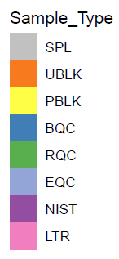
Quality Control plot
Export as pdf file with each transition covering one page
Injection Sequence Plot for Cer d18:1/12:0 (ISTD)

Slide 8
Motivation for using Plotly and Trelliscopejs
Samples are getting larger (increase to few thousands)
Static Bar plots and scatter plots will not work
To a few thousands

Slide 9
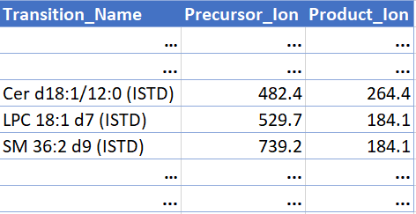
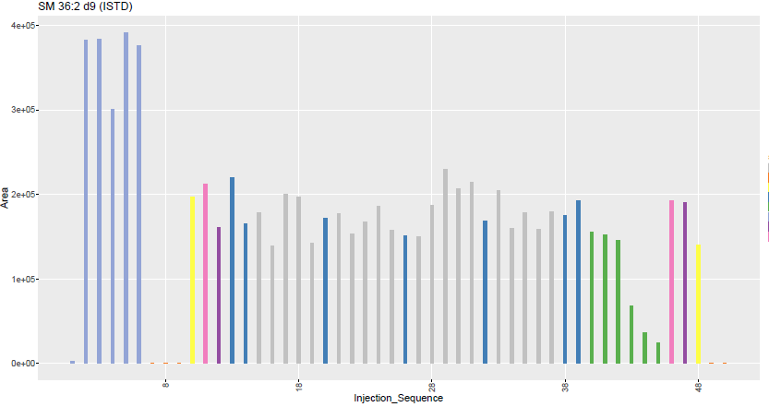
Motivation for using Plotly and Trelliscopejs
Number of transitions have increased to over 500
Leading to > 500-page pdf file full of plots.
> 500 plots
> 500 transition list

Slide 10
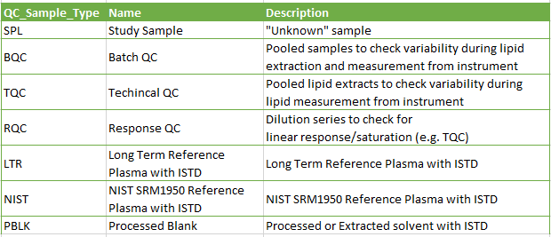
Motivation for using Plotly and Trelliscopejs
New QC sample types, leading to different plot type
Leading to multiple > 500-pages pdf files full of plots.

Slide 11


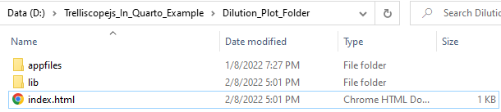
Motivation for using Plotly and Trelliscopejs

Slide 12
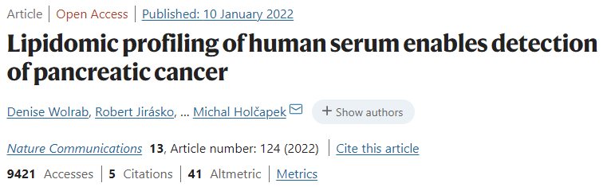
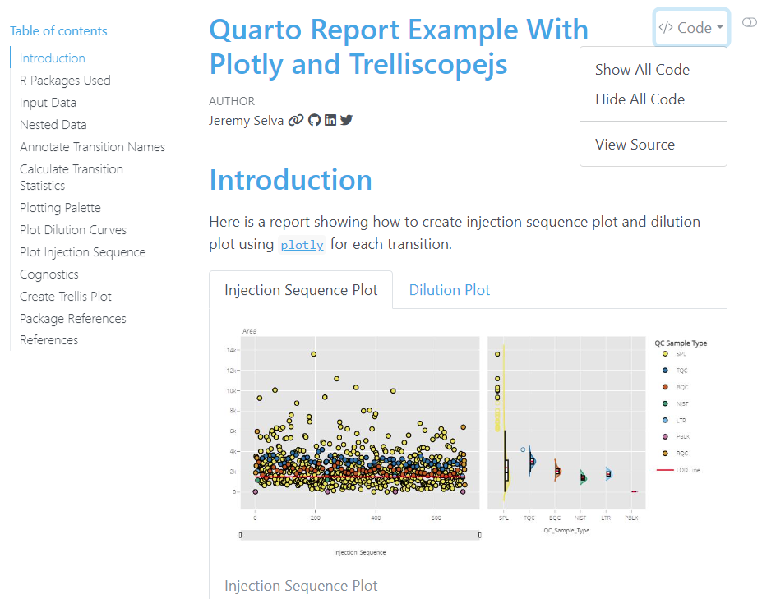
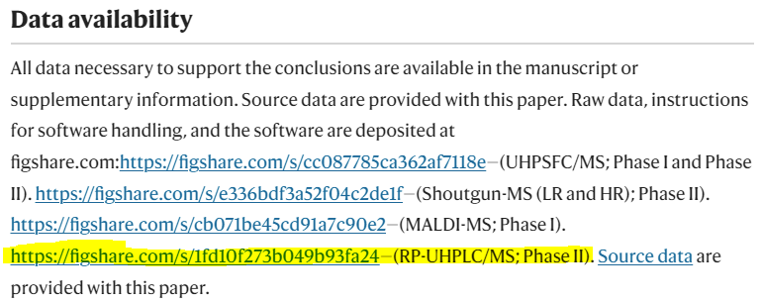
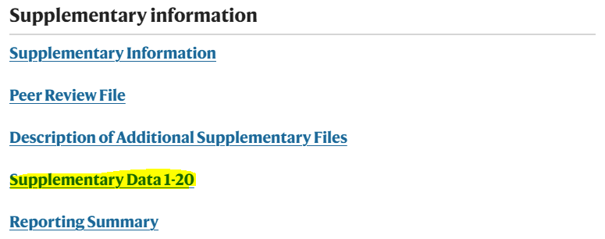

Slide 13
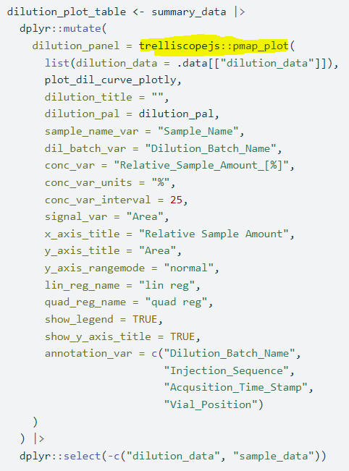
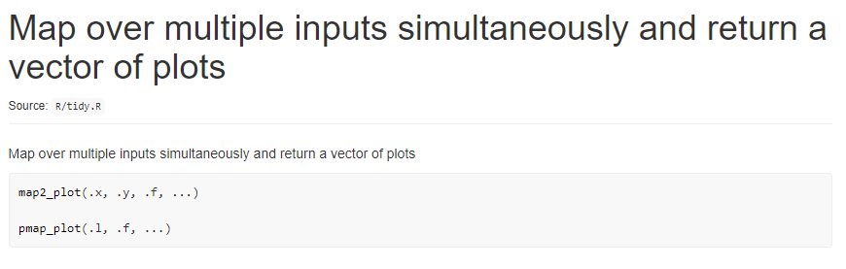
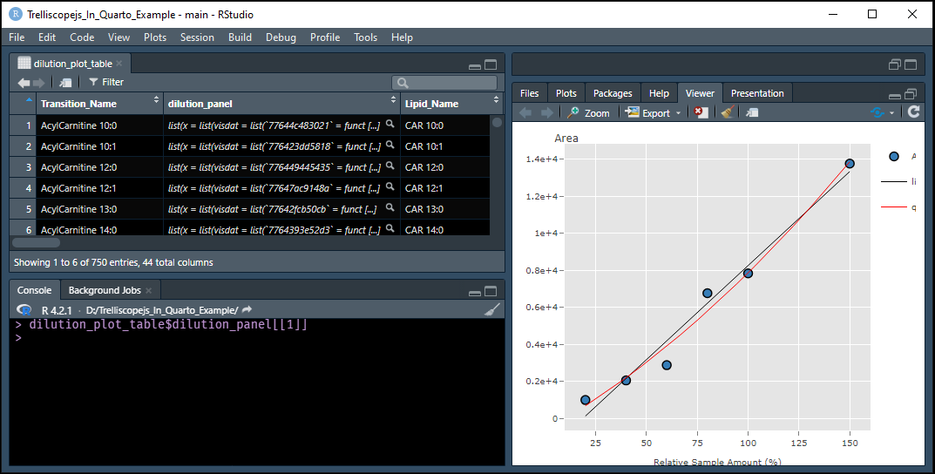
Lessons learned

Slide 14
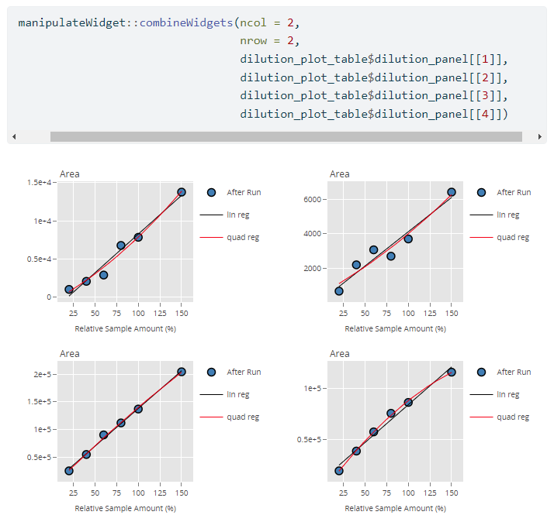
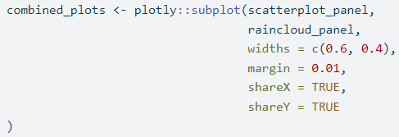
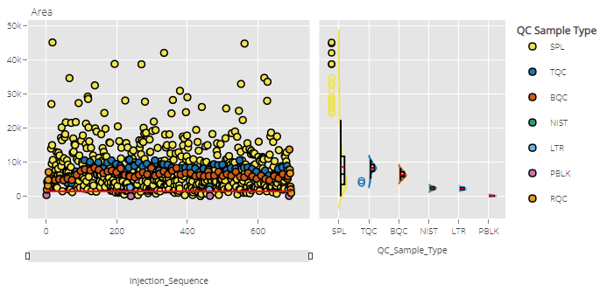
Lessons learned

Slide 15

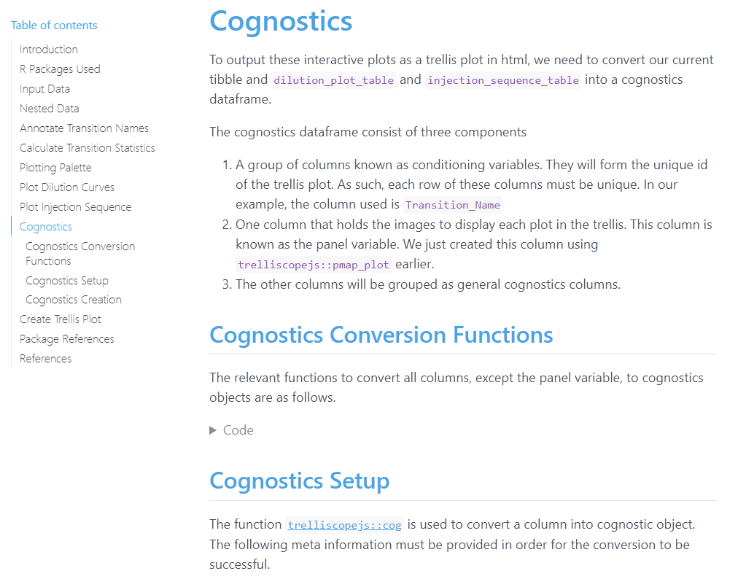
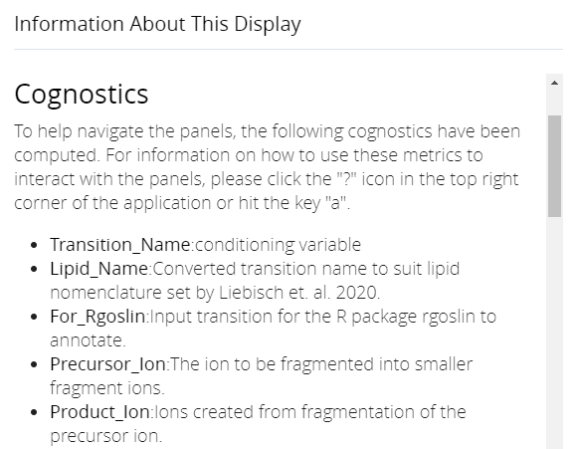
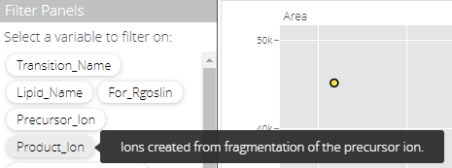
Lessons learned

Slide 16

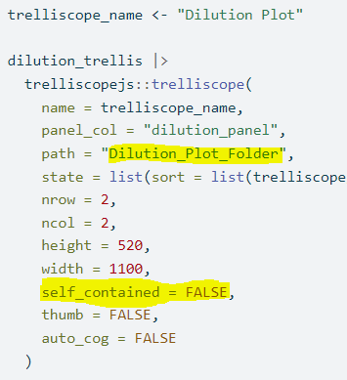
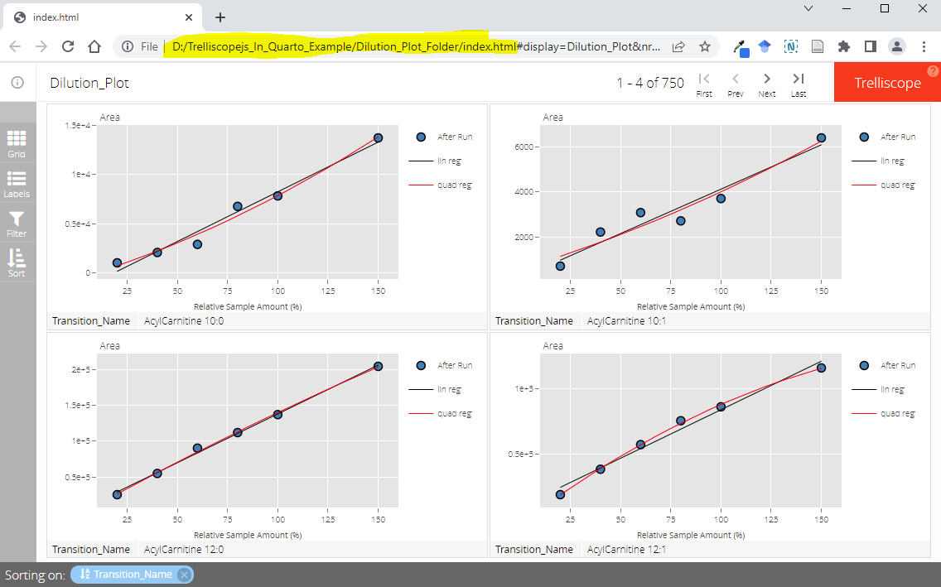
Step 1. Set working directory
Step 2. Call script in console
Step 3. Compress Folder

Slide 17

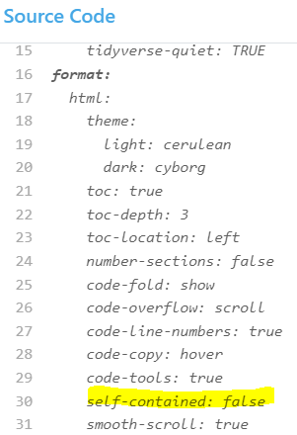
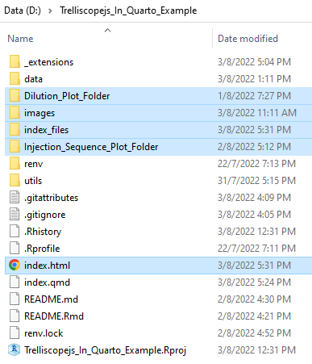
Step 1. Set working directory
Step 2. Render Quarto script
Step 3. Compress Highlighted Files/Folders

Slide 18
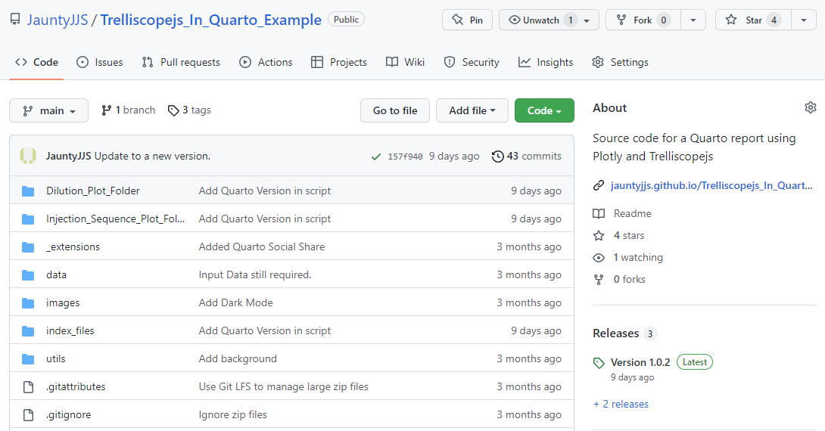
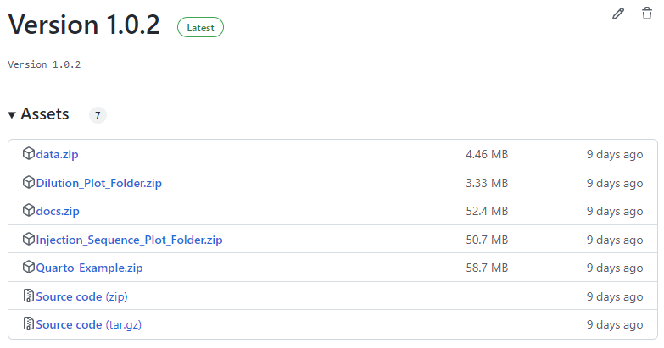

Slide 19



Slide 20


