Slide 2
https://how-to-draw-cartoons-online.com/cartoon-hydra.html
http://getdrawings.com/get-drawing#two-headed-dragon-drawing-54.jpg
https://drawinghowtos.com/baby-dragon-2-7909/

Slide 3

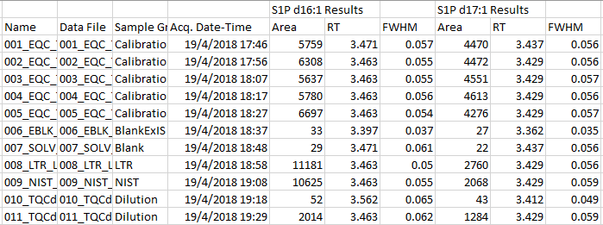
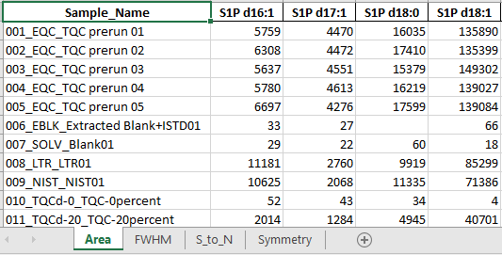
Export as csv
Single Python Script

Slide 4

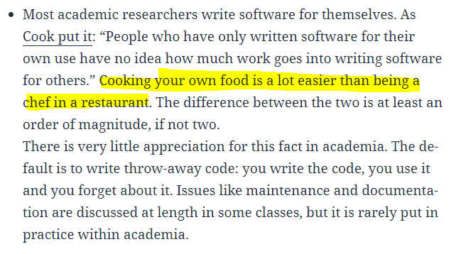

Slide 5


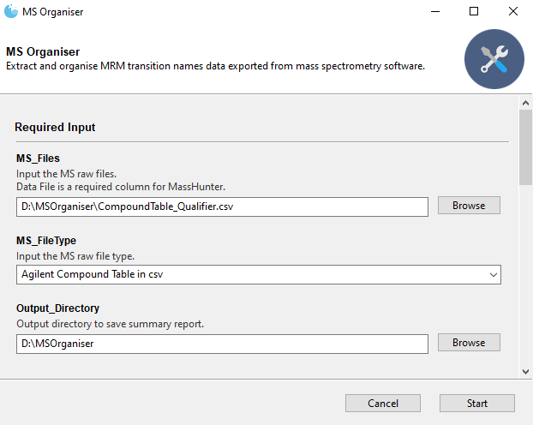


Attempt 1
Attempt 1
Attempt 2
vs
Attempt 100 … Finally

Slide 6
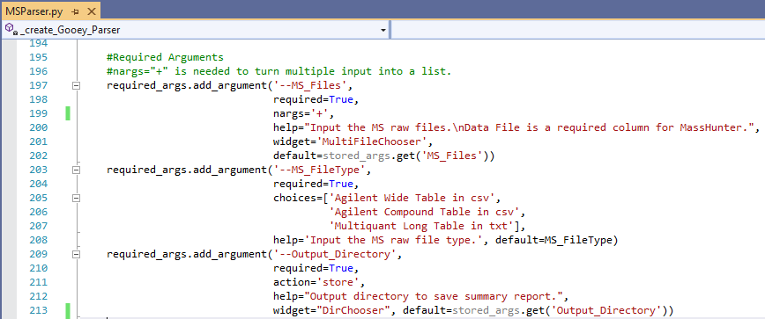
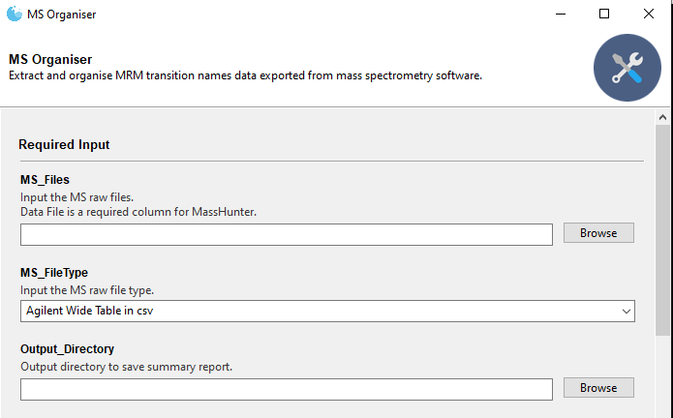


chriskiehl’s
Gooey
PyInstaller

Slide 7
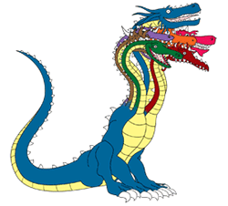

Simple program
Complex program
Several feature
request later
3 page
user manual
30 page
user manual

Slide 8


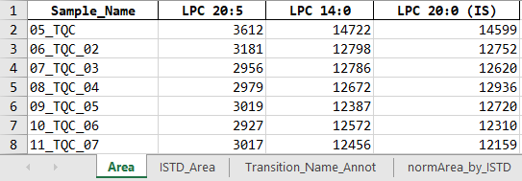

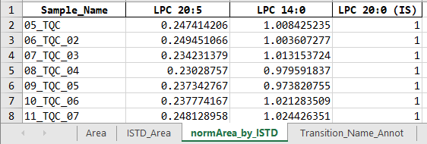
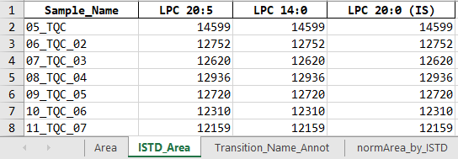
equals
divided by

Slide 9
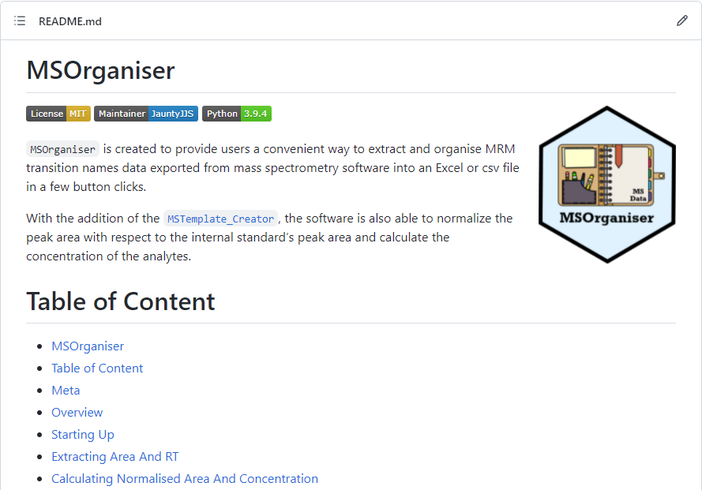
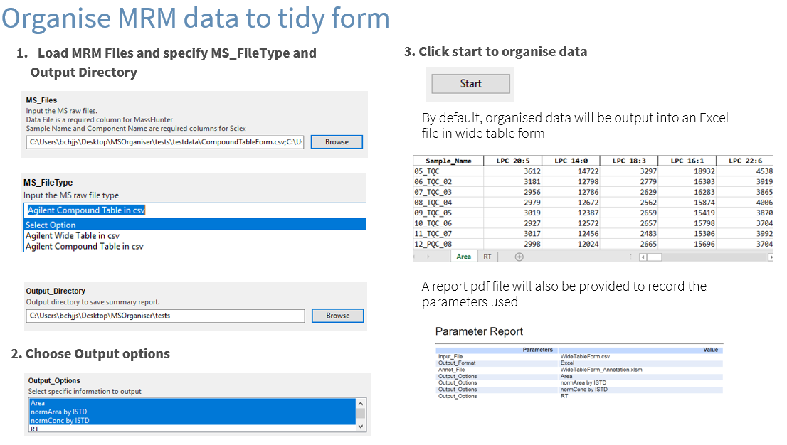
Tutorial: Github README
How to guide: Cheatsheet

Slide 10
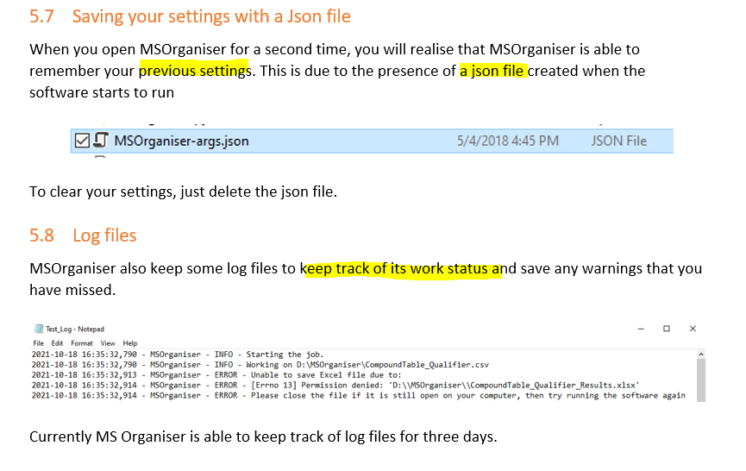
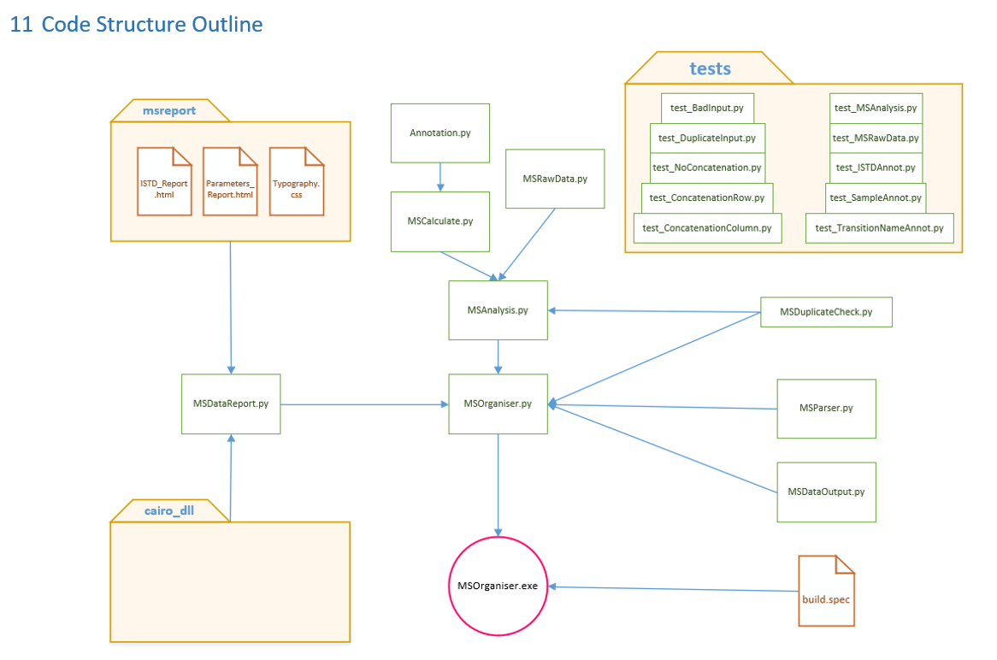
Explanation
Reference

