Slide 2
https://how-to-draw-cartoons-online.com/cartoon-hydra.html
http://getdrawings.com/get-drawing#two-headed-dragon-drawing-54.jpg
https://drawinghowtos.com/baby-dragon-2-7909/

Slide 3
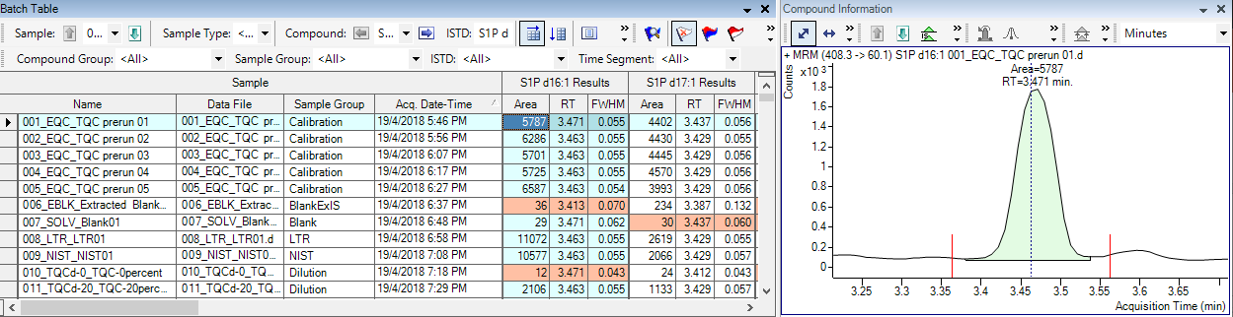
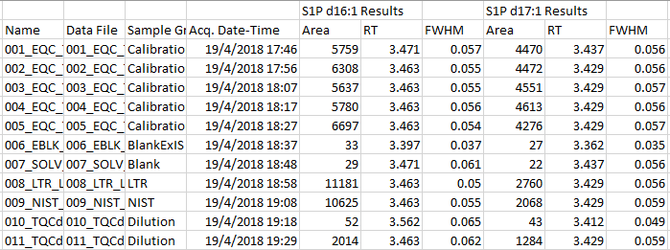
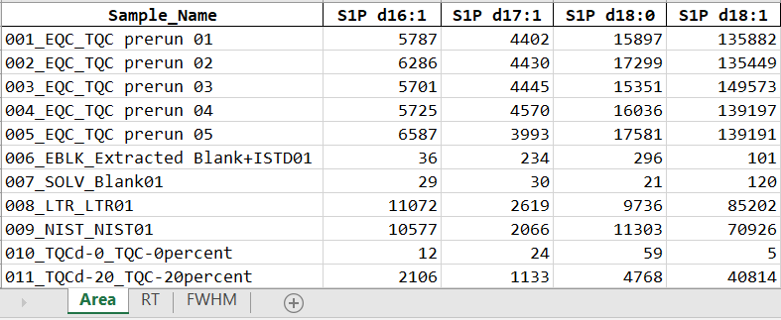
Export as csv
MSOrganiser

Slide 4
Export as csv
Single Python Script

Slide 5
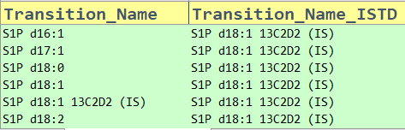
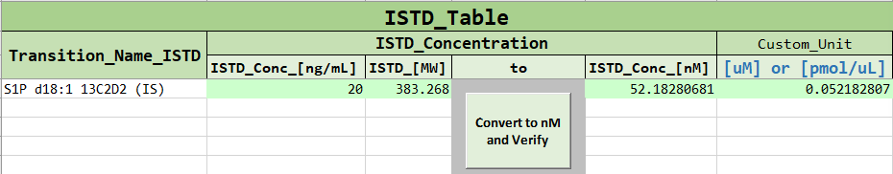
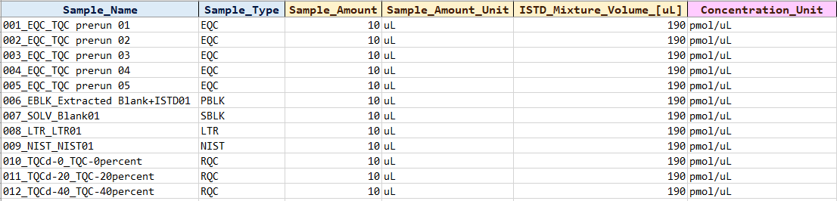
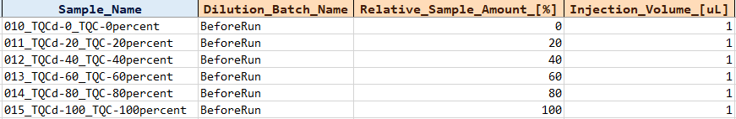
Export as csv
MSTemplate Creator

Slide 6
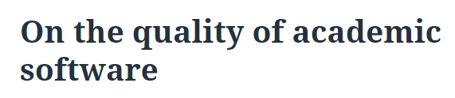
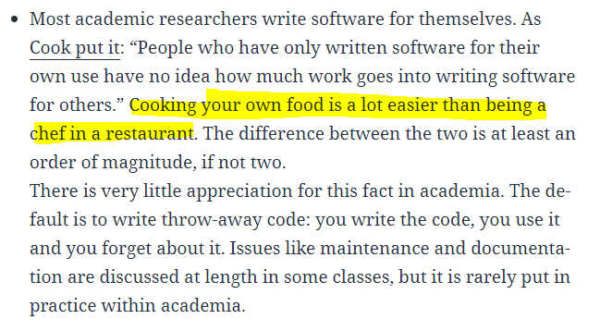

Slide 7
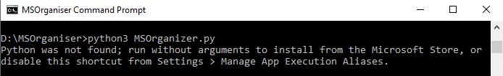

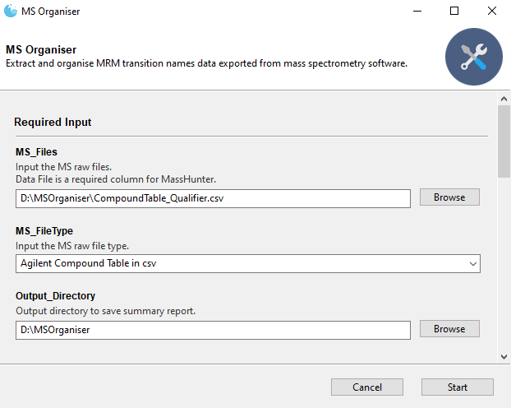
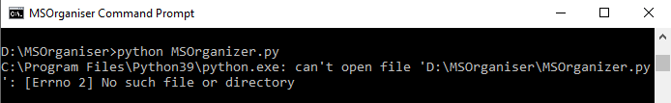
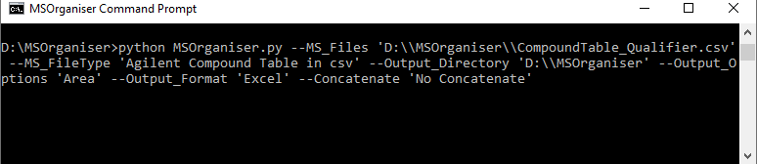
Attempt 1 … Need to install Python and libraries
Attempt 1 … Double-click, fill in parameters, click Start
Attempt 50 … Figure out how the script works
vs
Attempt 100 … Finally

Slide 8
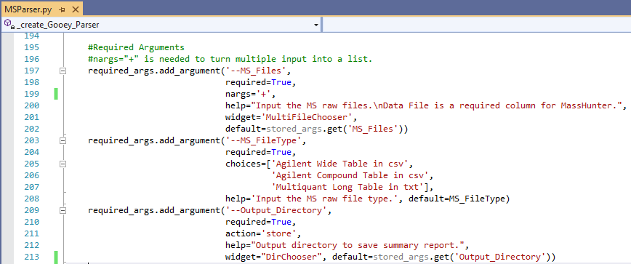
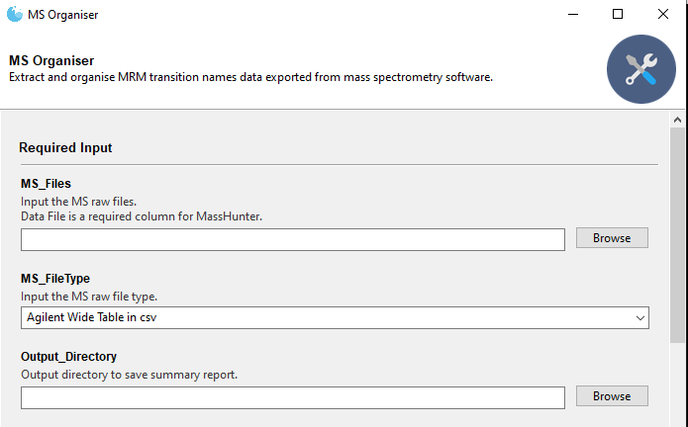


chriskiehl’s
Gooey
PyInstaller

Slide 9
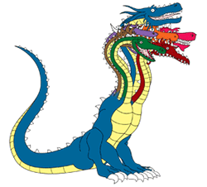

Simple program
Complex program
Several feature
request later
3 page
user manual
30 page
user manual

Slide 10

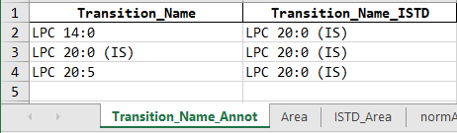
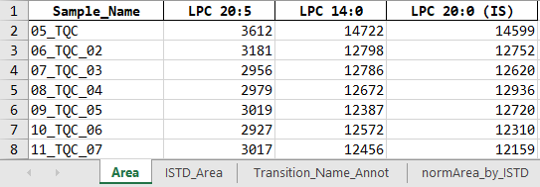

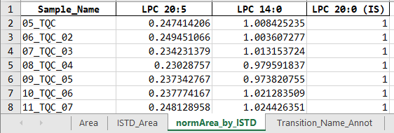
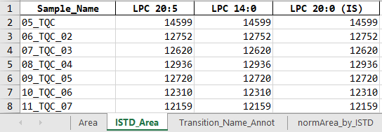
equals
divided by

Slide 11
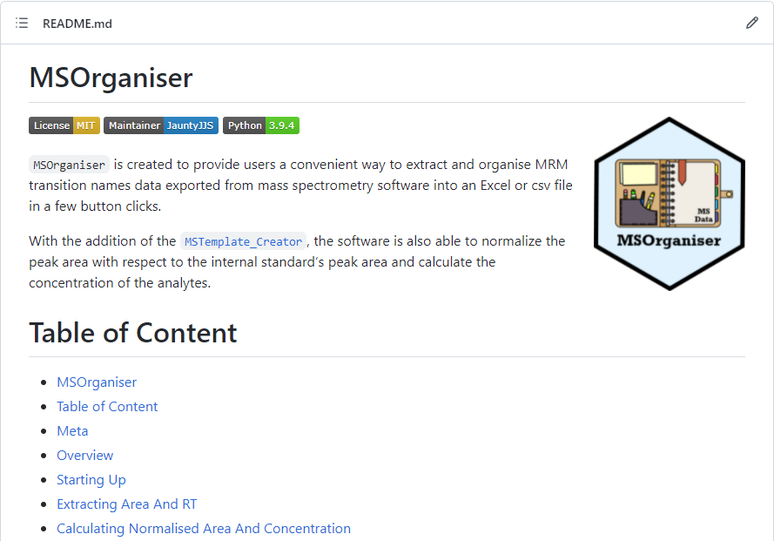
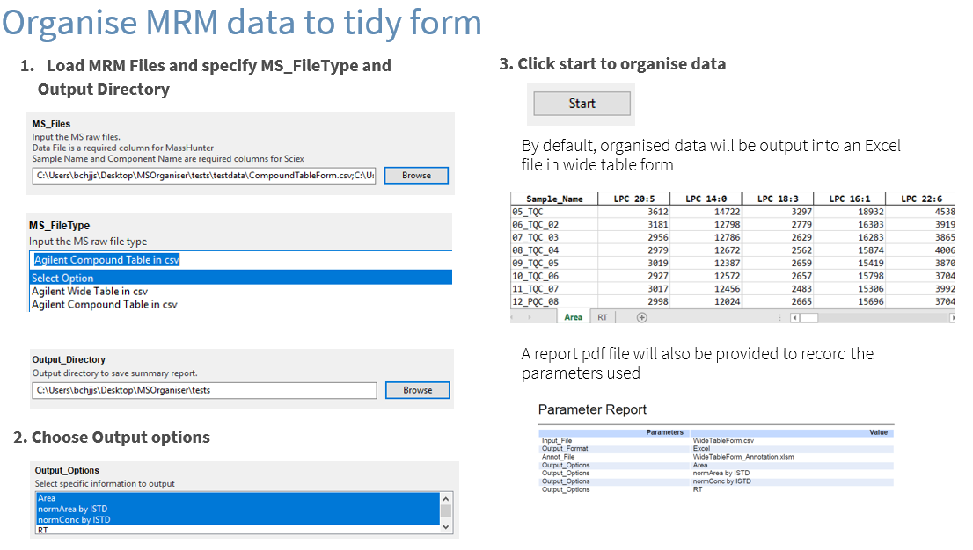
Tutorial: Github README
How to guide: Cheatsheet

Slide 12
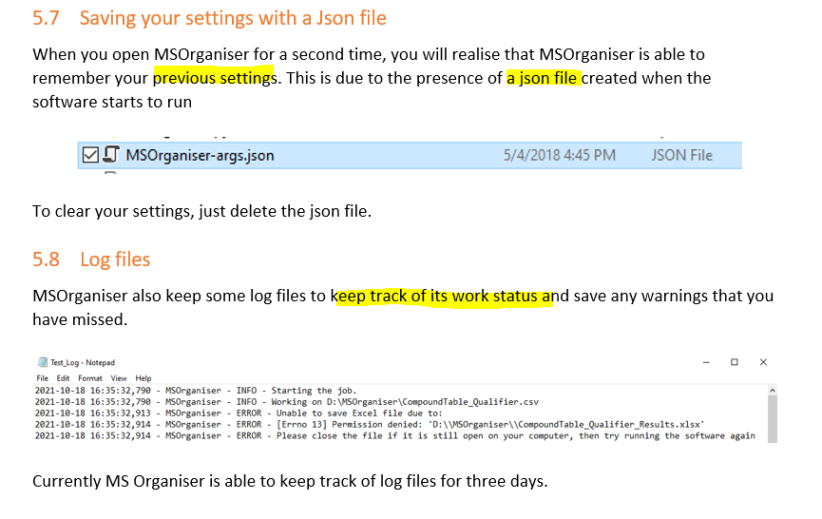
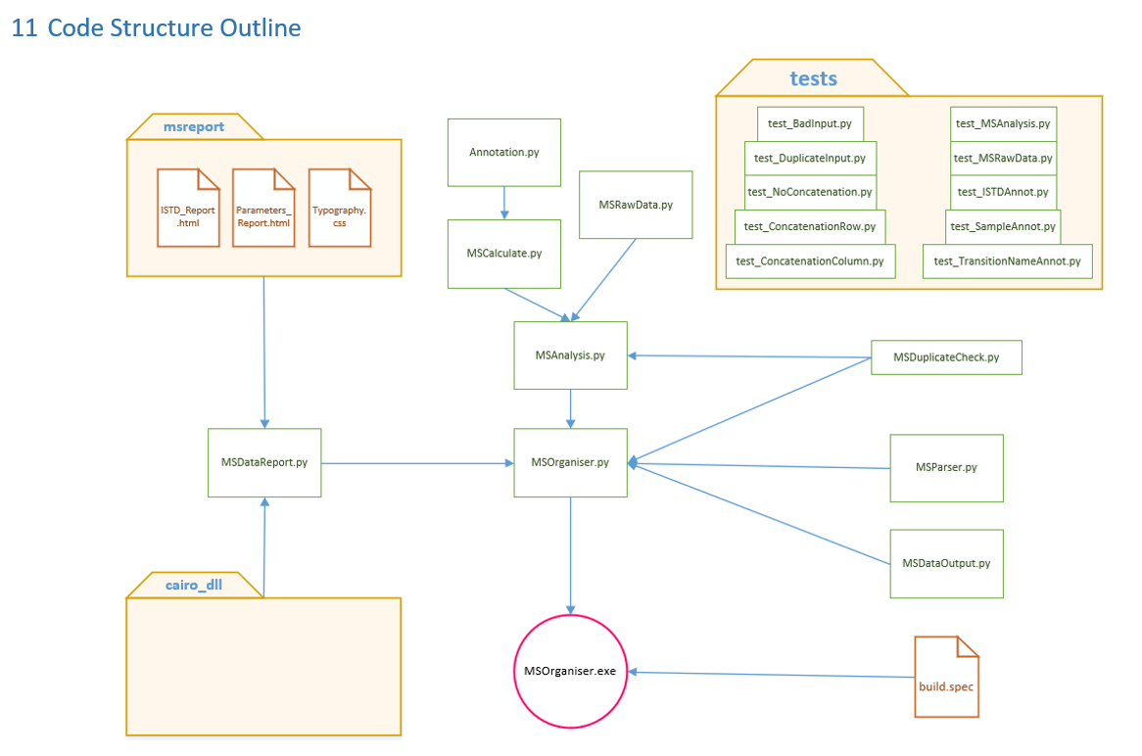
Explanation
Reference

