Slide 1
Variable Mapping Reporting Workflow
Show examples that the code works
Introduce mapping procedure
Code to validate
Code to do mapping
Clean up variables for merging

Slide 2
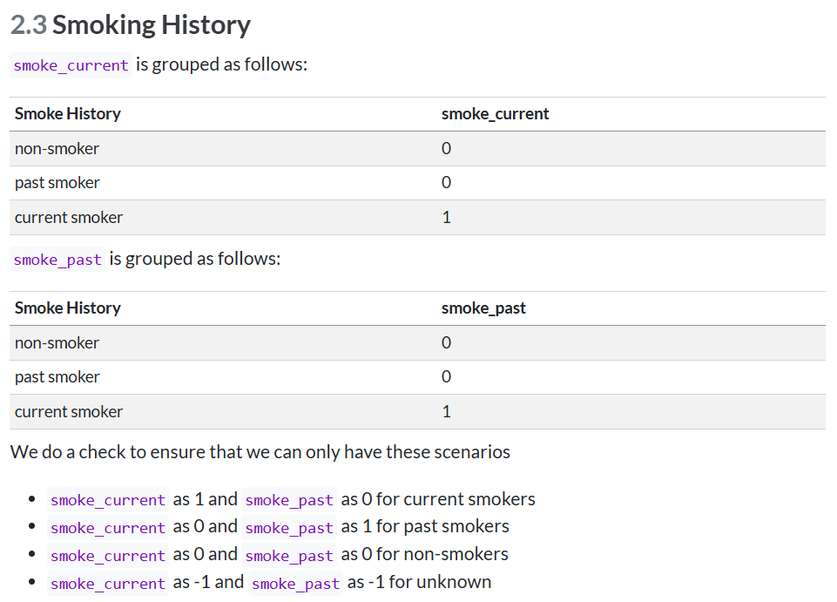
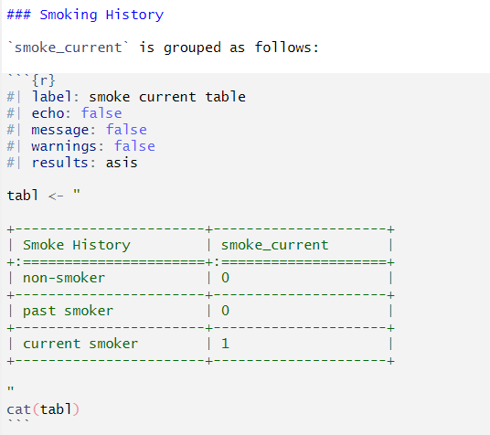
Introduce mapping procedure

Slide 4
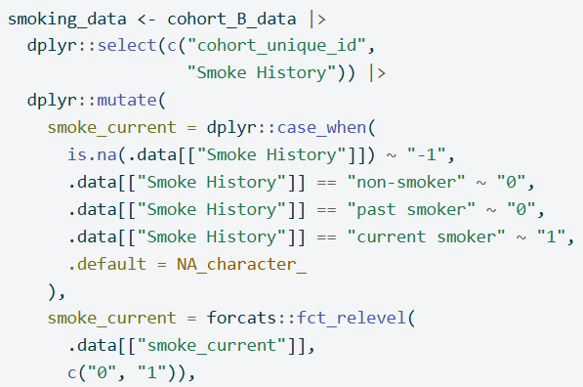
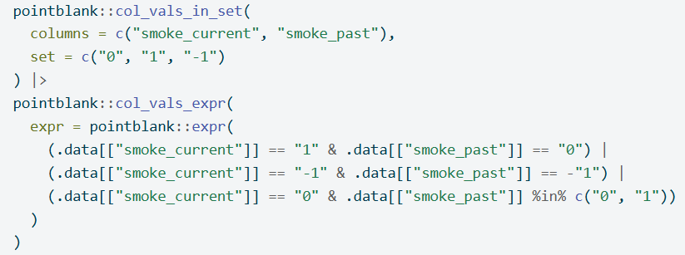
Code to do mapping
Code to validate

Slide 5
Show examples that the code works
Show data

Slide 6
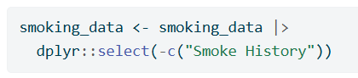
Clean up variables for merging

Slide 7
