Slide 1
Liaise with collaborator on what variables we need and collect them
Return to collaborator cleaned / harmonised dataset and report
Combine/Filter harmonized data from all cohorts
Provide analyst team combined data for further analysis
Harmonise data provided from each collaborator
Provide a data dictionary
Return harmonized data and data dictionary
Send harmonized/ filtered data for study
Provide an input template file
Return cleaning/ harmonization report

Slide 2
Variable Mapping Reporting Workflow
Show examples that the code works
Introduce mapping procedure
Code to validate
Code to do mapping
Clean up variables for merging

Slide 3
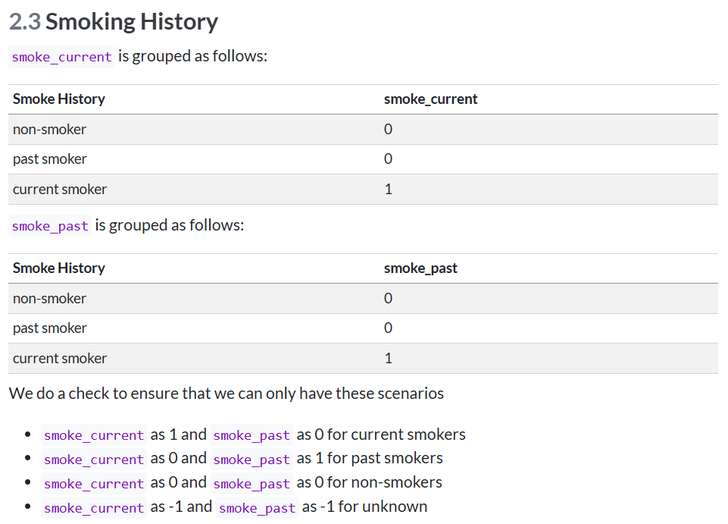
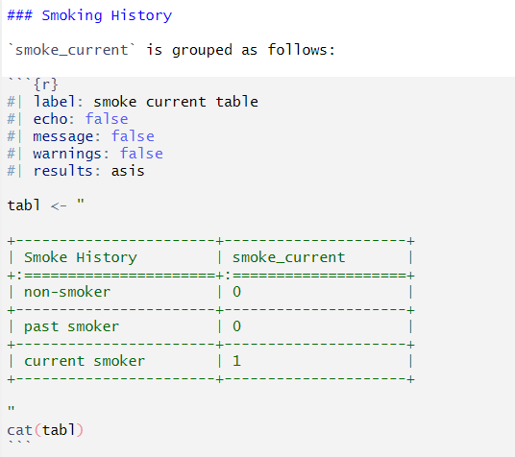
Introduce mapping procedure

Slide 5
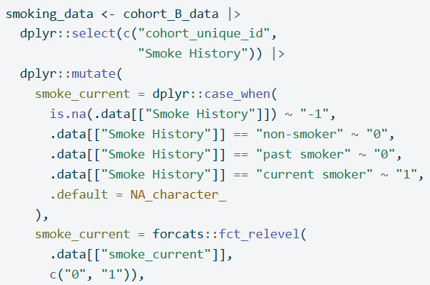
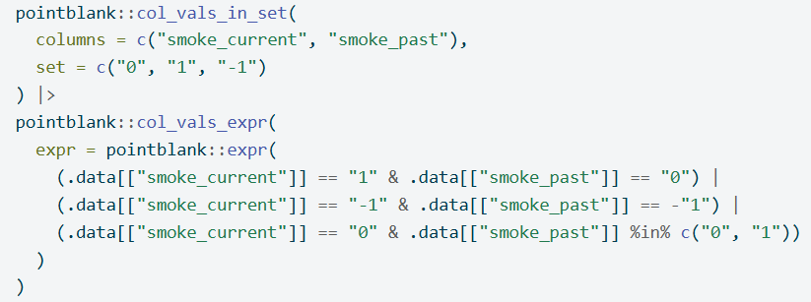
Code to do mapping
Code to validate

Slide 6
Show examples that the code works
Show data

Slide 7
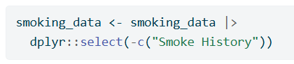
Clean up variables for merging

Slide 8
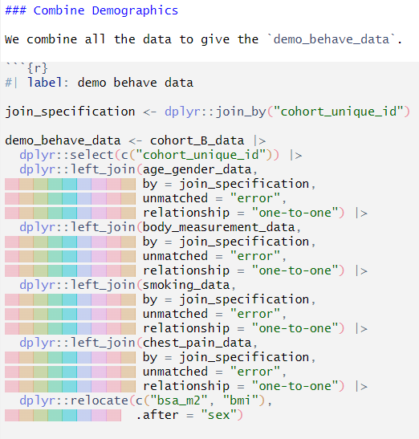

Slide 9
https://www.vecteezy.com/vector-art/464863-businessman-kneel-on-floor-with-pointing-finger-to-him
Businessman kneel on floor with pointing finger to him Free Vector Vecteezy! Amonrat Rungreangfangsai

Slide 10
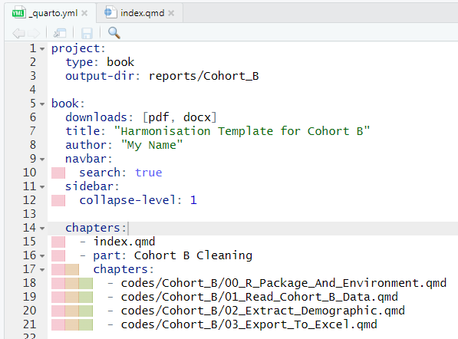
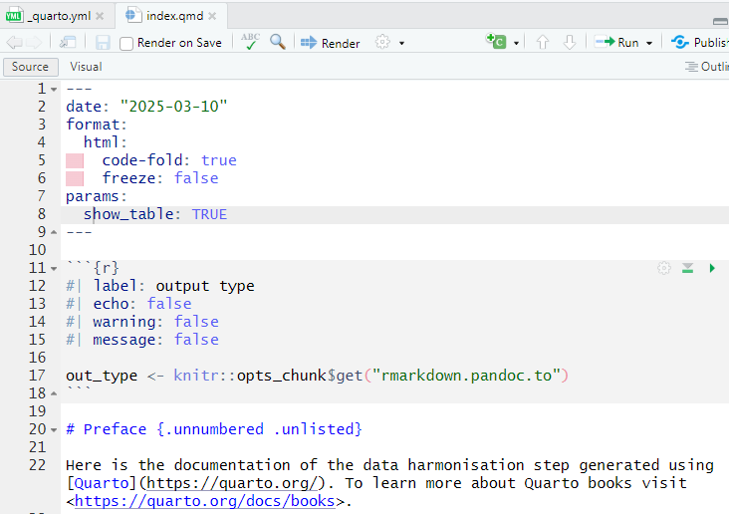

Slide 11
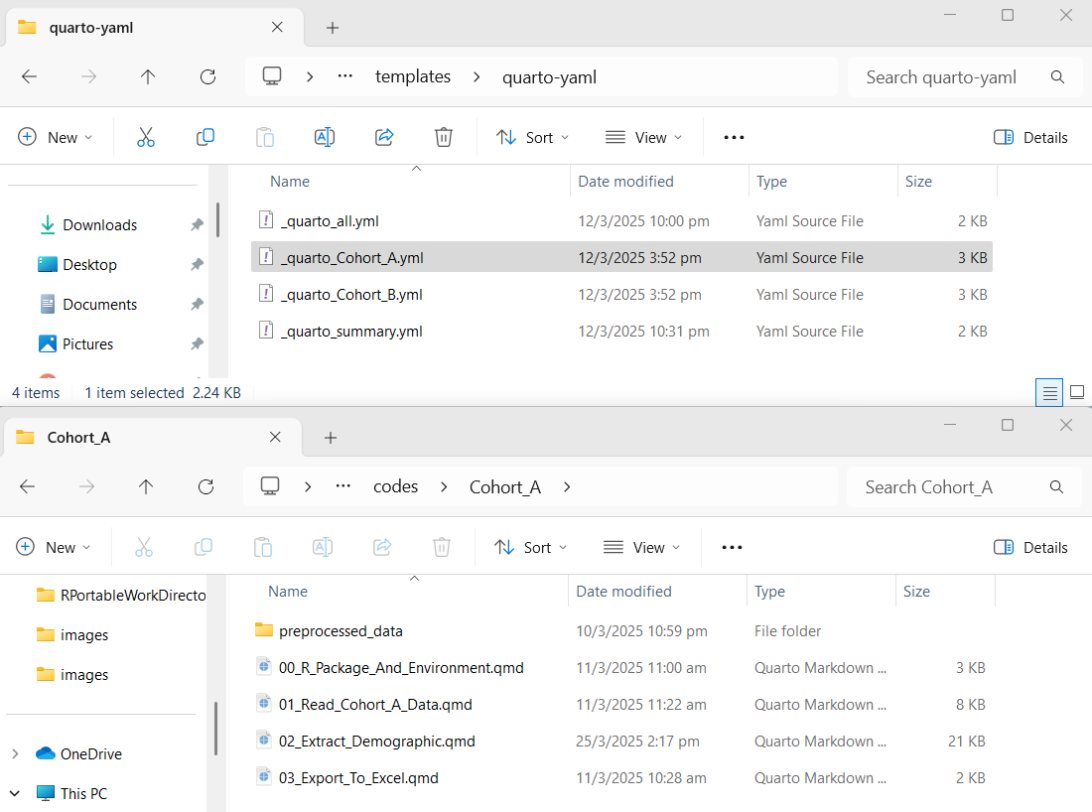

Slide 12
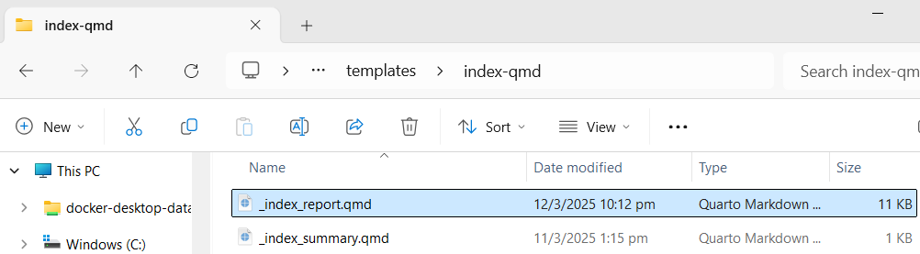
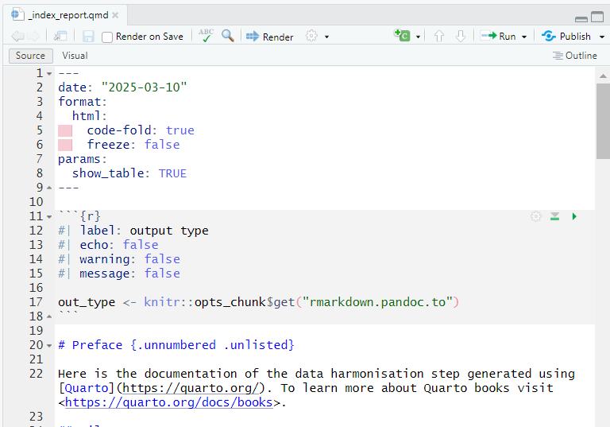

Slide 13
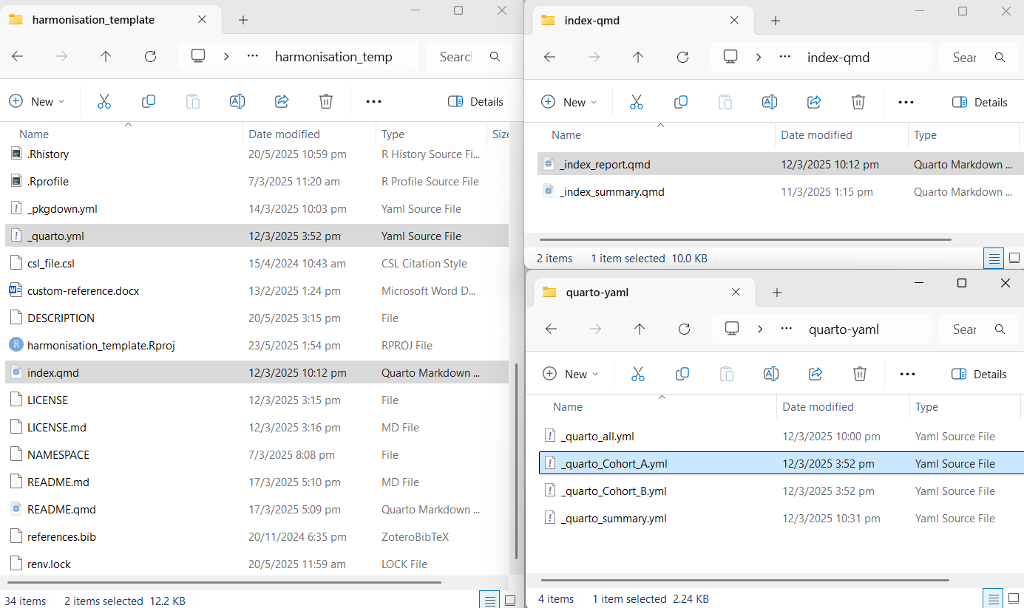

Slide 15
