Slide 1
Liaise with collaborator on what variables we need and collect them
Return to collaborator cleaned / harmonised dataset and report
Combine/Filter harmonized data from all cohorts
Provide analyst team combined data for further analysis
Harmonise data provided from each collaborator
Provide a data dictionary
Return harmonized data and data dictionary
Send harmonized/ filtered data for study
Provide an input template file
Return cleaning/ harmonization report

Slide 2
Variable Mapping Reporting Workflow
Show examples that the code works
Introduce mapping procedure
Code to validate
Code to do mapping
Clean up variables for merging

Slide 3
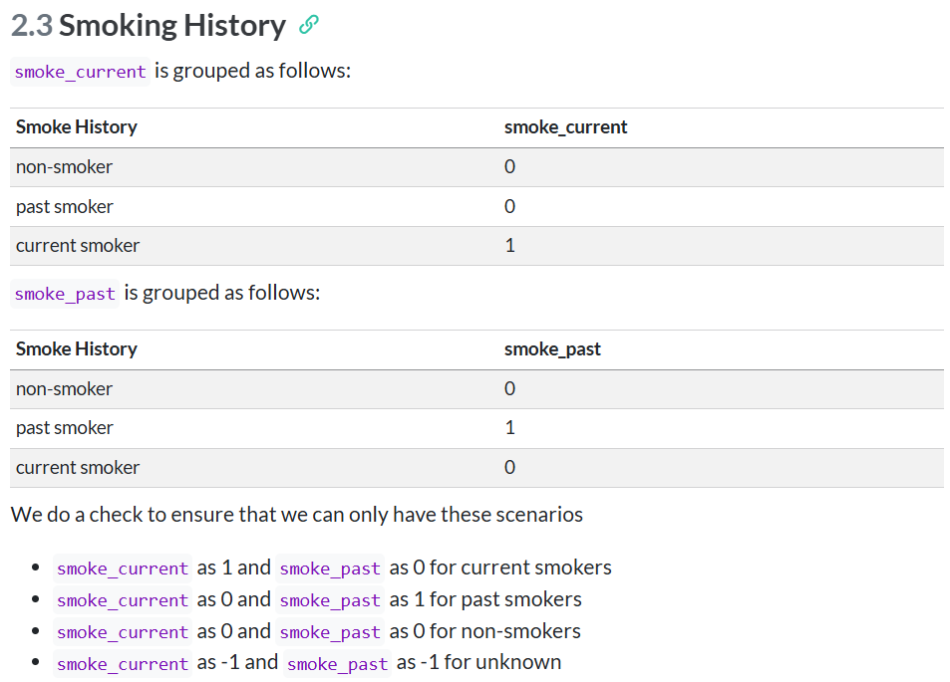
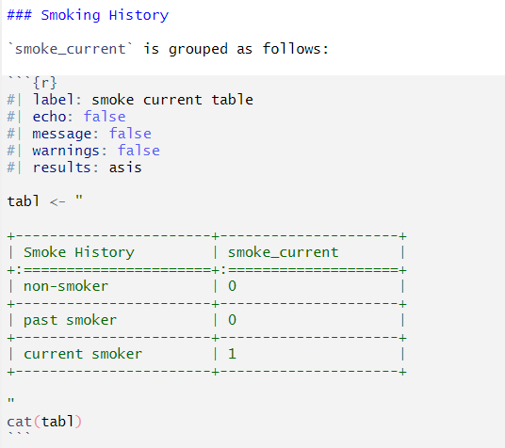
Introduce mapping procedure

Slide 4


Slide 5
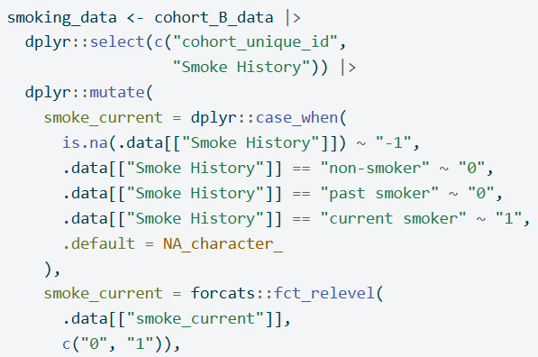
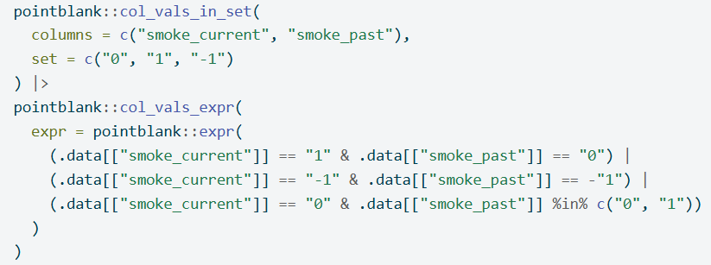
Code to do mapping
Code to validate

Slide 6
Show examples that the code works
Show data

Slide 7
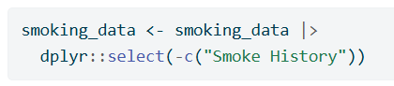
Clean up variables for merging

Slide 8
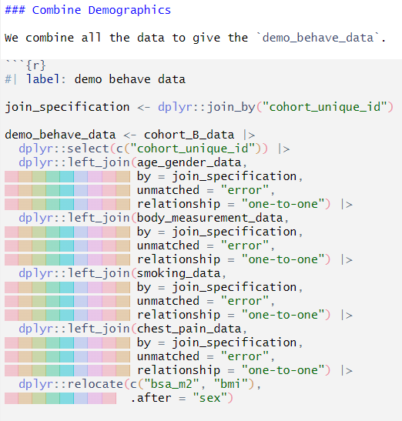

Slide 9
https://www.vecteezy.com/vector-art/464863-businessman-kneel-on-floor-with-pointing-finger-to-him
Businessman kneel on floor with pointing finger to him Free Vector Vecteezy! Amonrat Rungreangfangsai

Slide 10
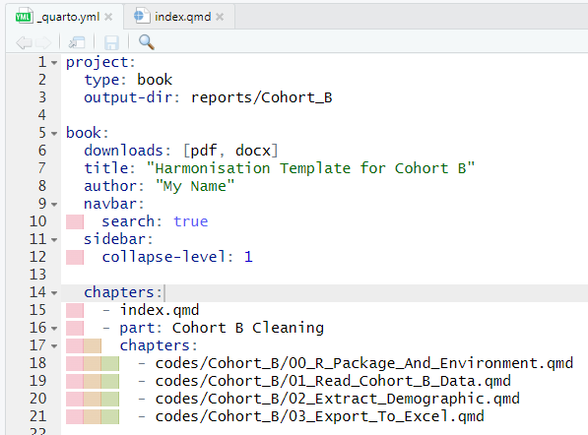
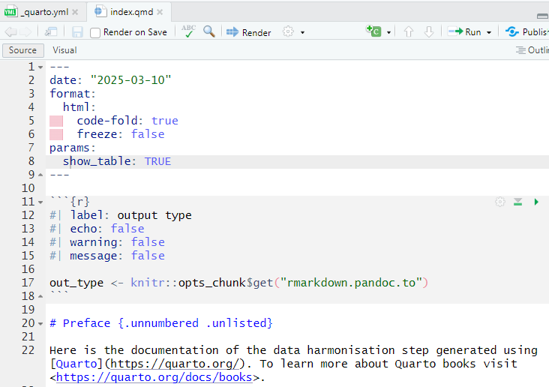

Slide 11
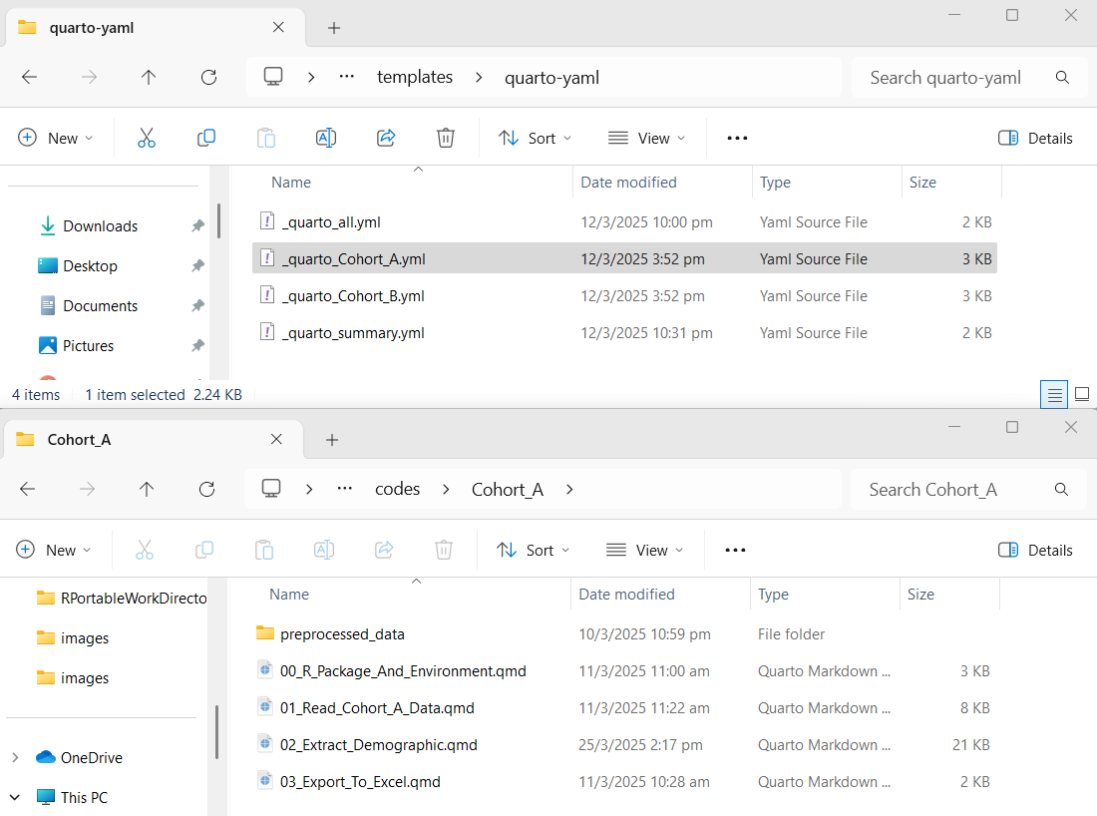

Slide 12
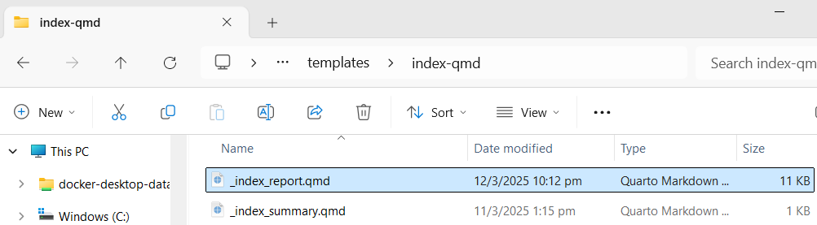
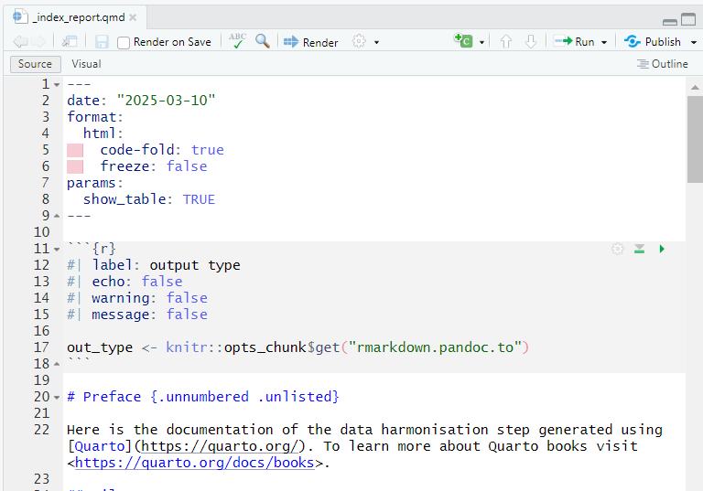

Slide 13
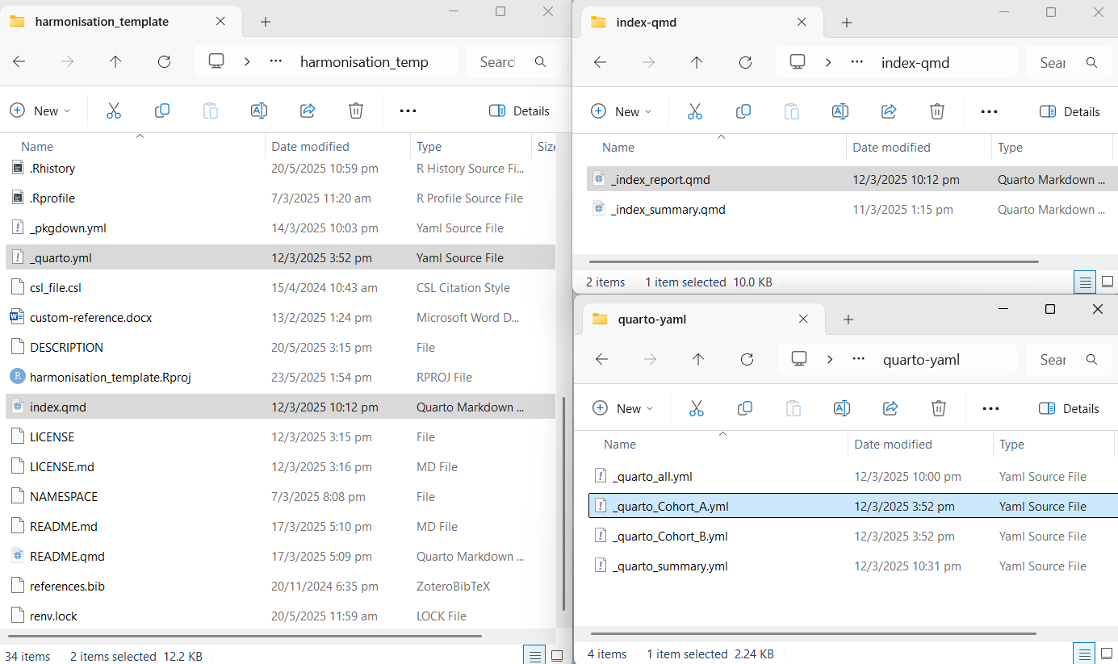

Slide 15
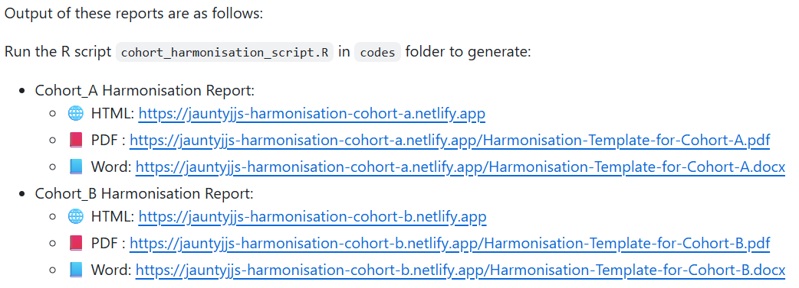
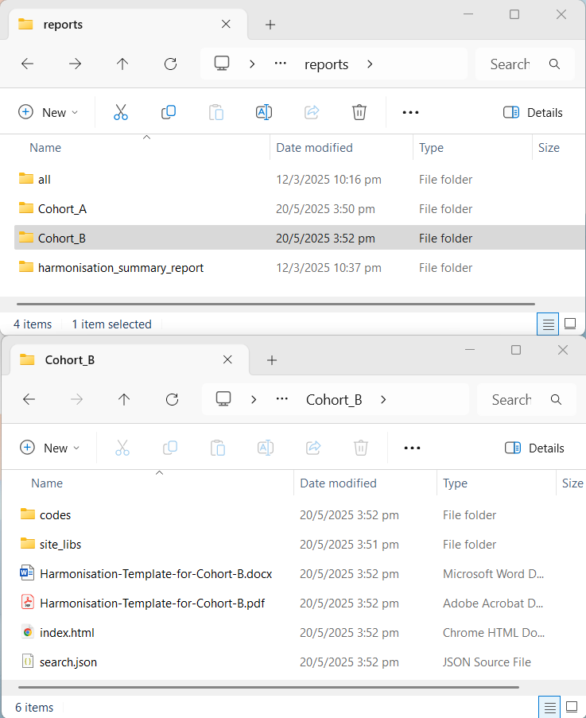

Slide 16
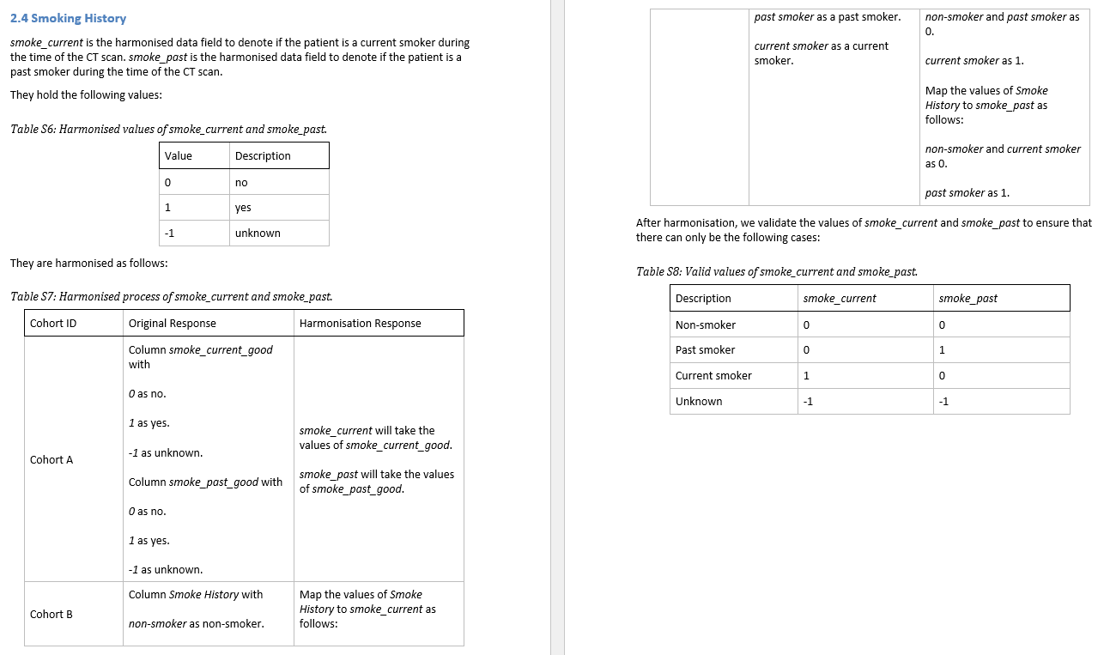

Slide 17
Patient | smoke_history | smoke_current | smoke_past
Current smoker | 1 | 1 | 0
Past smoker | 1 | 0 | 1
Non-smoker | 0 | 0 | 0
Have smoking history | 1 | -1 | -1
Missing | -1 | -1 | -1
Patient | smoke_history | Problem
Non-smoker | 0 | No smoking history
Current smoker | 1 | Have smoking history
Past smoker | 2
Missing | -1 | Missing

Slide 18
 |  |  |  | 11
 |  |  |  | Age
 |  |  |  | Sex
 |  |  |  | Hypertension
 |  |  |  | Dyslipidemia
 |  |  |  | Family Hx CAD
 |  |  |  | Diabetes
 |  |  |  | Smoke Current
 |  |  |  | Smoke Past |  |  | 2 | 2 | 2
 |  |  |  | Have Chest Pain | 1 | 1 | Height | HDL | Triglyceride
Country | Cohort | N | Variables | Chest Pain Character | Dyspnea | BMI | Weight | Total Cholesterol | LDL
Country A | Cohort A | 1000 | 15 | ✔ | ✔ | ✔ | ✔ | ✖ | ✖
 | Cohort B | 2000 | 16 | ✔ | ✔ | ✖ | ✖ | ✔ | ✔
Country B | Cohort C | 1500 | 18 | ✔ | ✔ | ✔ | ✔ | ✔ | ✔
Country C | Cohort D | 500 | 16 | ✔ | ✖ | ✔ | ✖ | ✔ | ✔
Country D | Cohort E | 1000 | 16 | ✔ | ✖ | ✔ | ✔ | ✔ | ✖
 | Cohort F | 2500 | 14 | ✔ | ✖ | ✔ | ✔
Total |  |  |  | 8500 | 4500 | 6500 | 6000 | 5000 | 4000
Variable Colour Legend
 | Age
 | Sex
 | Comorbidity
 | Smoking history
 | Symptoms
 | Obesity
 | Blood lipid
Table Legend
✔ | Available
✖ | Not available
 | Pending arrival

Slide 19
