Slide 1
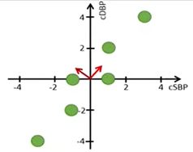
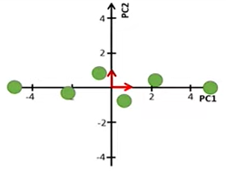
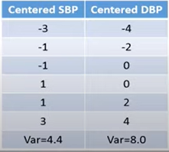




$$∅_{2}$$
$$∅_{1}$$
$$∅_{1}=(0.59, 0.81)$$
$$∅_{2}=(−0.81, 0.59)$$

Slide 2
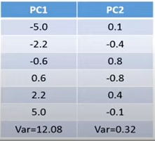


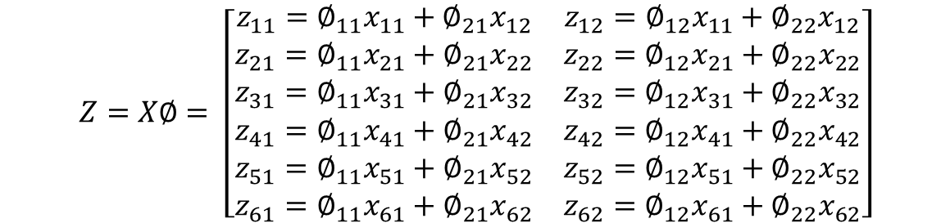





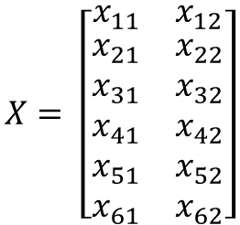




$$∅_{2}$$
$$∅_{1}$$
$${(z}_{11}, z_{12})$$
$${(x}_{11}, x_{12})$$
$$X_{1}$$
$$X_{2}$$
$$X= \left[\begin{matrix}x_{11} & x_{12} \\ \begin{aligned}x_{21} \\ x_{31} \\ x_{41} \\ x_{51} \\ x_{61}\end{aligned} & \begin{aligned}x_{22} \\ x_{32} \\ x_{42} \\ x_{52} \\ x_{62}\end{aligned}\end{matrix}\right]$$
$$∅_{1}$$
$$∅_{2}$$
$$∅= \left[\begin{matrix}∅_{11} & ∅_{12} \\ ∅_{21} & ∅_{22}\end{matrix}\right]$$
Data
Loading
$$Z_{1}=PC1$$
$$Z_{2}=PC2$$
$$Z=X∅= \left[\begin{matrix}{z_{11}=∅}_{11}x_{11}+∅_{21}x_{12} & {z_{12}=∅}_{12}x_{11}+∅_{22}x_{12} \\ \begin{aligned}{z_{21}=∅}_{11}x_{21}+∅_{21}x_{22} \\ {z_{31}=∅}_{11}x_{31}+∅_{21}x_{32} \\ {z_{41}=∅}_{11}x_{41}+∅_{21}x_{42} \\ {z_{51}=∅}_{11}x_{51}+∅_{21}x_{52} \\ {z_{61}=∅}_{11}x_{61}+∅_{21}x_{62}\end{aligned} & \begin{aligned}{z_{22}=∅}_{12}x_{21}+∅_{22}x_{22} \\ {z_{32}=∅}_{12}x_{31}+∅_{22}x_{32} \\ {z_{42}=∅}_{12}x_{41}+∅_{22}x_{42} \\ {z_{52}=∅}_{12}x_{51}+∅_{22}x_{52} \\ {z_{62}=∅}_{12}x_{61}+∅_{22}x_{62}\end{aligned}\end{matrix}\right]$$
Scores

Slide 3



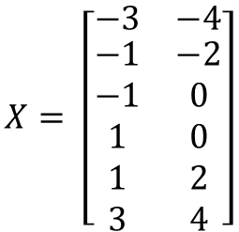
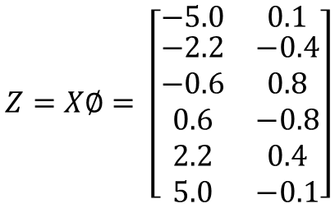

$$∅_{1}=(0.59, 0.81)$$
$$∅_{2}=(−0.81, 0.59)$$
$$X= \left[\begin{matrix}−3 & −4 \\ \begin{aligned}−1 \\ −1 \\ 1 \\ 1 \\ 3\end{aligned} & \begin{aligned}−2 \\ 0 \\ 0 \\ 2 \\ 4\end{aligned}\end{matrix}\right]$$
$$Z=X∅= \left[\begin{matrix}−5.0 & 0.1 \\ \begin{aligned}−2.2 \\ −0.6 \\ 0.6 \\ 2.2 \\ 5.0\end{aligned} & \begin{aligned}−0.4 \\ 0.8 \\ −0.8 \\ 0.4 \\ −0.1\end{aligned}\end{matrix}\right]$$
$$∅= \left[\begin{matrix}0.59 & −0.81 \\ 0.81 & 0.59\end{matrix}\right]$$

Slide 4



Loading
$$∅_{1}$$
$$∅_{2}$$
$$∅= \left[\begin{matrix}0.59 & −0.81 \\ 0.81 & 0.59\end{matrix}\right]$$
To maximise

Slide 5
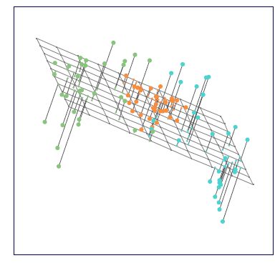
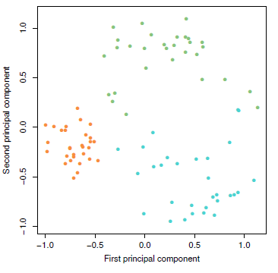




$$B$$
$$A$$
$$M=2$$
$$p=3$$

Slide 6
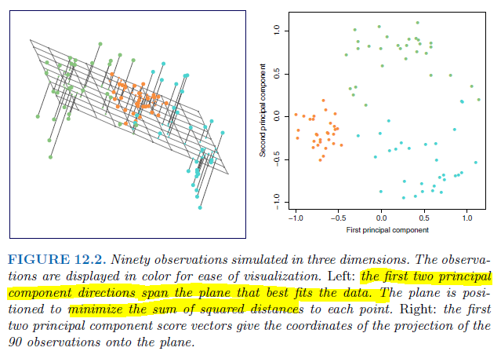

Slide 7
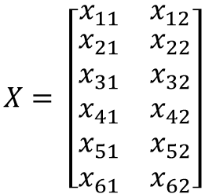

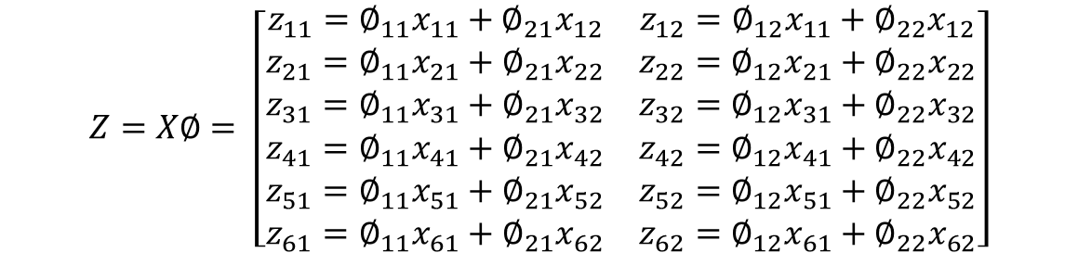
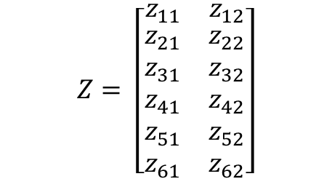
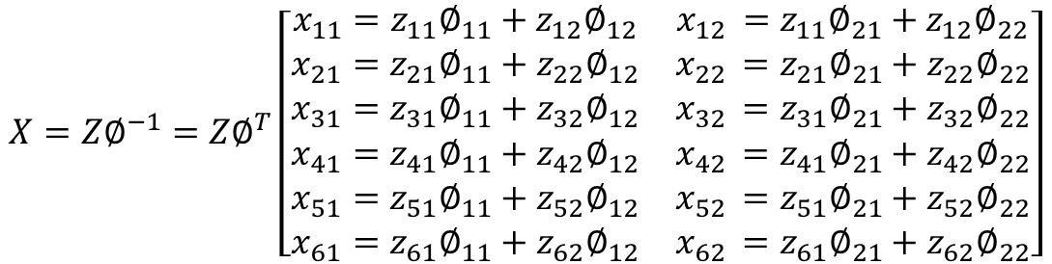

$$X= \left[\begin{matrix}x_{11} & x_{12} \\ \begin{aligned}x_{21} \\ x_{31} \\ x_{41} \\ x_{51} \\ x_{61}\end{aligned} & \begin{aligned}x_{22} \\ x_{32} \\ x_{42} \\ x_{52} \\ x_{62}\end{aligned}\end{matrix}\right]$$
$$Z=X∅= \left[\begin{matrix}{z_{11}=∅}_{11}x_{11}+∅_{21}x_{12} & {z_{12}=∅}_{12}x_{11}+∅_{22}x_{12} \\ \begin{aligned}{z_{21}=∅}_{11}x_{21}+∅_{21}x_{22} \\ {z_{31}=∅}_{11}x_{31}+∅_{21}x_{32} \\ {z_{41}=∅}_{11}x_{41}+∅_{21}x_{42} \\ {z_{51}=∅}_{11}x_{51}+∅_{21}x_{52} \\ {z_{61}=∅}_{11}x_{61}+∅_{21}x_{62}\end{aligned} & \begin{aligned}{z_{22}=∅}_{12}x_{21}+∅_{22}x_{22} \\ {z_{32}=∅}_{12}x_{31}+∅_{22}x_{32} \\ {z_{42}=∅}_{12}x_{41}+∅_{22}x_{42} \\ {z_{52}=∅}_{12}x_{51}+∅_{22}x_{52} \\ {z_{62}=∅}_{12}x_{61}+∅_{22}x_{62}\end{aligned}\end{matrix}\right]$$
$$∅= \left[\begin{matrix}∅_{11} & ∅_{12} \\ ∅_{21} & ∅_{22}\end{matrix}\right]$$
$$Z= \left[\begin{matrix}z_{11} & z_{12} \\ \begin{aligned}z_{21} \\ z_{31} \\ z_{41} \\ z_{51} \\ z_{61}\end{aligned} & \begin{aligned}z_{22} \\ z_{32} \\ z_{42} \\ z_{52} \\ z_{62}\end{aligned}\end{matrix}\right]$$
$$X=Z∅^{−1}=Z∅^{T}\left[\begin{matrix}x_{11}=z_{11}∅_{11}+z_{12}∅_{12} & x_{12 }=z_{11}∅_{21}+z_{12}∅_{22} \\ \begin{aligned}x_{21}=z_{21}∅_{11}+z_{22}∅_{12} \\ x_{31}=z_{31}∅_{11}+z_{32}∅_{12} \\ x_{41}=z_{41}∅_{11}+z_{42}∅_{12} \\ x_{51}=z_{51}∅_{11}+z_{52}∅_{12} \\ x_{61}=z_{61}∅_{11}+z_{62}∅_{12}\end{aligned} & \begin{aligned}x_{22 }=z_{21}∅_{21}+z_{22}∅_{22} \\ x_{32 }=z_{31}∅_{21}+z_{32}∅_{22} \\ x_{42 }=z_{41}∅_{21}+z_{42}∅_{22} \\ x_{52 }=z_{51}∅_{21}+z_{52}∅_{22} \\ x_{62 }=z_{61}∅_{21}+z_{62}∅_{22}\end{aligned}\end{matrix}\right]$$
$$∅^{−1}=∅^{T}= \left[\begin{matrix}∅_{11} & ∅_{21} \\ ∅_{12} & ∅_{22}\end{matrix}\right]$$

Slide 8


Slide 9



Slide 10

$${PVE}_{PC1}= \frac{12.08}{4.4+8}≈0.97$$

Slide 11
Var of Data = 12.4
Var of (M=1) PC = 12.08
MSE of (M=1) PC = 0.32

Slide 12
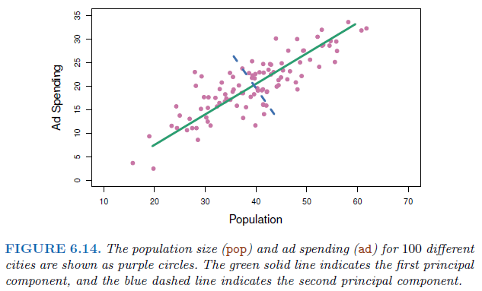






$$∅_{1}=(0.839, 0.544)$$
$$∅_{2}=(−0.544,0.839)$$
$$∅_{2}=(0.544,− 0.839)$$
$$∅_{1}=(−0.839, −0.544)$$
$$∅= \left[\begin{matrix}0.839 & 0.544 \\ 0.544 & −0.839\end{matrix}\right]$$
$$∅= \left[\begin{matrix}−0.839 & −0.544 \\ −0.544 & 0.839\end{matrix}\right]$$

Slide 13
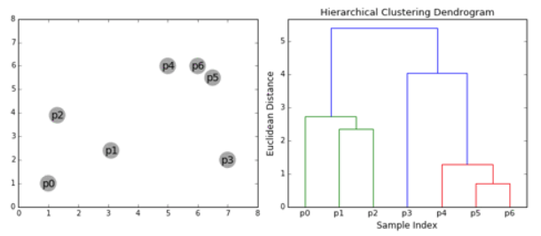

Slide 14
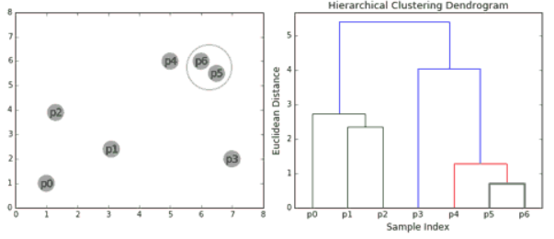
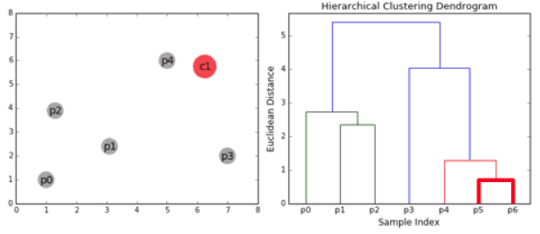

Slide 15
